Slide 1




HacXLerate
Hackathon 2025
Build a Two-Wheeler-marketplace : vahan bazar
CODE CREATE INNOVATE

Slide 2
Presentation Roadmap
01
2
Problem
App Design
3
4
APP Features
Summary

Slide 3


Vahan Bazar Problem Statement
Build a two-wheeler marketplace web app where users can browse bikes, scooters, and EVs, search and filter by brand, price, or fuel type, view detailed specs with images, compare model's side by side, use EMI and fuel cost calculators, check upcoming launches, explore showrooms, and book test rides or sell used bikes.
To Build
Emi calculator
Fuel cost calculator
Upcoming launches

Slide 4
Presentation Roadmap
01
2
Problem
App Design
3
4
APP Features
Summary

Slide 5
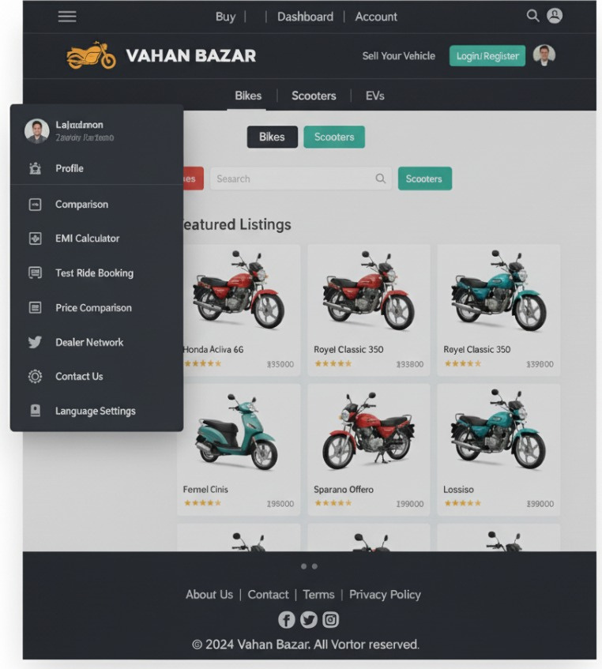
App Design
Main page include a drop down for the main features we include characterized by modern design with a clean and futuristic easy to use platform for users with sleek and engaging platform for users to browse, vehicles, detailed description of vehicles. and we also make sure user get interactive platform.
Ginyard International Co.

Slide 6
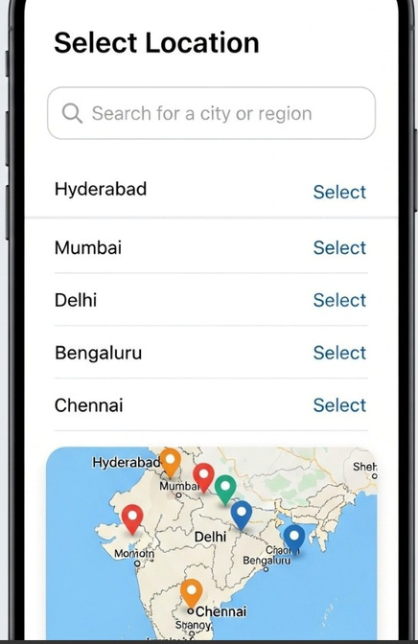
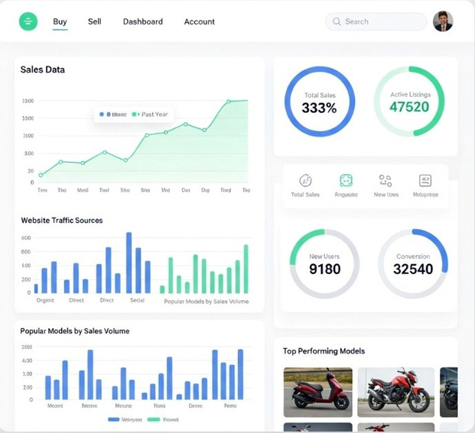
Analytical dashboard for gaining trust from users and we provide our success journey over the years gaining trust from users
The location settings option ensure that users browse vehicles from different locations all over the india and if needed provide connection between users to have an interactive environment between the buyer and seller.

Slide 7
Presentation Roadmap
01
2
Problem
App Design
3
4
APP Features
Summary

Slide 8
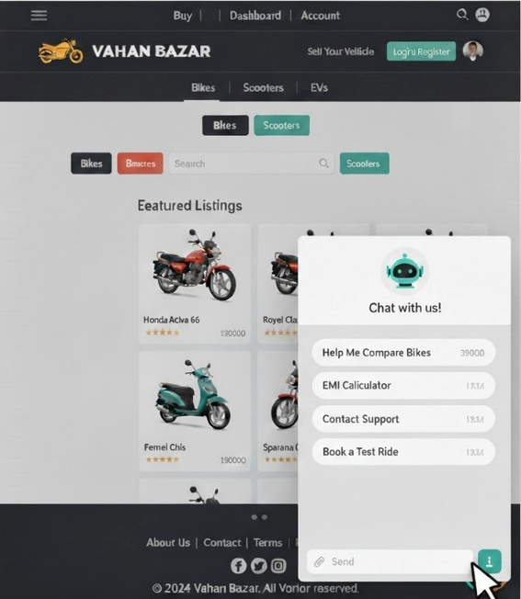
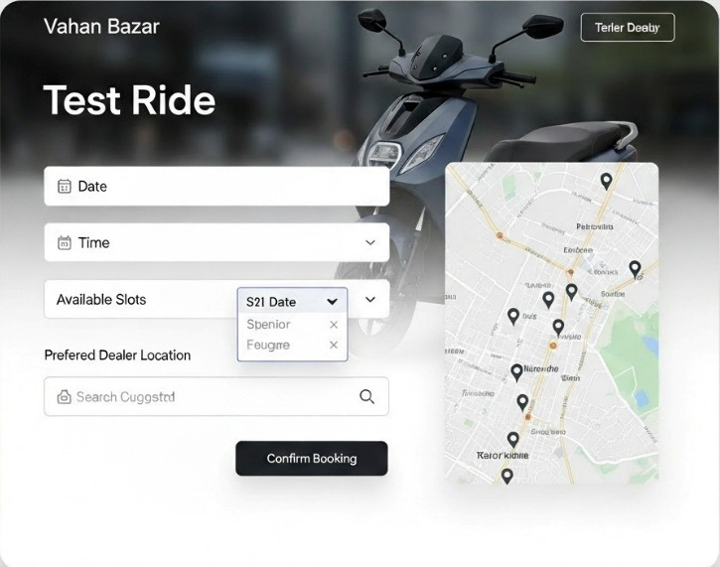
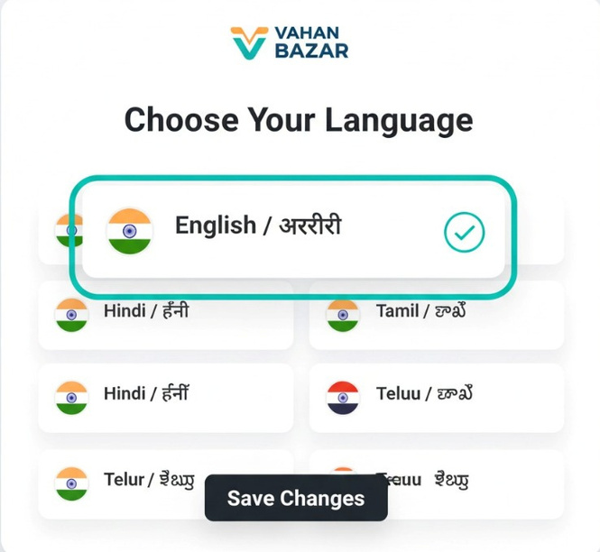
Features
Language changing feature include users to change language of the app to their native language and provide 100% user friendly interface.
We mainly focus on the chatbot feature that will be integrated with the web app that provide user who are unable to book bikes, or sheduling the test drive and we make will try to make sure to include answers for the question in native language
Test ride booking make sure that user can book test ride of the bikes from the nearest showroom

Slide 9
Presentation Roadmap
01
2
Problem
App Design
3
4
APP Features
Summary

Slide 10
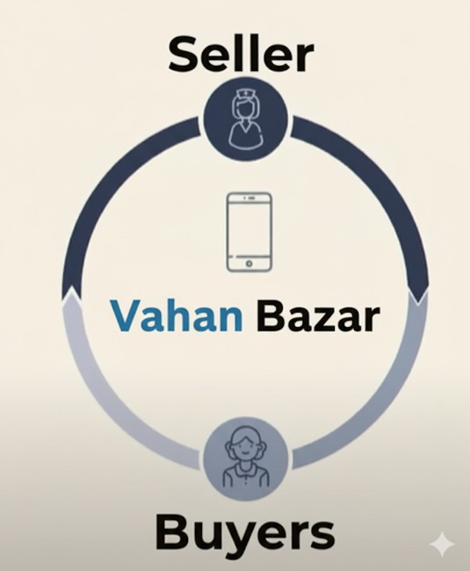
Summary
Reduce Workload :
for users who are confused to buy vehicles to compare specifications and provide a user friendly interface.
Enhance efficiency :
by providing detailed specifications, side-by-side model comparisons, and integrated EMI and fuel cost Calculator
Support :
by connecting online discovery (browsing, upcoming launches) with offline action (showroom exploration, test-drive booking and selling used bikes)

Slide 11

Thank you
Team Code Pulihora

