Slide 1

----Hotel Reservation System---
Project Based Learning (PBL) Report
for the course
<<DBMS- Course Code>>
BACHELOR OF TECHNOLOGY IN COMPUTER SCIENCE AND ENGINEERING
By
Name of the students
HT . No
Under the guidance of
<<K . Arpitha>>
Geethanjali College of Engineering and Technology
(UGC Autonomous)
(Affiliated to J.N.T.U.H, Approved by AICTE, New Delhi)
Cheeryal (V), Keesara (M), Medchal.Dist.-501 301.(M), Medchal.Dist.-501 301.

Slide 2
S . No | Contents | Page . No
1 | Abstract | 1
2 | Introduction | 2
3 | System Design | 3
4 | Implementation | 4-5
5 | Conclusion | 6

Slide 3
Abstract
The Hotel Reservation System is a software application designed to simplify hotel management by maintaining customer information, room details, reservations, check-in, check-out, and billing records. It helps hotel staff handle daily activities in an organized and efficient manner. Customers can check room availability and reserve suitable rooms, while hotel administrators can manage room status, customer details, and payments. The system reduces manual paperwork, avoids errors in record maintenance, and improves the overall booking experience. This project demonstrates how a computerized system can make hotel operations faster, more reliable, and easier to manage.
1

Slide 4
Introduction
About the Project
The Hotel Reservation System is developed to manage the major activities involved in hotel bookings. In a traditional hotel, maintaining reservation registers, customer details, room availability, and payment records manually can be time-consuming and may lead to mistakes . This project provides a structured way to store and access hotel information. It maintains customer records, displays available rooms, records reservations, tracks check-in and check-out details, and calculates the total bill for a customer's stay . The system can be used by hotel receptionists and administrators to perform their tasks efficiently. It also helps customers complete the reservation process with less effort.
Project Outcomes and Objectives
To maintain customer details in an organized format.
To manage room information, room types, and room availability.
To record and manage hotel reservations.
To maintain check-in and check-out information.
To calculate room charges and prepare customer bills.
To reduce manual work and minimize data entry errors.
To provide quick access to reservation and payment records.
Faster processing of room reservations.
Accurate maintenance of customer and room records.
Better tracking of available, booked, and occupied rooms.
Clear and organized billing information.
2

Slide 5
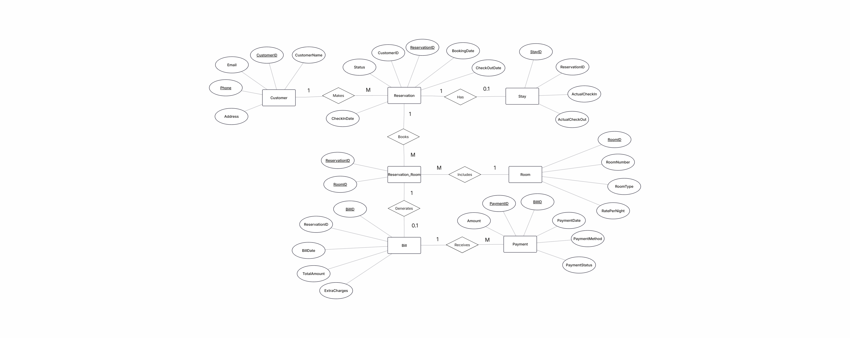
System Design
3

Slide 6
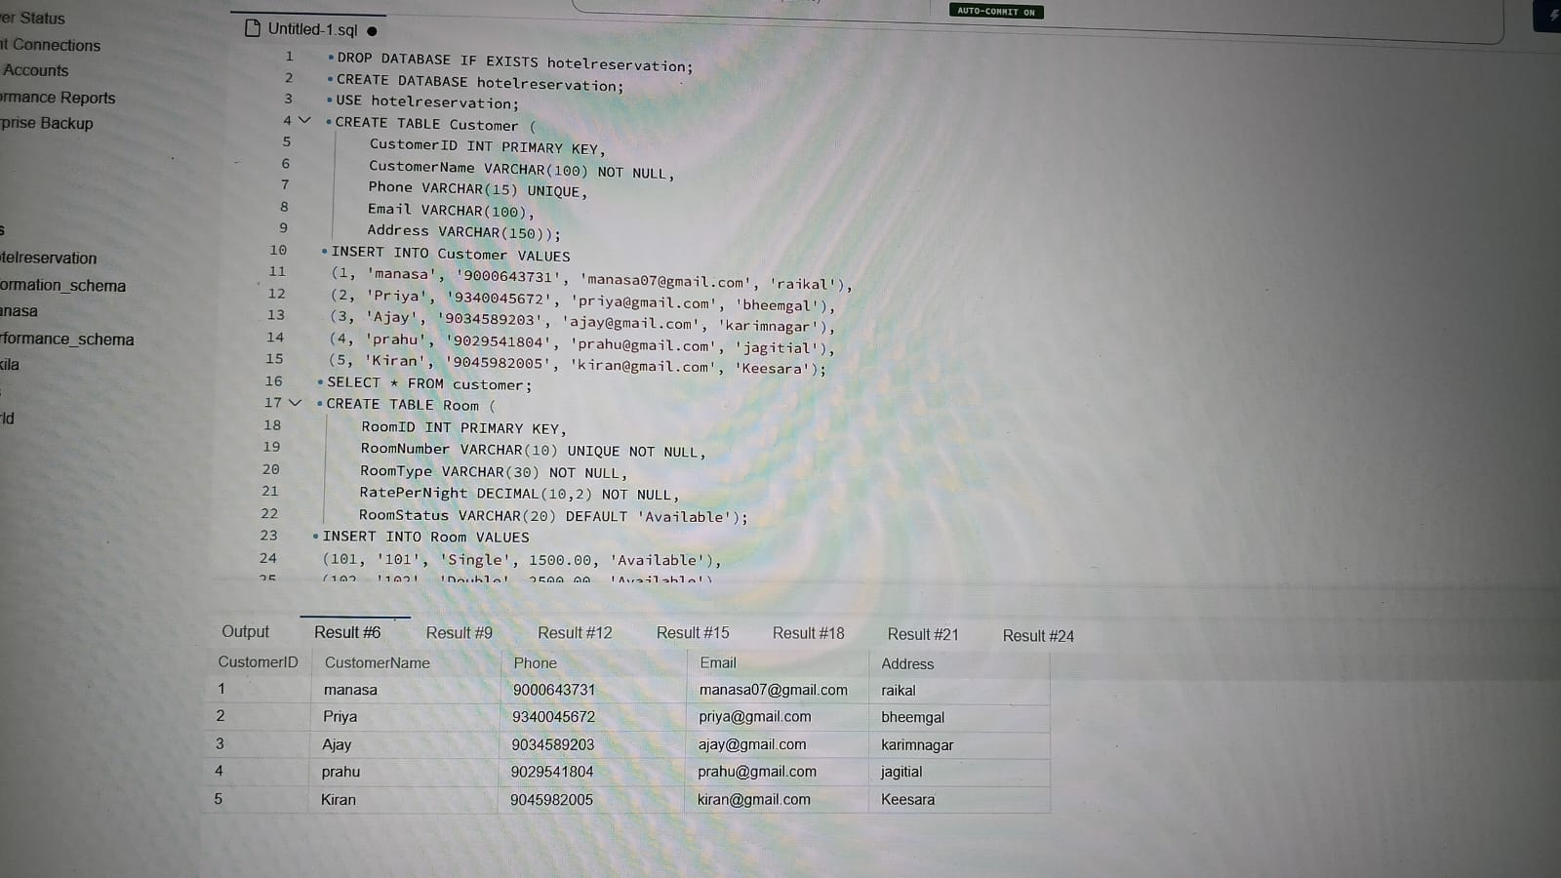
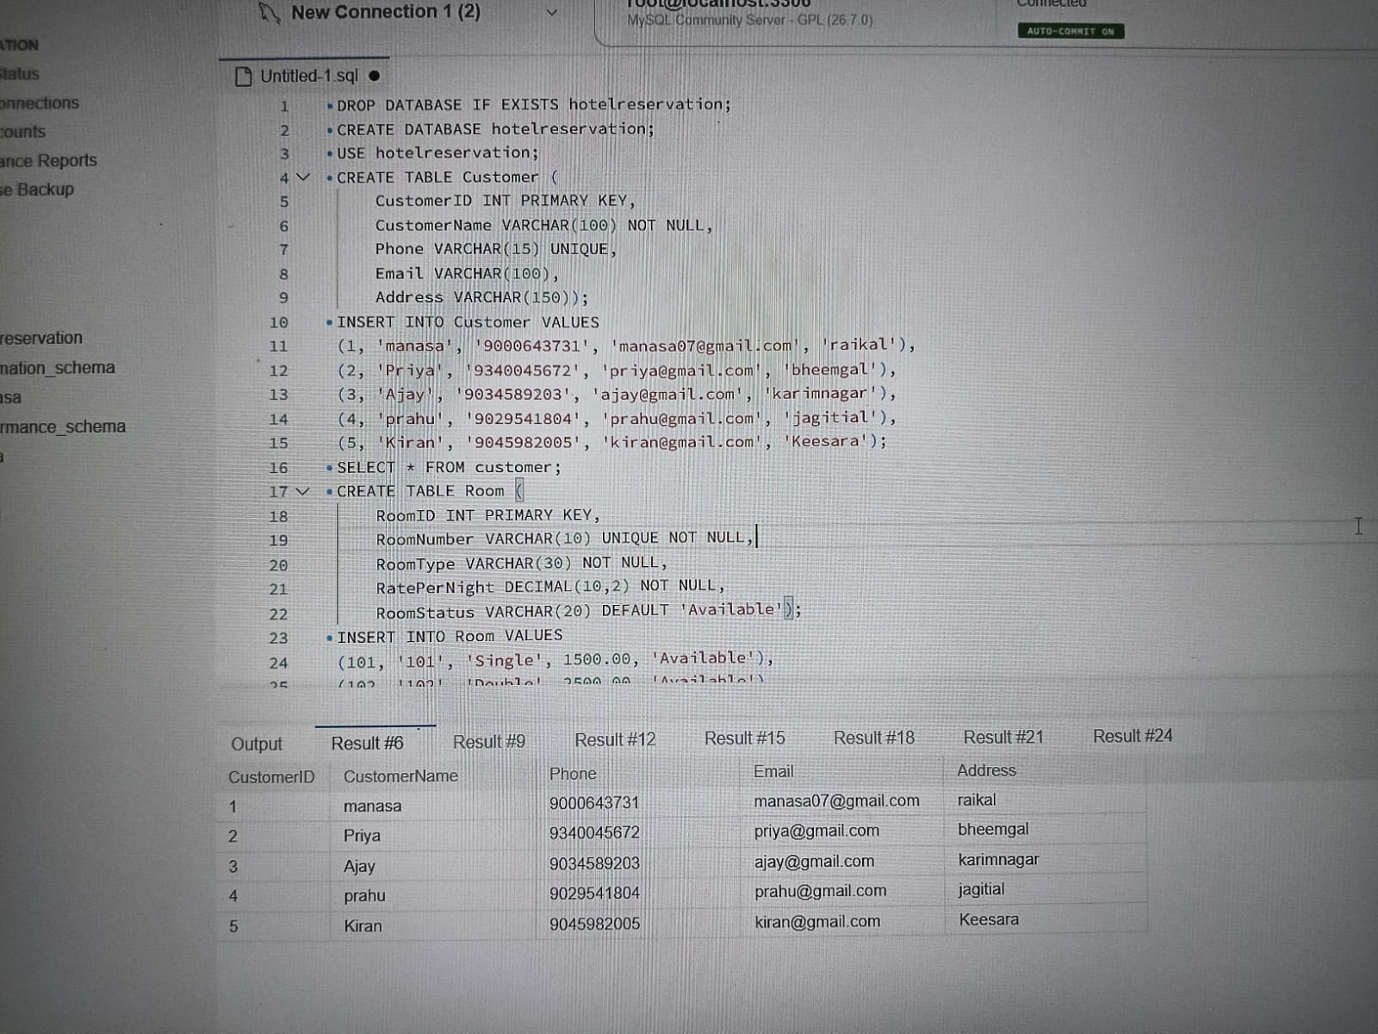
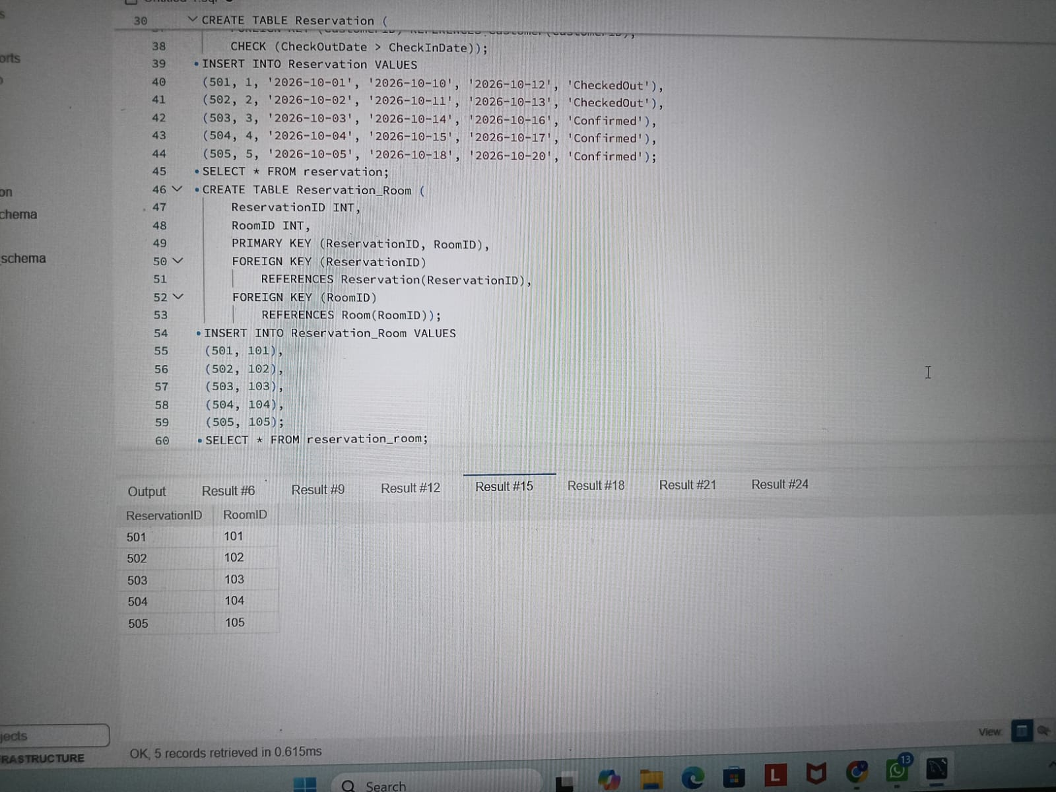
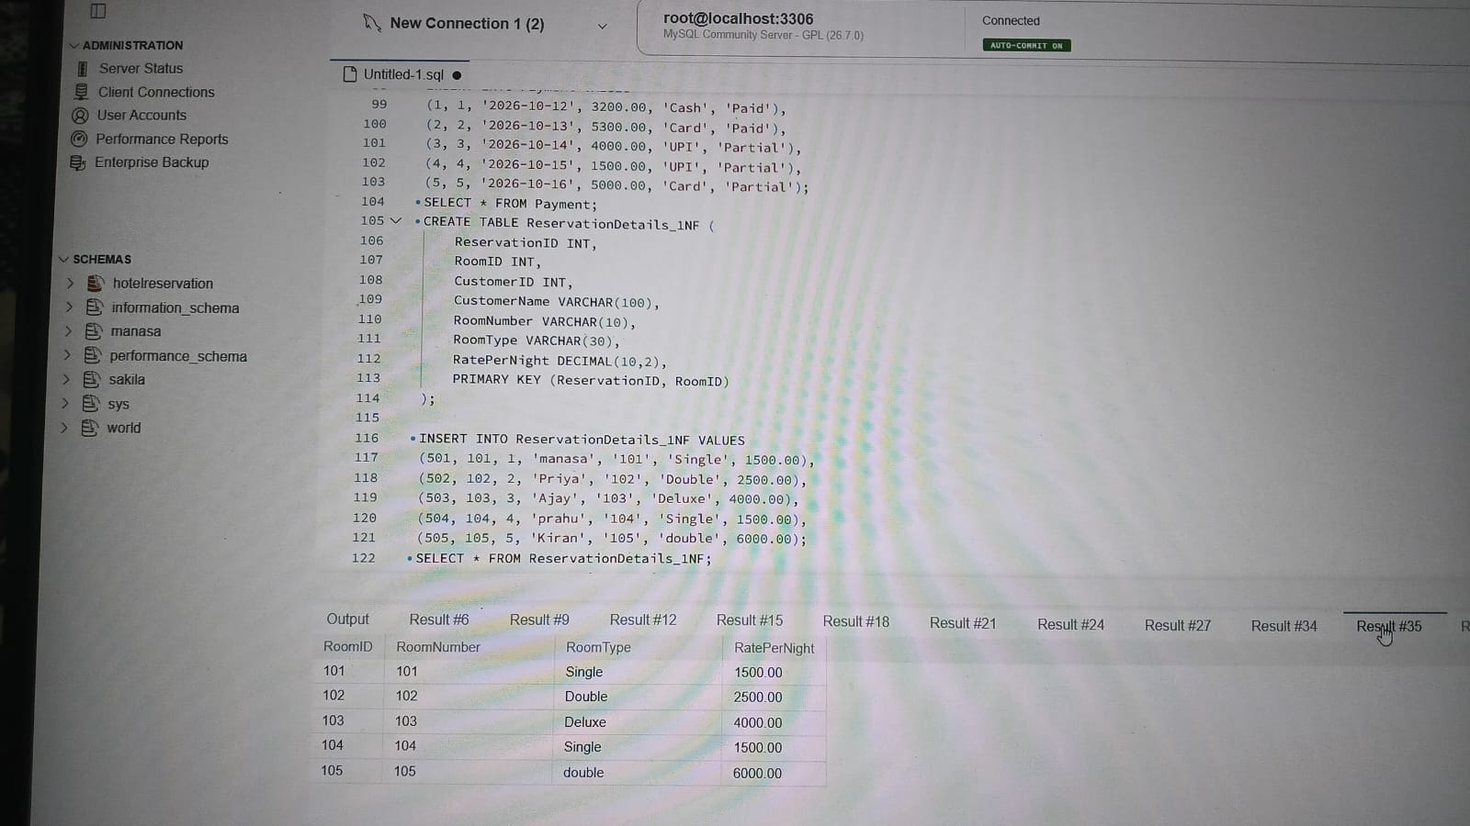
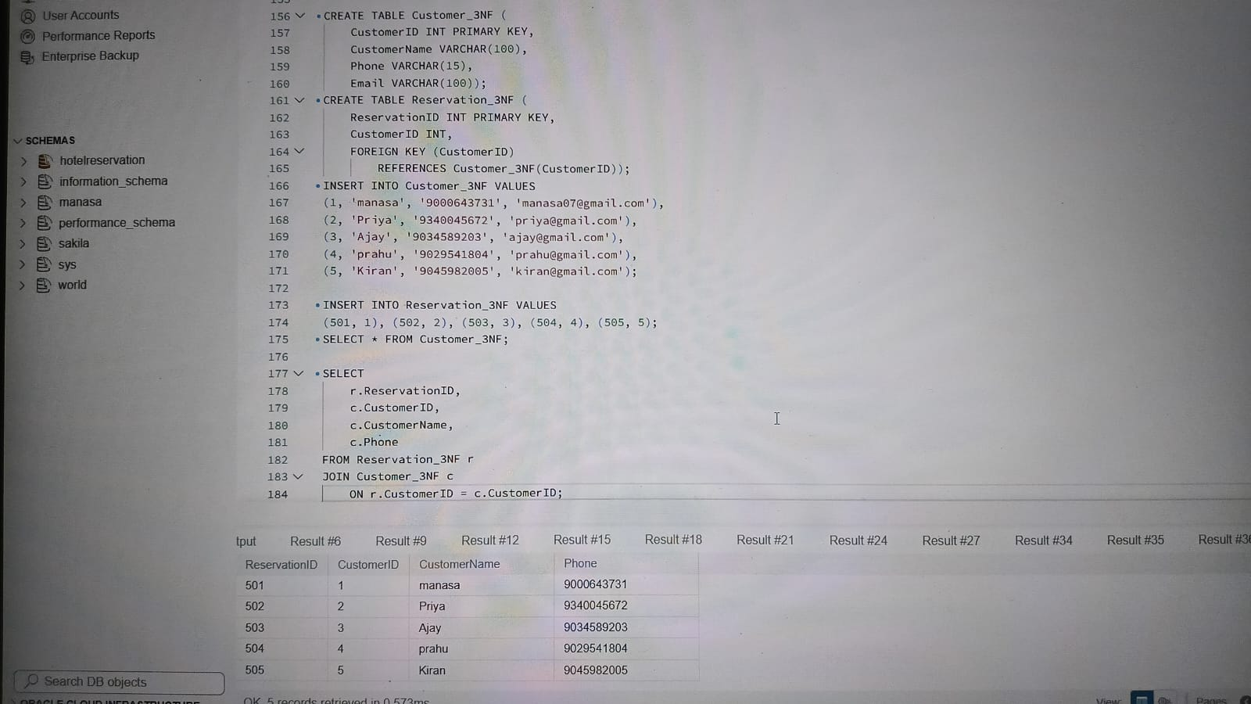
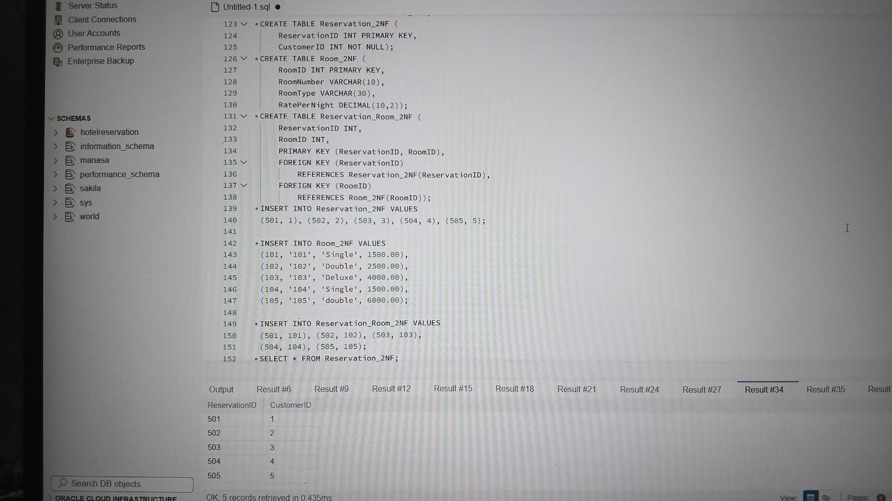
Implementation
4

Slide 7
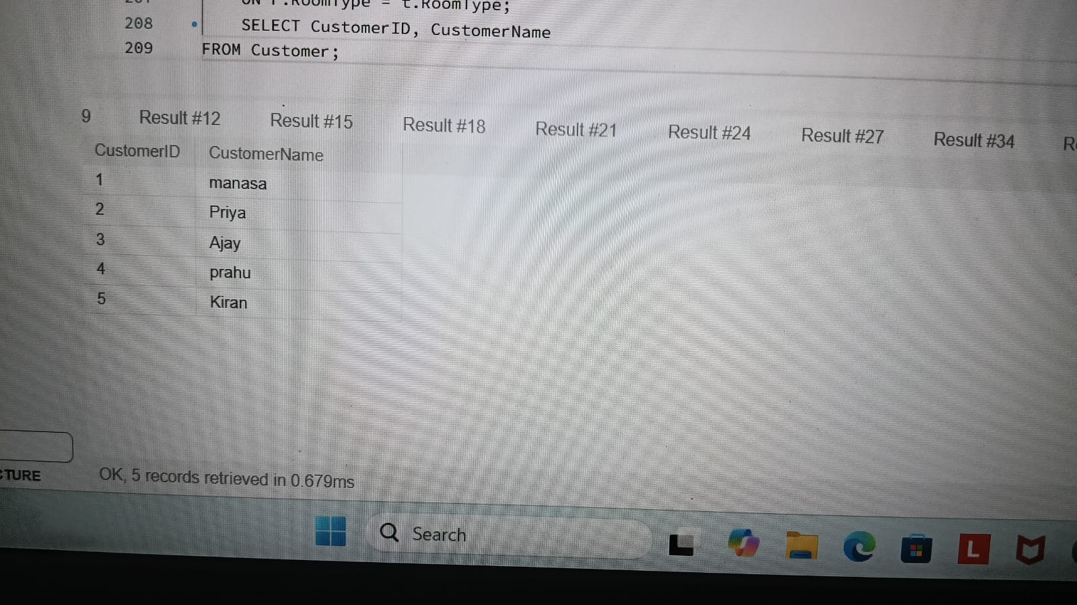
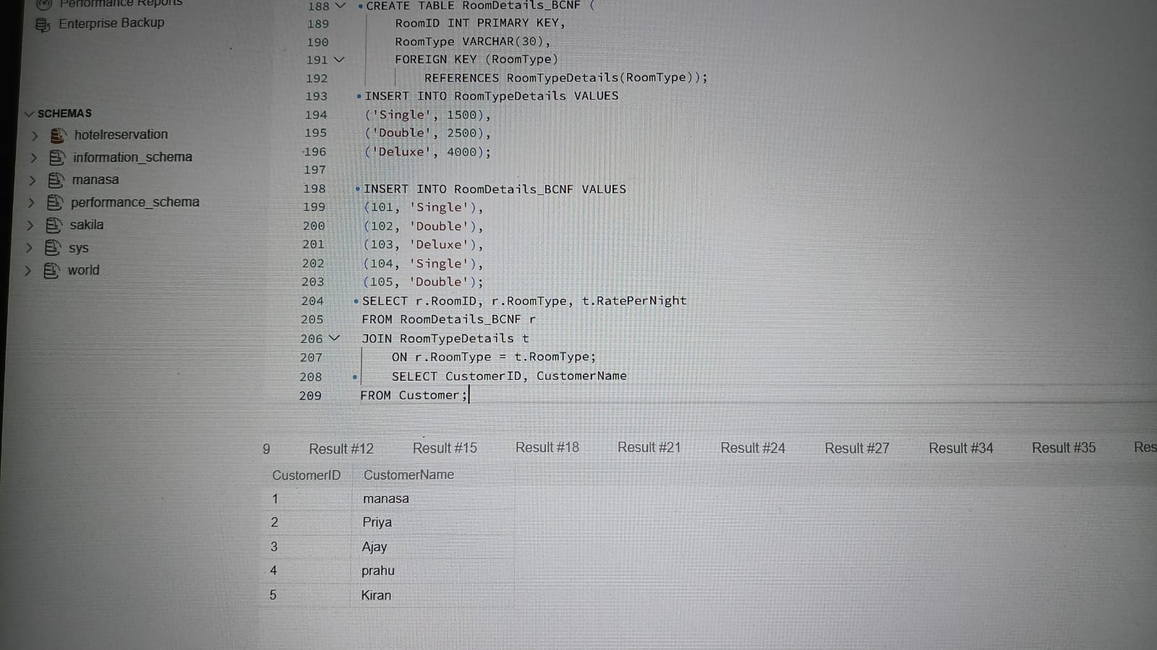
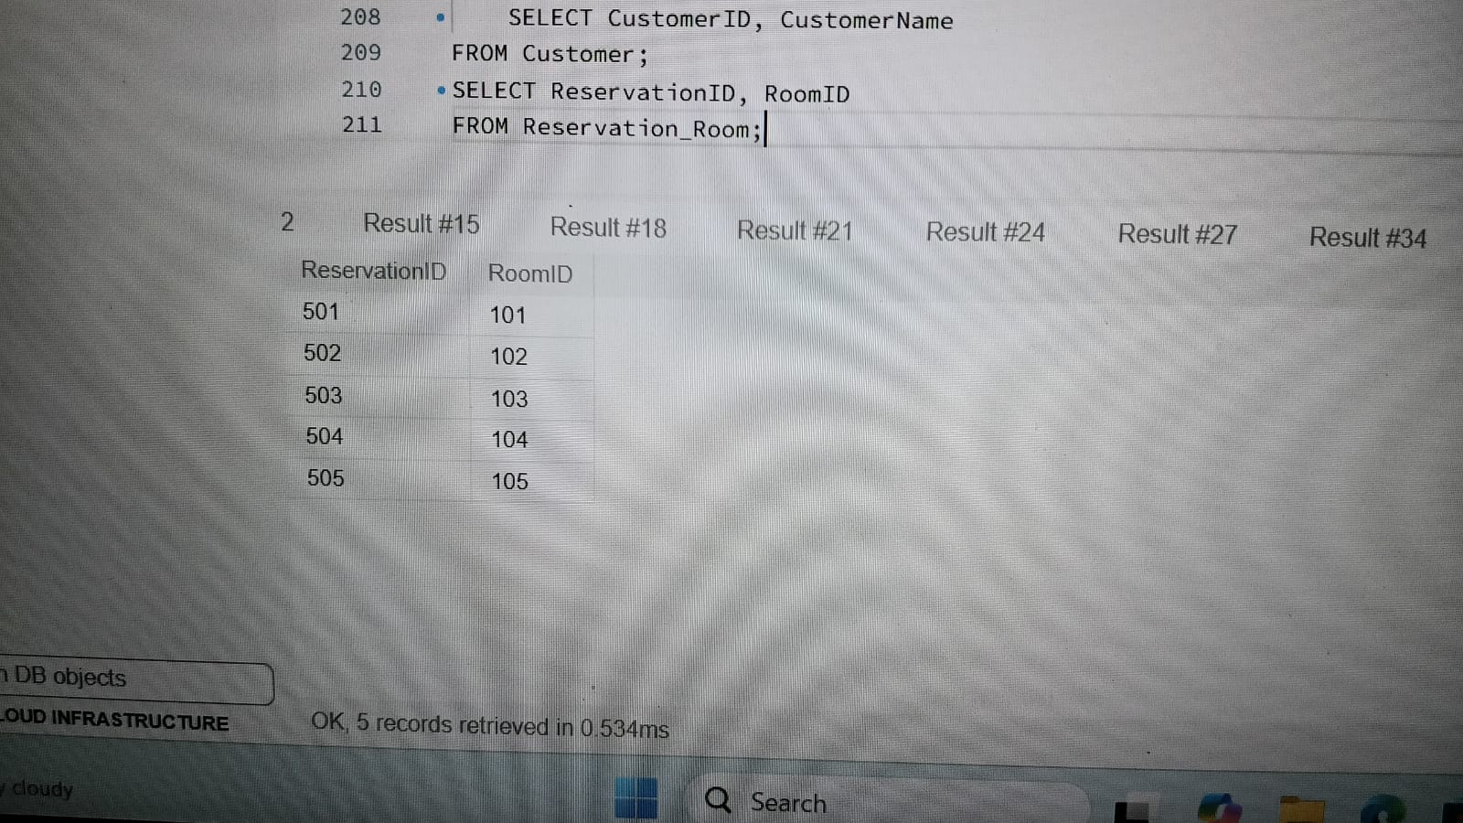
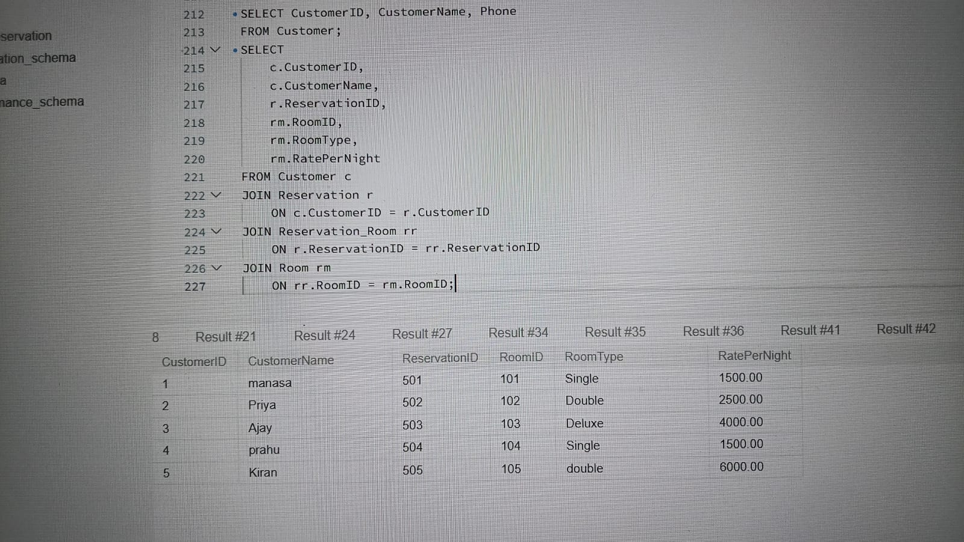
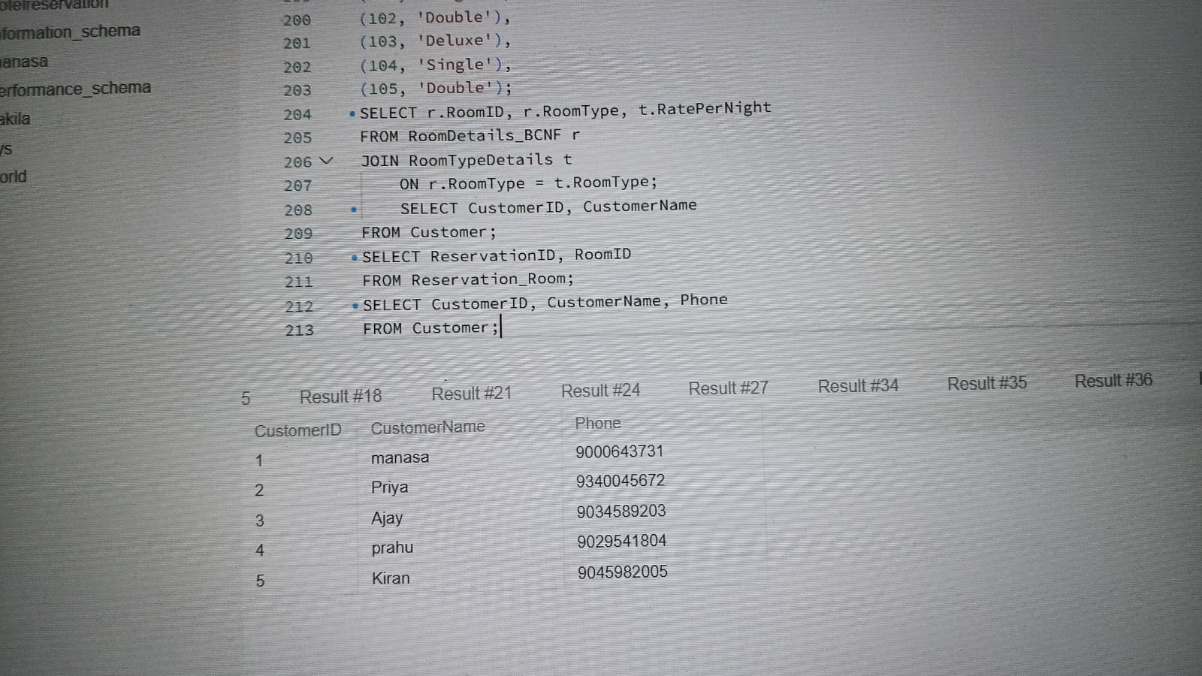
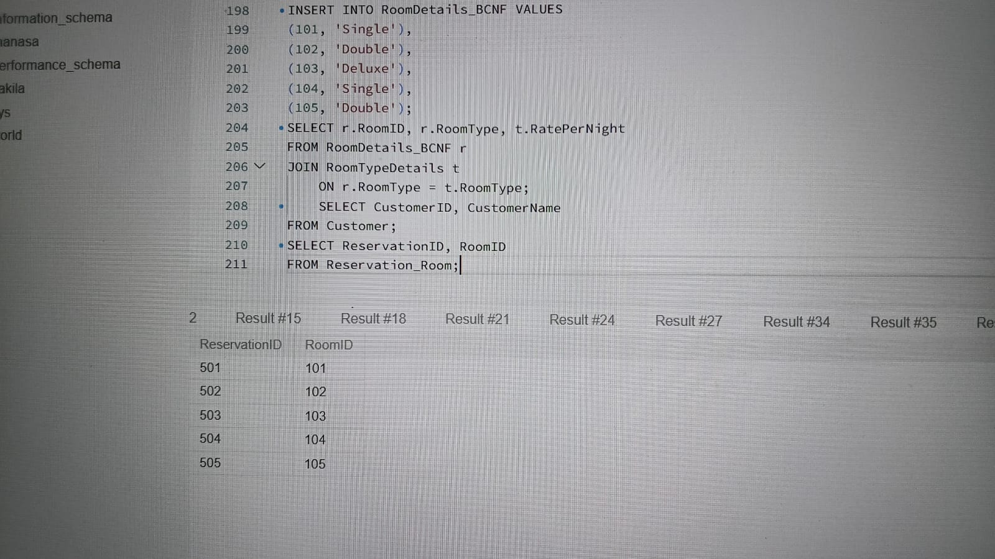
5

Slide 8
Conclusion
The Hotel Reservation System provides an organized method for handling hotel activities such as customer registration, room management, reservations, check-in, check-out, and billing. It reduces the effort required for maintaining manual records and makes information easier to retrieve. The modular design allows each function to be managed independently while keeping the overall process connected.
This project helps demonstrate the practical use of software development and database management in solving a real-world problem. In the future, the system can be enhanced with online payments, email or SMS booking confirmations, cancellation management, and a customer login facility.
5

