Slide 1
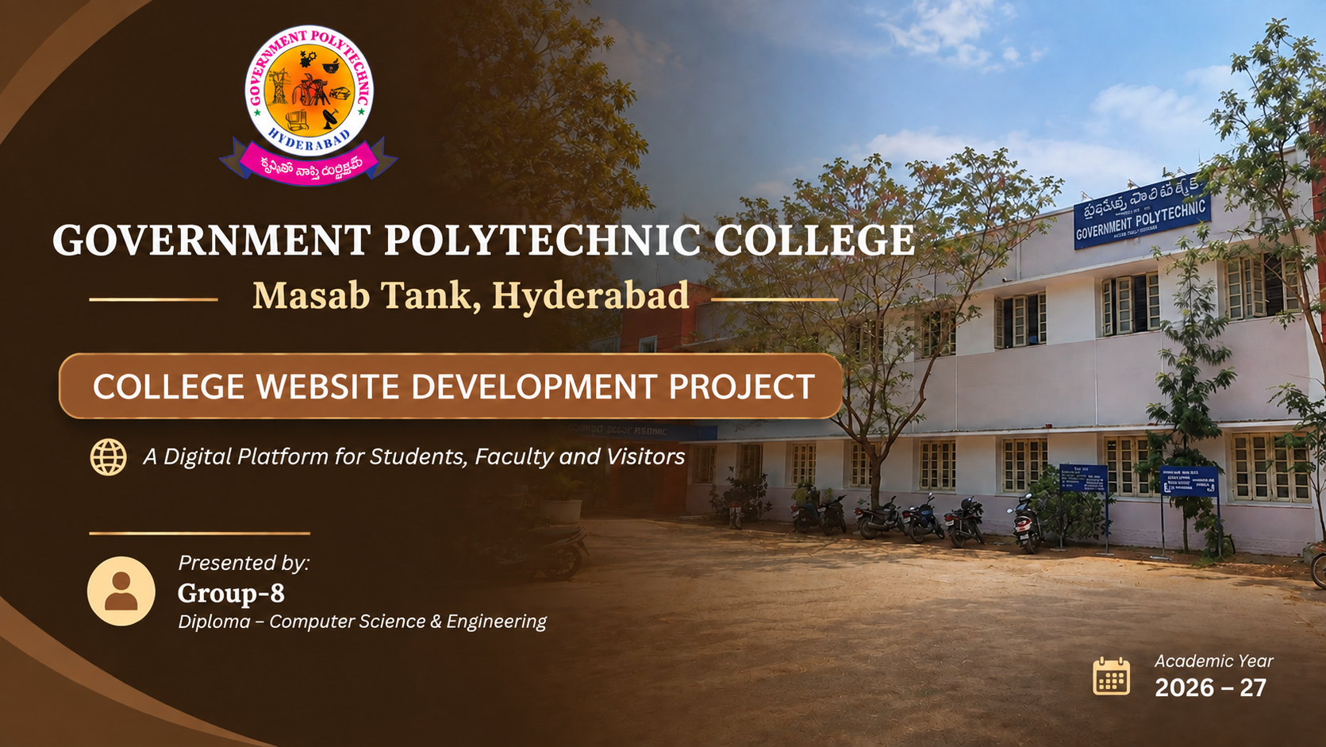

College Website Project
Government Polytechnic College
Masab Tank, Hyderabad
24001-cs-074
24001-cs-109
24001-cs-122
24001-cs-126
24001-cs-127
24001-cs-129
Live website: gptm-masabtank-website.tejayadavn.workers.dev
Government Polytechnic College • Website Project
1

Slide 2
INTRODUCTION
The Government Polytechnic College Website is a digital platform designed to provide important college information and services in one place. It includes sections for departments, faculty, placements, events, gallery, contact, and student services.
The website has a simple, clean, and user-friendly interface with clear navigation. Its organized layout helps students, faculty, and visitors quickly find the information they need.
Government Polytechnic College • Website Project
14

Slide 3
Project Objectives
Provide centralized access to important college information and services.
Organize Academic,Departments,Faculty, Event and Gallery content into dedicated modules.
Make college information easy to find through simple and clear navigation.
Provide a user-friendly and responsive website for students, faculty, and visitors.
Government Polytechnic College • Website Project
3

Slide 4

Home
Introduces the college with its name, location,and key information.
Provides easy navigation to all major website modules.
Highlights important activities and collegeupdates.
Displays college highlights through images andfeatured content.
Provides quick access to student and visitor services
A clear landing page guides every visitor
Government Polytechnic College • Website Project
5

Slide 5
About
Provides a structured introduction to the college.
Can include institutional background, vision, mission and major highlights
Supports a professional presentation of college information.
Keeps detailed descriptive content separate from the home page.
Institutional information is grouped in one place
Government Polytechnic College • Website Project
6

Slide 6
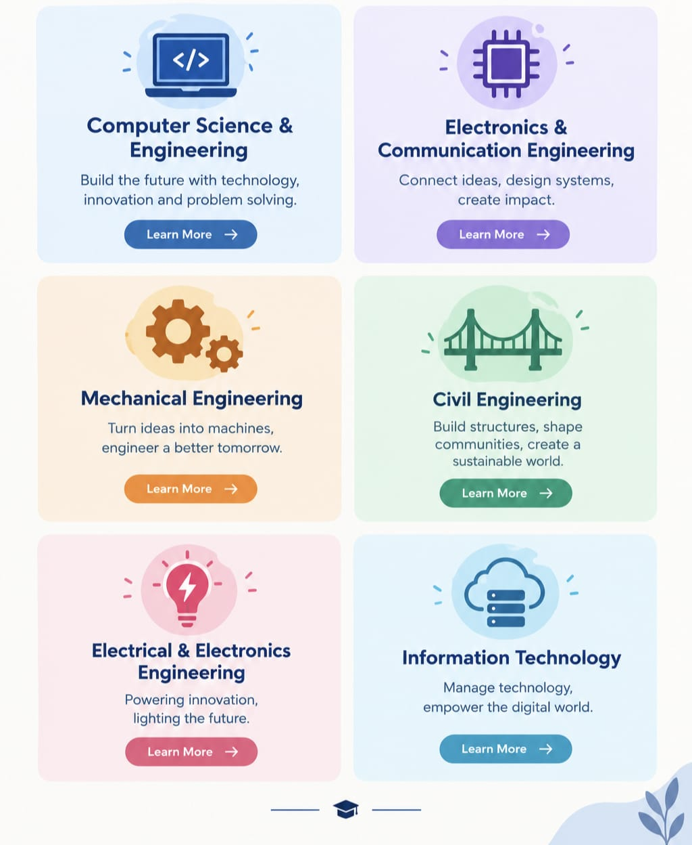
Departments
Organizes academic information branch-wise.
Each department can have a dedicated page or section.
Supports department overview, curriculum, facilities and related links.
Separate pages make the content easier for students to explore.
Branch-wise navigation improves clarity
Government Polytechnic College • Website Project
7

Slide 7
Faculty
Presents faculty information in consistent department-wise format.
Profiles can show name, experience, department and approved academic details.
A uniform profile layout keeps the page formal and easy to scan.
The structure can be expanded when verified faculty information is added.
Government Polytechnic College • Website Project
8

Slide 8

Placements
The Placements section provides
students with easy access to placement
and career-related information.
It highlights placement activities, training opportunities, recruitment details, and other career guidance to help students prepare for future employment.
Career information gets a dedicated module
Government Polytechnic College • Website Project
9

Slide 9
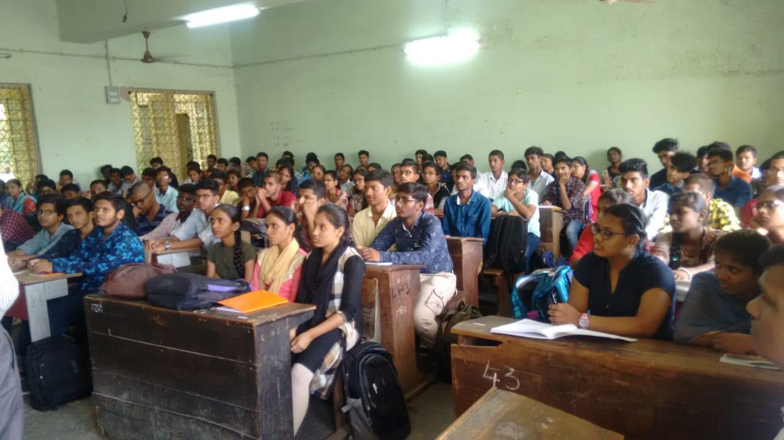
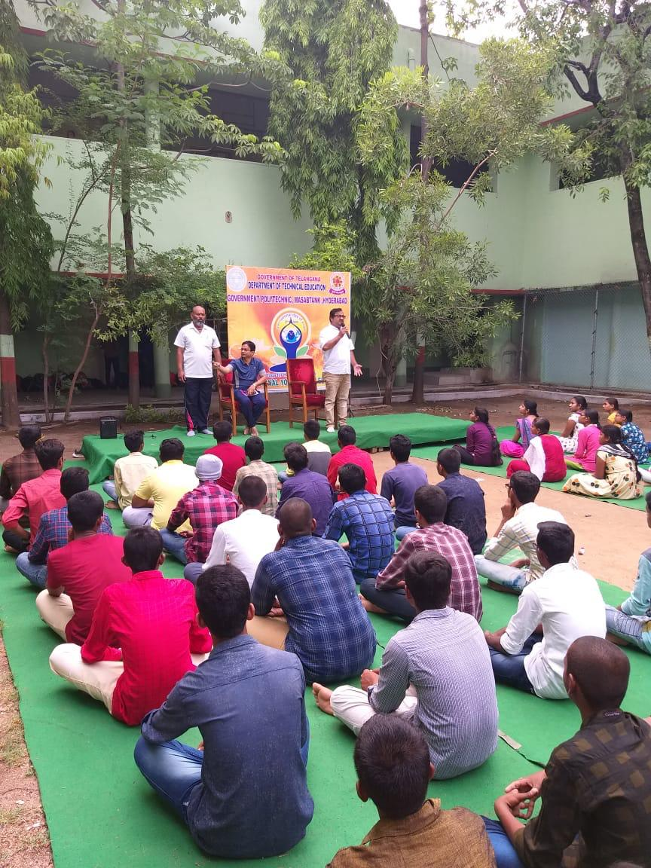
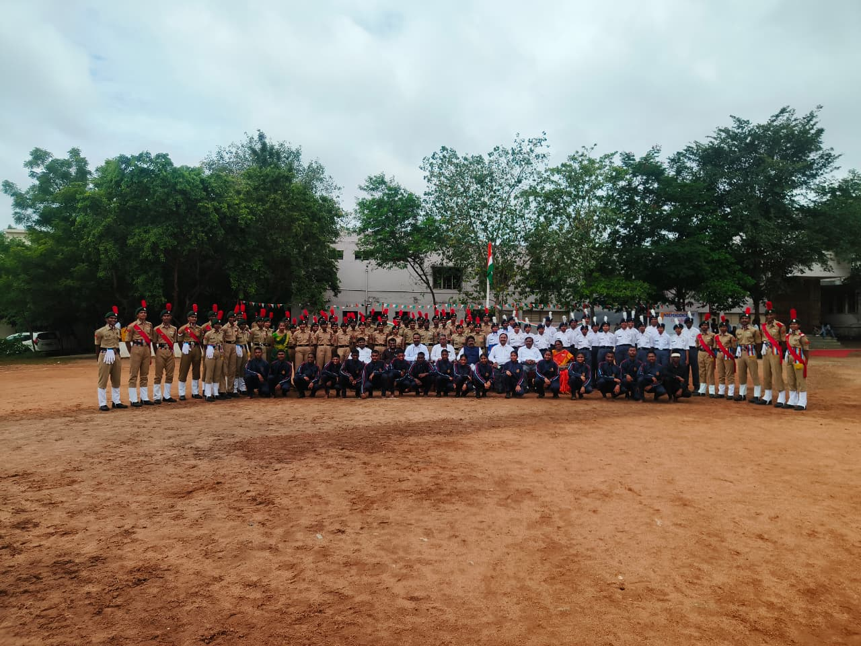
Events
Displays college events in a date-based format.
Can highlight seminars, celebrations, competitions and programs.
Each event can contain a title, short description and image.
Keeps students and visitors updated about upcoming and completed college activities.
Government Polytechnic College • Website Project
10

Slide 10
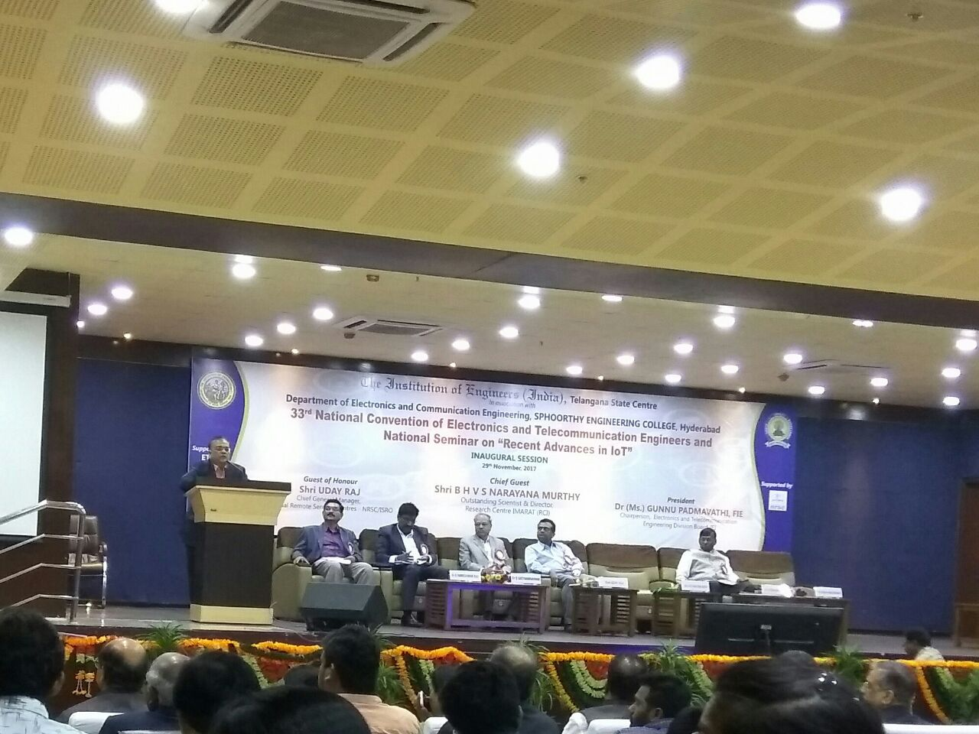
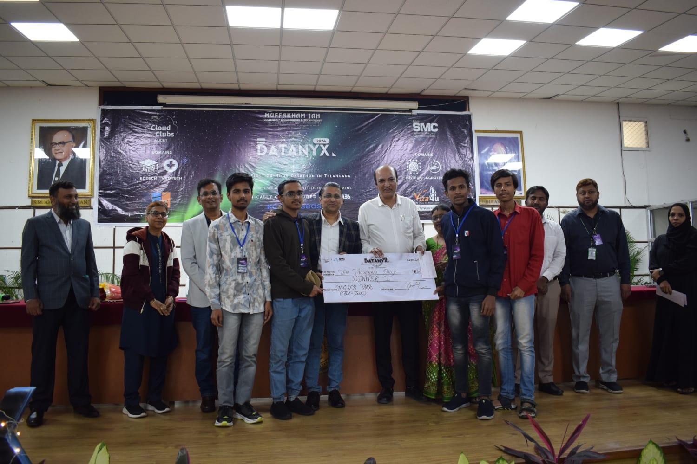
Gallery
Presents college photographs in a clean visual grid.
Helps visitors understand campus life through images.
Images can be grouped by event, activity or academic theme.
.
Visual content strengthens the college website
Government Polytechnic College • Website Project
11

Slide 11
Contact
Provides verified college contact information in one location.
Can include address, phone, email, map/location and enquiry form.
Gives visitors a clear action when they need additional information.
A simple contact layout improves accessibility and usability.
Easy-to-find contact details
Government Polytechnic College • Website Project
12

Slide 12
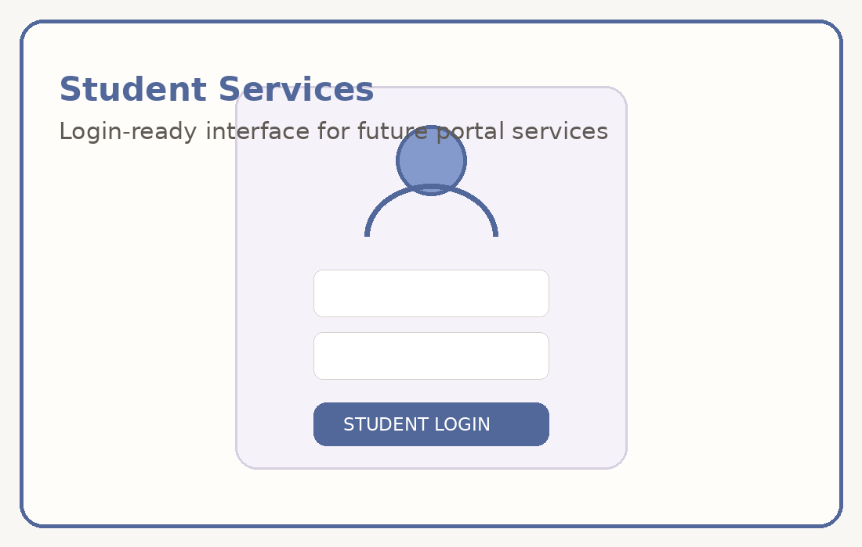
12 • MODULE 09
Student Portal
Provides a dedicated entry point for student-oriented services.
Can later support notices, academic information, student profiles and online services.
A separate portal keeps student functions organized and easier to expand.
The interface can be connected to authentication and a database in future.
Portal-ready design • Authentication and database can be added later
Government Polytechnic College • Website Project
13

Slide 13
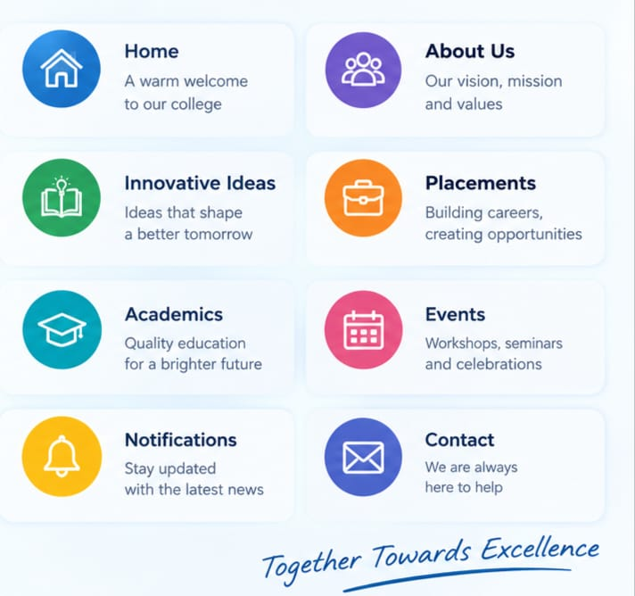
Project Overview
A dedicated college website that brings institutional information and student-oriented services into one structured platform.
The interface is organized into separate modules so users can reach the required information quickly.
The project is designed as a formal, responsive and maintainable web application.
Centralized college information • Clear navigation
Government Polytechnic College • Website Project
2

Slide 14
Technologies Used
React.js – Used to build the website interface and reusable components.
Vite – Used for fast project development and build setup.
JavaScript (JSX) – Used to create the website functionality and page structure.
CSS – Used for styling, layout, colors, spacing, and responsive design.
VS Code – Used as the development environment.

Slide 15
Conclusion
The website creates one structured digital platform for college information and student services.
The modular navigation keeps each area focused and easy to maintain.
. It brings together departments, faculty, placements, events, gallery, and student services, making information easily accessible to students, faculty, and visitors.
THANK YOU
Government Polytechnic College • Website Project
15

