Slide 1

Web page for Loot crypto coin
Done by
Man Kwan Karen Chung
Tashrif Ali
Nahid Sekander

Slide 2
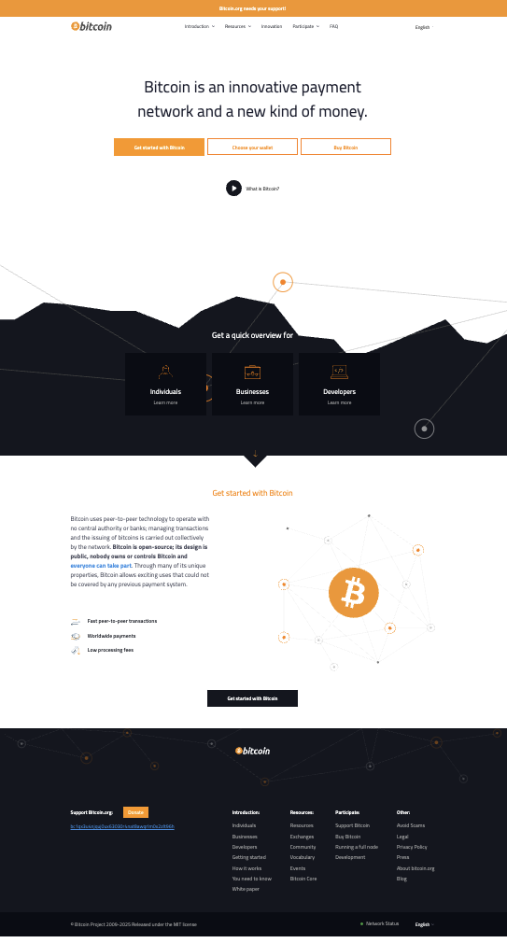
Application Purpose
It is a type of digital currency that has four main features:
Decentralized
Blockchain - Secure
Anyone Can Host a Node
Peer-to-Peer (P2P)
What we will be doing:
Creating a page that looks like a Bitcoin page
Notes:
It is Decentralized
Function: There is no central authority controlling the network. Instead, control is distributed across all participants, reducing risks of censorship, corruption, and single points of failure.
Anyone Can Host a Node
Function: Any individual or entity can set up and run a node, helping to validate and relay transactions. This promotes inclusivity, ensuring that the network remains decentralized and resilient.
It’s Secure
Function: Blockchain uses cryptographic techniques to secure data, ensuring that transactions are tamper-proof, and the integrity of the blockchain is maintained. This protects the network from fraud and unauthorized access.
Peer-to-Peer (P2P)
Function: Transactions occur directly between participants (peers) without needing intermediaries. This allows for faster, more cost-effective exchanges and promotes a trustless environment where users can transact securely.

Slide 3
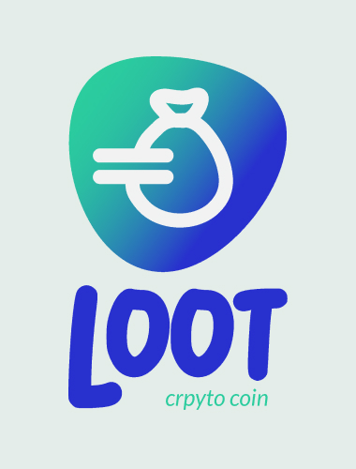
Branding Guidelines
Horizontal
Vertical

Slide 4
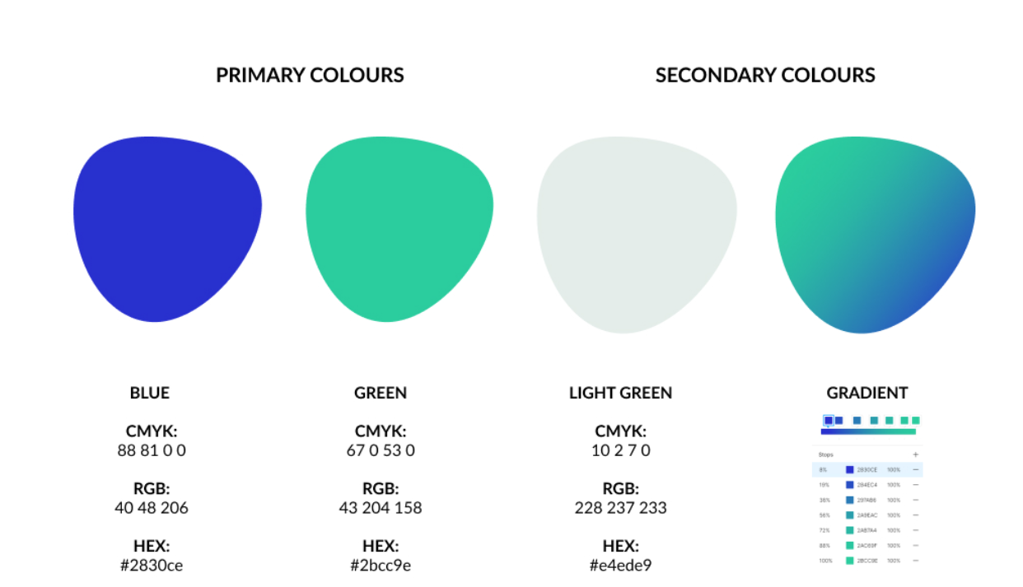
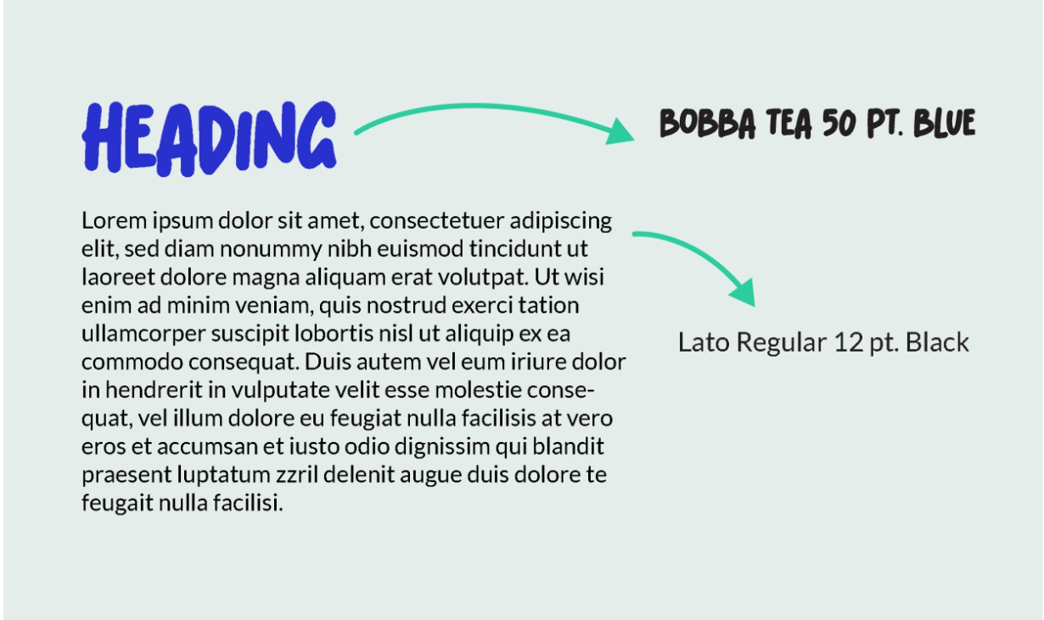
Branding Guidelines
Typography: Bobba tea 50pt blue for heading
Colors: Blue, Green Light green
Typography: Lato Regular 12 pt. Black

Slide 5
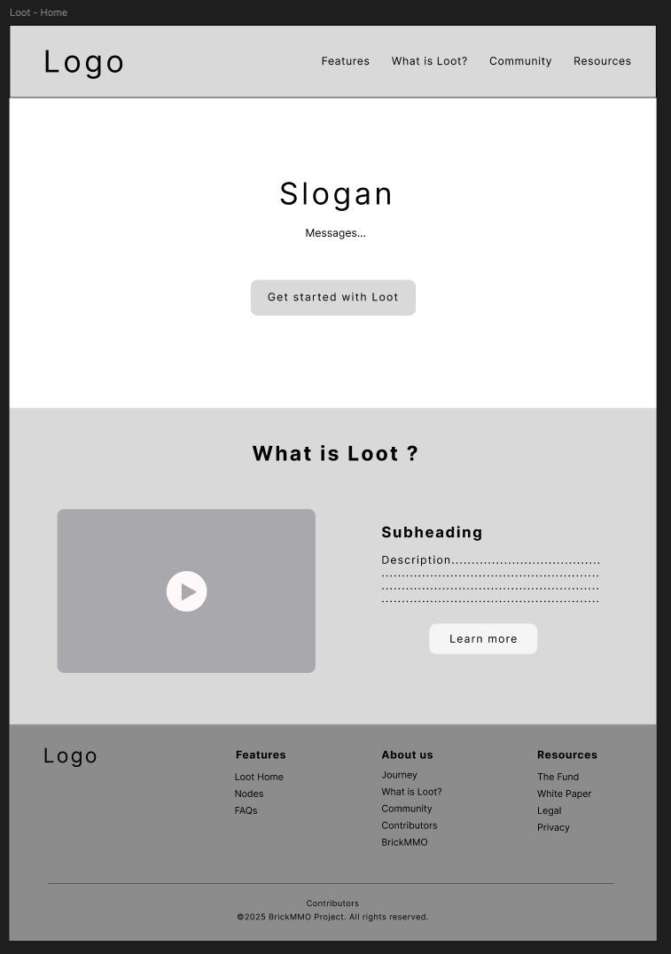
Wireframe
Focus on following aspects:
Simple and Clean Design
Modern Aesthetic
Easy Navigation
Dynamic Visuals

Slide 6
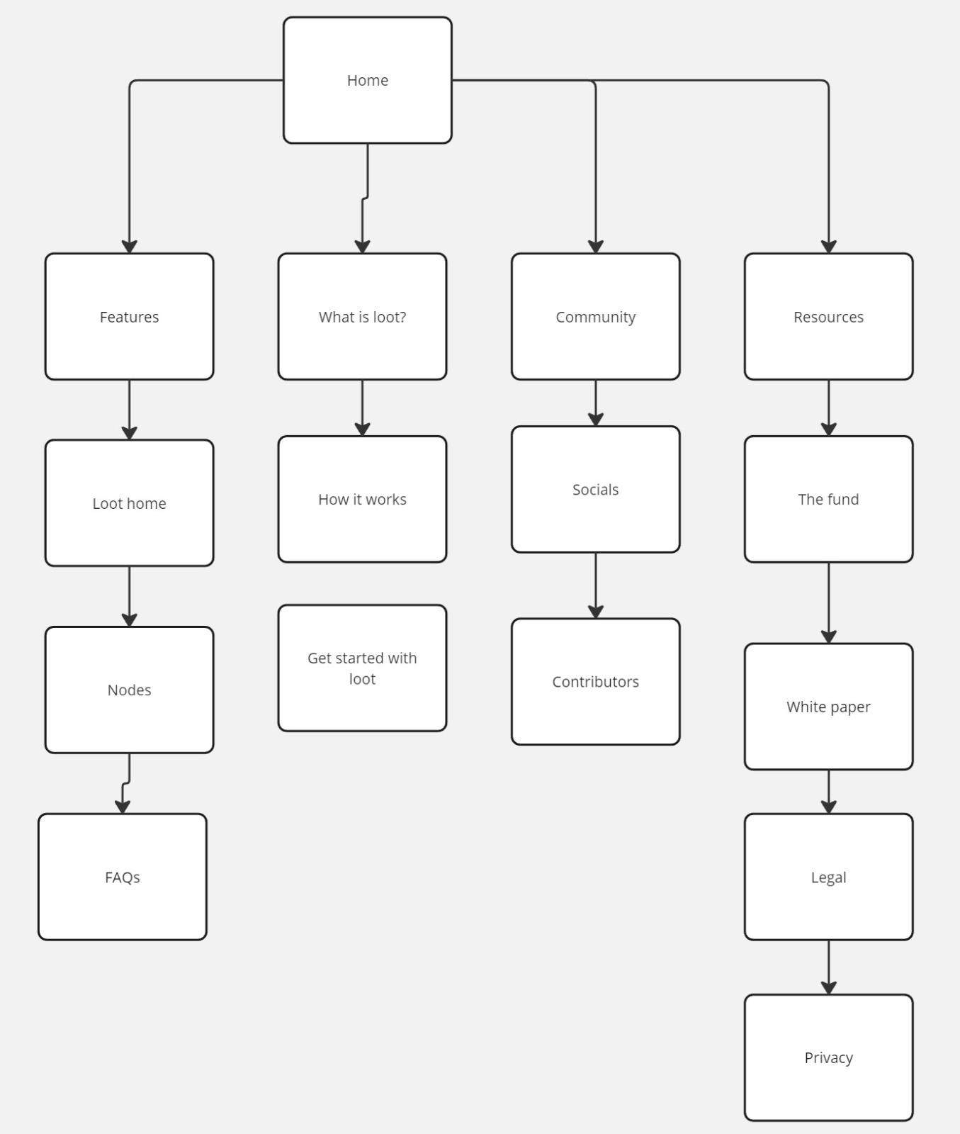
Main Navigation

