Slide 1
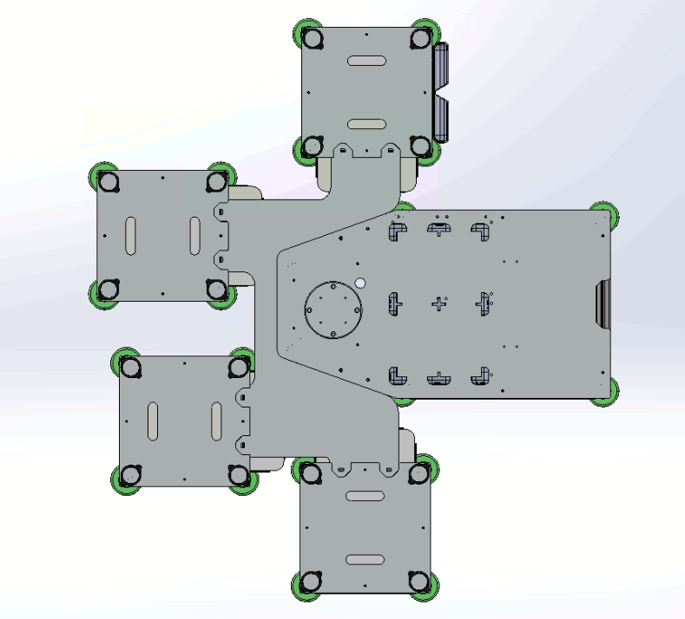
S4
S3
Ur3
+ve Y
-ve X
+ve X
S2
-ve Y
S1

Slide 2
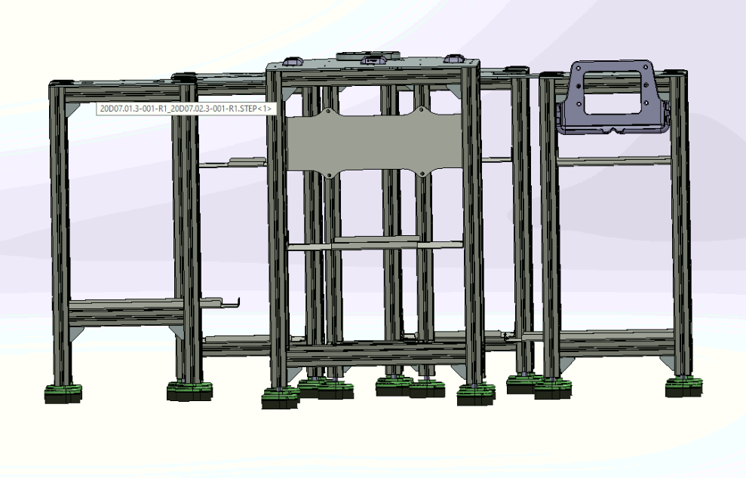
Z+ve
63..8mm
Z-ve

Slide 3
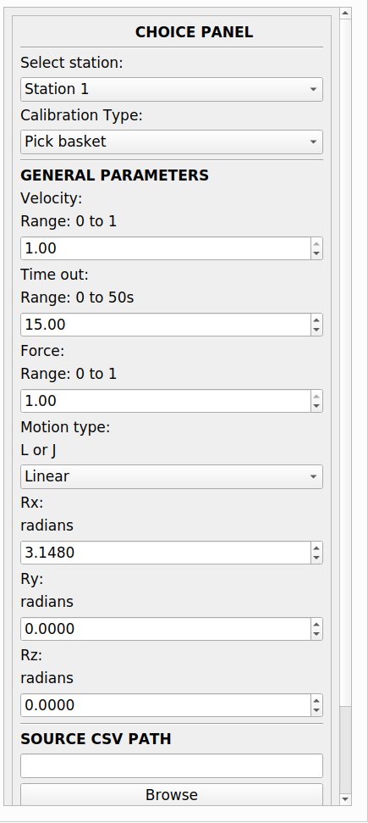
Enables the user to select the station to calibrate and also to select the component to calibrate
Selection
Displays the default general robot parameter values that gets transferred to the cal files
General Parameters
Displays the default general robot parameter values that gets transferred to the cal files
Path selection

Slide 4
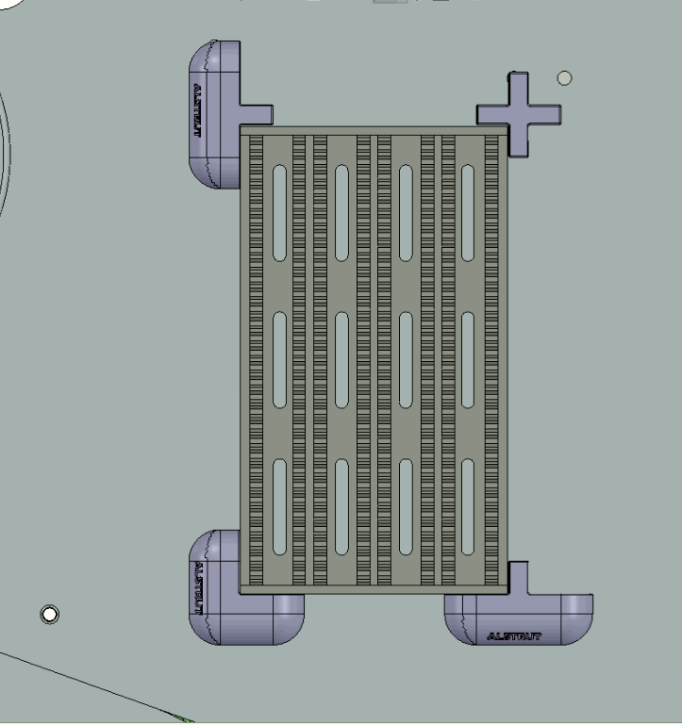
A0
D0
B3
B4
Fiducial markings POSE
B2
B1
A1
D1

Slide 5
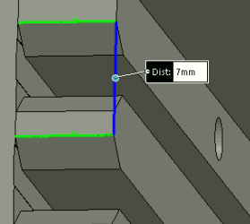
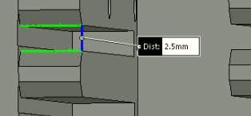
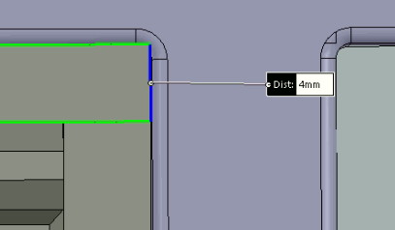
127mm
7 mm
distance between two slot walls
222.5mm
2.5 mm
Slide slot gap
4 mm
External wall thickness

