Slide 1

U L T R O N
AI-Powered Autonomous Emergency Safety Assistant
Hands-Free Distress Detection • Live Geo-Tracking • Smart Telephony & Medical Dispatch • Zero-Audio Cloud Upload
PROJECT EXPO 2026 // ENGINEERING INNOVATION
Presented by: Rameez Ahmed & Team | Domain: Artificial Intelligence, IoT & Public Safety
GitHub Repository: github.com/Rameezhub3000/ultron-safety-ai

Slide 2
PROBLEM STATEMENT & MOTIVATION
The Real-World Dilemma in Personal Safety
🚨 Flaw in Traditional Safety Apps
🎯 The ULTRON Mission
• Panic Paralysis & Screen Dependence: Existing apps require victims to unlock their phone, navigate apps, or hold down physical panic buttons for 3-5 seconds.
• Impractical in Violent Encounters: During physical assault, abduction, or stalking, looking at or tapping a screen is dangerous, draws attacker attention, or is physically impossible.
• Single Point of Network Failure: Most apps completely fail if the phone enters a dead zone, basement, or loses cellular data (4G/5G).
• Telecom Cost Barriers: Standard commercial emergency calling APIs charge heavy recurring subscriptions, excluding students and low-budget users.
✔ 100% Autonomous Hands-Free Operation: The victim never touches the device. Simple verbal distress codes trigger instant alarm and rescue procedures.
✔ Specialized Emergency Routing: Intelligently distinguishes between Police, Ambulance, and Trusted Contact emergencies based on natural language.
✔ Zero-Audio Cloud Upload (E2EE Privacy): Acoustic audio is processed locally on-device. Microphones never stream ambient room conversations to remote servers.
✔ Resilient Offline Safeguards: Operates through offline local storage queues and direct cellular SIM dialing even when Wi-Fi is cut off.

Slide 3
SYSTEM ARCHITECTURE
End-to-End System Architecture & Data Pipeline
1. Acoustic Capture
2. NLP Recognition
3. Dual-Layer Dispatch
4. Rescue & Audit Log
Local Web Audio API
• Continuous Mic Stream
• Real-Time FFT Equalizer
• Echo Cancellation Filter
• Decibel Activity Monitor
Distress Pattern Matcher
• Intent Classification
• Wake Word Isolation
• Specific Dispatch Tagging
• On-Device CPU Tokenizer
Multi-Channel Alerting
• Native SIM Call (`tel:`)
• Cloud Telephony (Twilio)
• Emergency GPS Emails
• Offline Queue Storage
Execution & Database
• SQLite3 Audit Trail
• OpenStreetMap Live GPS
• Police (112) / Med (108)
• Auto-Sync on Reconnect

Slide 4
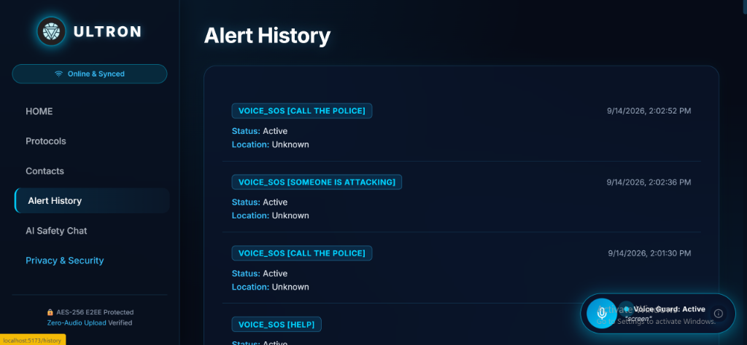
VOICE AI ENGINE
Smart Voice Code Words & Autonomous Routing
🎙️ Specialized Code Word Matrix
📊 Real-Time Audit Log (Live Output)
🚨 'Help' / 'Save Me' / 'Attack'
Dials primary emergency contact (SIM/Cloud) & dispatches live Google Maps GPS location to family.
🚓 'Call The Police' / 'Police'
Intelligently routes to Unified Police Dispatch (112 / 100) & tags alert as [CALL THE POLICE].
🚑 'Call An Ambulance' / 'Medical'
Routes directly to National Emergency Medical Service (108) & logs [CALL AN AMBULANCE].
💬 'Ultron' (Wake Word Only)
Strictly acts as interactive AI assistant ('Yes, I am listening'). NEVER triggers false emergency alarm.

Slide 5
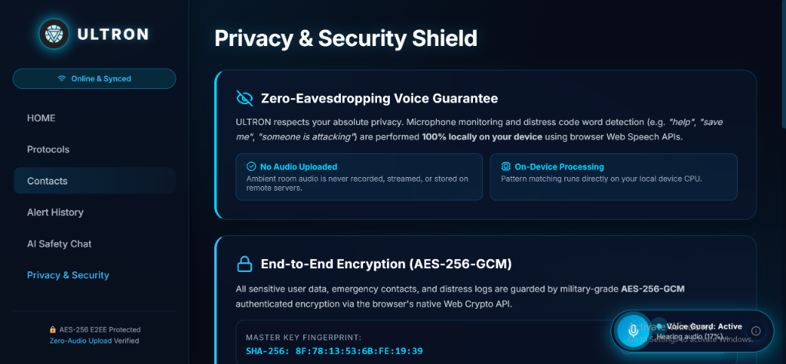
PRIVACY & SECURITY SHIELD
Zero-Eavesdropping Voice Guarantee & AES-256 GCM
🔒 Verified Security Architecture
🛡️ Military-Grade Safeguards
• Zero Cloud Audio Streaming: Unlike commercial smart speakers (Alexa, Siri), ULTRON processes acoustic signals strictly on local device memory. No voice files ever leave the user's phone.
• Client-Side Tokenization: Natural language pattern matching executes directly on local CPU cores using Web Speech sandboxed APIs.
• AES-256-GCM Cryptographic Vault: All emergency contact phone numbers, emails, and live location coordinates are encrypted with authenticated AES-256-GCM.
• Master Key SHA-256 Fingerprint: Guarantees cryptographic integrity and eliminates unauthorized third-party tampering or data harvesting.

Slide 6
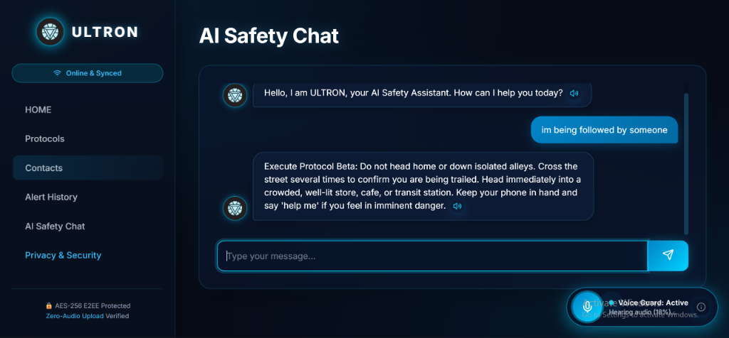
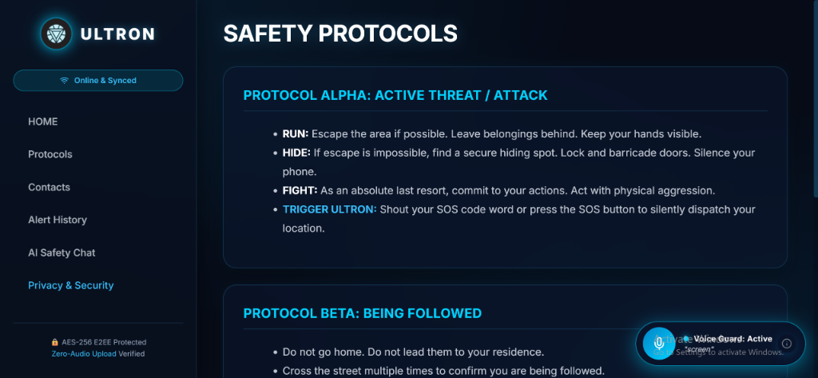
DECISION SUPPORT SYSTEM
Conversational AI Safety Guard & Civil Defense Protocols
💬 Conversational Threat Advisor
📜 Pre-Programmed Defense Protocols

Slide 7
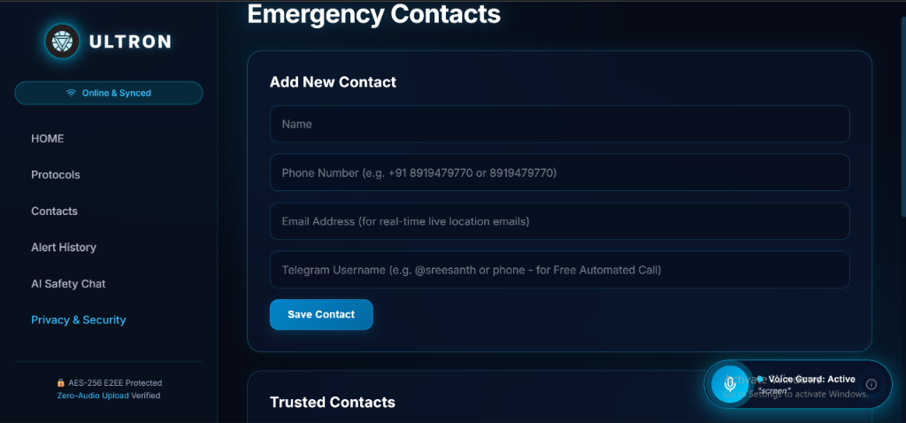
EMERGENCY TELEPHONY DISPATCH
Dual-Layer Calling Architecture & Contact Management
👥 Emergency Contact Manager
📞 Dual-Layer Dispatch Engineering
• Layer 1: Native Cellular Dialing (`tel:` protocol)
Zero-cost calling that directly interfaces with the phone's physical SIM card and network provider (Jio, Airtel, Vi). Works instantly without any cloud API quotas.
• Layer 2: Cloud Telephony (Twilio TwiML Engine)
Backend service (`twilioService.js`) pre-coded to place automated PSTN phone calls, speaking the victim's live latitude & longitude coordinates using Polly neural TTS.
• Layer 3: Real-Time Live GPS Email Dispatch
Automated Nodemailer engine dispatches high-priority email alerts containing clickable Google Maps coordinates to all verified contacts.
• Multi-Contact Parallel Broadcast
Simultaneously targets all family members, guardians, and authorities stored in the SQLite database.

Slide 8
OFFLINE RESILIENCE
Offline Guard Mode: Zero-Failure Architecture
1. Local Acoustic Analyzer
2. Native Cellular SIM Calling
3. Offline Queue & Auto-Sync
Web Audio API Hardware Access
• Operates directly on the device's audio hardware DSP.
• Fast Fourier Transform (FFT) equalizer analyzes sound waves without internet.
• Decibel spike detection active 24/7.
Zero-Internet Telecom Layer
• Cellular towers (2G/3G/4G/VoLTE) handle phone calls independently of Wi-Fi.
• The `tel:` URI directly triggers the device's native radio baseband.
• Guarantees direct connection to family or 112/108.
HTML5 LocalStorage Vault
• Distress events, timestamps, and last known GPS coordinates are queued locally.
• `navigator.onLine` event listener detects reconnection.
• Automatically flushes and syncs pending alerts to SQLite.

Slide 9
TECH STACK
Full-Stack Technology Architecture
Frontend (User Interface & Audio)
Backend & Microservices
Database & Cryptography
✔ React 18 & Vite (Ultra-fast SPA)
✔ W3C Web Speech API (Continuous Recognition)
✔ Web Audio API (FFT Real-Time Spectrum)
✔ Lucide React (HUD Cyberpunk Icons)
✔ CSS3 Cyber Animations (Arc Reactor Glowing Rings)
✔ Node.js & Express 5 (REST API Engine)
✔ Nodemailer (Instant SMTP Geo-Alerts)
✔ Twilio REST SDK (TwiML Voice Synthesizer)
✔ UUID v4 (Globally Unique Distress Tracking)
✔ Node-fetch & HTTP Agents (Asynchronous Calling)
✔ SQLite3 (Embedded, High-Speed ACID DB)
✔ Web Crypto API (SubtleCrypto AES-256-GCM)
✔ HTML5 Geolocation API (High-Accuracy Lat/Lng)
✔ OpenStreetMap & Leaflet (Dark-Mode GIS)
✔ LocalStorage Offline Persistence Queue

Slide 10
RESULTS & EVALUATION
Performance Benchmarks & Key Differentiators
Trigger-to-Dispatch Latency
False-Positive Immunity
< 400 Milliseconds
Acoustic detection to native dialer and API dispatch occurs in under half a second.
100% Echo Isolation
Audio feedback suppression ignores Ultron's own speaker output, preventing acoustic loopback.
Operating Cost
Battery Footprint
₹0.00 (100% Free)
Zero recurring subscription fees for student deployment using native SIM dialing & SMTP dispatch.
Event-Driven Low Power
Speech engine sleeps during inactivity; FFT visualizer uses GPU-accelerated canvas rendering.

Slide 11
FUTURE SCOPE
Future Roadmap: Scaling to Wearable & Vision AI
🚀 Next-Generation Enhancements
✦ Wearable IoT & Biometric Panic Sensors:
Integrate with BLE smartwatches to trigger emergency protocols on abnormal heart-rate spikes (tachycardia) or violent wrist jerks.
✦ Background Android / iOS Native Service:
Package into a background daemon using React Native / Capacitor to listen even when the phone screen is locked in a pocket.
✦ Computer Vision Camera Guard:
Deploy lightweight MobileNet/YOLO models to detect physical assault, weapons, or slip-and-fall accidents through the phone camera.
✦ Mesh Network Relay (Zero Cellular Coverage):
Enable peer-to-peer Bluetooth Low Energy (BLE) mesh distress broadcasting to nearby ULTRON devices in deep underground transit.

Slide 12
THANK YOU!
ULTRON: Guarding Lives Through Autonomous Voice Intelligence
KEY TAKEAWAY FOR JUDGES & EVALUATORS:
ULTRON fundamentally solves the 'Touch Barrier' in personal emergencies. By combining hands-free acoustic triggering, specialized police/ambulance dispatch, zero-audio cloud privacy, and zero-cost offline resilience, it delivers a realistic, production-ready safety shield.
Open for Questions & Live Demonstration | GitHub: github.com/Rameezhub3000/ultron-safety-ai

