Slide 1
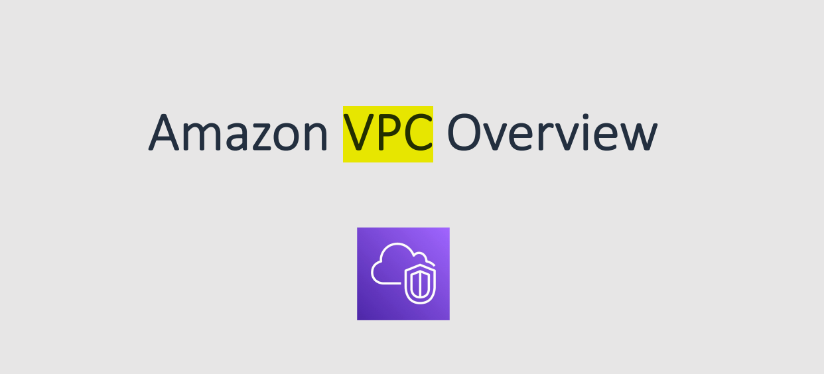

Slide 2
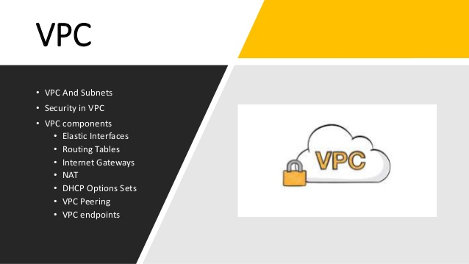

Slide 3
Virtual Private Cloud (VPC)
A Virtual Private Cloud is a virtual network that closely resembles a traditional network that you operate in your own data centre with the benefits of using the scalable infrastructure of AWS.
OR
In Simple Language VPC is a Virtual Network or Data Centre inside AWS of one Client.

Slide 4
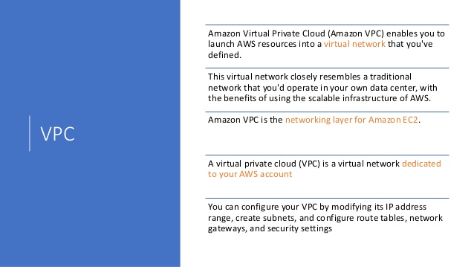

Slide 5
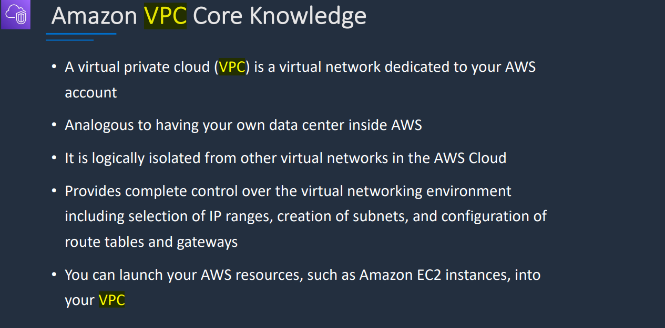

Slide 6
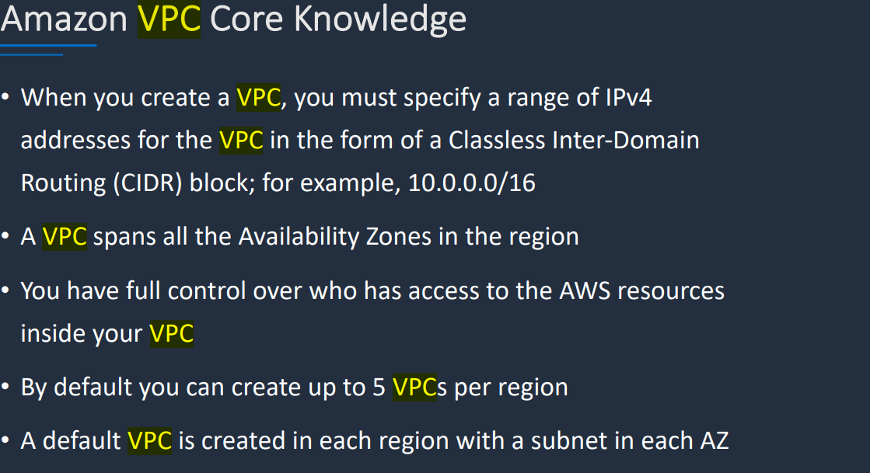

Slide 7
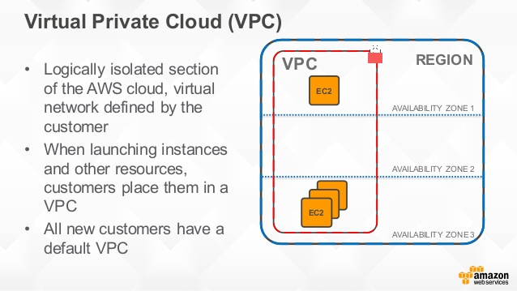

Slide 8
Use cases: multi-tier web applications
Host multi-tier web applications and strictly enforce access and security restrictions between your web servers, application servers, and databases. Launch web servers in a publicly accessible subnet while running your application servers and databases in private subnets. This will ensure that application servers and databases cannot be directly accessed from the internet. You control access between the servers and subnets using inbound and outbound packet filtering provided by network access control lists and security groups. To create a VPC that supports this use case, you can select "VPC with Public and Private Subnets" in the Amazon VPC console wizard.

Slide 9
CIDR
CIDR are used for Security Groups rules, or AWS networking in general
Classless Inter-Domain Routing is a method for allocating IP addresses
A CIDR has two components:
The base IP (XX.XX.XX.XX)
The Subnet Mask (/26)
The base IP represents an IP contained in the range
The subnet masks defines how many bits can change in the IP
They help to define an IP address range
We’ve seen AA.BB.CC.ZZ/32 == one IP
We’ve seen 0.0.0.0/0 == all IPs
But we can define for ex: 192.168.0.0/26: 192.168.0.0 – 192.168.0.63 (64 IP)

Slide 10
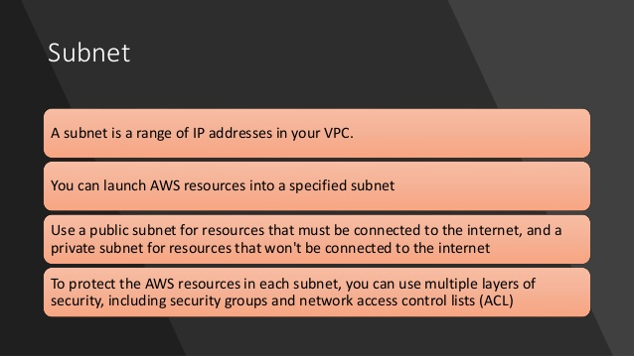

Slide 11
Subnet Masks
The subnet masks basically allows part of the underlying IP to get additional next values from the base IP
/32 allows for 1 IP = 2^0
/31 allows for 2 IP = 2^1
/30 allows for 4 IP = 2^2
/29 allows for 8 IP = 2^3
/28 allows for 16 IP = 2^4
/27 allows for 32 IP = 2^5
/26 allows for 64 IP = 2^6
/25 allows for 128 IP = 2^7
/24 allows for 256 IP = 2^8
/16 allows for 65,536 IP = 2^16
0 allows for all IPs = 2^32

Slide 12
On Tips:
/32 – no IP number can change
/24 - last IP number can change
/16 – last IP two numbers can change
/8 – last IP three numbers can change
/0 – all IP numbers can change

Slide 13
Practice CIDR & Subnet Mask
192.168.0.0/24 = …
192.168.0.0 – 192.168.0.255 (256 IP)
192.168.0.0/16 = … ?
192.168.0.0 – 192.168.255.255 (65,536 IP)
134.56.78.123/32 = … ?
Just 134.56.78.123
0.0.0.0/0 All IP!

Slide 14
Private vs Public IP (IPv4) ranges
The Internet Assigned Numbers Authority (IANA) established certain blocks of IPV4 addresses for the use of private (LAN) and public (Internet) addresses.
Private IP can only allow certain values
10.0.0.0 – 10.255.255.255 (10.0.0.0/8) <= in large networks
172.16.0.0 – 172.31.255.255 (172.16.0.0/12) <= default AWS one
192.168.0.0 – 192.168.255.255 (192.168.0.0/16) <= home/personal networks
“All the rest of the IP on the internet are public IP”

Slide 15
Subnets - IPv4
AWS reserves 5 IPs address (first 4 and last 1 IP address) in each Subnet
These 5 IPs are not available for use and cannot be assigned to an instance
Suppose if CIDR block 10.0.0.0/24, reserved IP are:
10.0.0.0: Network address
10.0.0.1: Reserved by AWS for the VPC router
10.0.0.2: Reserved by AWS for mapping to Amazon-provided DNS
10.0.0.3: Reserved by AWS for future use
10.0.0.255: Network broadcast address
If you need 29 IP addresses for EC2 instances, you can’t choose a Subnet of size /27 (32 IP)
You need at least 64 IP, Subnet size /26 (64-5 = 59 > 29, but 32-5 = 27 < 29)

Slide 16
VPC Virtual Private Cloud
You can have multiple VPCs in a region max 5 per region
Max CIDR per VPC is 5.
For each CIDR:
Min size is /28 = 16 IP Addresses
Max size is /16 = 65536 IP Addresses
Because VPC is private, only the Private IP ranges are allowed:
10.0.0.0 – 10.255.255.255 (10.0.0.0/8)
172.16.0.0 – 172.31.255.255 (172.16.0.0/12)
192.168.0.0 – 192.168.255.255 (192.168.0.0/16)
VPC CIDR should not overlap with your other networks

Slide 17
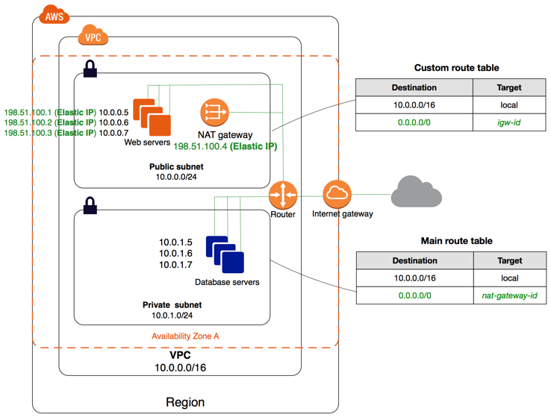

Slide 18
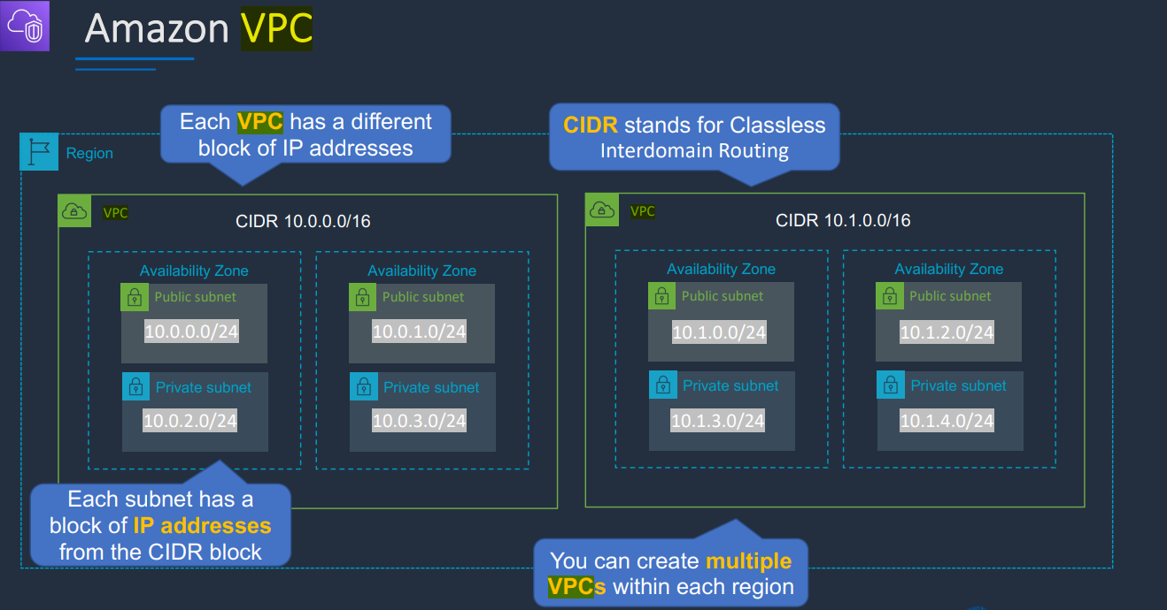

Slide 19
VPC
Amazon Virtual Private Cloud (Amazon VPC) enables you to launch AWS resources into a virtual network that you've defined.
Amazon VPC service helps you control your virtual networking environment by letting you choose your own IP Address range, create your own subnets, and configure route tables to any available gateways.
There's no additional charge for using a VPC. There are charges for the following VPC components: Site-to-Site VPN connection, PrivateLink, Traffic Mirroring, and a NAT gateway.
As one of AWS's foundational services, Amazon VPC makes it easy to customize your VPC's network configuration

Slide 20
Some More Points To Know
VPC is logically isolated from other Virtual network in the AWS Cloud.
Max 5 VPC’s can be created in one region & 200 Subnets in one VPC.
We can attach maximum of 5 Elastic IP’s per Region.
Once We Create VPC , three things by default will be created
DHCP , NACL & Security Group.
VPC is confined to an AWS Region and does not extend between Regions.

Slide 21
Everyone can make VPC (10.0.0.0/16) in their Region. But you cannot use in your same region.
Public Subnet can go to internet but no private subnet can go directly.
Routers exist on region.
Once your VPC create you cannot change its CIDR Range.(ex 10.0.0.0/16)
If you need a different CIDR Size create a new VPC.
The different subnets within a VPC cannot overlap.
Router use for connecting two different network. But subnets in same VPC does not require any router as VPC Itself is a router that’s why target is local in route tables.

Slide 22
Default VPC
All new accounts have a default VPC
New instances are launched into default VPC if no subnet is specified
Default VPC have internet connectivity and all instances have public IP
We also get a public and a private DNS name

Slide 23
Public Subnet Vs Private Subnet
Public Subnet
If a Subnet has a route to Internet Gateway then that subnet is called as Public Subnet.
Instance is in a public subnet to communicate with internet must have a public IPV4 or Elastic IP address..
Private Subnet
If a Subnet is not a route to Internet Gateway then that subnet is called as Private Subnet.

Slide 24
Router & Route Tables
It is the Central Routing function
Routers Connects Different AZ’s together and connects the VPC to the Internet Gateway.
We Can have 200 Route Tables per VPC.
We can have 50 Route Entries per Route Table.
Each Subnet must be associated with only one route table at any given time.
If you not specify a Subnet to Route Table association , the subnet will get associate with the default VPC Route Table.

Slide 25
Route Table Contd
We can also edit the main route table if needed , but cannot delete it.
However we can make our own custom Route Table manually which will now become the main route table then we can delete the former one.
Remember we can associate multiple subnets with the same Route Table.

Slide 26
Internet Gateway (IGW)
An Internet Gateway is a Virtual Router that connects VPC to the Internet.
Default VPC is already attached with an Internet Gateway.
If you create a new VPC you must attach to the Internet Gateway in order to access the Internet.
Ensure that your Subnet’s Route table points to the internet gateway.
It performs NAT between your private & public IPV4 address.

Slide 27
NAT Gateway
NAT stands for Network Address Translation.
We can use a Network address translation gateway to enable instances in a private subnet to connect to the internet or other AWS services but prevent the internet from initiating a connection with those instances.
We are charged for creating and using a NAT gateway in our account .
To create a NAT gateway , we must specify the public subnet in which the NAT gateway should reside.
We must also specify a Elastic IP address to associate with NAT gateway when you create it.

Slide 28
NAT (Contd)
No need to assign Public IP address to your private instances.
After NAT Gateway is created we must update the route table with one or more of your private subnets to point internet bound traffic to the NAT gateway.
This enables instances in our subnet to communicate with the internet.
Deleting a NAT gateway dissociates its elastic IP address , but does not release the address from your account.

Slide 29
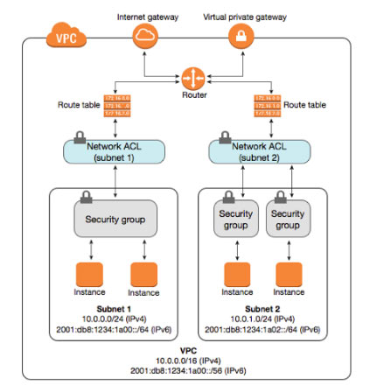

Slide 30
NACL
NACL stands for Network Access Control List.
It is the function formed in the Router.
NACL is an optional layer security for your VPC that acts as an firewall for controlling traffic in and out of one or more subnets.
VPC automatically comes with a modifiable default NACL.
By Default , NACL allows all inbound and outbound IPV4 traffic.
We can create a custom Network ACL and associate it with a subnet . By default , each custom network NACL denies all inbound & outbound traffic until we specify rules.

Slide 31
Security Groups
Security Groups are a Virtual Firewalls.
Upto 5 Security Groups per EC2 instance can be applied.
Sg can only have permit rules cannot have deny rules.
Stateful , Return traffic of allowed inbound traffic is allowed even if there are no rules to allow it .

Slide 32
NACL (Contd)
Each Subnet in our VPC must be associated with a Network ACL , if we don’t explicitly associate a subnet with a network ACL , th subnet is automatically associated with the default Network ACL.
Associating of a network ACL with multiple subnets is possible but a particular subnet can be associated only to one NACL at a time.
Network ACL contains a numbers list of rules that we evaluate with the lowest numbered rule.
NACL are stateless, outbound traffic for an allowed inbound traffic must be explicitly allowed too.
You can have permit and deny rules in a NACL.

Slide 33
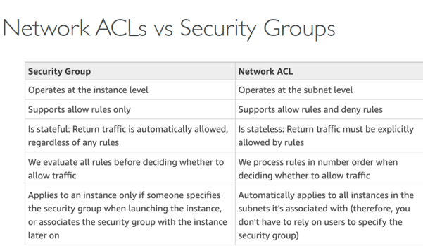

Slide 34
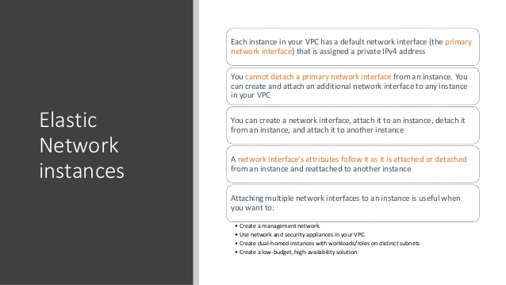

Slide 35
Elastic network interface
An elastic network interface is a logical networking component in a VPC that represents a virtual network card. It can include the following attributes:
A primary private IPv4 address from the IPv4 address range of your VPC
One or more secondary private IPv4 addresses from the IPv4 address range of your VPC
One Elastic IP address (IPv4) per private IPv4 address
One public IPv4 address
One or more IPv6 addresses
One or more security groups
A MAC address
A source/destination check flag
A description

Slide 36
Working with network interface
Create a network interface
View details about a network interface
Attach a network interface to an instance
Detach a network interface from an instance
Manage IP addresses
Modify network interface attributes
Add or edit tags
Delete a network interface

Slide 37
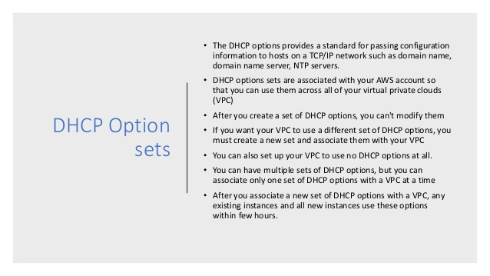

Slide 38
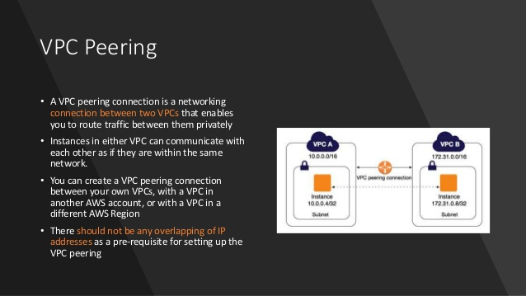

Slide 39
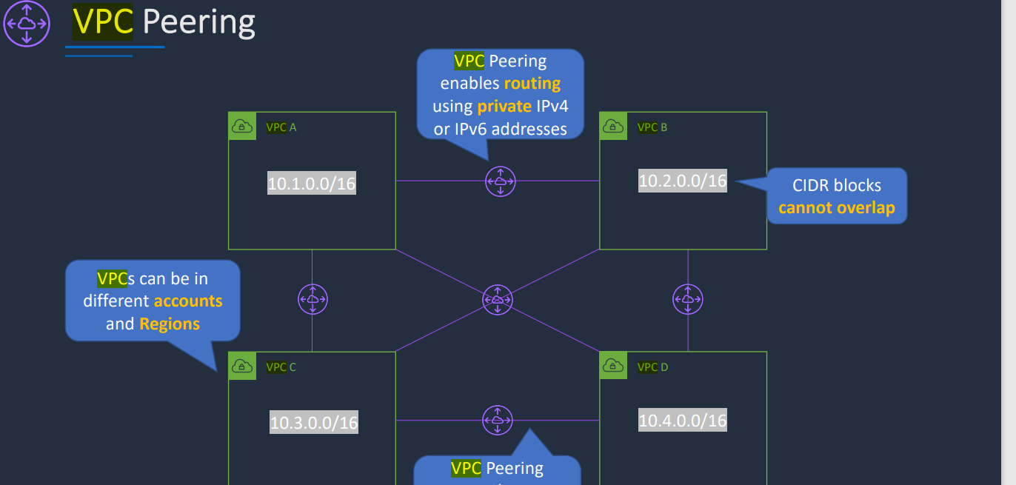

Slide 40
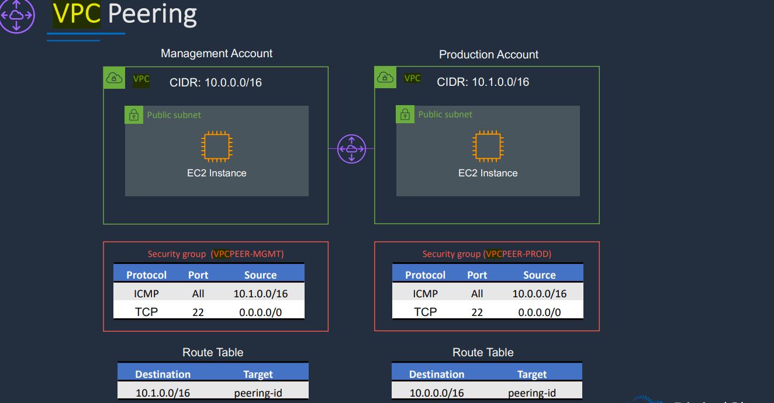

Slide 41
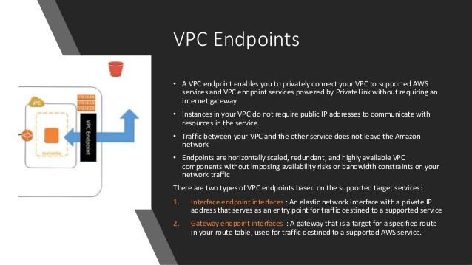

Slide 42
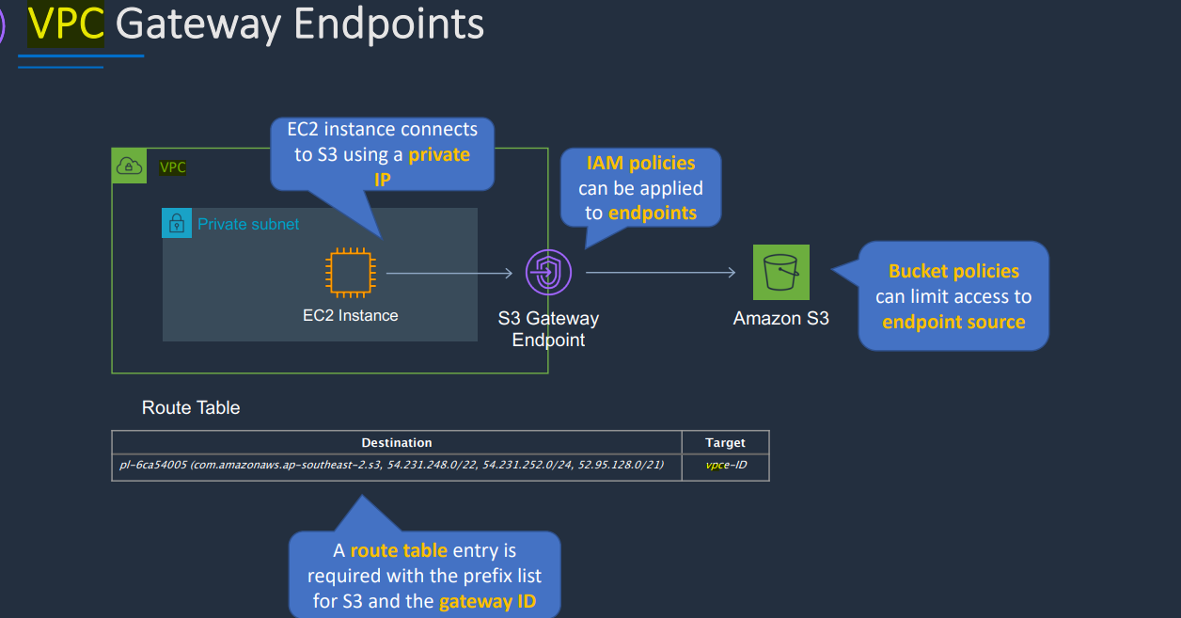

Slide 43
AWS Client VPN
AWS Client VPN is a managed client-based VPN service that enables you to securely access your AWS resources and resources in your on-premises network. With Client VPN, you can access your resources from any location using an OpenVPN-based VPN client.
The administrator is responsible for setting up and configuring the service
After the Client VPN endpoint is set up and configured, the administrator downloads the Client VPN endpoint configuration file and distributes it to the clients who need access
The client is the end user. This is the person who connects to the Client VPN endpoint to establish a VPN session. The client establishes the VPN session from their local computer or mobile device using an OpenVPN-based VPN client application.

Slide 44
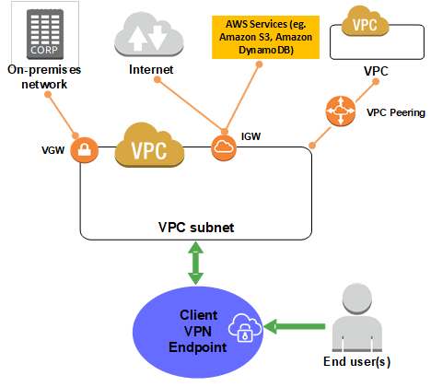

Slide 45
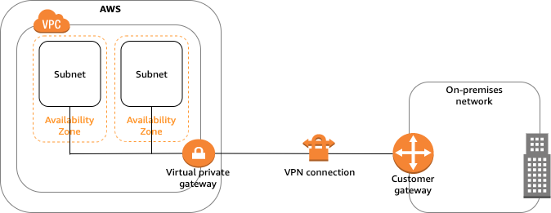
Site to Site VPN in AWS
A site-to-site virtual private network (VPN) refers to a connection set up between multiple networks. This could be a corporate network where multiple offices work in conjunction with each other or a branch office network with a central office and multiple branch locations.

Slide 46
Site to Site VPN in AWS
The VPC has an attached virtual private gateway, and your on-premises (remote) network includes a customer gateway device, which you must configure to enable the Site-to-Site VPN connection.
You set up the routing so that any traffic from the VPC bound for your network is routed to the virtual private gateway.
A virtual private gateway is the VPN concentrator on the Amazon side of the Site-to-Site VPN connection. You create a virtual private gateway and attach it to the VPC from which you want to create the Site-to-Site VPN connection.
A customer gateway device is a physical device or software application on your side of the Site-to-Site VPN connection. You configure the device to work with the Site-to-Site VPN connection.

Slide 47
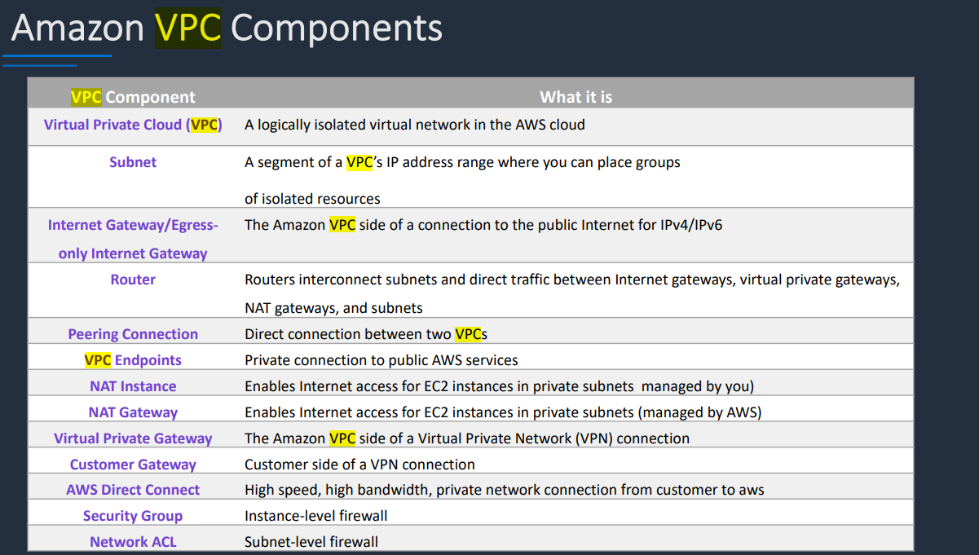

Slide 48
AWS Transit Gateway
AWS Transit Gateway connects VPCs and on-premises networks through a central hub. This simplifies your network and puts an end to complex peering relationships. It acts as a cloud router – each new connection is only made once.
As you expand globally, inter-Region peering connects AWS Transit Gateways together using the AWS global network

Slide 49
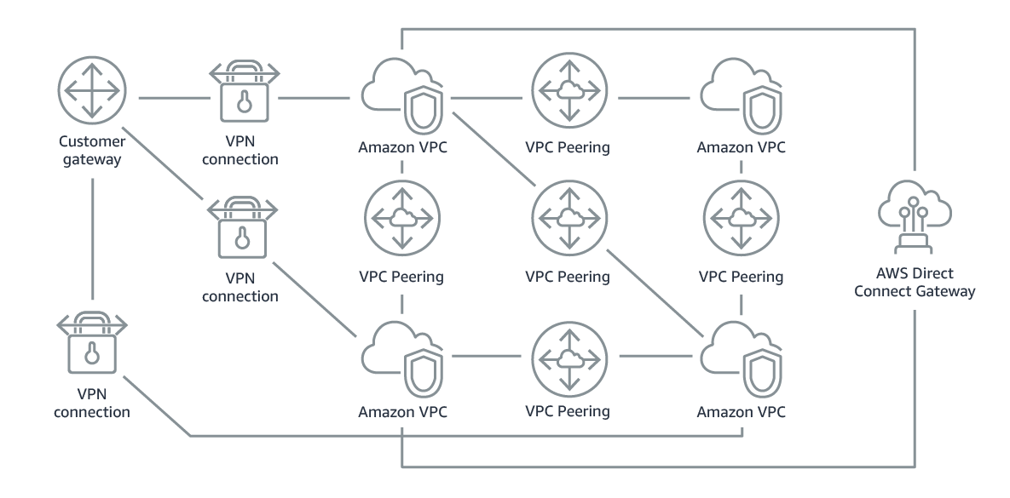
Without AWS Transit Gateway

Slide 50
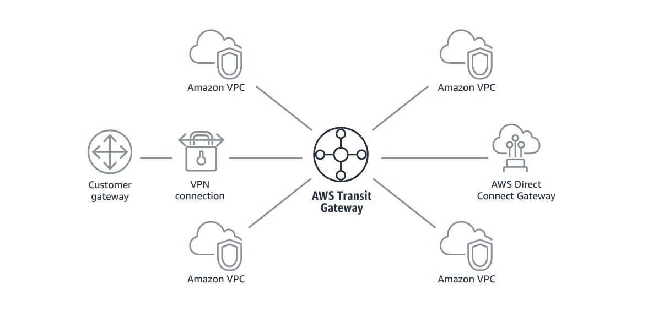
With AWS Transit Gateway

Slide 51
AWS Transit Gateway use cases
Deliver applications around the world
AWS Transit Gateway helps you build applications spanning thousands of Amazon VPCs. This means deploying new applications without updating massive route tables to create peering relationships. Everything is easier to deploy, manage, and troubleshoot.
Smoothly respond to spikes in demand
With AWS Transit Gateway, you can quickly add Amazon VPCs, AWS accounts, VPN capacity, or AWS Direct Connect gateways to meet unexpected demand, without having to wrestle with complex connections or massive routing tables.

Slide 52
Benefits of using AWS Transit Gateway
Easier connectivity
AWS Transit Gateway acts as a cloud router to simplify your network architecture. As your network grows, the complexity of managing incremental connections doesn’t slow you down. When building global applications, you can connect AWS Transit Gateways using inter-Region peering.
Better visibility and control
With AWS Transit Gateway Network Manager, you can easily monitor your Amazon VPCs and edge connections from a central console. Integrated with popular SD-WAN devices, AWS Transit Gateway Network Manager helps you quickly identify issues and react to events on your global network.

Slide 53
Improved security
Traffic between an Amazon VPC and AWS Transit Gateway remains on the AWS global private network and is not exposed to the public internet. AWS Transit Gateway inter-Region peering encrypts all traffic, with no single point of failure or bandwidth bottleneck. This helps protect against distributed denial of service (DDoS) attacks and other common exploits.
Flexible multicast
AWS Transit Gateway multicast support distributes the same content to multiple specific destinations. This eliminates the need for expensive on-premises multicast networks and reduces the bandwidth needed for high-throughput applications such as video conferencing, media, or teleconferencing.

Slide 54
AWS Direct Connect
AWS Direct Connect bypasses the public Internet and establishes a secure, dedicated connection from your infrastructure into AWS. This dedicated connection occurs over a standard 1 GB or 10 GB Ethernet fiber-optic cable with one end of the cable connected to your router and the other to an AWS Direct Connect router. AWS has established these Direct Connect routers in large colocation facilities across the world, providing access to all AWS regions. With established connectivity via AWS Direct Connect, you can access your Amazon VPC and all AWS services.
AWS Direct Connect is a great option for businesses that are seeking secure, ultra-low latency connectivity into AWS. While provisioning AWS Direct Connect can sometimes be more involved, it is worth it once the connectivity is established the because of the ease of predictable network performance and 60% cost savings.
https://www.stormit.cloud/blog/comparison-aws-direct-connect-vs-vpn/#dx-vs-aws-vpn ( diff between Site to site vpn and direct connect)

Slide 55
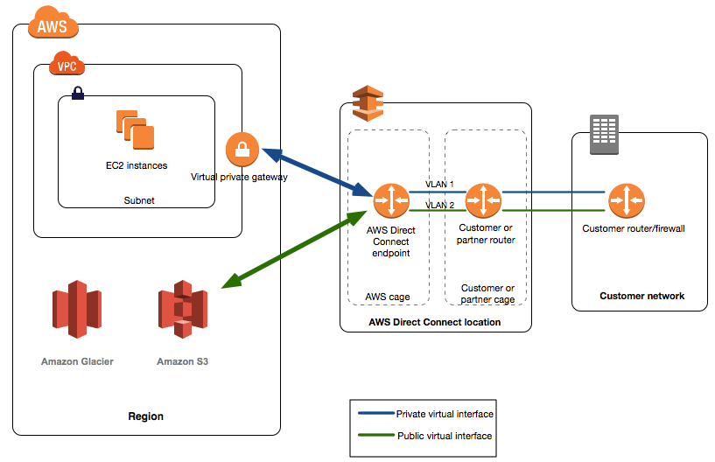

Slide 57
Summary
VPC: Virtual Private Cloud
Subnets: Tied to an AZ, network partition of the VPC
Internet Gateway: at the VPC level, provide Internet Access
NAT Gateway / Instances: give internet access to private subnets
NACL: Stateless, subnet rules for inbound and outbound
Security Groups: Stateful, operate at the EC2 instance level or ENI
VPC Peering: Connect two VPC with non overlapping IP ranges, non transitive
VPC Endpoints: Provide private access to AWS Services within VPC
VPC Flow Logs: network traffic logs
Site to Site VPN: VPN over public internet between on-premises DC and AWS
Direct Connect: direct private connection to a AWS

