Slide 1
welcome

Slide 2
Artificial Intelligence and
Expert System
CSE - 351

Slide 3
Chapter 02: Intelligent Agents

Slide 4
Outline
Agents and Environments
Rationality
Task Environment
Environment types
Agent types
Examples

Slide 5
Agents
An agent is anything that can be viewed as perceiving its environment through sensors and acting upon that environment through actuators.
Human agent:
Sensors: eyes, ears, and other organs for sensors
Actuators: hands, legs, mouth, and other body parts
Robotic agent:
Sensors: cameras, touch sensor and infrared range finders
Actuator: various motors for actuators

Slide 6

Agents and environments
The agent function maps from percept histories to actions:
[f: P* → A]
The agent program runs on the physical architecture to produce f.
agent comprised of : architecture + program

Slide 7

Vacuum-cleaner world
Percepts: location and contents, e.g., [A,Dirty]
Actions: Left, Right, Clean

Slide 8
A vacuum-cleaner agent
Percept Sequence | Action
[A, Clean] | Right
[A,Dirty] | Clean
[B, Clean] | Left
[B, Dirty] | Clean
[A, Clean], [A, Clean] | Right
[A,Clean], [A,Dirty] | Clean
…. | …..
[A, Clean], [A, Clean], [A, Clean] | Right
[A, Clean], [A, Clean], [A, Dirty] | Clean
….. | ….

Slide 9
Rational agents (1/3)
An agent should strive to "do the right thing", based on what it can perceive and the actions it can perform. The right action is the one that will cause the agent to be most successful.
Performance measure: An objective criterion for success of an agent's behavior.
E.g., performance measure of a vacuum-cleaner agent could be amount of dirt cleaned up, amount of time taken, amount of electricity consumed, amount of noise generated, etc.

Slide 10
Rational agents (2/3)
Rational Agent: For each possible percept sequence:
a rational agent should select an action that is expected to maximize its performance measure,
given the evidence provided by the percept sequence and whatever built-in knowledge the agent has.

Slide 11
Rational agents (3/3)
An agent is autonomous if its behavior is determined by its own experience
(with ability to learn and adapt).

Slide 12
Task environment (1/5)
PEAS: Performance measure, Environment, Actuators, Sensors
Must first specify the setting for intelligent agent design.

Slide 13
Task environment (2/5)
Must first specify the setting for intelligent agent design.
Consider, e.g., the task of designing an automated taxi driver:
  Performance measure: Safe, fast, legal, comfortable trip, maximize profits.
  Environment: Roads, other traffic, pedestrians, customers.
  Actuators: Steering wheel, accelerator, brake, signal, horn.
  Sensors: Cameras, sonar, speedometer, GPS, odometer, engine sensors, keyboard.

Slide 14
Task environment (3/5)
Agent: Medical diagnosis system
Performance measure: Healthy patient, minimize costs, lawsuits.
Environment: Patient, hospital, staff.
Actuators: Screen display (questions, tests, diagnoses, treatments, referrals).
Sensors: Keyboard (entry of symptoms, findings, patient's answers).

Slide 15
Task environment (4/5)
Agent: Part-picking robot
Performance measure: Percentage of parts in correct bins
Environment: Conveyor belt with parts, bins
Actuators: Jointed arm and hand
Sensors: Camera, joint angle sensors

Slide 16
Task environment (5/5)
Agent: Interactive English tutor
Performance measure: Maximize student's score on test
Environment: Set of students
Actuators: Screen display (exercises, suggestions, corrections)
Sensors: Keyboard

Slide 17
Environment types
Fully observable (vs. partially observable): An agent's sensors give it access to the complete state of the environment at each point in time.
Deterministic (vs. stochastic): The next state of the environment is completely determined by the current state and the action executed by the agent
Episodic (vs. sequential): The agent's experience is divided into atomic "episodes" (each episode consists of the agent perceiving and then performing a single action), and the choice of action in each episode depends only on the episode itself.

Slide 18
Environment types
Static (vs. dynamic): The environment is unchanged while an agent is deliberating.
Discrete (vs. continuous): A limited number of distinct, clearly defined percepts and actions.
Single agent (vs. multiagent): An agent operating by itself in an environment.

Slide 19
Environment types
Chess with Chess without Taxi driving
a clock a clock
Fully observable Yes Yes No
Deterministic Strategic Strategic No
Episodic No No No
Static Semi Yes No
Discrete Yes Yes No
Single agent No No No
The environment type largely determines the agent design.
The real world is (of course) partially observable, stochastic, sequential, dynamic, continuous, multi-agent.

Slide 20
Agent functions and programs
An agent is completely specified by the agent function mapping percept sequences to actions
One agent function (or a small quivalence class) is rational.
Aim: find a way to implement the rational agent function concisely.

Slide 21
Table-lookup agent
Function Table_Driven_Agent(percept) return an action
Static: percepts, a sequence initially empty
table: a table of actions, indexed by percept sequence, fully specified
append percept to the end of percepts
action ← LookUp(percepts, table)
return action
Drawbacks:
  Huge table (10^{250,000,000,000} entries for an hour driving)
  Take a long time to build the table
  No autonomy
  Even with learning, need a long time to learn the table entries

Slide 22
Agent types
Four basic types:
Simple reflex agents
Model-based reflex agents
Goal-based agents
Utility-based agents

Slide 23
Simple reflex agents
Sensors
Agent
What the world is now like?
Environment
Condition-action rule
What action should I do now?
Actuator

Slide 24
Simple Reflex Agent
Table lookup of percept-action pairs defining all possible condition-action rules necessary to interact in an environment
Problems
  Too big to generate and to store (Chess has about 10^120 states, for example)
  No knowledge of non-perceptual parts of the current state
  Not adaptive to changes in the environment; requires entire table to be updated if changes occur
  Looping: Can't make actions conditional

Slide 25
Agent program for a vacuum-cleaner agent
Function Reflex_Va_Agent([location, status]) return an action
If status = Dirty then return Suck
Else if location = A then return Right
Else if location = B then return Left
Good only if environment is fully observable otherwise disaster.
For example if location sensor is off then problem? [dirty] [clean]

Slide 26
Model-based reflex agents
Keep track of the world it can’t see now. Consider lane change.
Sensor
state
How does the world evolve?
What the world is now like?
What my action do?
Environment
Condition-action rule
What action should I do now?
Agent
Actuator

Slide 27
Reflex Agent with Internal State
Encode "internal state" of the world to remember the past as contained in earlier percepts
Needed because sensors do not usually give the entire state of the world at each input, so perception of the environment is captured over time. "State" used to encode different "world states" that generate the same immediate percept.
Requires ability to represent change in the world; one possibility is to represent just the latest state, but then can't reason about hypothetical courses of action

Slide 28
Model-based reflex agents
Function Reflex_agent_with_state(percept)
return an action
Static: state, a description of the current world
rules, a set of condition action rules
action, the most recent action, initially none
state ← Update-State (state, action, percept)
rule ← Rule-Match (state, rules)
action ← Rule-action (rule)
return action
Knowing about the current environment is not always enough to decide what to do
For example in the junction, left, right, go straight

Slide 29
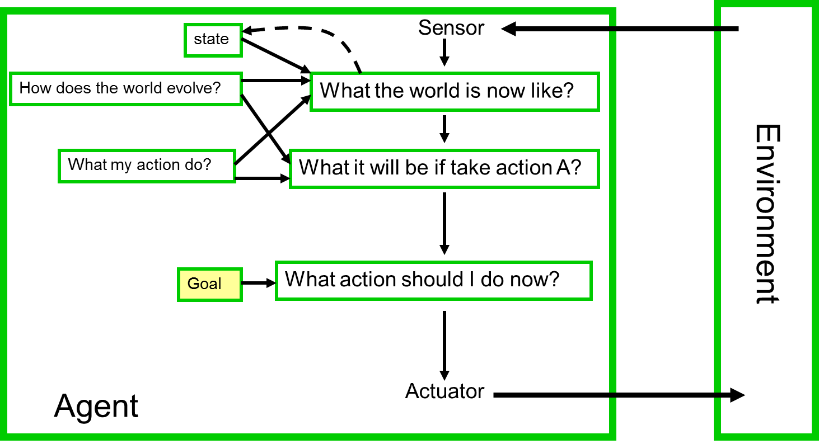
Goal-based agents

Slide 30
Goal-Based Agent
Choose actions so as to achieve a (given or computed) goal.
A goal is a description of a desirable situation
Keeping track of the current state is often not enough -- need to add goals to decide which situations are good
Deliberative instead of reactive
May have to consider long sequences of possible actions before deciding if goal is achieved -- involves consideration of the future, “what will happen if I do...?”

Slide 31
Utility-based agents
Goal alone is not enough. There can be many way to achieve goal but some are quicker, safer, more reliable or cheaper than other.
Sensor
state
How does the world evolve?
What the world is now like?
What my action do?
What it will be if take action A?
Environment
Utility
How happy I will be in that state?
What action should I do now?
Agent
Actuator

Slide 32
Utility-Based Agent
When there are multiple possible alternatives, how to decide which one is best?
A goal specifies a crude distinction between a happy and unhappy state, but often need a more general performance measure that describes "degree of happiness"
Utility function U: State --> Reals indicating a measure of success or happiness when at a given state
Allows decisions comparing choice between conflicting goals, and choice between likelihood of success and importance of goal (if achievement is uncertain)

Slide 33
Learning agents
Performance Standard
Sensor
Critic
feedback
changes
Learning Element
Performance Element
Knowledge
Environment
Learning goals
Problem Generator
Agent
Actuator

Slide 34

Learning agents
Performance element is what was previously the whole agent
  Input sensor
  Output action
Learning element
  Modifies performance element.
Artificial Intelligence a modern approach
Notes:
Problem generator: acts in new ways, explores.

Slide 35
Learning agents
Critic: how the agent is doing
  Input: checkmate?
  Fixed
Problem generator
  Tries to solve the problem differently instead of optimizing.
  Suggests exploring new actions -> new problems.
Artificial Intelligence a modern approach

Slide 36
Learning agents(Taxi driver)
  Performance element
    How it currently drives
  Taxi driver Makes quick left turn across 3 lanes
    Critics observe shocking language by passenger and other drivers and informs bad action
    Learning element tries to modify performance elements for future
    Problem generator suggests experiment out something called Brakes on different Road conditions
  Exploration vs. Exploitation
    Learning experience can be costly in the short run
    shocking language from other drivers
    Less tip
    Fewer passengers
Artificial Intelligence a modern approach

Slide 37
Summary
An agent perceives and acts in an environment, has an architecture and is implemented by an agent program.
An ideal agent always chooses the action which maximizes its expected performance, given percept sequence received so far.
An autonomous agent uses its own experience rather than built-in knowledge of the environment by the designer.
An agent program maps from percept to action & updates its internal state.
  Reflex agents respond immediately to percpets.
  Goal-based agents act in order to achieve their goal(s).
  Utility-based agents maximize their own utility function.
Representing knowledge is important for successful agent design.
Some environments are more difficult for agents than others. The most challenging environments are inaccessible, nondeterministic, nonepisodic, dynamic, and continuous.

Slide 38
Thank You ☺

