Slide 1
Software Testing & Quality Assurance
CSE-453
Intake : 26 (1)
Lecture - 10

Slide 2
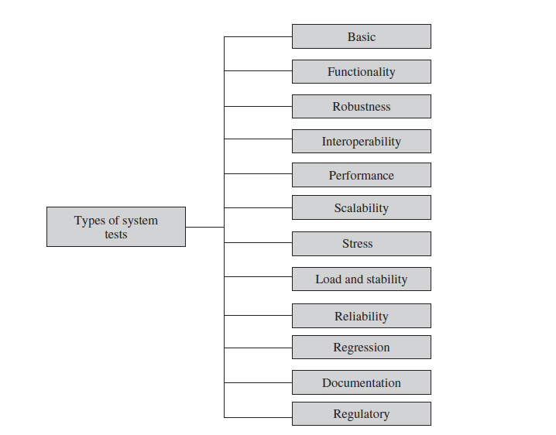
Types of System Tests

Slide 3
Basic Tests
Basic tests provide an evidence that the system can be installed, configured and brought to an operational state. Some of the basic tests are -
Boot tests – Boot tests are designed to verify that the system can boot up its software image (or build) from the supported boot options.
Upgrade/downgrade tests - Upgrade/downgrade tests are designed to verify that the system software can be upgraded or downgraded (rollback) in a graceful manner from the previous version to the current version or vice versa.

Slide 4
Functionality Tests
Functionality tests provide comprehensive testing over the full range of the requirements within the capabilities of the system. Some of the functionality tests are –
Communication systems tests – designed to verify the implementation of the communication systems as specified in the customer requirements specification – basic interaction test, behavior test, capability test.
Logging & tracing tests – designed to verify the configurations and operations of logging and tracing. This also includes verification of logs when the system crashes.

Slide 5
Robustness Tests
Robustness tests determine how well the system recovers from various input errors and other failure situations.
Boundary value tests – Boundary value tests are designed to cover boundary conditions, special values, and system defaults. The tests include providing invalid input data to the system and observing how the system reacts to the invalid input.

Slide 6
Interoperability Tests
Tests are designed to verify the ability of the system to interoperate with third-party products.
An interoperability test typically combines different network elements in one test environment to ensure that they work together.
During interoperability tests, users may require the hardware devices to be interchangeable, removable, or reconfigurable. The reconfiguration activities during interoperability tests are known as configuration testing.
Another kind of interoperability test is called compatibility test . Compatibility tests verify that the system works the same way across different platforms, operating systems, and database management systems.
Backward compatibility tests verify that the current software build flawlessly works with older version of platforms.

Slide 7
Performance Tests
Performance tests are designed to determine the performance of the actual system compared to the expected one.
The performance metrics needed to be measured vary from application to application.
Tests are designed to verify response time, execution time, throughput, resource utilization, and traffic rate.
For performance tests, one needs to be clear about the specific data to be captured in order to evaluate performance metrics.
If the performance metric is unsatisfactory, then actions are taken to improve it.
The performance improvement can be achieved by rewriting the code, allocating more resources, and redesigning the system.

Slide 8
Scalability Tests
Tests are designed to verify that the system can scale up to its engineering limits. A system may work in a limited-use scenario but may not scale up.
The idea is to test the limit of the system, that is, the magnitude of demand that can be placed on the system while continuing to meet latency and throughput requirements.
Scaling tests are conducted to ensure that the system response time remains the same or increases by a small amount as the number of users are increased.
Extrapolation is often used to predict the limit of scalability. The system is tested on an increasingly larger series of platforms or networks or with an increasingly larger series of workloads. Memory and CPU utilizations are measured and plotted against the size of the network or the size of the load.

Slide 9
Stress Tests
The goal of stress testing is to evaluate and determine the behavior of a software component while the offered load is in excess of its designed capacity.
The system is deliberately stressed by pushing it to and beyond its specified limits.
It ensures that the system can perform acceptably under worst-case conditions under an expected peak load. If the limit is exceeded and the system does fail, then the recovery mechanism should be invoked.
Stress tests are targeted to bring out the problems associated with Memory leak and Buffer allocation and memory carving.
One way to design a stress test is to impose the maximum limits on all system performance characteristics at the same time, such as the response time, availability, and throughput thresholds.

Slide 10
Load and Stability Tests
Load and stability tests are designed to ensure that the system remains stable for a long period of time under full load. A system might function flawlessly when tested by a few careful testers who exercise it in the intended manner.
Load and stability testing typically involves exercising the system with virtual users and measuring the performance to verify whether the system can support the anticipated load.
Operational profiles are used to guide load and stability testing.
In load and stability testing, the objective is to ensure that the system can operate on a large scale for several months, whereas, in stress testing, the objective is to break the system by overloading it to observe the locations and causes of failures.

Slide 11
Reliability Tests
Reliability tests are designed to measure the ability of the system to remain operational for long periods of time. The reliability of a system is typically expressed in terms of mean time to failure (MTTF).
As we test the software and move through the system testing phase, we observe failures and try to remove the defects and continue testing. As this progresses, we record the time durations between successive failures. Let these successive time intervals be denoted by t1, t2, . . ., ti.
The average of all the i time intervals is called the MTTF. After a failure is observed, the developers analyze and fix the defects, which consumes some time—let us call this interval the repair time. The average of all the repair times is known as the mean time to repair (MTTR).
Now we can calculate a value called meantime between failures (MTBF) as MTBF = MTTF+MTTR.

Slide 12
Regression Tests
In this category, new tests are not designed. Instead, test cases are selected from the existing pool and executed to ensure that nothing is broken in the new version of the software.
The main idea in regression testing is to verify that no defect has been introduced into the unchanged portion of a system due to changes made elsewhere in the system.
During system testing, many defects are revealed and the code is modified to fix those defects.
Regression testing is an expensive task; a subset of the test cases is carefully selected from the existing test suite to (i) maximize the likelihood of uncovering new defects and (ii) reduce the cost of testing.

Slide 13
Documentation Tests
Documentation testing means verifying the technical accuracy and readability of the user manuals, including the tutorials and the on-line help.
Documentation testing is performed at three levels as explained in the following:
Read Test : In this test a documentation is reviewed for clarity, organization, flow, and accuracy without executing the documented instructions on the system.
Hands-On Test : The on-line help is exercised and the error messages verified to evaluate their accuracy and usefulness.
Functional Test : The instructions embodied in the documentation are followed to verify that the system works as it has been documented.

Slide 14
Regulatory Tests
In this category, the final system is shipped to the regulatory bodies in those countries where the product is expected to be marketed. The idea is to obtain compliance marks on the product from those bodies.
Most of these regulatory bodies issue safety and EMC (electromagnetic compatibility)/EMI (electromagnetic interference) compliance certificates (emission and immunity). The regulatory agencies are interested in identifying flaws in software that have potential safety consequences.
Software safety is defined in terms of hazards. A hazard is a state of a system or a physical situation which when combined with certain environmental conditions could lead to an accident or mishap. An accident or mishap is an unintended event or series of events that results in death, injury, illness, damage or loss of property, or harm to the environment. A hazard is a logical precondition to an accident.

Slide 15
THANK YOU

