Slide 1
Software Testing & Quality Assurance
CSE-453
Intake : 26 (1)
Lecture - 11

Slide 2
Release Testing
Release testing is the process of testing a particular release of a system that is intended for use outside of the development team.
The primary goal of the release testing process is to convince the supplier of the system that it is good enough for use.
Release testing, therefore, has to show that the system delivers its specified functionality, performance and dependability, and that it does not fail during normal use.
Release testing is usually a black-box testing process where tests are only derived from the system specification.

Slide 3
Release Testing and System Testing
Release testing is a form of system testing.
Important differences:
A separate team that has not been involved in the system development, should be responsible for release testing.
System testing by the development team should focus on discovering bugs in the system (defect testing). The objective of release testing is to check that the system meets its requirements and is good enough for external use (validation testing).

Slide 4
Release Testing Types
Requirements based testing
Scenario testing
Performance testing
Stress testing

Slide 5
Requirements Based Testing
Requirements-based testing involves examining each requirement and developing a test or tests for it.
A general principle of good requirements engineering practice is that requirements should be testable; that is, the requirement should be written so that a test can be designed for that requirement.
A tester can then check that the requirement has been satisfied. Requirements-based testing, therefore, is a systematic approach to test case design where you consider each requirement and derive a set of tests for it.
Requirements-based testing is validation rather than defect testing—you are trying to demonstrate that the system has properly implemented its requirements.
You should also maintain traceability records of your requirements based testing, which link the tests to the specific requirements that are being tested.

Slide 6
Requirements Based Testing
Mentcare system requirements:
If a patient is known to be allergic to any particular medication, then prescription of that medication shall result in a warning message being issued to the system user.
If a prescriber chooses to ignore an allergy warning, they shall provide a reason why this has been ignored.

Slide 7
Requirements Tests
Set up a patient record with no known allergies. Prescribe medication for allergies that are known to exist. Check that a warning message is not issued by the system.
Set up a patient record with a known allergy. Prescribe the medication to that the patient is allergic to, and check that the warning is issued by the system.
Set up a patient record in which allergies to two or more drugs are recorded. Prescribe both of these drugs separately and check that the correct warning for each drug is issued.
Prescribe two drugs that the patient is allergic to. Check that two warnings are correctly issued.
Prescribe a drug that issues a warning and overrule that warning. Check that the system requires the user to provide information explaining why the warning was overruled.

Slide 8
Scenario Testing
Scenario testing is an approach to release testing where you devise typical scenarios of use and use these to develop test cases for the system.
A scenario is a story that describes one way in which the system might be used. Scenarios should be realistic and real system users should be able to relate to them.
A scenario test should be a narrative story that is credible and fairly complex. It should motivate stakeholders; that is, they should relate to the scenario and believe that it is important that the system passes the test.
When you use a scenario-based approach, you are normally testing several requirements within the same scenario. Therefore, as well as checking individual requirements, you are also checking that combinations of requirements do not cause problems.

Slide 9
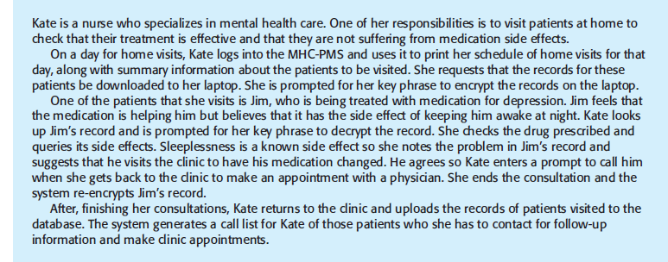
Scenario Test

Slide 10
Scenario Test
1. Authentication by logging on to the system.
2. Downloading and uploading of specified patient records to a laptop.
3. Home visit scheduling.
4. Encryption and decryption of patient records on a mobile device.
5. Record retrieval and modification.
6. Links with the drugs database that maintains side-effect information.
7. The system for call prompting.

Slide 11
Other Release Testing
Performance testing
Measuring response time, throughput, latency
Stress testing
Stressing the system by making demands that are outside the design limits of the software.

Slide 12
User Testing
User or customer testing is a stage in the testing process in which users or customers provide input and advice on system testing.
This may involve formally testing a system that has been commissioned from an external supplier, or could be an informal process where users experiment with a new software product to see if they like it and that it does what they need.
User testing is essential, even when comprehensive system and release testing have been carried out.
The reason for this is that influences from the user’s working environment have a major effect on the reliability, performance, usability and robustness of a system. These cannot be replicated in a testing environment.

Slide 13
Types of User Testing
Alpha testing
Users of the software work with the development team to test the software at the developer’s site.
Beta testing
A release of the software is made available to users to allow them to experiment and to raise problems that they discover with the system developers.
Acceptance testing
Customers test a system to decide whether or not it is ready to be accepted from the system developers and deployed in the customer environment. Primarily for custom systems.

Slide 14
Alpha Testing
In alpha testing, users (internal employees) and developers work together to test a system as it is being developed. This means that the users can identify problems and issues that are not readily apparent to the development testing team.
Developers can only really work from the requirements but these often do not reflect other factors that affect the practical use of the software. Users can therefore provide information about practice that helps with the design of more realistic tests.
Alpha testing requires lab environment or testing environment
Users of these products may be willing to get involved in the alpha testing process because this gives them early information about new system features that they can exploit.

Slide 15
Beta Testing
Beta testing takes place when an early, sometimes unfinished, release of a software system is made available to customers and users for evaluation.
Beta testers may be a selected group of customers who are early adopters of the system. Alternatively, the software may be made publicly available for use by anyone who is interested in it.
Beta testing is mostly used for software products that are used in many different environments (as opposed to custom systems which are generally used in a defined environment).
It is impossible for product developers to know and replicate all the environments in which the software will be used.
Beta testing is therefore essential to discover interaction problems between the software and features of the environment where it is used.

Slide 16
Acceptance Testing
Acceptance testing is an inherent part of custom systems development. It takes place after release testing.
It involves a customer formally testing a system to decide whether or not it should be accepted from the system developer.
The customer generally reserves the right to refuse to take delivery of the product if the acceptance test cases do not pass.
There are two categories of acceptance testing:
User acceptance testing.
Business acceptance testing.

Slide 17
Acceptance Testing Types
There are two categories of acceptance testing:
• User acceptance testing
UAT (User Acceptance Testing) is primarily focused on stakeholder or user or user group/s requirements in dealing with a solution. It could be in the form of additional functionality or special needs that may or may not have an impact in other areas. This is derived from stakeholder requirements and enumerated in detail.
• Business acceptance testing
BAT (Business Acceptance Testing) is primarily focused on assessing the business requirement of an organization and deals with strategy. It is based on approach, dynamics, culture, information technology, statutory requirements, operational framework and customers. BAT is derived from business strategy or business requirements.

Slide 18
THANK YOU

