Slide 1
Software Testing & Quality Assurance
CSE-453
Intake : 26 (1)
Lecture - 12

Slide 2
Acceptance Testing Process

Slide 3
Acceptance Testing Process
Define acceptance criteria – functional completeness, correctness, data recovery
Plan acceptance testing – resources, time, budget, testing schedule
Derive acceptance tests – tests have to be designed to check whether or not a system is acceptable
Run acceptance tests – execute acceptance tests
Negotiate test results – the developer and the customer have to negotiate to decide if the system is good enough
Reject/accept system – meeting between the developers and the customer to decide on whether or not the system should be accepted.

Slide 4
Acceptance Criteria
Competitive edge – The system must provide a distinct advantage over existing methods and competing products through innovative features.
Usability – How easy it is to use the system and how easy it is to learn?
Performance – response time, execution time, throughput, latency
Reliability – The longer a system runs without failure, the more reliable it is.
Timeliness - Time to market is an important aspect of any contractual agreement.

Slide 5
Test-driven development
Test-driven development (TDD) is an approach to program development in which you inter-leave testing and code development.
Tests are written before code and ‘passing’ the tests is the critical driver of development.
You develop code incrementally, along with a test for that increment. You don’t move on to the next increment until the code that you have developed passes its test.
TDD was introduced as part of agile methods such as Extreme Programming. However, it can also be used in plan-driven development processes.

Slide 6
Test-driven development

Slide 7
TDD process activities
Start by identifying the increment of functionality that is required. This should normally be small and implementable in a few lines of code.
Write a test for this functionality and implement this as an automated test.
Run the test, along with all other tests that have been implemented. Initially, you have not implemented the functionality so the new test will fail.
Implement the functionality and re-run the test.
Once all tests run successfully, you move on to implementing the next chunk of functionality.

Slide 8
Benefits of test-driven development
Code coverage
Every code segment that you write has at least one associated test so all code written has at least one test.
Regression testing
A regression test suite is developed incrementally as a program is developed.
Simplified debugging
When a test fails, it should be obvious where the problem lies. The newly written code needs to be checked and modified.
System documentation
The tests themselves are a form of documentation that describe what the code should be doing.

Slide 9
Test Case
A test case is a set of conditions or variables under which a tester will determine whether a system under test satisfies requirements or works correctly for a particular test scenario.
The process of developing test cases can also help find problems in the requirements or design of an application.
You can not write every test case in document, many test cases emerges while real testing but having a test case document provides a starting point to tester and also it helps in testing major requirements.

Slide 10
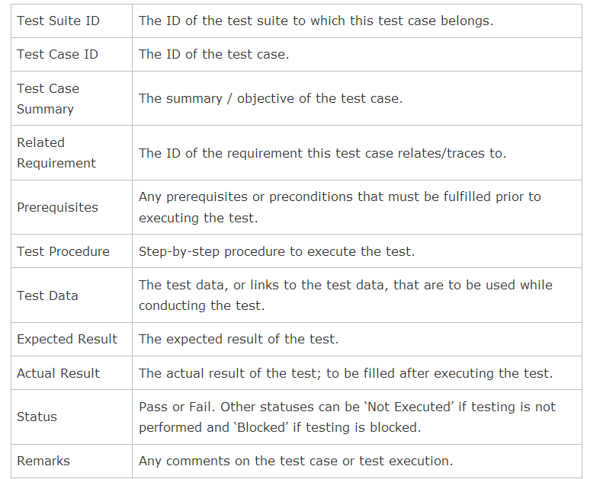
Test Case Template

Slide 11
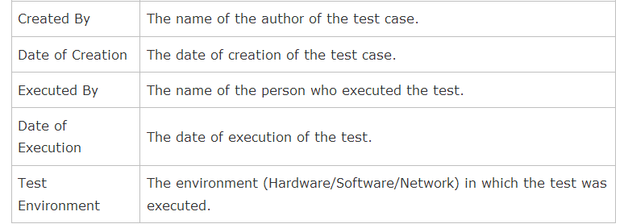
Test Case Template

Slide 12
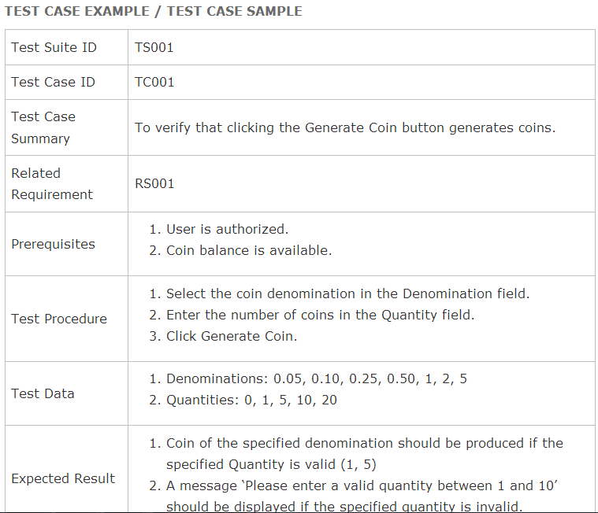
Test Case Template

Slide 13
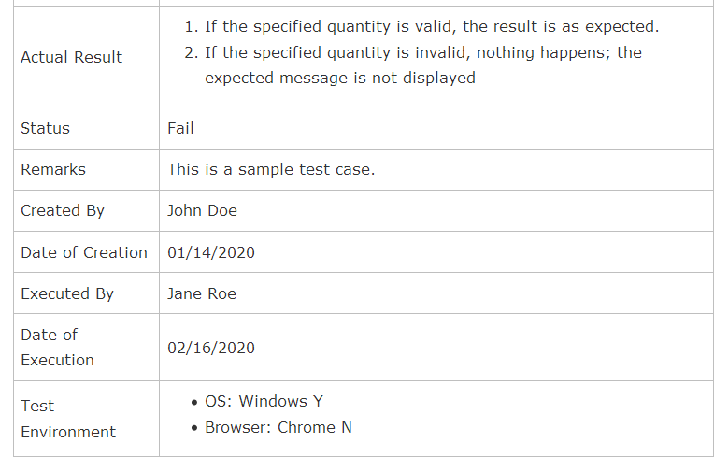
Test Case Template

Slide 14
Writing Good Test Cases
As far as possible, write test cases in such a way that you test only one thing at a time. Do not overlap or complicate test cases. Attempt to make your test cases ‘atomic’.
Ensure that all positive scenarios and negative scenarios are covered.
Language:
Write in simple and easy to understand language.
Use active voice: Do this, do that.
Use exact and consistent names (of forms, fields, etc).
Characteristics of a good test case:
Accurate: Exacts the purpose.
Economical: No unnecessary steps or words.
Traceable: Capable of being traced to requirements.
Repeatable: Can be used to perform the test over and over.
Reusable: Can be reused if necessary.

Slide 15
THANK YOU

