Slide 1
Software Testing & Quality Assurance
CSE-453
Intake : 26 (1)
Lecture - 13

Slide 2
Software Quality Assurance
Software quality assurance (SQA) consists of a means of monitoring the software engineering processes and methods used to ensure defined or standardized quality specifications.
SQA is an ongoing process within the software development life cycle (SDLC) that routinely checks the developed software to ensure it meets desired quality measures.
The methods by which this is accomplished are many and varied, and may include ensuring conformance to one or more standards, such as ISO 9000 or a model such as CMMI (Capability Maturity Model Integration)
It is a part of software project management.

Slide 3
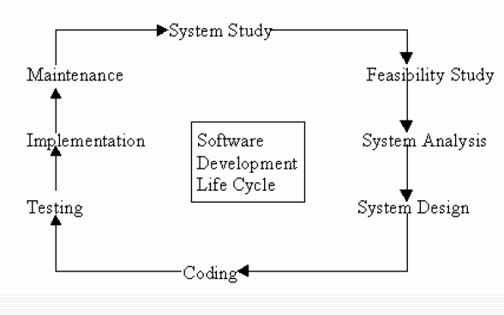
SDLC Lifecycle

Slide 4
Variation Control
Variation control is the heart of quality control. A manufacturer wants to minimize the variation among the products that are produced.
From one project to another, we want to minimize
the difference between the predicted resources needed to complete a project
the actual resources used, including staff, equipment, and calendar time.
We would like to make sure our testing program covers a known percentage of the software, from one release to another.
We would like to minimize the differences in speed and accuracy of our hotline support responses to customer problems.

Slide 5
Software Quality
Quality refers to measurable attributes or characteristics.
Two kinds of quality may be encountered:
quality of design
quality of conformance
Quality of design refers to the characteristics that designers specify for an item. The grade of materials, tolerances, and performance specifications all contribute to the quality of design. As higher-grade materials are used, tighter tolerances and greater levels of performance are specified, the design quality of a product increases, if the product is manufactured according to specifications.

Slide 6
Software Quality
Quality of conformance is the degree to which the design specifications are followed during manufacturing. Again, the greater the degree of conformance, the higher is the level of quality of conformance.
In software development, quality of design encompasses requirements, specifications and the design of the system.
Quality of conformance is an issue focused primarily on implementation. If the implementation follows the design and the resulting system meets its requirements and performance goals, conformance quality is high.

Slide 7
Software Quality
But are quality of design and quality of conformance the only issues that software engineers must consider?
User satisfaction = compliant product + good quality +
delivery within budget and schedule

Slide 8
Quality Control
Variation control is one of the pre-requisites of quality control.
Quality control involves the series of inspections, reviews, and tests used throughout the software process to ensure each work product meets the requirements placed upon it.
Quality control includes a feedback loop to the process that created the work product. The combination of measurement and feedback allows us to tune the process when the work products created fail to meet their specifications.
This feedback approach views quality control as part of the manufacturing process.

Slide 9
Quality Control
Quality control activities may be fully automated, entirely manual, or a combination of automated tools and human interaction.
A key concept of quality control is that all work products have defined, measurable specifications to which we may compare the output of each process.
The feedback loop is essential to minimize the defects produced.
The process of Software Quality Control (SQC) is governed by Software Quality Assurance (SQA). While SQA is oriented towards prevention, SQC is oriented towards detection.

Slide 10
Quality Assurance
Quality assurance consists of the auditing and reporting functions of management.
There is a software quality assurance management team to conduct the respective work.
The goal of quality assurance is to provide management with the data necessary to be informed about product quality, thereby gaining insight and confidence that product quality is meeting its goals.
Of course, if the data provided through quality assurance identify problems, it is management’s responsibility to address the problems and apply the necessary resources to resolve quality issues.

Slide 11
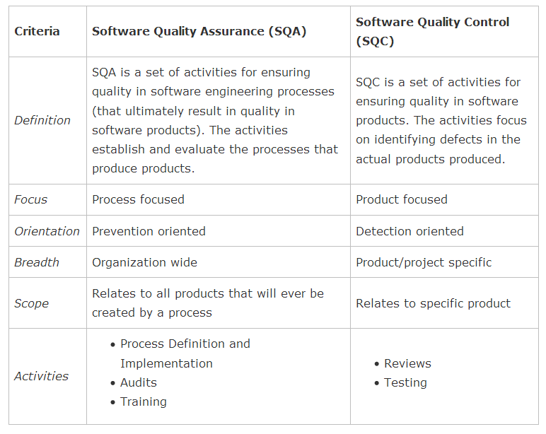
Difference between Quality Assurance & Quality Control

Slide 12
Cost of Quality
The cost of quality includes all costs incurred in the pursuit of quality or in performing quality-related activities.
Cost of quality studies are conducted to provide a base-line for the current cost of quality, identify opportunities for reducing the cost of quality, and provide a normalized basis of comparison.
The basis of normalization is almost always dollars.
Once we have normalized quality costs on a dollar basis, we have the necessary data to evaluate where the opportunities lie to improve our processes. Furthermore, we can evaluate the effect of changes in dollar-based terms.

Slide 13
Cost of Quality
Quality costs may be divided into costs associated with the following terms –
Prevention Cost
Appraisal Cost
Failure Cost
External Failure Cost
Internal Failure Cost

Slide 14
Prevention Cost
Prevention costs include activities associated with preventing errors that might occur in future. Some examples are -
quality planning
formal technical reviews
test equipment
training

Slide 15
Appraisal Cost
Appraisal costs include activities to gain insight into product condition the “first time through” each process. Examples of appraisal costs include –
in-process and inter-process inspection
equipment calibration and maintenance
testing

Slide 16
Failure Cost
Failure costs are those that would disappear if no defects appeared before shipping a product to customers. Failure costs may be subdivided into internal failure costs and external failure costs.
Internal failure costs are incurred when we detect a defect in our product prior to shipment. Internal failure costs include –
rework
repair
failure mode analysis

Slide 17
Failure Cost
External failure costs are associated with defects found after the product has been shipped to the customer. Examples of external failure costs are –
complaint resolution
product return and replacement
help line support
warranty work

Slide 18
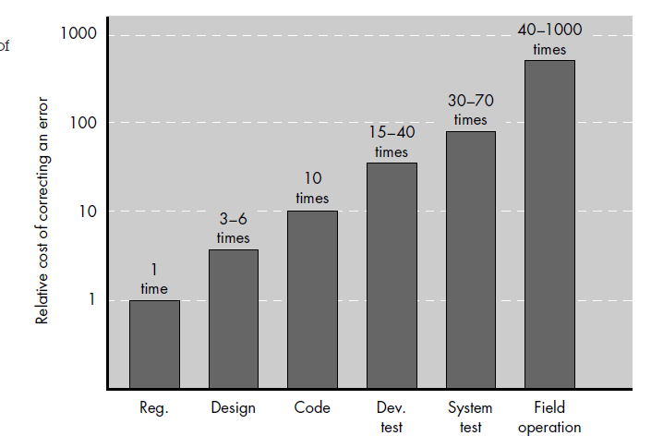
Quality Cost
As expected, the relative costs to find and repair a defect increase dramatically as we go from prevention to detection to internal failure to external failure costs.

Slide 19
THANK YOU

