Slide 1
Software Testing & Quality Assurance
CSE-453
Intake : 26 (1)
Lecture - 14

Slide 2
Quality Assurance Criteria
Below are the Quality assurance criteria against which the software would be evaluated against:
Correctness – the level of accuracy
Efficiency – less effort
Flexibility – easily modification
Integrity – real and undivided data
Interoperability – inter operation
Maintainability – repair action
Portability – easily movable
Reliability – low failure rate
Reusability – use in similar projects
Testability – supports testing in a
specific test context
Usability – easier to use

Slide 3
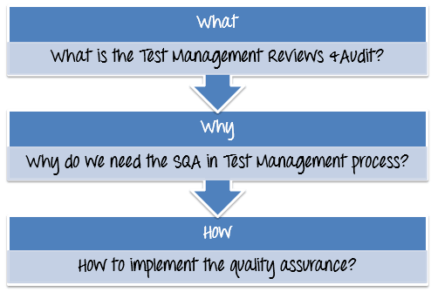

Slide 4
What is the Test Management Reviews & Audit?
Management Review: Management Review is also known as Software Quality Assurance or (SQA). It focuses more on the software process rather than the software work products. Quality Assurance is a set of activities designed to ensure that the project manager follows the standard process which is already pre-defined. In other words, Quality Assurance makes sure the Test Manager is doing the right things in the right way.
Audit: An audit is the examination of the work products and related information to assesses whether the standard process was followed or not.

Slide 5
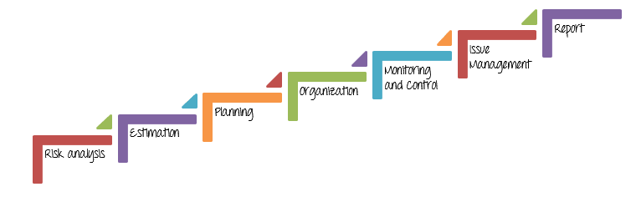
Why do we need SQA in Test Management process?

Slide 6
Why do we need SQA in Test Management process?
A Test Manager is the person who takes in charge these activities.
An SQA auditor is the person who reviews and checks the project management activities are executed to the highest possible standard. Only through the result of this review, the Management Board can evaluate the quality of your project handling.
This is the reason why we do need Management Review or SQA in Test Management process.
The SQA interviews the Test Manager, to benchmark the project against set standards.

Slide 7
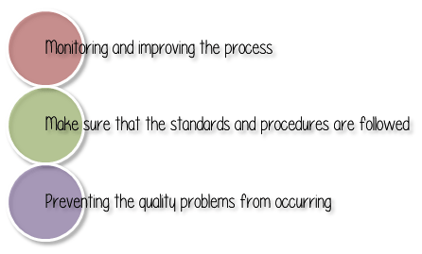
Benefits of SQA

Slide 8
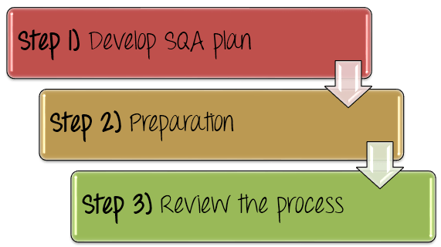
Software Quality Assurance Activities
How to implement software quality assurance?

Slide 9
Develop SQA Plan
Step 1) Develop SQA Plan
Testing activity needs Test Plan likewise SQA activity also needs a plan which is called SQA plan.
The goal of SQA plan is to craft planning processes and procedures to ensure products manufactured, or the service delivered by the organization are of exceptional quality.
During project planning, Test Manager makes an SQA plan where SQA audit is scheduled periodically

Slide 10
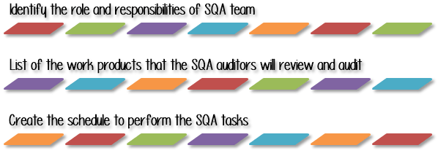
Develop SQA Plan
In the SQA Plan, the Test Manager should do as following

Slide 11
Develop SQA Plan
Step 1.1) Identify the role and responsibilities of SQA team
In a project team, every member must have responsibility for the quality of his or her work. Each person has to make sure their work meet the QA criteria.
The SQA team is the group of person who plays the major role in the project. Without QA, no business will run successfully. Therefore, the Test Manager has to make clear the responsibility of each SQA member in SQA plan

Slide 12
Develop SQA Plan
Review and evaluate the quality of project activities to meet the QA criteria
Coordinate with management board and project teams to assess requirements and engage in project review and status meetings.
Design track and collect metrics to monitor project quality.
Measure the quality of product; ensure the product meet the customer expectations.

Slide 13
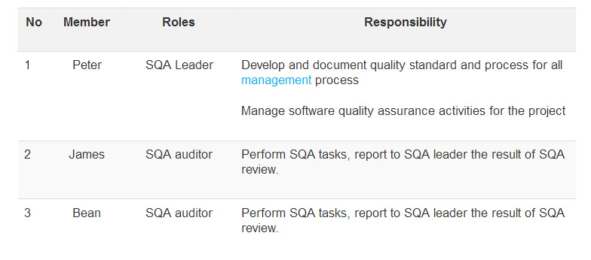
Develop SQA Plan
For example, you can create the list members of SQA team as below

Slide 14
THANK YOU

