Slide 1
Software Testing & Quality Assurance
CSE-453
Intake : 26 (1)
Lecture - 15

Slide 2
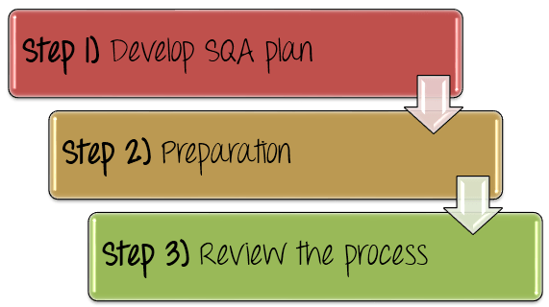
How to Implement Quality Assurance?

Slide 3
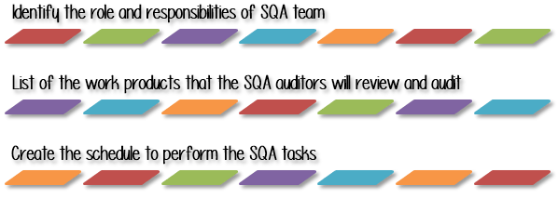
Step 1: Develop SQA Plan

Slide 4
Develop SQA Plan
Step 1.2) List of the work products that the SQA auditor will review and audit
The Test Manager should
List out all the work products of each Test Management Process
Define which facilities or equipment the SQA auditor can access to perform SQA tasks such as process evaluations and audits.

Slide 5
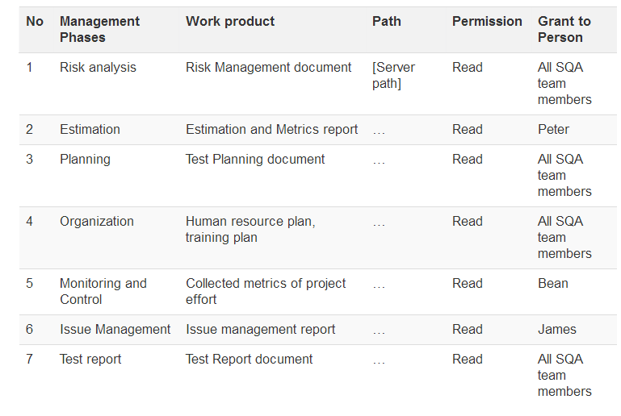
Develop SQA Plan
For example, you can list out the work products of each Test Management Process and define permission for SQA members to access these work products as per the following table

Slide 6
Develop SQA Plan
Step 1.3) Create the schedule to perform the SQA tasks
In this step, the Test Manager should describe the tasks to be performed by SQA auditor with special emphasis on SQA activities as well as the work product for each task.
Test Manager also creates the scheduling of those SQA tasks. Normally, the SQA schedule is driven by the project development schedule. Therefore, an SQA task is performed in relationship to what software development activities are taking place.

Slide 7
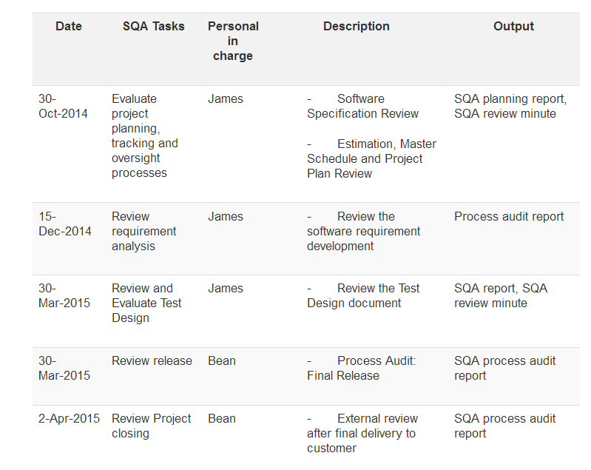
Develop SQA Plan
In the SQA plan, Test Manager makes the schedule for management review. For example

Slide 8
Step 2: Preparation
Step 2) Define the standards/methodology
To review the Management activities against the standards process, you should do the following steps
Define the policies and procedures intended to prevent defects from occurring in the management process
Document the policies & procedures
Inform and train the staff to use it

Slide 9
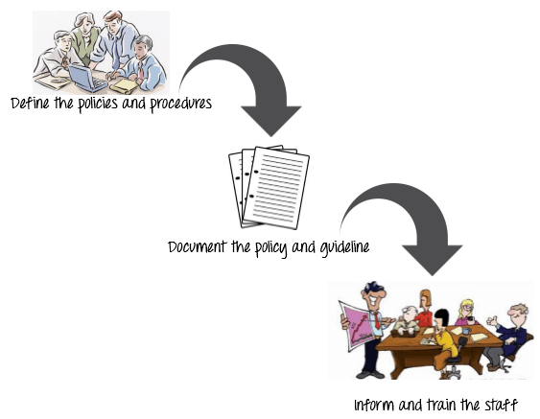
Step 2: Preparation

Slide 10
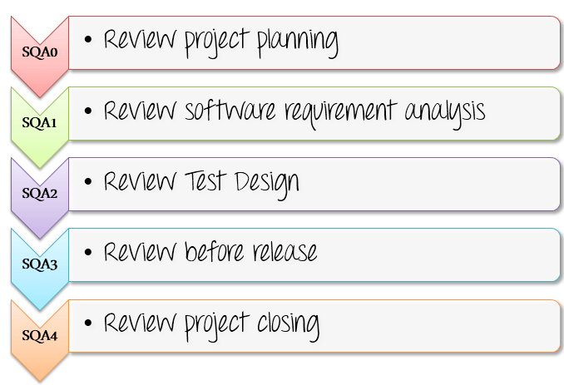
Step 3: Review the Process
Step 3) Review the process
Review project activities to verify compliance with the defined management process. In the management review, the SQA members have to perform 5 SQA reviews as following

Slide 11
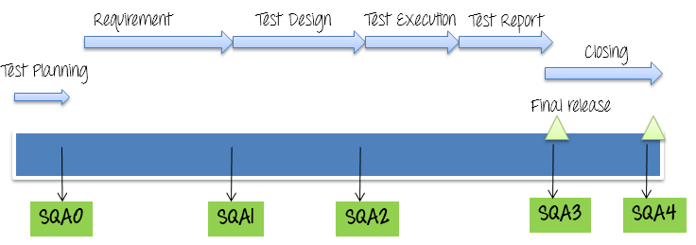
Step 3: Review the Process
Review time for SQA depends on the project’s development lifecycle model. The review schedule should be following

Slide 12
SQA: Plan, Audit and Review
In each SQA phase, the SQA members provide consultation and review of the project plans, work product, and procedures regarding compliance to defined organizational policy and standard procedures.
During Audit, the SQA members should use SQA review checklist
After you walk through the 3 steps of software assurance implementation, you have the result of Test Management Review & Audit. This is the evidence to show to your stakeholders about your management quality.

Slide 13

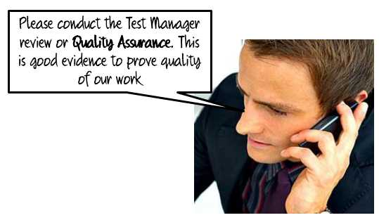

SQA: Plan, Audit and Review

Slide 14
SQA: Best Practice
Here are some best practices for an effective SQA implementation
Continuous improvement: All the standard process in SQA must be improved frequently and made official so that the other can follow. This process should be certified by popular organization such as ISO, CMMI… etc.
Documentation: All the QA policies and methods, which are defined by QA team, should be documented for training and reuse for future projects.
Experience: Choosing the members who are seasoned SQA auditors is a good way to ensure the quality of management review

Slide 15
SQA: Best Practice
Tool Usage: Utilizing tool such as the tracking tool, management tool for SQA process reduces SQA effort and project cost.
Metrics: Developing and creating metrics to track the software quality in its current state, as well as to compare the improvement with previous versions, will help increase the value and maturity of the Testing process
Responsibility: The SQA process is not the SQA member’s task, but everyone’s task. Everybody in the team is responsible for quality of product, not just the test lead or manager.

Slide 16
THANK YOU

