Slide 1
Software Testing & Quality Assurance
CSE-453
Intake : 26 (1)
Lecture - 16

Slide 2
Configuration Management
Managing the products of system change.
Software systems always change during development and use.
Bugs are discovered and have to be fixed.
System requirements change and you have to implement these changes in a new version of the system.
New versions of hardware and system platforms become available and you have to adapt your systems to work with them.
Competitors introduce new features in their system that you have to match.

Slide 3
Configuration Management
As changes are made to the software, a new version of a system is created.
Most systems, therefore, can be thought of as a set of versions, each of which has to be maintained and managed.
Configuration management (CM) is concerned with the policies, processes, and tools for managing changing software systems.
You need to manage evolving systems because it is easy to lose track of what changes and component versions have been incorporated into each system version.
Versions implement proposals for change, corrections of faults, and adaptations for different hardware and operating systems.

Slide 4
Benefits of Configuration Management
Configuration management is useful for individual projects as it is easy for one person to forget what changes have been made.
It is essential for team projects where several developers are working at the same time on a software system.
Sometimes these developers are all working in the same place but, increasingly, development teams are distributed with members in different locations across the world.
The use of a configuration management system ensures that teams have access to information about a system that is under development and do not interfere with each other’s work.

Slide 5
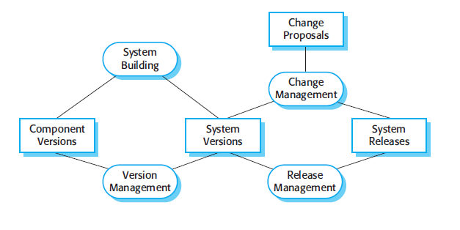
Configuration Management Activities

Slide 6
Configuration Management Activities
Configuration management involves the following activities –
Configuration management planning
Change management
Version and release management
System building

Slide 7
Configuration Management Activities
Change management: This involves keeping track of requests for changes to the software from customers and developers, working out the costs and impact of making these changes, and deciding if and when the changes should be implemented.
Version management: This involves keeping track of the multiple versions of system components and ensuring that changes made to components by different developers do not interfere with each other.
System building: This is the process of assembling program components, data, and libraries, and then compiling and linking these to create an executable system.
Release management: This involves preparing software for external release and keeping track of the system versions that have been released for customer use.

Slide 8
Configuration Management & SQA
Configuration management is sometimes considered to be part of software
quality management
The same manager having both quality management and configuration management responsibilities.
When a new version of the software has been implemented, it is handed over by the development team to the quality assurance (QA) team.
The QA team checks that the system quality is acceptable.
If so, it then becomes a controlled system, which means that all changes to the system have to be agreed on and recorded before they are implemented.

Slide 9
CM standards
CM should always be based on a set of standards which are applied within an organisation
Standards should define how items are identified, how changes are controlled and how new versions are managed
Standards may be based on external CM standards (e.g. IEEE standard for CM)
Existing standards are based on a waterfall process model - new standards are needed for evolutionary development

Slide 10
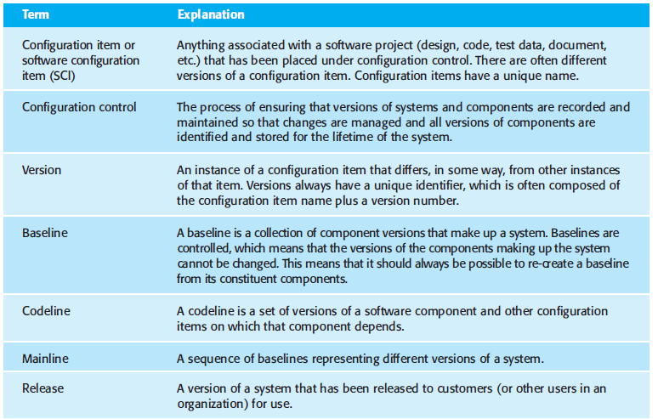
CM terminology

Slide 11
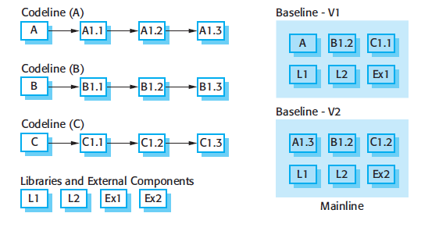
CM terminology

Slide 12
THANK YOU

