Slide 1
Software Testing & Quality Assurance
CSE-453
Intake : 26 (1)
Lecture - 17

Slide 2
Process Improvement
Nowadays, there is a constant demand from industry for cheaper, better software, which has to be delivered to ever-tighter deadlines.
Consequently, many software companies have turned to software process improvement as a way of enhancing the quality of their software, reducing costs, or accelerating their development processes.
Process improvement means understanding existing processes and changing these processes to increase product quality and/or reduce costs and development time.

Slide 3
Process Improvement Approach
Two quite different approaches to process improvement and change are used:
The process maturity approach, which has focused on improving process and project management and introducing good software engineering practice into an organization. The level of process maturity reflects the extent to which good technical and management practice has been adopted in organizational software development processes. The primary goals of this approach are improved product quality and process predictability.
The agile approach, which has focused on iterative development and the reduction of overheads in the software process. The primary characteristics of agile methods are rapid delivery of functionality and responsiveness to changing customer requirements.

Slide 4
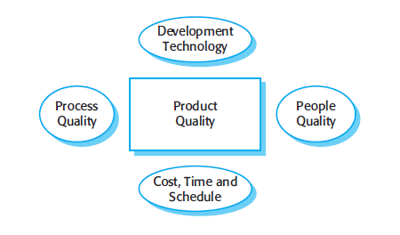
Process Improvement
Factors affecting software product

Slide 5
Process Improvement Process
Software processes can be observed in all organizations, from one-person companies to large multinationals. These processes are of different types depending on the degree of formality of the process, the types of products developed, the size of the organization, and so on.
There is no such thing as an ‘ideal’ or ‘standard’ software process that is applicable in all organizations or for all software products of a particular type.
Each company has to develop its own process depending on its size, the background and skills of its staff, the type of software being developed, customer and market requirements, and the company culture.

Slide 6
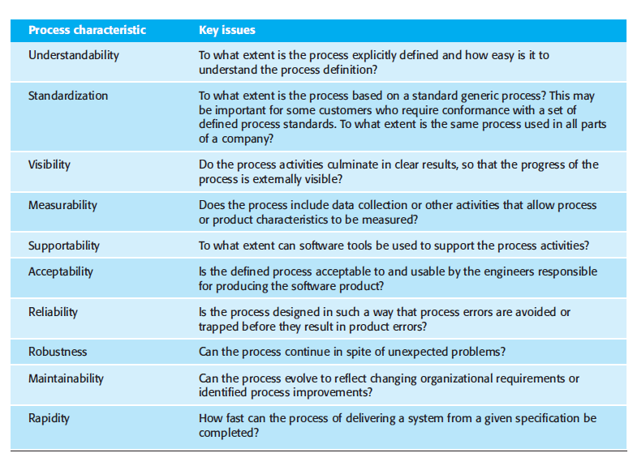
Process Improvement Process

Slide 7
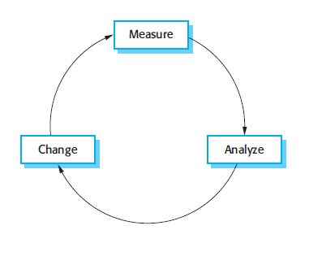
Process Improvement Cycle

Slide 8
Process Improvement Cycle
Process measurement Attributes of the current project or the product are measured. The aim is to improve the measures according to the goals of the organization involved in process improvement. This forms a baseline that helps you decide if process improvements have been effective.
Process analysis The current process is assessed, and process weaknesses and bottlenecks are identified. Process models (sometimes called process maps) that describe the process may be developed during this stage. The analysis may be focused by considering process characteristics such as rapidity and robustness.
Process change Process changes are proposed to address some of the identified process weaknesses. These are introduced and the cycle resumes to collect data about the effectiveness of the changes.

Slide 9
Process Measurement
Process measurements are quantitative data about the software process. Three types of process metrics can be collected:
The time taken for a particular process to be completed This can be the total time devoted to the process, calendar time, the time spent on the process by particular engineers, and so on.
The resources required for a particular process Resources might include total effort in person-days, travel costs, or computer resources.
The number of occurrences of a particular event Examples of events that might be monitored include the number of defects discovered during code inspection, the number of requirements changes requested, and the average number of lines of code modified in response to a requirements change.

Slide 10
Process Capability Assessment
The CMMI framework is the current stage of work on process assessment and improvement that started at the Software Engineering Institute in the 1980s.
It has had a profound influence on process improvement
Capability Maturity Model introduced in the early 1990s.
Revised maturity framework (CMMI) introduced in 2001.
Intended as a means to assess the extent to which an organization's processes follow best practice.
By providing a means for assessment, it is possible to identify areas of weakness for process improvement.

Slide 11
CMMI
Capability Maturity Model Integration
An integrated capability model that includes software and systems engineering capability assessment.
The model has two instantiations
Staged where the model is expressed in terms of capability levels
Continuous where a capability rating is computed.

Slide 12
CMMI Model Components
Process areas
24 process areas that are relevant to process capability and improvement are identified. These are organized into 4 groups.
Goals
Goals are descriptions of desirable organizational states. Each process area has associated goals.
Practices
Practices are ways of achieving a goal - however, they are advisory and other approaches to achieve the goal may be used

Slide 13
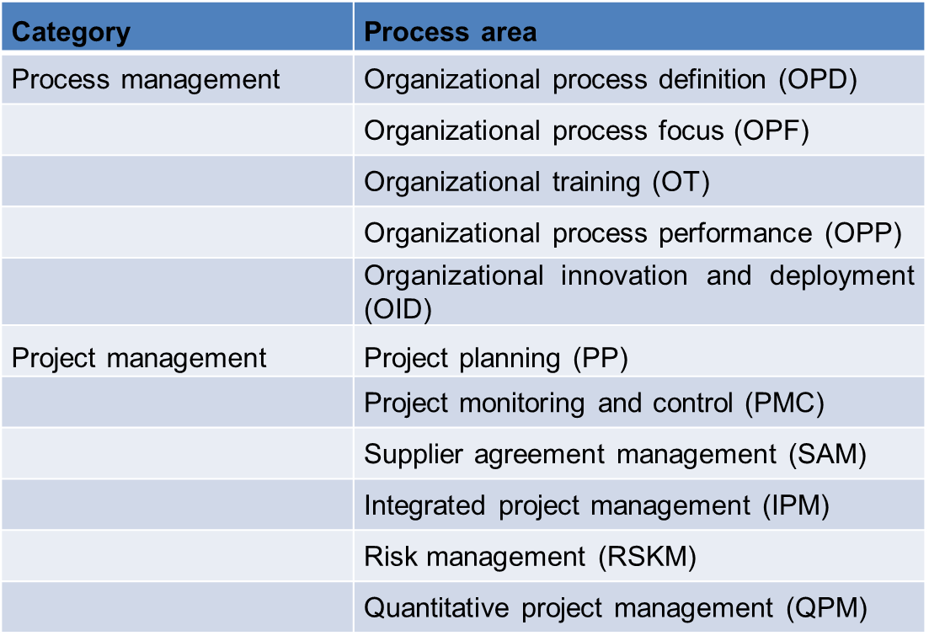
Process Areas

Slide 14
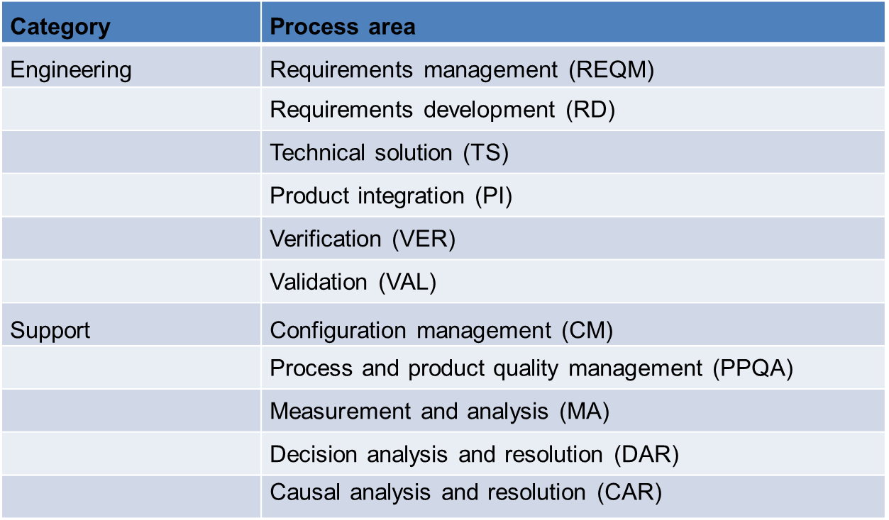
Process Areas

Slide 15
Goals
Goal | Process area
Corrective actions are managed to closure when the project’s performance or results deviate significantly from the plan. | Project monitoring and control (specific goal)
Actual performance and progress of the project are monitored against the project plan. | Project monitoring and control (specific goal)
The requirements are analyzed and validated, and a definition of the required functionality is developed. | Requirements development (specific goal)
Root causes of defects and other problems are systematically determined. | Causal analysis and resolution (specific goal)
The process is institutionalized as a defined process. | Generic goal

Slide 16
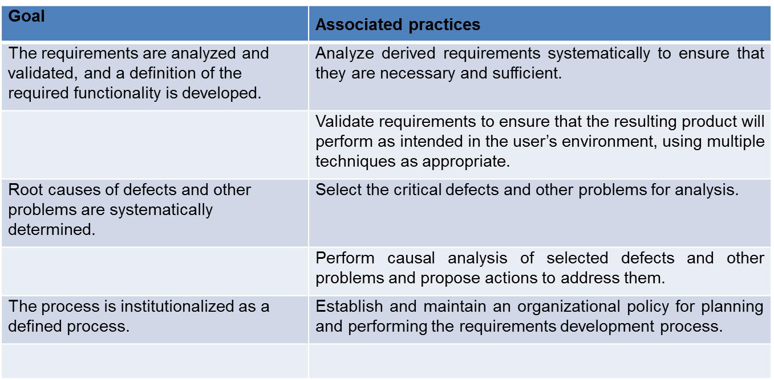
Practices

Slide 17
CMMI Assessment
Examines the processes used in an organization and assesses their maturity in each process area.
Based on a 6-point scale:
Not performed - At least one of the specific goals associated with the process area is not satisfied.
Performed - The goals associated with the process area are satisfied.
Managed - The goals associated with the process area are met and organizational policies are in place that define when each process should be used.

Slide 18
CMMI Assessment
Defined - This level focuses on organizational standardization and deployment of processes. Each project has a managed process that is adapted to the project requirements from a defined set of organizational processes.
Quantitatively managed - At this level, there is an organizational responsibility to use statistical and other quantitative methods to control sub processes.
Optimizing - At this highest level, the organization must use the process and product measurements to drive process improvement.

Slide 19
THANK YOU

