Slide 1
Software Testing & Quality Assurance
CSE-453
Intake : 27 (1)
Lecture- 01

Slide 2
Contact
Course Teacher:
Tarannum Zaki
Lecturer, CSE Dept.
BUBT
Email ID: tarannumzaki@yahoo.com
Room No. 310

Slide 3
Course Objective
Fundamentals of software quality and testing concepts, objectives
Software testing levels, techniques, models and test documentation
Software project planning, risk management and software reliability
Building test teams, including recruiting and retaining test engineers
Software quality measurement and metrics
Software quality, quality assurance management, accreditation factors and process improvement

Slide 4
Books
SagarNaik and PiyuTripathy, Software Testing and Quality Assurance: Theory and Practice, published by Wiley- Spektrum.
Ron Patton, Software Testing, published by Sams Publishing.
Software Engineering, 9th edition by Ian Sommerville
Software Engineering by Roger S. Pressman

Slide 5
Course Outline
To Be Provided

Slide 6
Software Testing
is an integral part of
Software Engineering

Slide 7
Software Engineering
Engineering discipline that is concerned with all aspects of software production.
S/W Engg. must understand the customer’s business needs and design software to help them.
Thus, SW engineering task requires:
Ability to quickly learn new and diverse disciplines and business processes
Ability to communicate with domain experts, extract an abstract model of the problem and formulate a solution.
Ability to design the software systems for the proposed solution to meet the business needs for many years.

Slide 8
Role of Software Engineering
Software engineering is often confused with Programming
S/W engineering is the creative activity of understanding the business problems, coming up with an idea for solution, and designing the ‘blueprints’ of the solution.
Programming is the craft of implementing the given blueprints

Slide 9
Software
A software engineer starts with problem definition and applies various tools to obtain a problem solution in order to fulfill user requirements for a particular business goal.
A collection of instructions that enable the user to interact with a computer, its hardware, or perform tasks.

Slide 10
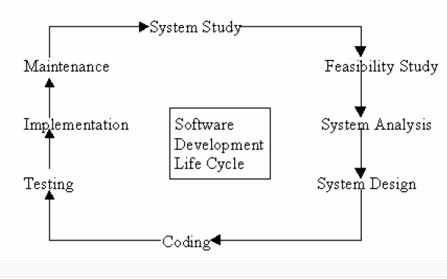
SDLC Lifecycle

Slide 11
Why Program Testing?
Testing is performed to show that a program does what it is intended to do and to discover program defects before it is put into use.
Testing is part of a more general verification and validation process.

Slide 12
Program Testing Goals
To demonstrate to the developer and the customer that the software meets its requirements.
To discover situations in which the behavior of the software is incorrect, undesirable or does not conform to its specification.

Slide 13
Validation & Verification
The first goal leads to validation testing
You expect the system to perform correctly using a given set of test cases that reflect the system’s expected use.
To demonstrate to the developer and the system customer that the software meets its requirements
The second goal leads to defect testing/Verification testing
The test cases are designed to expose defects.
Defect testing discover faults or defects in the software where its behaviour is incorrect or not in conformance with its specification

Slide 14
THANK YOU

