Slide 1
Software Testing & Quality Assurance
CSE-453
Intake : 26 (1)
Lecture - 02

Slide 2
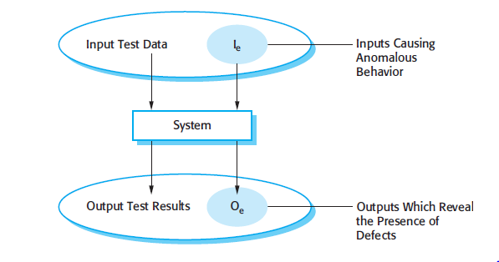
An Input/Output Model of Program Testing

Slide 3
An Input/Output Model of Program Testing
Explain the differences between validation testing and defect testing.
Think of the system being tested as a black box.
The system accepts inputs from some input set I and generates outputs in an output set O.
Some of the outputs will be erroneous. These are the outputs in set Oe that are generated by the system in response to inputs in the set Ie.
The priority in defect testing is to find those inputs in the set Ie because these reveal problems with the system.
Validation testing involves testing with correct inputs that are outside Ie. These stimulate the system to generate the expected correct outputs.

Slide 4
Testing shows only Presence of Errors
“Testing can only show the presence of errors, not their absence”
Testing cannot demonstrate that the software is free of defects or that it will behave as specified in every circumstance.
It is always possible that a test that you have overlooked could discover further problems with the system.

Slide 5
Verification VS. Validation
Verification: "Are we building the product right”.
The software should conform to its specification.
Validation: "Are we building the right product”.
The software should do what the user really requires.

Slide 6
V&V Confidence
Aim of V & V is to establish confidence that the system is ‘fit for purpose’. This means that the system must be good enough for its intended use.
The level of required confidence depends on system’s purpose, user expectations and marketing environment
Software purpose
The level of confidence depends on how critical the software is to an organization. The more critical the more it is reliable.
User expectations
Users may have low expectations of certain kinds of software.
Marketing environment
Getting a product to market early may be more important than finding defects in the program.

Slide 7
V&V Techniques
Software inspections: Concerned with analysis of the static system representation to discover problems (static verification)
Software testing: Concerned with exercising and observing product behavior (dynamic verification)

Slide 8
V&V Techniques

Slide 9
Software Inspections
These involve people examining the source representation with the aim of discovering anomalies and defects.
Inspections not require execution of a system so may be used before implementation.
They may be applied to any representation of the system (requirements, design, configuration data, test data, etc.).
They have been shown to be an effective technique for discovering program errors.

Slide 10
Advantages of Inspections
During testing, errors can mask (hide) other errors. Because inspection is a static process, you don’t have to be concerned with interactions between errors.
Incomplete versions of a system can be inspected without additional costs.
As well as searching for program defects, an inspection can also consider broader quality attributes of a program, such as compliance with standards, portability and maintainability.

Slide 11
Disadvantages of Inspections
Inspections can check conformance with a specification but not conformance with the customer’s real requirements.
Program inspections are an old idea and mostly used in software quality management.
In small companies or development groups, it can be difficult and expensive to put together a separate inspection team

Slide 12
Advantages of Software Testing
Supports both validation and verification
Gives a much needed assurance that it will work suitably and its performance won’t get affected due to the integration with other existing legacy systems
Performs a root cause analysis for which helps in making it more efficient
Software testing is carried out keeping the end user in mind
Reliability of software can be measured by certification or its conformation with any set technical standard.
*http://testorigen.com/top-5-benefits-of-software-testing/

Slide 13
THANK YOU

