Slide 1
Software Testing & Quality Assurance
CSE-453
Intake : 26 (1)
Lecture - 05

Slide 2
Black box testing & White box testing
Two broad concepts in testing, based on the sources of information for test design are
White-box testing
Black-box testing
White-box testing techniques are also called structural testing techniques
Black-box testing techniques are called functional testing techniques

Slide 3
Black Box Testing
One does not have access to the internal details of a program
A test engineer is concerned only with the part that is accessible outside the program, that is, just the input and the externally visible outcome.
A test engineer applies input to a program, observes the externally visible outcome of the program, and determines whether or not the program outcome is the expected outcome.
Inputs are selected from the program’s requirements specification and properties of the program’s input and output domains.
A test engineer is concerned only with the functionality and the features found in the program’s specification.

Slide 4
White Box Testing
One primarily examines source code with a focus on control flow and data flow
Control flow refers to flow of control from one instruction to another.
Control passes from one instruction to another instruction in a number of ways, such as one instruction appearing after another, function call, message passing, and interrupts. Conditional statements alter the normal, sequential flow of control in a program.
Data flow refers to the propagation of values from one variable or constant to another variable.
Definitions and uses of variables determine the data flow aspect in a program.

Slide 5
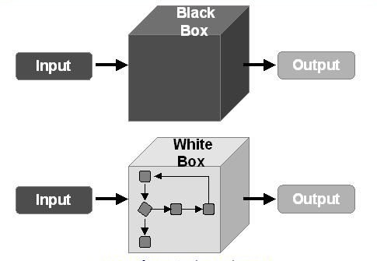
Black box & White box Testing

Slide 6
Black box testing VS. White box testing
White box testing techniques can be applied to individual units of a program
Black box testing techniques can be applied to both an entire system and the individual program units.
Since individual programmers know the details of the source code they write, they themselves perform white box testing on the individual program units they write.
Black box testing is performed at the external interface level of a system and it is conducted by a separate software quality assurance group.

Slide 7
Black box testing VS. White box testing
The ideas of white box testing and black box testing do not give programmers and test engineers a choice of whether to design test cases from the source code or from the requirements specification of a program.
These strategies are used by different groups of people at different times during a software’s life cycle.
Neither structural testing nor functional testing is by itself good enough to detect most of the faults.
A combination of both structural and functional testing techniques must be used in program testing.

Slide 8
Test planning & Design
The purpose of system test planning is to get ready and organized for test execution.
A test plan provides a framework, scope, details of resource needed, effort required, schedule of activities, and a budget.
A framework is a set of ideas, facts, or circumstances within which the tests will be conducted.
The stated scope outlines the domain of the test activities. The scope covers the managerial aspects of testing, rather than the detailed techniques and specific test cases.

Slide 9
Test planning & Design
Test design is a critical phase of software testing.
During the test design phase, the system requirements are critically studied, system features to be tested are thoroughly identified, the objectives of test cases and the detailed behavior of test cases are defined.
Test objectives are identified from different sources, namely, the requirement specification and the functional specification and one or more test cases are designed for each test objective.
Each test case is designed as a combination of modular test components called test steps. These test steps can be combined together to create more complex, multistep tests.
A test case is clearly specified so that others can easily borrow, understand, and reuse it.

Slide 10
Monitoring & Measuring Test Execution
It is important to monitor certain metrics which truly represent the progress of testing and reveal the quality level of the system.
Based on those metrics, the management can trigger corrective and preventive actions.
By putting a small but critical set of metrics in place the executive management will
be able to know whether they are on the right track
Test execution metrics
Metrics for monitoring test execution
Metrics for monitoring defects

Slide 11
Monitoring & Measuring Test Execution
The first class of metrics concerns the process of executing test cases
The second class concerns the defects found as a result of test execution.
These metrics need to be tracked and analyzed on a periodic basis, say, daily or weekly.
In order to effectively control a test project, it is important to gather valid and accurate information about the project
Metrics are meaningful only if they enable the management to make decisions which result in lower cost of production, reduced delay in delivery, and improved quality of software systems.

Slide 12
Monitoring & Measuring Test Execution
Quantitative Evaluation – Measurement lets one evaluate parameters of interest in a quantitative manner
Evaluate the effectiveness of a test generation technique
Evaluate the productivity of the development activities
Evaluate the quality of the product
Evaluate the product testing
Test case effectiveness metric
Test effort effectiveness metric

Slide 13
Test Tool & Automation
Software testing is a highly labor intensive task. This is because test cases are to a great extent manually generated and often manually executed. Moreover, the results of test executions are manually analyzed
The durations of those tasks can be shortened by using appropriate tools
a static code analyzer – analysis without actually executing the program
a test data generator – creating a set of data for testing
a network analyzer – investigate, characterize, and troubleshoot designs

Slide 14
Test Tool & Automation
Test automation is essential for any testing and quality assurance division of
an organization to move forward to become more efficient. The benefits of test
automation are as follows:
• Increased productivity of the testers
• Better coverage of regression testing
• Reduced durations of the testing phases
• Reduced cost of software maintenance
• Increased effectiveness of test cases

Slide 15
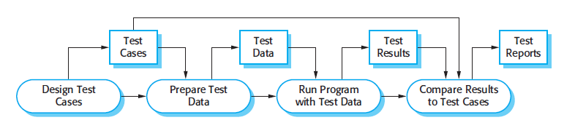
SW Testing Process Model

Slide 16
THANK YOU

