Slide 1
Software Testing & Quality Assurance
CSE-453
Intake : 27 (1)
Lecture - 06

Slide 2
Stages of testing
Development testing - where the system is tested during development to discover bugs and defects.
Release testing - where a separate testing team test a complete version of the system before it is released to users.
User testing - where users or potential users of a system test the system in their own environment.

Slide 3
Development testing
Development testing includes all testing activities that are carried out by the team developing the system.
Development team includes programmer (who developed the software ) and tester (who develops tests and assist with the testing process)
The programmer can work as a tester or there maybe separate tester team associated with a programmer
Development testing is primarily a defect testing process, where the aim of testing is to discover bugs in the software. It is therefore usually interleaved with debugging

Slide 4
Development testing
Development testing includes four levels of testing -
Unit testing - where individual program units or object classes are tested. Unit testing should focus on testing the functionality of objects or methods.
Component testing - where several individual units are integrated to create composite components. Component testing should focus on testing component interfaces.
Integration Testing - where individual software modules or components are combined and tested as a group. Integration testing should focus on testing interface between the group of modules or components
System testing - where testing is conducted on a complete, integrated system as a whole. System testing should focus on testing component/module interactions.

Slide 5
Debugging
Debugging is the process of fixing errors and problems that have been discovered by testing.
Using information from the program tests, debuggers use their knowledge of the programming language and the intended outcome of the test to locate and repair the program error.
This process is often supported by interactive debugging tools that provide extra information about program execution.

Slide 6
Unit testing
Unit testing refers to testing program units in isolation
A program unit may be viewed as a piece of code implementing a “low”-level function
Unit testing is performed by the programmer who writes the program unit because the programmer is intimately familiar with the internal details of the unit.
The objective for the programmer is to be satisfied that the unit works as expected.
Units may be a program unit. Syntactically, a program unit is a piece of code which can be -
Individual functions or methods within an object
Object classes with several attributes and methods
Composite components with defined interfaces used to access their functionality

Slide 7
Unit testing
Unit testing has a limited scope. A programmer will need to verify whether or not a code works correctly by performing unit-level testing. Intuitively, a programmer needs to test a unit as follows:
Execute every line of code. This is desirable because the programmer needs to know what happens when a line of code is executed. In the absence of such basic observations, surprises at a later stage can be expensive.
Execute every predicate in the unit to evaluate them to true and false separately.
Observe that the unit performs its intended function and ensure that it contains no known errors.

Slide 8
Unit testing
Unit testing is conducted in two complementary phases:
• Static unit testing
• Dynamic unit testing

Slide 9
Static Unit testing
In static unit testing, a programmer does not execute the unit; instead, the code is examined over all possible behaviors that might arise during run time.
Static unit testing is also known as non-execution-based unit testing
In static unit testing, the code of each unit is validated against requirements of the unit by reviewing the code.
During the review process, potential issues are identified and resolved.
Before units are individually tested by actually executing them, those are subject to usual review and correction as it is commonly understood in static unit testing

Slide 10
Static Unit testing
In static unit testing, code is reviewed by applying techniques commonly known as inspection and walkthrough.
• Inspection: It is a step-by-step group review of a work product, with each step checked against predetermined criteria.
• Walkthrough: It is a review where the author leads the team through a manual or simulated execution of the product using predefined scenarios.

Slide 11
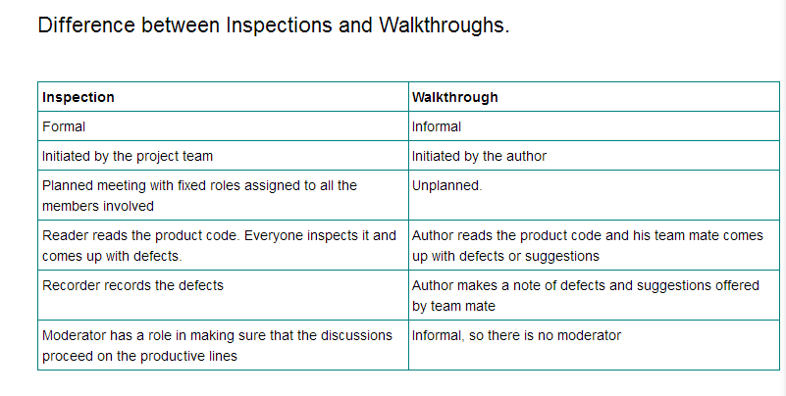
Static Unit testing

Slide 12
Dynamic Unit testing
Execution-based unit testing is referred to as dynamic unit testing. In this testing, a program unit is actually executed in isolation
A unit under test is taken out of its actual execution environment.
The actual execution environment is emulated by writing more code so that the unit and the emulated environment can be compiled together.
The above compiled aggregate is executed with selected inputs. The outcome of such an execution is collected in a variety of ways, such as straightforward observation on a screen, logging on files, and software instrumentation of the code to reveal run time behavior.

Slide 13
Dynamic Unit testing
The result is compared with the expected outcome. Any difference between the actual and expected outcome implies a failure and the fault is in the code.
An environment for dynamic unit testing is created by emulating the context of the unit under test
The context of a unit test consists of two parts:
(i) a caller of the unit - test driver
(ii) all the units called by the unit – stubs
The test driver and the stubs are together called scaffolding

Slide 14
Automated Unit Testing
Whenever possible, unit testing should be automated so that tests are run and checked without manual intervention.
In automated unit testing, you make use of a test automation framework (such as JUnit) to write and run your program tests.

Slide 15
Automated Unit Test Components
A setup part, where you initialize the system with the test case, namely the inputs and expected outputs.
A call part, where you call the object or method to be tested.
An assertion part where you compare the result of the call with the expected result. If the assertion evaluates to true, the test has been successful if false, then it has failed.

Slide 16
Choosing Unit Test Case
Testing is expensive and time consuming, so it is important that you choose effective unit test cases. Effectiveness, in this case, means two things:
The test cases should show that, when used as expected, the component that you are testing does what it is supposed to do.
If there are defects in the component, these should be revealed by test cases.

Slide 17
Choosing Unit Test Case
Two possible strategies here that can be effective in helping you choose
test cases. These are:
1. Partition testing - where you identify groups of inputs that have common characteristics and should be processed in the same way. You should choose tests from
within each of these groups.
2. Guideline-based testing - where you use testing guidelines to choose test cases.
These guidelines reflect previous experience of the kinds of errors that programmers
often make when developing components.

Slide 18
Partition Testing
Input data and output results often fall into different classes where all members of a class are related.
Example of these classes are positive numbers, negative numbers, and menu selections
Each of these classes is an equivalence partition or domain where the program behaves in an equivalent way for each class member.
Test cases should be chosen from each partition.
18

Slide 19
Guideline Based Testing
Choose inputs that force the system to generate all error messages
Design inputs that cause input buffers to overflow
Repeat the same input or series of inputs numerous times
Force invalid outputs to be generated
Force computation results to be too large or too small.

Slide 20
THANK YOU

