Slide 1
Software Testing & Quality Assurance
CSE-453
Intake : 27 (1)
Lecture - 07

Slide 2
Unit Test Tools
The well-known tools used by programmers in everyday life are an editor, a compiler, an operating system, and a debugger
Code Auditor: This tool is used to check the quality of software to ensure that it meets some minimum coding standards.
Bound Checker: This tool can check for accidental writes into the memory location outside the data storage area of the application.
Test Data Generator: These tools assist programmers in selecting test data that cause a program to behave in a desired manner.
Static Code (Path) Analyzer: These tools identify paths to test, based on the structure of the code

Slide 3
Testing Stages
Testing
Development Testing
Release Testing
User Testing
Unit Testing
Component Testing
Integration Testing
System testing

Slide 4
Component Testing
Software components are often composite components that are made up of several interacting objects.
You access the functionality of these objects through the defined component interface.
Testing composite components should therefore focus on showing that the component interface behaves according to its specification.
The test cases are not applied to the individual components but rather to the interface of the composite component created by combining these components.
You can assume that unit tests on the individual objects within the component have been completed.

Slide 5
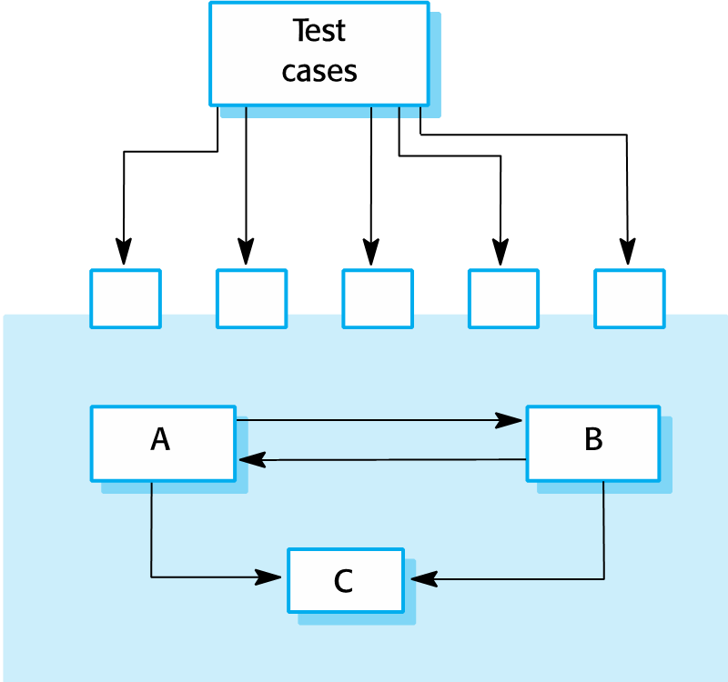
Component Testing

Slide 6
Interface Testing
An interface is a shared boundary across which two separate components of a computer system exchange information.
Objectives
To detect faults due to interface errors or invalid assumptions about interfaces.
To evaluate whether systems or components pass data and control correctly to one another
Interface errors in the composite component may not be detectable by testing the individual objects because these errors result from interactions between the objects in the component

Slide 7
Interface Types
There are different types of interface between program components
Interface types
Parameter interfaces: Data passed from one method or procedure to another.
Shared memory interfaces: Block of memory is shared between procedures or functions.
Procedural interfaces: Sub-system encapsulates a set of procedures to be called by other sub-systems.
Message passing interfaces: Sub-systems request services from other sub-systems

Slide 8
Interface Errors
Interface misuse
A calling component calls another component and makes an error in its use of its interface e.g. parameters in the wrong order.
Interface misunderstanding
A calling component embeds assumptions about the behaviour of the called component which are incorrect.
Timing errors
The called and the calling component operate at different speeds and out-of-date information is accessed.

Slide 9
Interface Testing Guidelines
Design tests so that parameters to a called procedure are at the extreme ends of their ranges.
Always test pointer parameters with null pointers.
Design tests which cause the component to fail.
Use stress testing in message passing systems.
In shared memory systems, vary the order in which components are activated.

Slide 10
Integration Testing
The testing in which individual software modules are combined and tested as a group.
A module is formed by a group of components.
Objectives
To combine the software modules into a working system so that system-level tests can be performed on the complete system.
Some modules are more error prone than other modules, because of their inherent complexity. It is essential to identify the ones causing most failures.
Putting the modules together in an incremental manner and ensuring that the additional modules work as expected without disturbing the functionalities of the modules already put together.

Slide 11
Granularity of Integration Testing
System integration testing is performed at different levels of granularity –
Intrasystem testing - This form of testing constitutes low-level integration testing with the objective of combining the modules together to build a cohesive system in an incremental manner
Intersystem testing – This form of testing is a high-level testing phase which requires interfacing independently tested systems. In this phase, all the systems are connected together, and testing is conducted from end to end.
Pairwise testing - Pairwise testing is a kind of intermediate level of integration testing. In pairwise integration, only two interconnected systems in an overall system are tested at a time.

Slide 12
Integration Testing Techniques
The Software Industry uses variety of strategies to execute integration testing. They are -
Big Bang Approach
Incremental Approach which is further divided into following -
Top Down Approach
Bottom Up Approach
Sandwich Approach - Combination of Top Down and Bottom Up

Slide 13
Big Bang Approach
Here all component are integrated together at once, and then tested.
Advantages:
Convenient for small systems.
Disadvantages:
Fault Localization is difficult.
Given the sheer number of interfaces that need to be tested in this approach, some interfaces links to be tested could be missed easily.
Since the integration testing can commence only after "all" the modules are designed, testing team will have less time for execution in the testing phase.
Since all modules are tested at once, high risk critical modules are not isolated and tested on priority.

Slide 14
Incremental Methods
In this approach, testing is done by joining two or more modules that are logically related. Then the other related modules are added and tested for the proper functioning. Process continues until all of the modules are joined and tested successfully.
This process is carried out by using programs called Stubs and Drivers
Stub: Is called by the Module under Test.
Driver: Calls the Module to be tested.
Incremental Approach in turn is carried out by two different Methods:
Bottom Up
Top Down

Slide 15
Bottom Up Integration
In the bottom up strategy, each module at lower levels is tested with higher modules until all modules are tested. It takes help of Drivers for testing.
Advantages:
Fault localization is easier.
No time is wasted waiting for all modules to be developed unlike Big-bang approach
Disadvantages:
Critical modules (at the top level of software architecture) which control the flow of application are tested last and may be prone to defects.
Early prototype is not possible

Slide 16
Top Down Integration
In Top to down approach, testing takes place from top to down following the control flow of the software system.
Takes help of stubs for testing
Advantages:
Fault Localization is easier.
Possibility to obtain an early prototype.
Critical Modules are tested on priority; major design flaws could be found and fixed first
Disadvantages:
Needs many Stubs.
Modules at lower level are tested inadequately.

Slide 17
THANK YOU

