Slide 1
Risk Factors: A Visual Narrative
Heart Disease
Clinical Data Analysis for State Health Department
918
12
55.3%
28-77
Records
Variables
Prevalence
Age Range

Slide 2
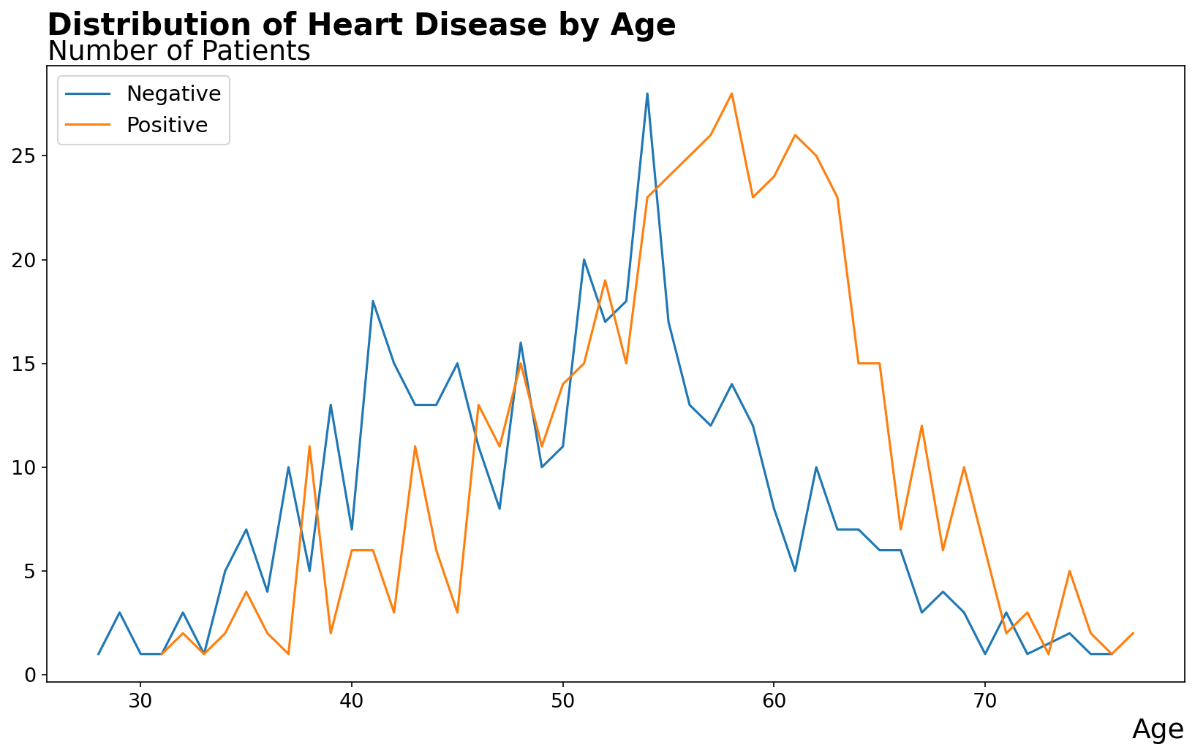
Distribution of Heart Disease by Age
Key Finding: Younger patients (30–35) show fewer cases. Risk rises sharply from age 50, peaking at 55–65.

Slide 3
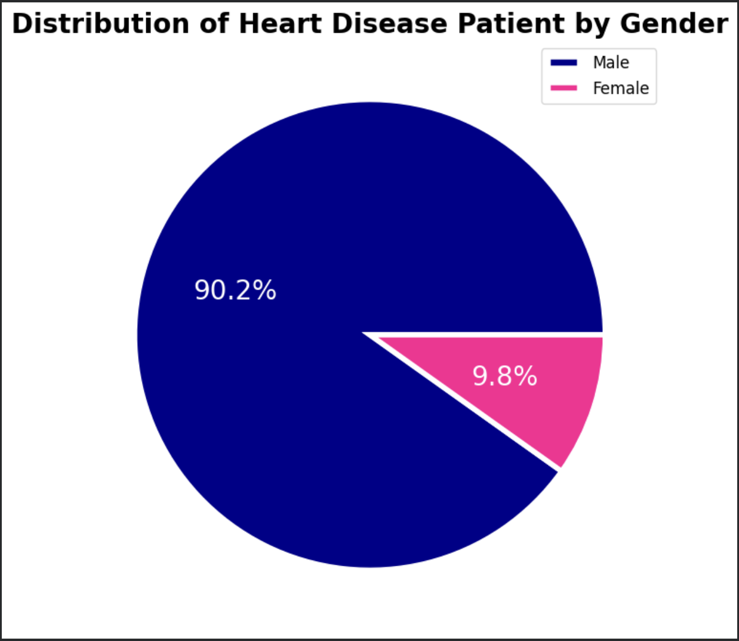
Distribution of Heart Disease by Gender
Key Finding: Males make up 90.2% of patients and show nearly 10 times positive heart disease rate compared to females.

Slide 4
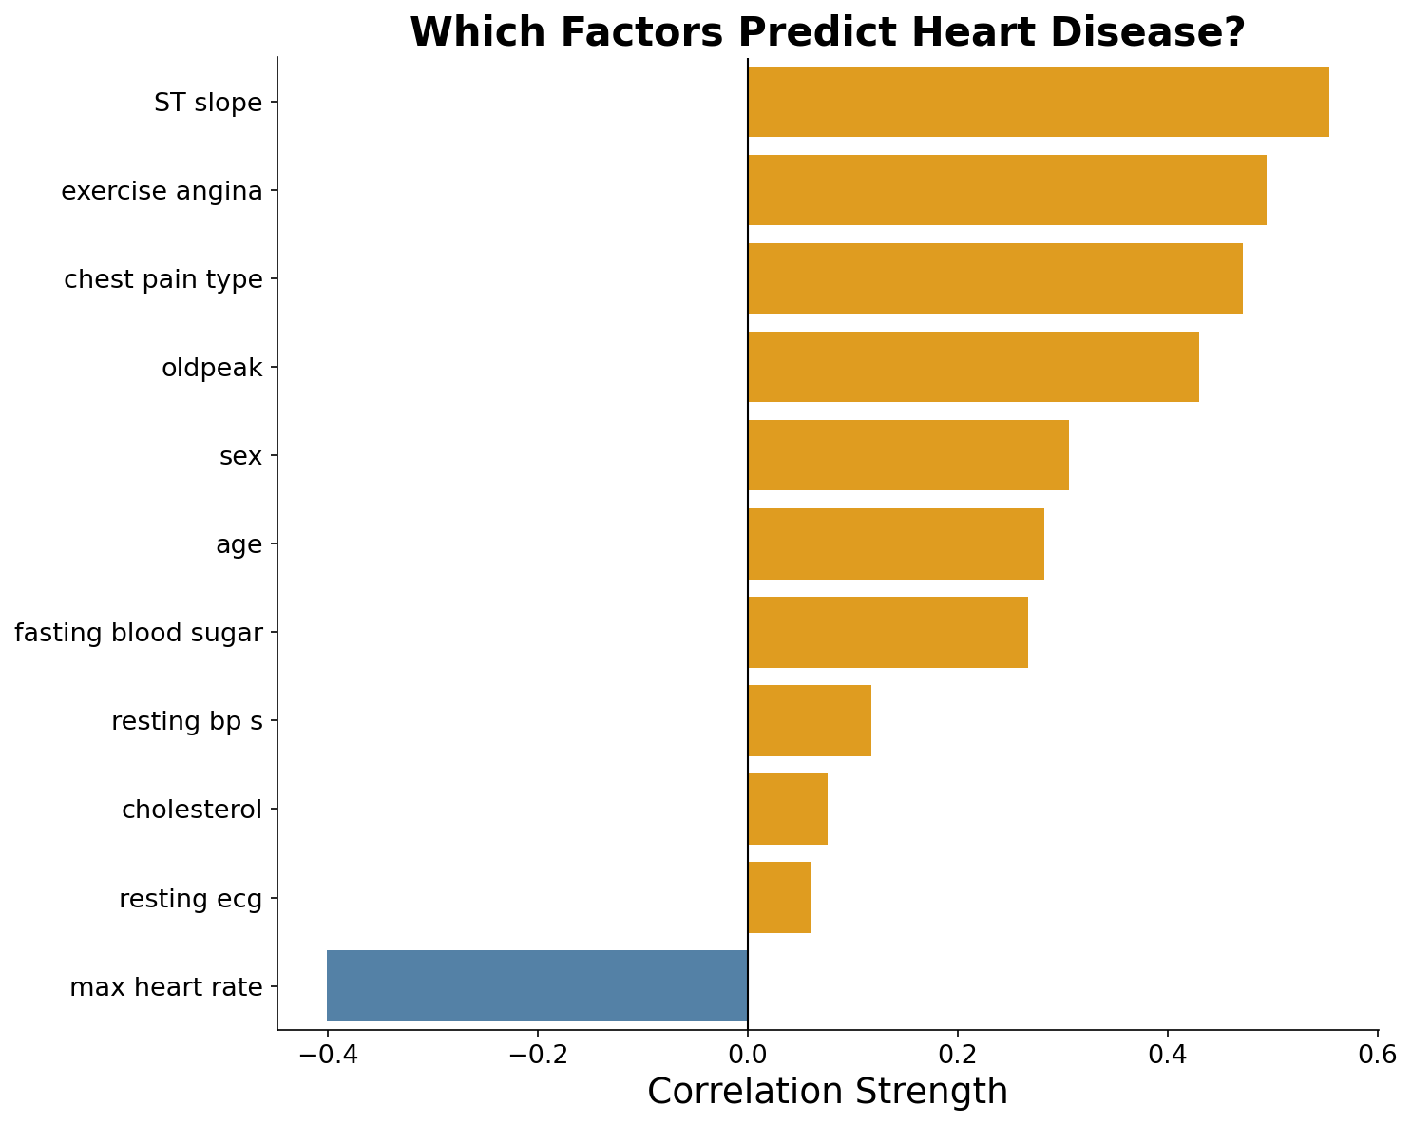
Which Factors Predict Heart Disease?
Key Finding: ST Slope (0.55) is the strongest predictor. Cholesterol (0.08) & Resting ECG (0.06) show very weak correlation.

Slide 5
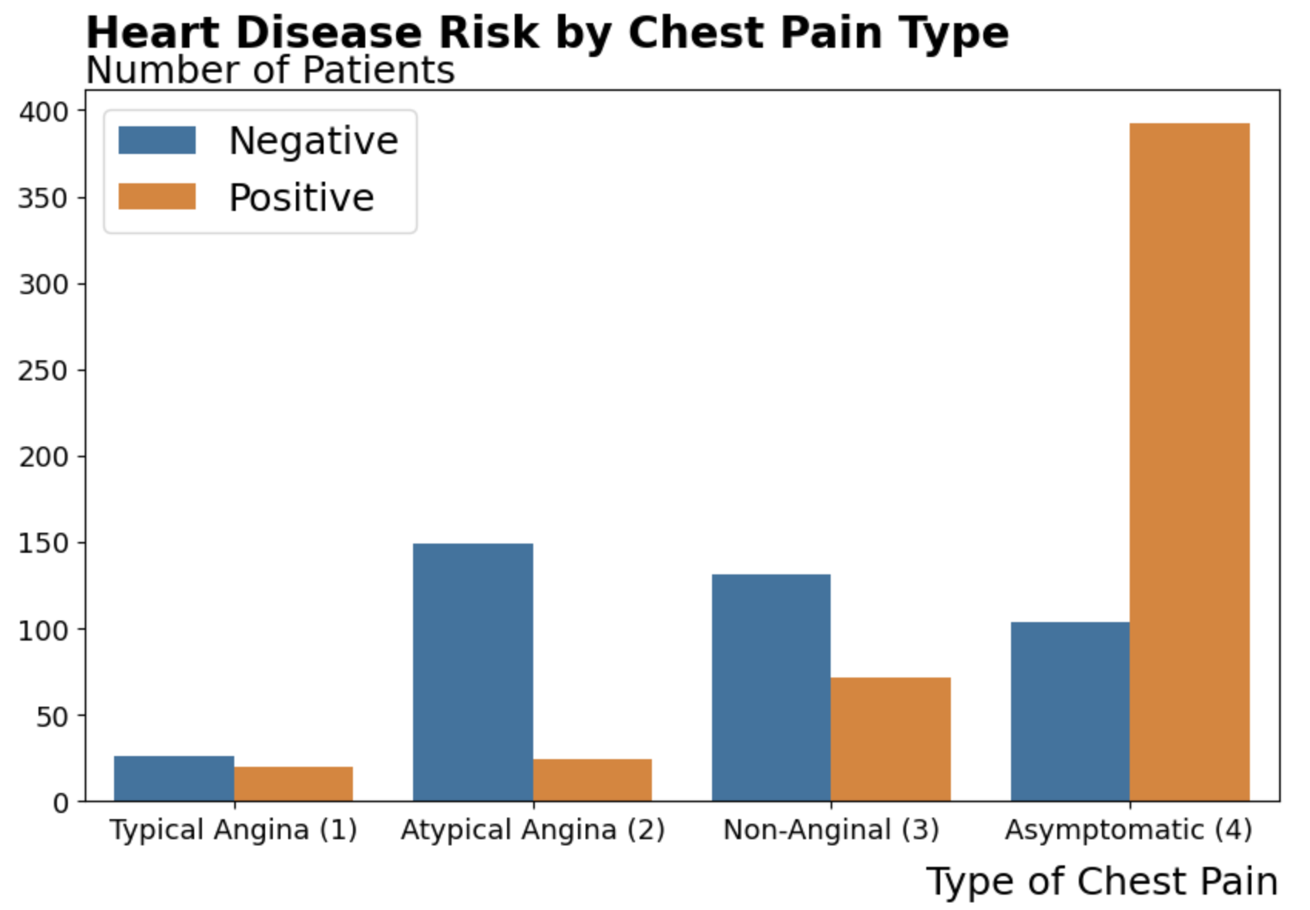
Heart Disease Risk by Chest Pain Type
The Paradox: Asymptomatic (Type 4) — patients feeling NO chest pain — have the highest heart disease rate: 374 of 496 cases (75.5%).

Slide 6
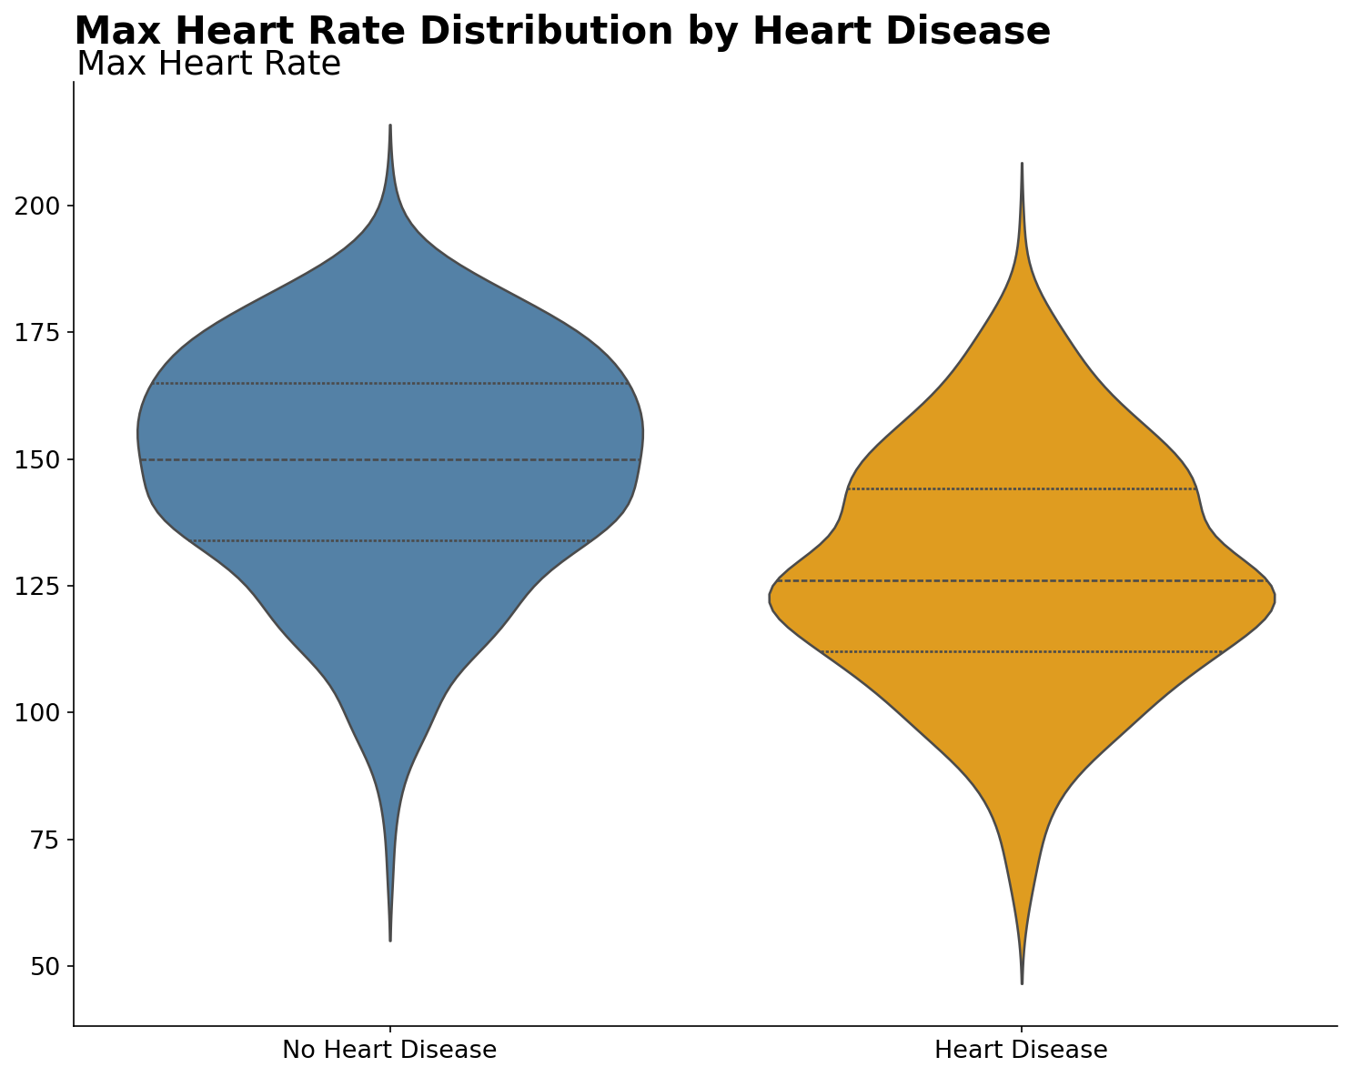
Max Heart Rate by Heart Disease
Key Finding: Heart disease patients average 127.7 bpm vs 148.2 bpm for healthy patients — a 20.5 bpm difference (r = −0.40).

Slide 7
Key Insights
🚨
Silent Danger
📈
Age Critical
🏃
Exercise Metrics
75.5% of asymptomatic patients (type-4) have disease
Risk peaks at 55–65 years old
ST Slope (0.55) & Exercise Anigna (0.5)
👨
Gender Matters
💓
Heart Rate
📊
Data Quality
Males: 90.2% | Females: 9.8% disease
Negative correlation (-0.4) with disease
22.9% records required cleaning

Slide 8
Conclusion & Next Steps
What We Achieved
✓ Cleaned dataset from 1,190 → 918 records by identifying medically implausible values
✓ Identified the "Symptom Paradox" — asymptomatic patients carry highest disease burden
✓ Established exercise-based metrics (ST Slope, Max HR) as most reliable indicators
✓ Demonstrated gender and age as consistent demographic risk stratifiers
Next Steps: Build predictive ML model | Create interactive health dashboards
Heart disease is preventable. Data-driven awareness saves lives.

