Slide 1
Heart Disease
Risk Factors: A Visual Narrative
Exploring Clinical Predictors Through Data
1,190
918
12
55.3%
Raw Records
Cleaned Records
Clinical Variables
Heart Disease Rate
Source: Kaggle — Heart Disease Dataset (Hosam Mohamed Ali) | UCI ML Repository

Slide 2
About the Dataset
Dataset Background
Key Clinical Variables
This dataset contains 1,190 clinical records consolidated from five major heart disease databases: Cleveland • Hungary • Switzerland
Long Beach VA • Stalog
Originally hosted by the UCI Machine Learning Repository, this combined dataset provides broad population coverage across different geographies and clinical settings.
The target variable indicates:
1 = Heart Disease Present
0 = No Heart Disease
Age
28 – 77 years
Sex
Male (76%) / Female (24%)
Chest Pain Type
4 types (Typical to Asymptomatic)
Resting BP
Resting blood pressure (mm Hg)
Cholesterol
Serum cholesterol (mg/dl)
Max Heart Rate
Max HR achieved during exercise
Exercise Angina
Chest pain during exercise (Y/N)
ST Slope
Slope of peak exercise ST segment
Oldpeak
ST depression induced by exercise
Target
Heart Disease Diagnosis (0/1)

Slide 3
Data Cleaning Process
Zero-Value Cholesterol
Zero Resting Blood Pressure
PROBLEM
PROBLEM
172 out of 1,190 records (14.5%) had cholesterol = 0, which is physiologically impossible.
1 record had resting BP = 0, which is clinically impossible in a living patient.
SOLUTION
SOLUTION
Rows with zero cholesterol were identified and replaced with median value as data was of wide range (mean wouldn’t be best fitting)
The single zero-BP record was replaced by overall mean.
No Explicit Null Values
Duplicate Records Check
PROBLEM
PROBLEM
All 12 columns reported 0 null values in the raw dataset.
Consolidated dataset from 5 sources risked duplicates across databases.
SOLUTION
.
Duplicate rows were checked and removed
Result: Dataset reduced from 1,190 → 918 records | 272 rows removed (22.9%) | All remaining values are clinically valid

Slide 4
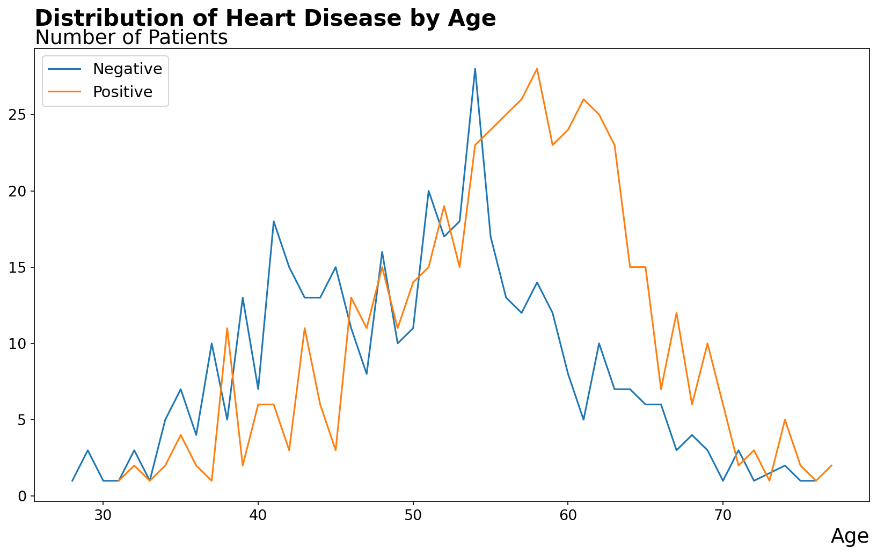
Distribution of Heart Disease by Age
Key Finding: Younger patients (30–35) show fewer heart disease cases. Risk rises sharply from age 50, peaking at 55–65.

Slide 5
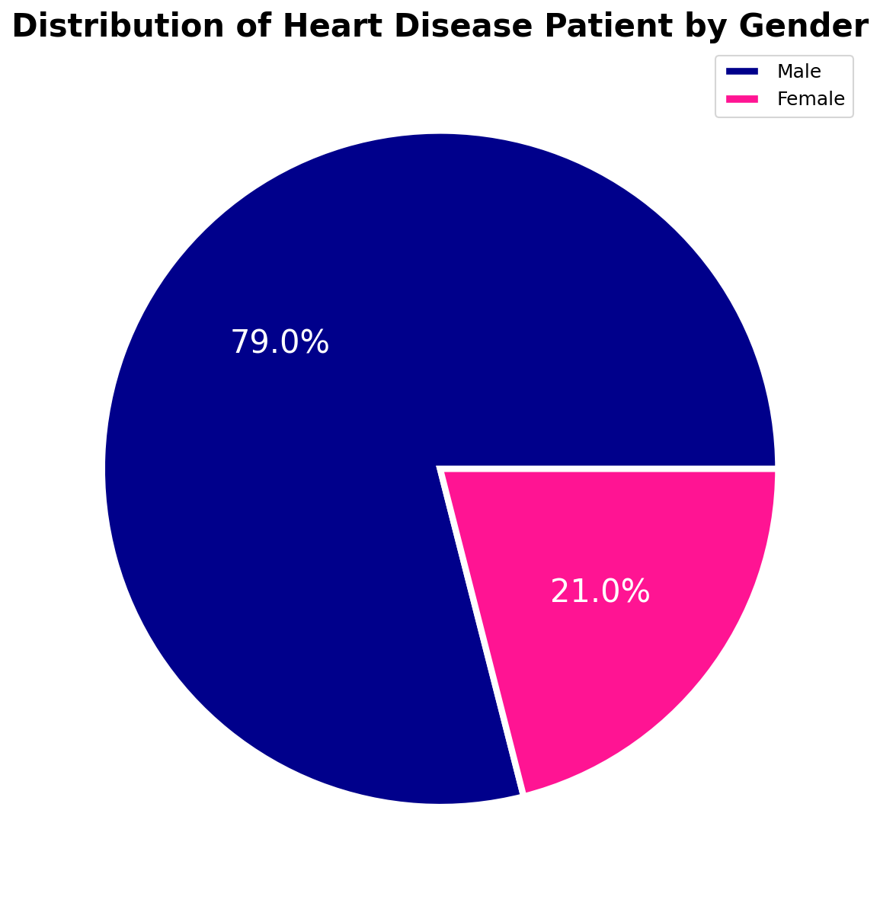
Distribution of Heart Disease Patient by Gender
Key Finding: Males make up ~76% of patients and show nearly twice the heart disease rate compared to females.

Slide 6
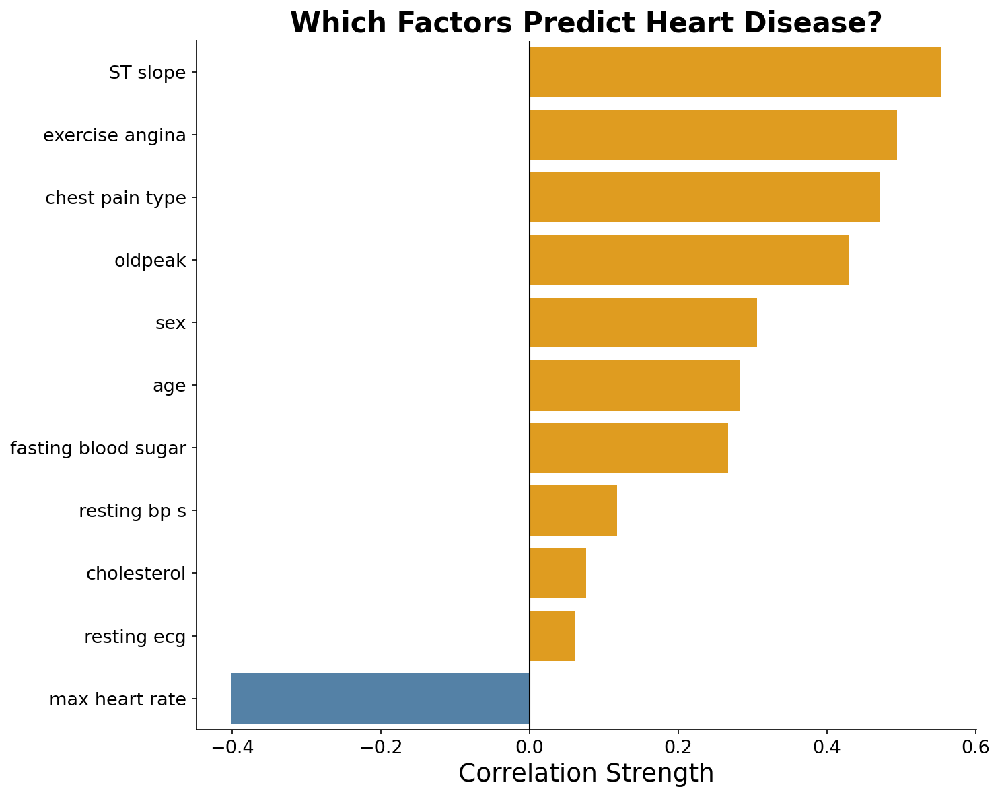
Which Factors Predict Heart Disease?
Key Finding: ST Slope (0.55) is the strongest predictor. Cholesterol (0.08) & Resting ECG (0.06) show very weak correlation.

Slide 7
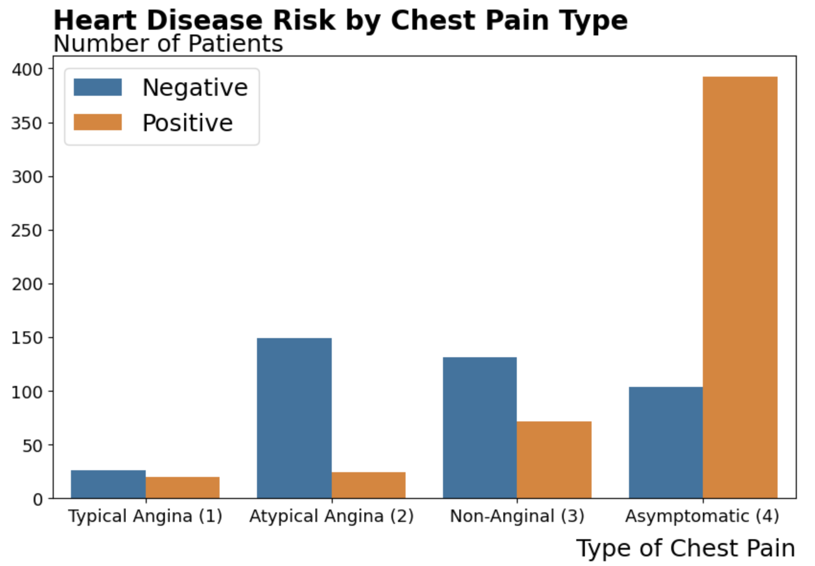
Heart Disease Risk by Chest Pain Type
The Paradox: Asymptomatic (Type 4) — patients feeling NO chest pain — have the highest heart disease rate: 374 of 496 cases (75.5%).

Slide 8
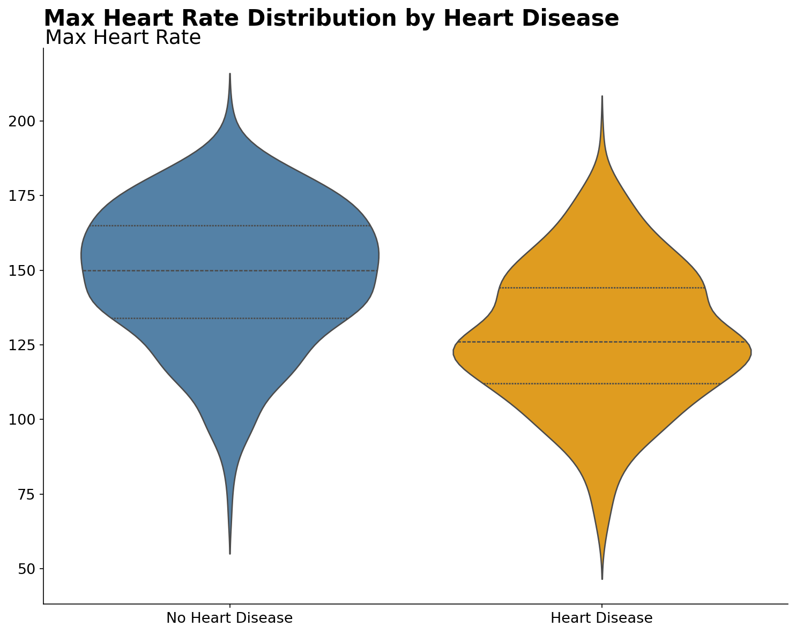
Max Heart Rate Distribution by Heart Disease
Key Finding: Heart disease patients average 127.7 bpm vs 148.2 bpm for healthy patients — a 20.5 bpm difference (correlation: −0.40).

Slide 9
Key Insights
What the data tells us about heart disease risk
1
2
3
Silent Danger
Age is a Critical Factor
Exercise Reveals the Truth
75.5% of asymptomatic patients (those feeling NO chest pain) were diagnosed with heart disease — the highest rate of any group.
Risk accelerates sharply after age 50, peaking at 55–65.
ST Slope and Exercise angina are the top predictors.
4
5
6
Gender Matters
Max Heart Rate
Data Quality is Critical
Male patients show nearly twice the heart disease rate. 59.4% of males were positive versus 40.1% of females.
Heart Rate had the lowest correlation with diagnosis (-0.4)
22.9% of records were invalid (zero cholesterol, zero BP). Domain knowledge, not just null checks, is essential for medical data.

Slide 10
Conclusion & Next Steps
What We Achieved
Next Steps
▸ Cleaned a real-world clinical dataset from 1,190 → 918 records by identifying medically implausible zero-values
1
Build predictive ML model using the top correlated features
▸ Identified the "Symptom Paradox" — asymptomatic patients carry the highest disease burden
2
Create interactive dashboards for public health educators
▸ Established that exercise-based metrics (ST Slope, Max HR) are the most reliable visual indicators
▸ Demonstrated gender and age as consistent demographic risk stratifiers
Heart disease is preventable. Data-driven awareness saves lives.

