Slide 1
TONTADARYA COLLEGE OF ENGINEERING
DEPARTMENT OF COMPUTER SCIENCE AND DESIGN
Mini project on
“Online DJ Management System”
Under the guidance of
Prof. Lohit Javali
Presented by :
Ramesh P Koujalagi
Pruthviraj S Arakeri
Sachin A Navi
Rajsingh C Doddamani

Slide 2

INTRODUCTION
The objective of this application is to develop a system that effectively manages all the data related to the various DJ events that take place in a function.
The purpose is to maintain a centralized database of all DJ event related information. The goal is to support various functions and processes necessary to manage the data efficiently.
The development of this new system will try to automate the entire process keeping in the view of database integration approach.
This system maintains user’s personal, and contact details. This system will provide on line help and search capabilities.

Slide 3
Online DJ Management System Module
In ODJMS project we use PHP and MySQL database. It has two modules.
1.Admin Module 2.User Module
Admin Module
Dashboard: In this section, admin can see all detail in brief like the total services, Total unread queries ,Total read queries, Total new booking, Total Approved booking, Total Cancelled Booking and Total Event Type
DJ Services: In this section, admin can manage services (add/delete).
Type of Event: In this section, admin can manage event type (add/delete).
Pages: In this section, the admin can manage about us and contact us pages.
Booking: In this section, admin can view new, approved, cancelled bookings and also give a remark.
Contact us Queries: In this section, admin can view and maintain the Queries.
Reports: In this section, admin can view booking in a particular period.

Slide 4
ER DIAGRAM

Slide 5
Tables
ADMIN
BOOK_DJ
EVENT_TYPE
PAGE
SERVICE
USER

Slide 6
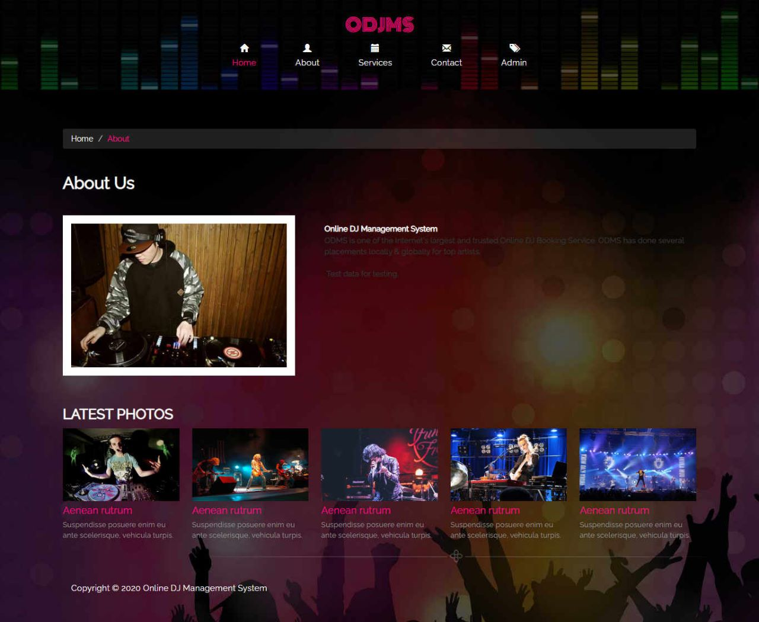
SNAP SHOTS OF THE PROJECT

Slide 7
Dashboard:

Slide 8
Profile:

Slide 9
Manage Services:

Slide 10
All Booking:

Slide 11
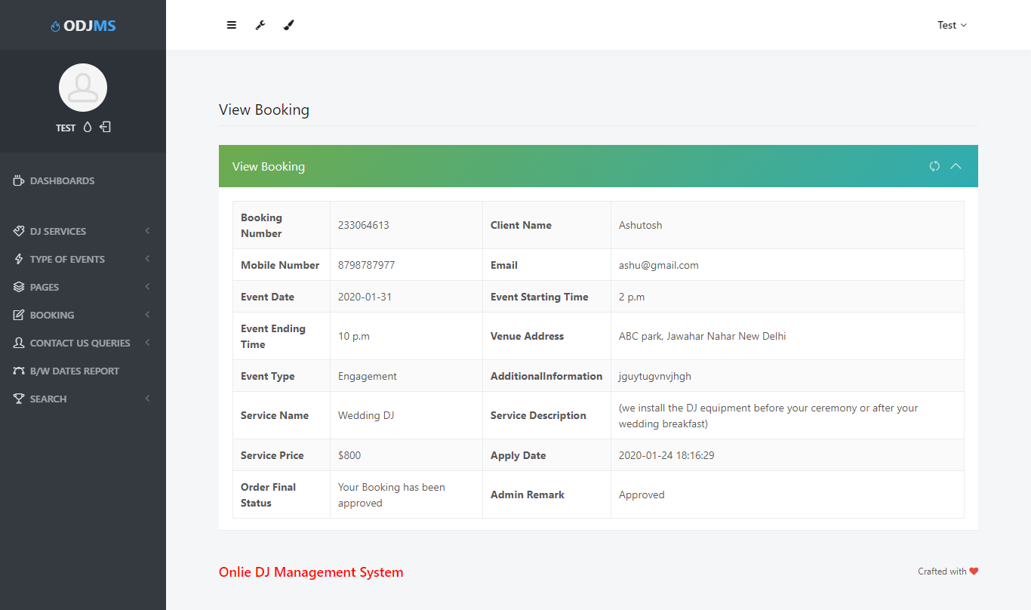
View Approved Booking:

Slide 12
GOALS ACHIVIED
Reduced entry work
Easy retrieval of information
Reduced errors due to human intervention
User friendly screens to enter the data
Portable and flexible for further enhancement
Web enabled
Fast finding of information request

Slide 13
CONCLUSION
The “Online DJ Management System” was successfully designed and is tested for accuracy and quality. During this project we have accomplished all the objectives and this project meets the needs of the organization. The developed will be used in searching, retrieving and generating information for the concerned requests.

Slide 14
Thank You

