Slide 1

Hybrid APPS using Angular and ionic
Banuprakash. C
banuprakashc@yahoo.co.in

Slide 2
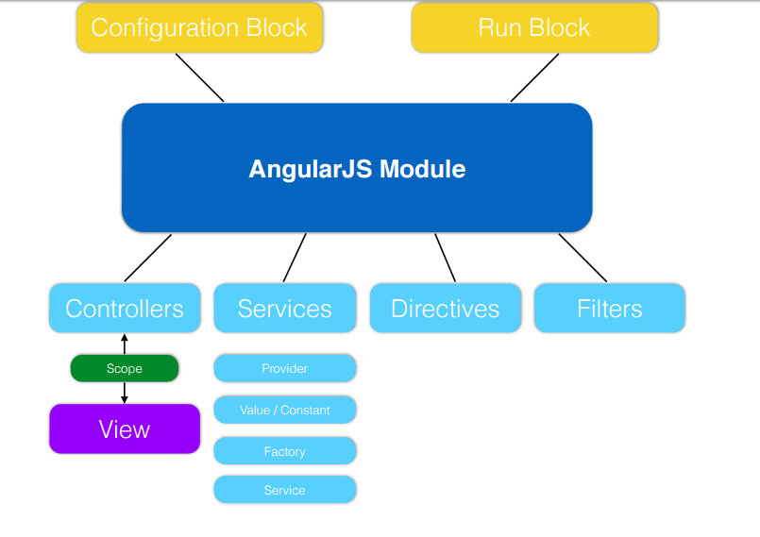
Angular JS Module

Slide 3
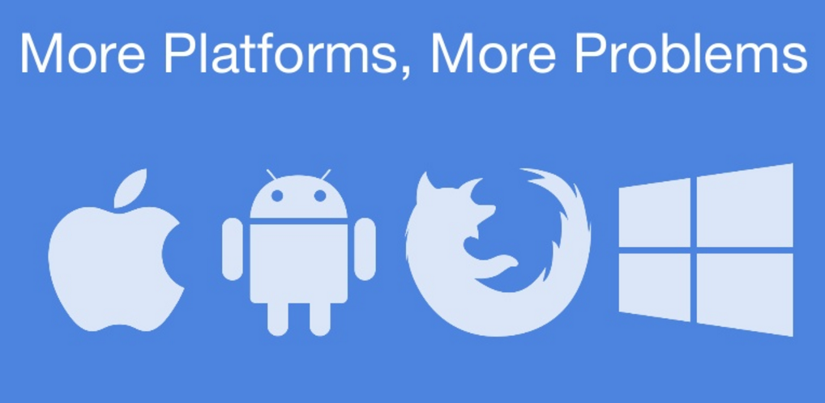
Hybrid apps using Angular and ionic framework

Slide 4
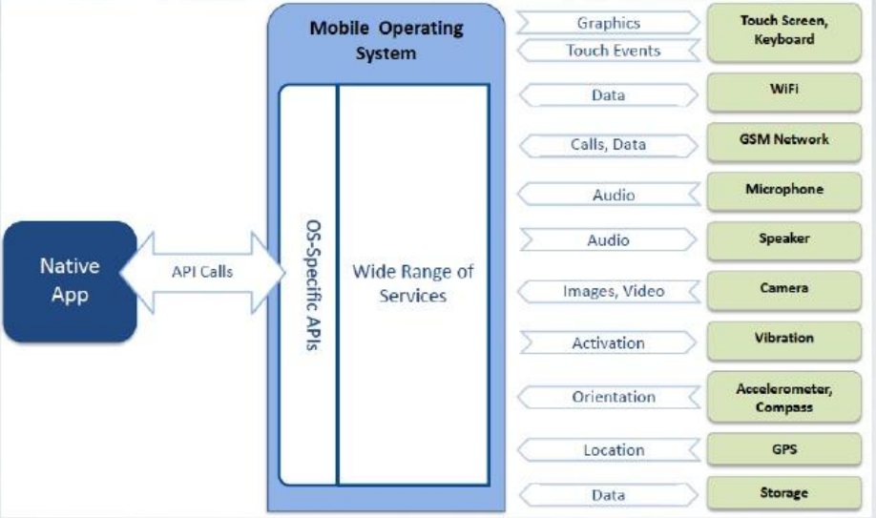
Native Apps

Slide 5
Native Apps
Platform specific
Respective development tools
Best performance
Time consuming
Expensive development

Slide 6
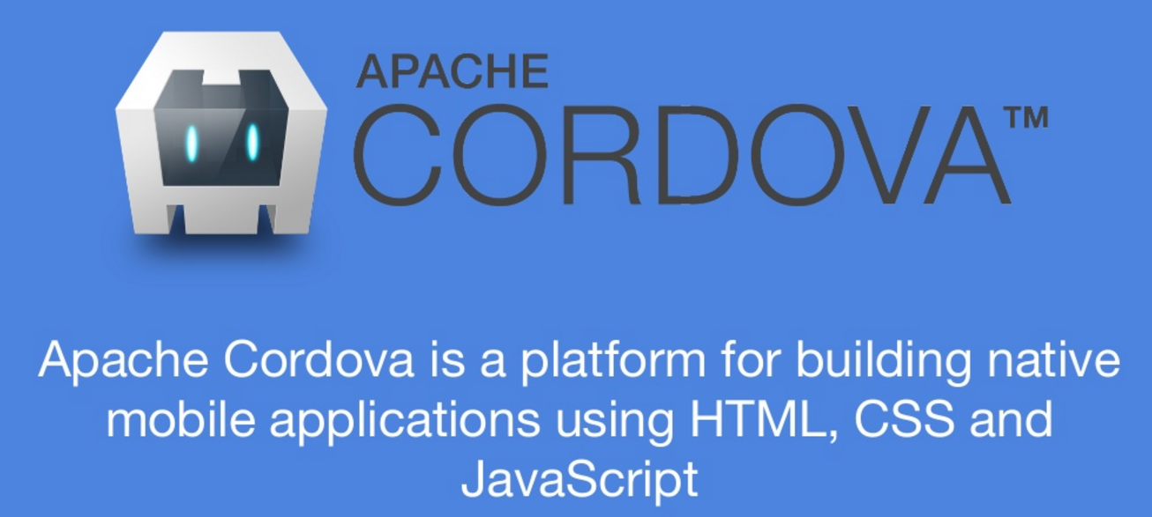
Apache Cordova

Slide 7
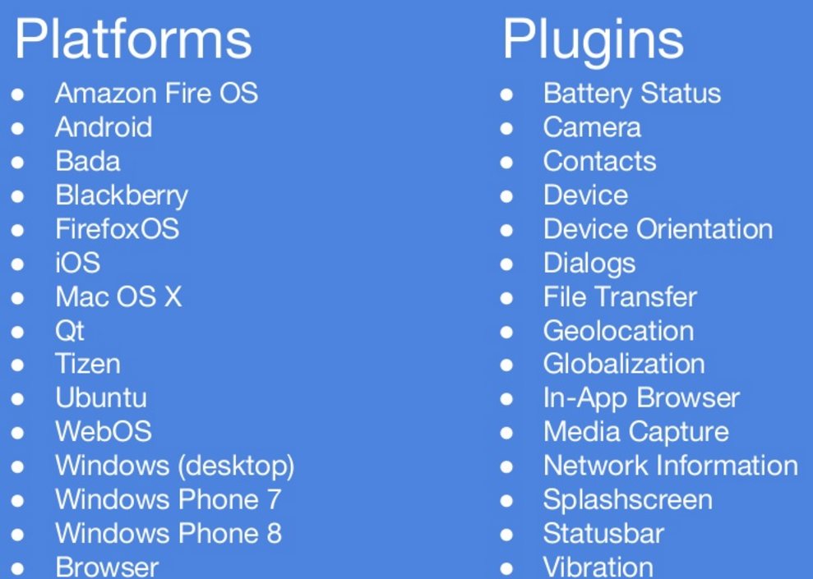
Apache Cordova

Slide 8
Difference between Cordova and Phonegap
PhoneGap is a distribution of Apache Cordova
You can think of Apache Cordova as the engine that powers PhoneGap, similar to how WebKit is the engine that powers Chrome or Safari.
When to use cordova?
Before starting the project and making the architecture ask yourself this:
Am I going to end up writing too many plugins?
If YES go NATIVE
If NO go Cordova

Slide 9
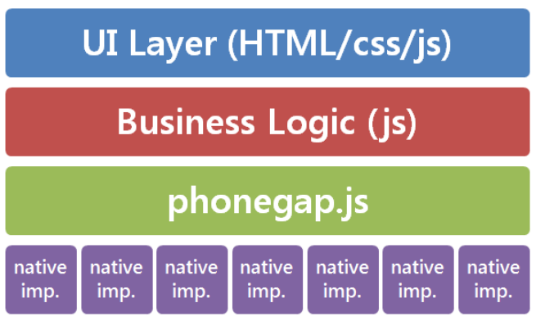
Hybrid Cordova app

Slide 10

Ionic

Slide 11
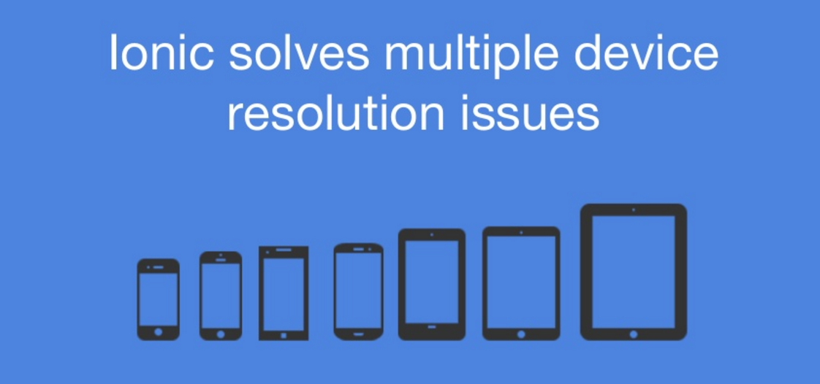
Ionic

Slide 12
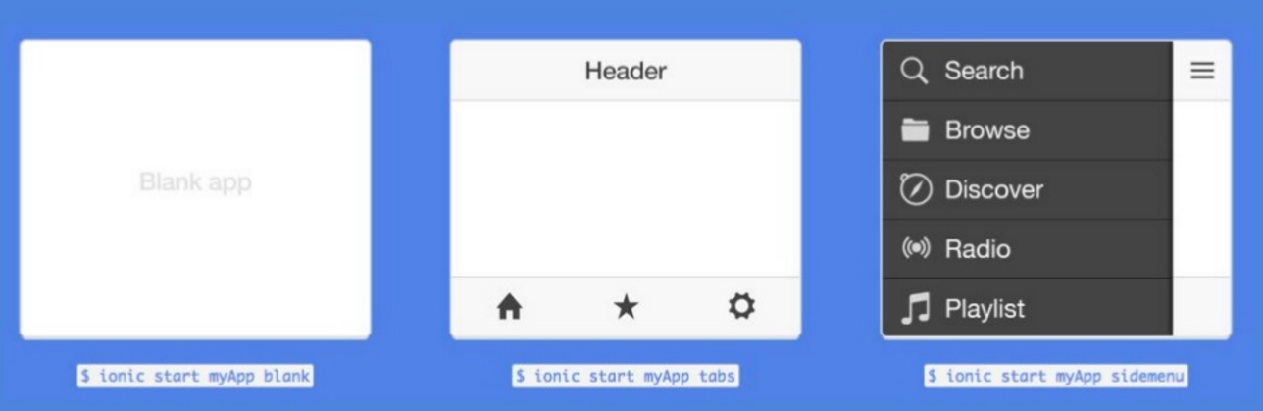
Ionic Templates

Slide 13
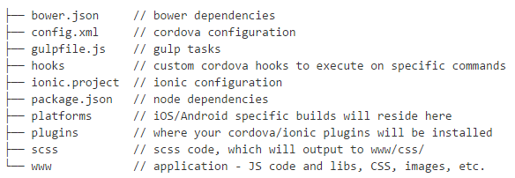
Installation
Apache Cordova
npm install cordova –g
Ionic
npm install ionic –g
Create the project
ionic start todo blank or ionic start myApp tabs or any other template

Slide 14
Configure Platforms
ionic platform add ios
ionic platform add android
Test it out
ionic build ios
ionic emulate ios

Slide 15
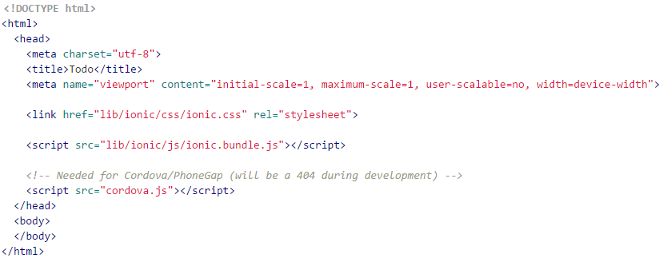
Starting your app
Create www/index.html and initialize it with this:

Slide 16
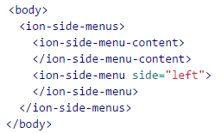
Starting your app
To create side menus in Ionic, we can use ion-side-menus.
Edit the index.html file and change the <body> content to look like this:
In the code above, we’ve added our <ion-side-menus> controller which will handle the dragging and exposing of the side menu.
Inside of the controller we have a <ion-side-menu-content> which is the center content area of the app, and a <ion-side-menu side="left"> which is a left, initially hidden, side menu.

Slide 17
Building your app
Create an Angular controller and add it to the page:
angular.module('todo', ['ionic'])
.controller('TodoCtrl', function($scope) {
$scope.tasks = [
{ title: 'Collect coins' },
{ title: 'Eat mushrooms' },
{ title: 'Get high enough to grab the flag' },
{ title: 'Find the Princess' }
];
})
<body ng-app="todo" ng-controller="TodoCtrl">

Slide 18
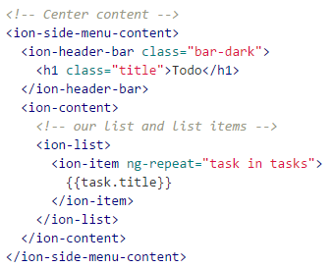
Building your app
The center content becomes:

Slide 19
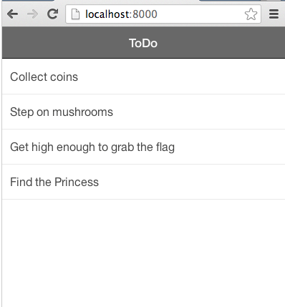
Testing your app
Desktop browser testing
ionic serve
Mobile browser testing
if our desktop is running a test server at 192.168.1.123:8000, we can just load that address into our mobile Chrome or Safari to test it.
Simulator testing
ionic build ios
ionic emulate ios
Testing as a native app
ionic run android

