Slide 1



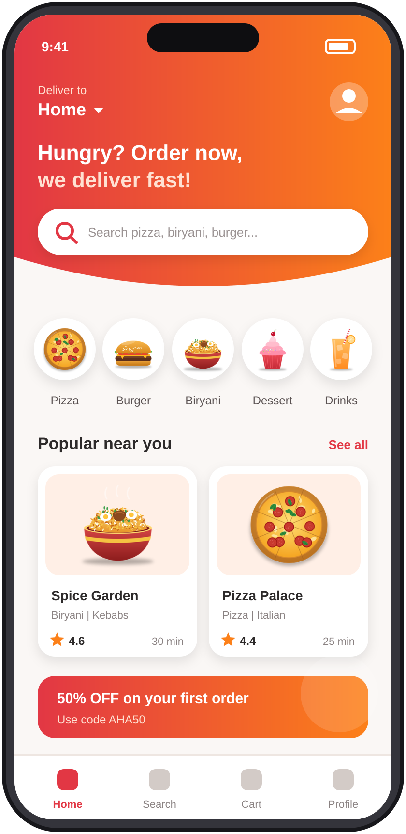


AAROHAN PROJECT PRESENTATION
Order Cheyyandi
Aaha Anandi !
Online Food Delivery Website
Order online. Track live. Enjoy it fresh.
TEAM MEMBERS
SK
Siva Kumar
SG
Seshagiri
RN
Ramesh Naidu
RB
Raju Babu
B
Bunny
Notes:
Welcome. Introduce the project "Order Cheyandi Aha Anandi", an online food delivery website, and the five team members: Siva Kumar, Seshagiri, Ramesh Naidu, Raju Babu, Bunny.

Slide 2









02 | INTRODUCTION
Order Cheyyandi Aaha Anandi
INTRODUCTION
“Order Cheyyandi Aaha Anandi” is a modern food delivery platform that connects customers with restaurants through a user-friendly website. The platform aims to provide a fast, convenient, and reliable food ordering experience.
Delivery Ecosystem
Customer
Browses and orders
For Customers
For Restaurants
Order cheyyandi Aaha Anandi
Platform
Browse many restaurants in one place
Order anytime in a few clicks
Track the order and pay securely
Reach more customers online
Digital, error-free order handling
Reviews help improve service
Payment Gateway
Secure payments
Restaurant
Prepares the food
Delivery Partner
Delivers it fast
Pizza
Burger
Biryani
Desserts
Beverages
Online Food Delivery Website
02 / 07
Notes:
Explain online food delivery in one line: customers order, restaurants prepare, delivery partners deliver, the platform connects everyone. Point out the benefits for both customers and restaurants.

Slide 3




03 | THE CHALLENGE
Order Cheyyandi Aaha Anandi
Problem Statement
Traditional food ordering is slow, opaque and error-prone.
01
02
What frustrates customers most
Long Waiting Times
No Order Tracking
Busy phone lines and manual order-taking delay every order.
Customers can't see order status or the delivery time.
03
04
Payment Difficulties
Errors & Limited Choice
Cash-only orders, change issues and no secure digital options.
Paper menus, wrong orders and no reviews to guide choices.
Online Food Delivery Website
03 / 07
Notes:
Walk through the four pain points of traditional ordering: long waits, no tracking, payment difficulties, and errors with limited choice. The chart is illustrative; replace it with your own survey data.

Slide 4






04 | THE SOLUTION
Order Cheyyandi Aaha Anandi
Proposed Solution & Technologies Used
Easy food browsing.
Live order tracking.
Easy price checking.
Easy Ordering.
System Architecture
Technology Stack
Website Structure
Styling
Interactivity
HTML
HTML
CSS
JS
Java Script
Builds Content Skeleten.
Text, images & links.
Using Colors, Background.
Design and stylesheet.
Logic and Action
Handle user clicks.
Validate user entries.
HTML5
CSS3
JavaScript
Structure
Styling
Interactivity
AI
Using ChatGPT
Online Food Delivery Website
04 / 07
Notes:
Solution: one responsive website for customers and restaurants. Technologies: HTML5, CSS3, JavaScript and Bootstrap for the front end, PHP or Node.js for server logic, MySQL for data. Explain the three layers and the external services.

Slide 5






05 | WHAT IT OFFERS
Order Cheyyandi Aaha Anandi
Main Features
User Registration & Login
Secure sign-up with saved profiles
Restaurant Listings
Menus, ratings and timings
Add to Cart
Customise items and quantities
Search & Filter Foods
Find by cuisine, price or rating
Live Order Tracking
Follow the order in real time
Responsive Design
Works on phone, tablet, desktop
Online Payment
UPI, cards and wallets, safely
Ratings & Reviews
Feedback on food and delivery
Online Food Delivery Website
05 / 07
Notes:
Eight core features: registration and login, restaurant listings, search and filter, cart, online payment, live order tracking, ratings and reviews, responsive design. The bar chart compares the traditional way with our website; the scores are illustrative.

Slide 6
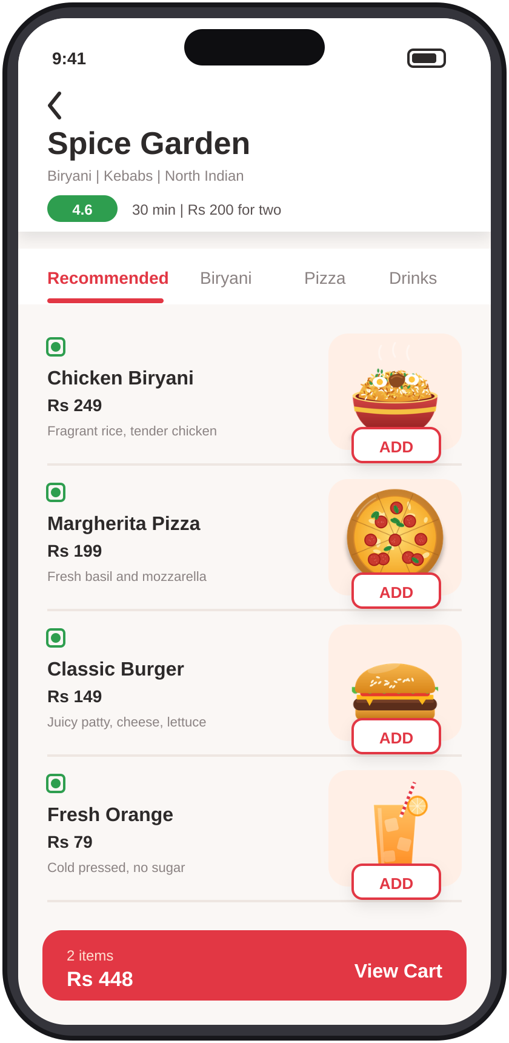
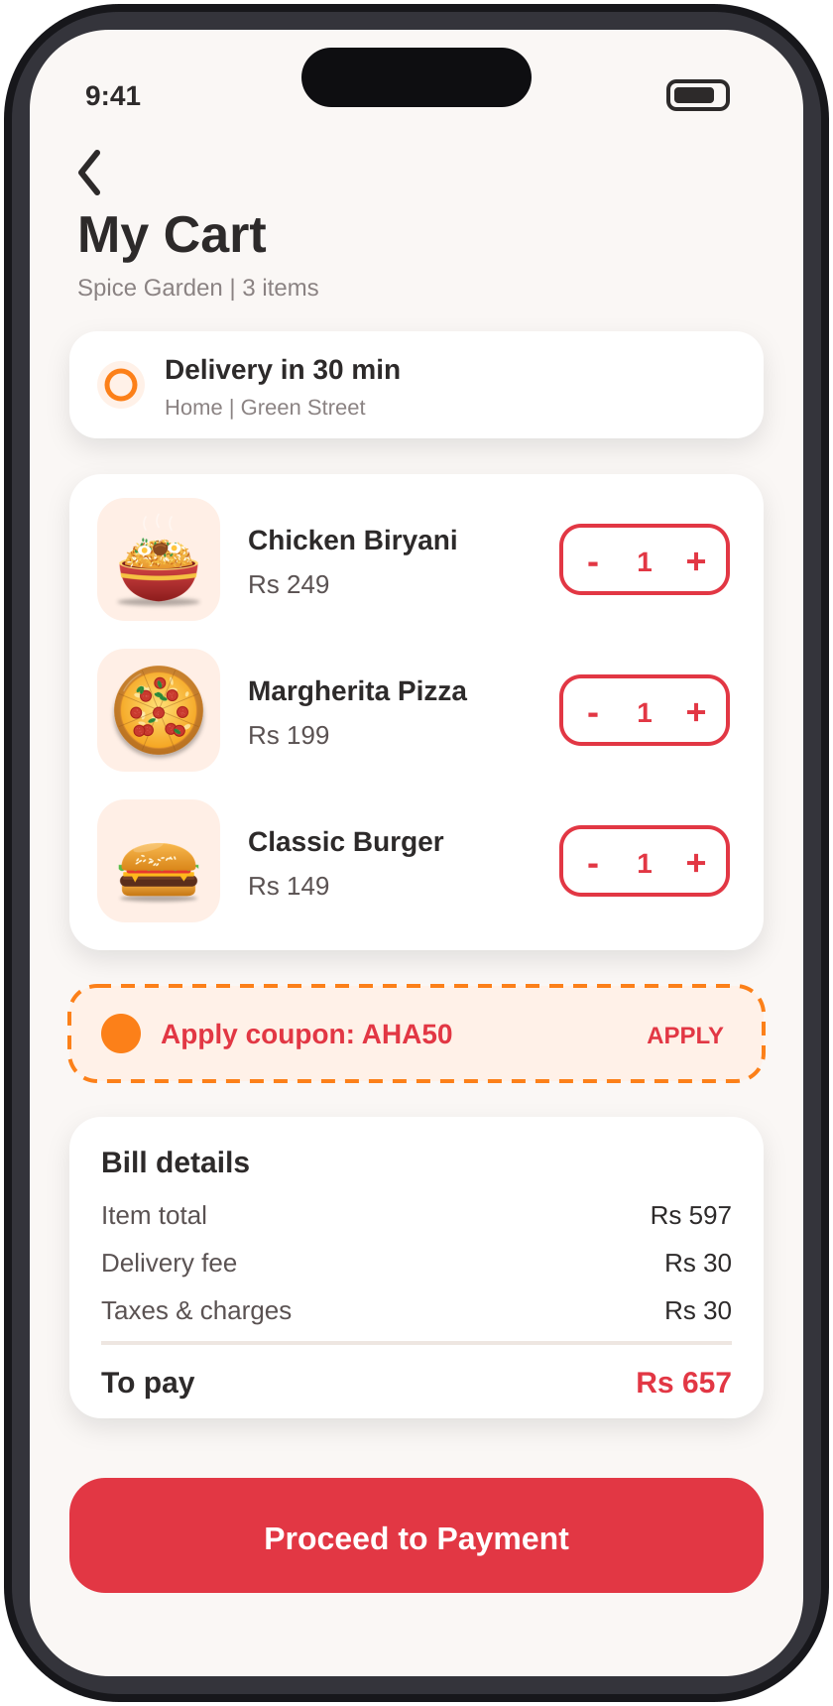
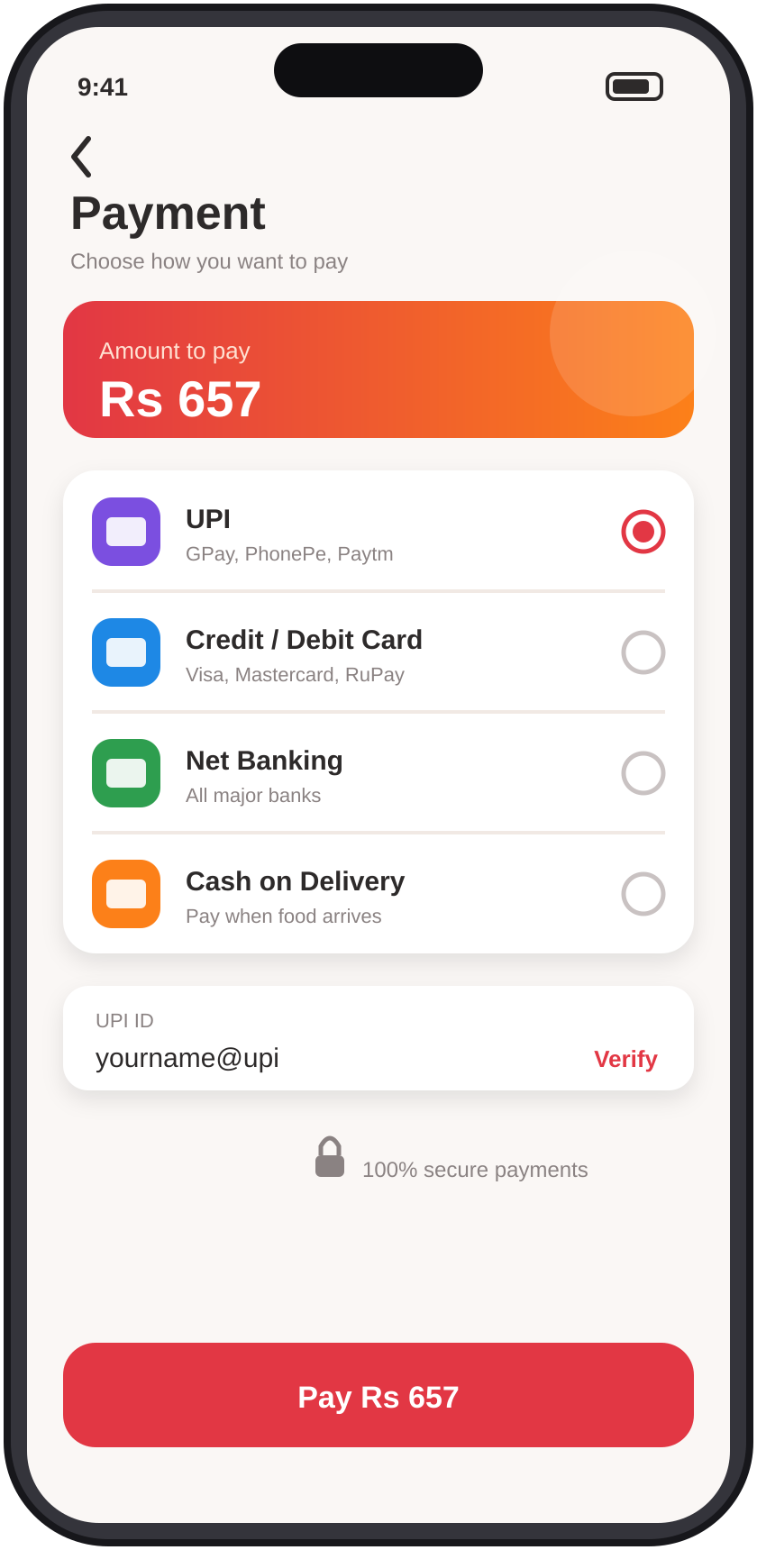
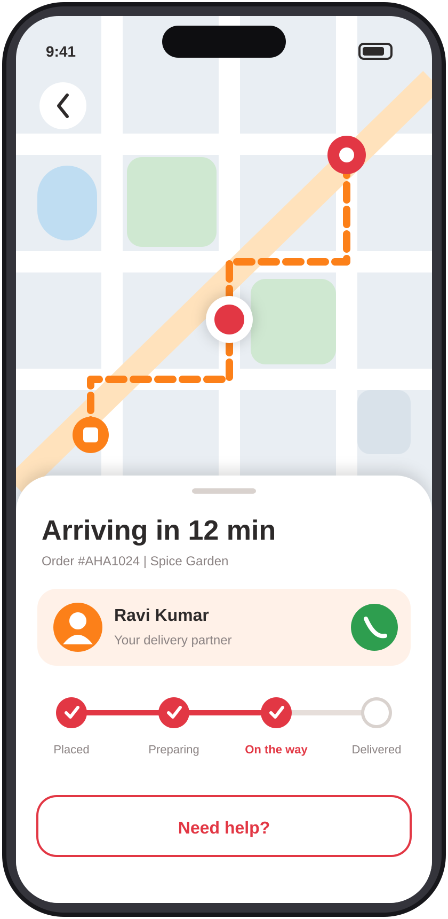


06 | SEE IT IN ACTION
Order Cheyyandi Aaha Anandi
Project Screenshots & Live Demo
LIVE DEMO
Scan to try it live
Home Page
Menu Page
Cart Page
Payment Page
Order Tracking
https://darling-sorbet-31b7fa.netlify.app/
Open Live Demo
User journey
Browse
Add to Cart
Pay Online
Track Live
Delivered
Best on Chrome. Mobile ready.
Online Food Delivery Website
06 / 07
Notes:
Show the five main screens: home, menu, cart, payment and order tracking. Replace the mockups with real screenshots of your project if you have them (Right-click > Change Picture). Replace the QR code and URL with your real demo link, then start the live demo.

Slide 7






07 | WRAP UP
Order Cheyyandi Aaha Anandi
Conclusion & Future Scope
Future Enhancements
Project Summary
Order Cheyandi Aha Anandi brings customers, restaurants and delivery partners together on one responsive website, with easy ordering, secure payment and live order tracking.
AI Recommendations
Voice Ordering
Personalised dishes based on order history
Order hands-free with voice commands
For Customers
For Restaurants
Faster, easier ordering
Live order tracking
Safe digital payments
Wider customer reach
Digital order handling
Feedback through reviews
Real-time GPS Tracking
Mobile App Integration
Live rider location on the map
Android and iOS apps with push alerts
Thank You!
https://darling-sorbet-31b7fa.netlify.app/
Online Food Delivery Website
07 / 07
Notes:
Summarise the project and its benefits for customers and restaurants, then present the future scope: AI recommendations, voice ordering, real-time GPS tracking and mobile app integration. Close with thanks and invite questions.

