Slide 1
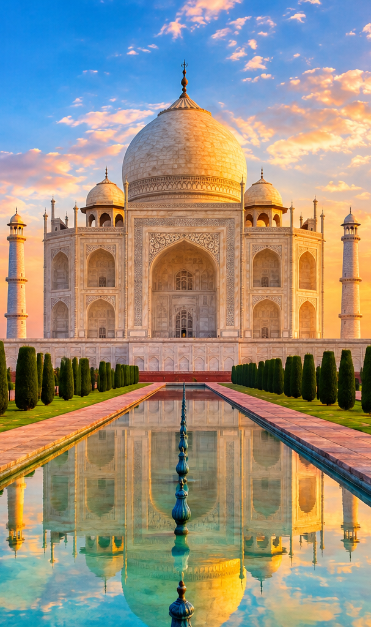
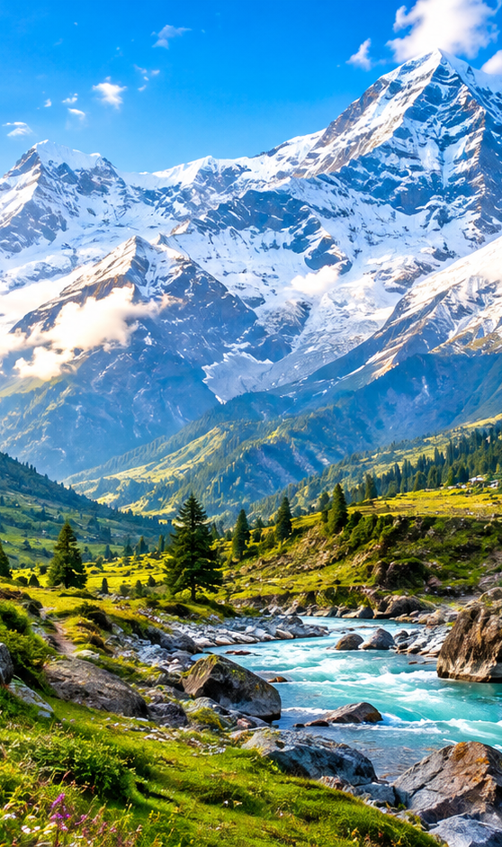
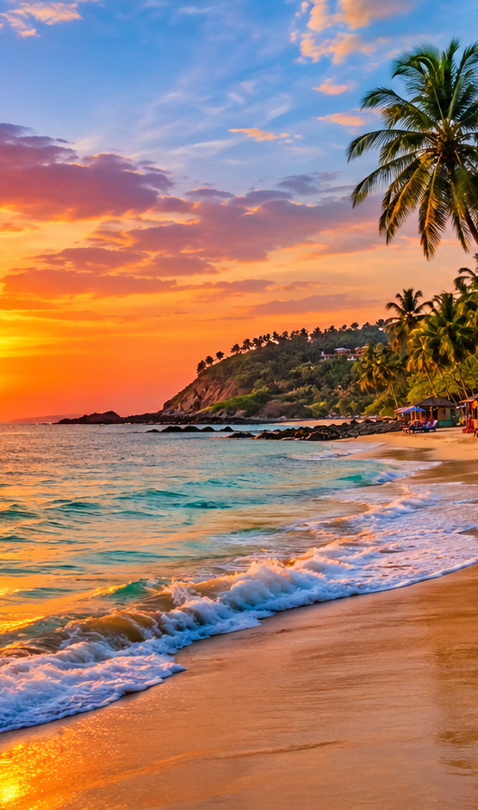
gr
INCREDIBLE INDIA
TOURISM
Explore • Discover • Experience
A Smart Tourism Website with API Integration
PRESENTED BY • MOHAN SAI
Rameshnaidu
Geetha
Deepak
Bunny
Maps • Places • Geocoding • Weather • JSON
🇮🇳

Slide 2
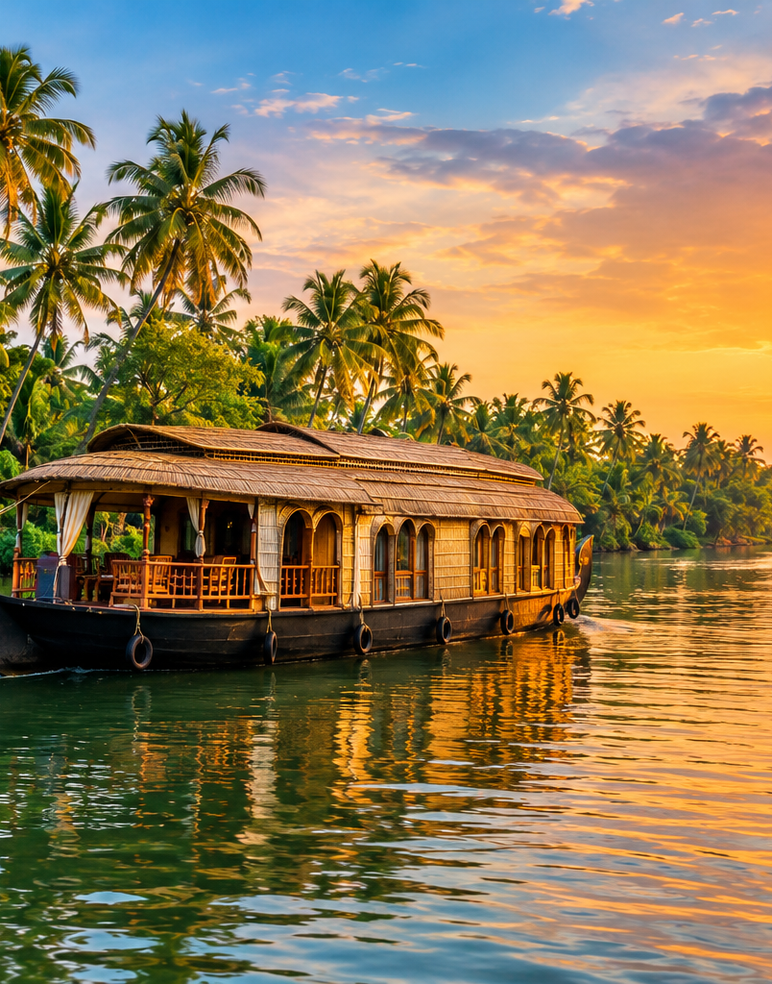
02
Introduction
A digital platform for discovering India's cultural, natural and historical destinations
One website. Many travel experiences.
The project combines an attractive tourism interface with API-powered location services so users can search destinations, view locations and explore nearby places.
⌖
Discover
◉
Locate
Explore tourist destinations and attractions.
Convert place names into coordinates and map locations.
★
Explore Nearby
☁
Stay Informed
Find attractions and useful services around a destination.
Use external APIs for dynamic travel information.
EXPLORE INDIA
Nature • Heritage • Adventure • Culture
INCREDIBLE INDIA TOURISM • API PROJECT 02

Slide 3
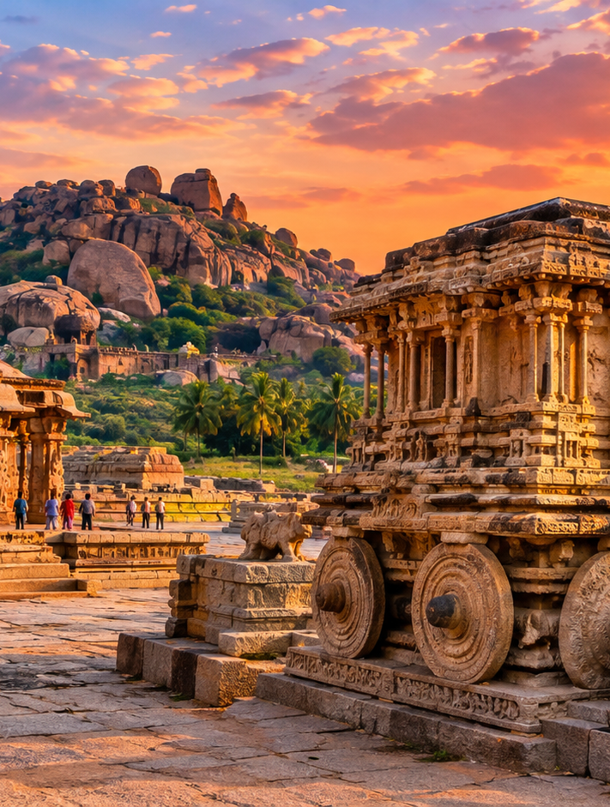
03
Problem Statement
Common challenges when tourism information is spread across multiple services
Information is scattered
Users may need multiple websites and apps to gather travel details.
01
02
Location discovery
Finding nearby attractions, services and exact coordinates can take time.
03
Static content
A static website cannot easily request changing location-based data.
04
Disconnected journey
Search, maps, places and other information are often separate steps.
HERITAGE • HISTORY • CULTURE
INCREDIBLE INDIA TOURISM • API PROJECT 03

Slide 4
04
Proposed System
A unified tourism experience connecting the website UI to external API services
USER
WEBSITE
API LAYER
RESULT
Search destination
HTML • CSS • JS
REST • JSON
Places • Map • Data
Destination Search
Location & Maps
⌕
⌖
Search Indian places quickly.
Display coordinates and locations.
Nearby Places
API Data
★
☁
Discover attractions and services.
Fetch external JSON data.
INCREDIBLE INDIA TOURISM • API PROJECT 04

Slide 5
05
API Integration
APIs connect the tourism website with useful location and travel services
Geocoding
Reverse Geocoding
⌖
↗
Place/address → latitude & longitude
Coordinates → readable address
API
Request → Response
Places API
Weather API
★
☁
Nearby attractions, hotels and services
Current / forecast information
JavaScript → fetch(API_URL) → JSON → Dynamic UI
INCREDIBLE INDIA TOURISM • API PROJECT 05

Slide 6
06
Technology Stack
Each technology has a clear role in building the tourism platform
HTML
CSS
JS
API
MAP
HTML
CSS
JavaScript
REST API
Maps / Location
Structure
Design
Logic
Integration
Experience
Pages • navigation • content
Colors • layout • animation
Events • API calls • dynamic data
External services • JSON
Coordinates • maps • nearby places
INCREDIBLE INDIA TOURISM • API PROJECT 06

Slide 7
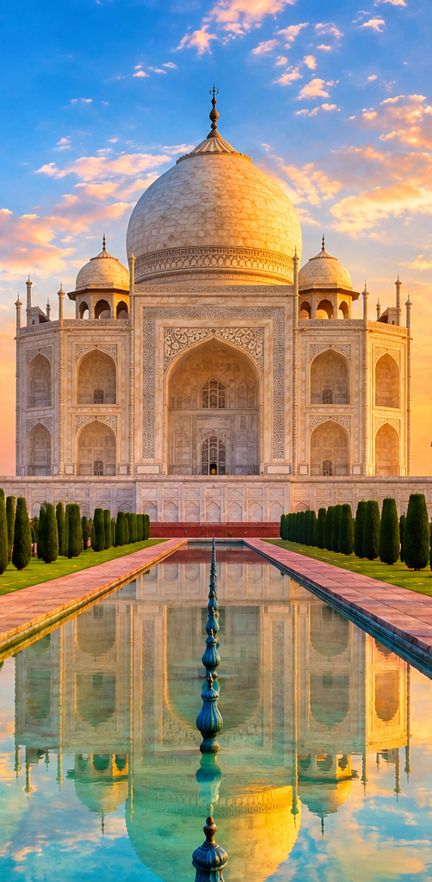
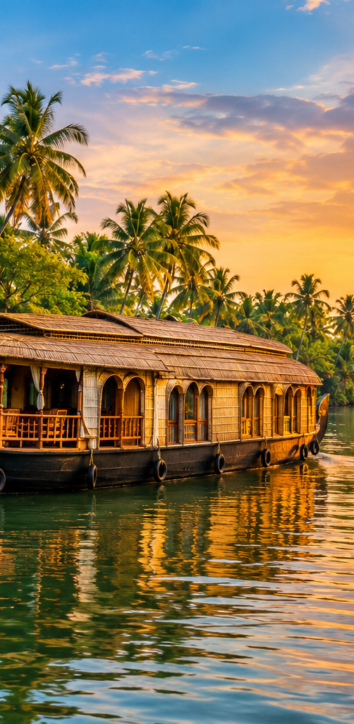
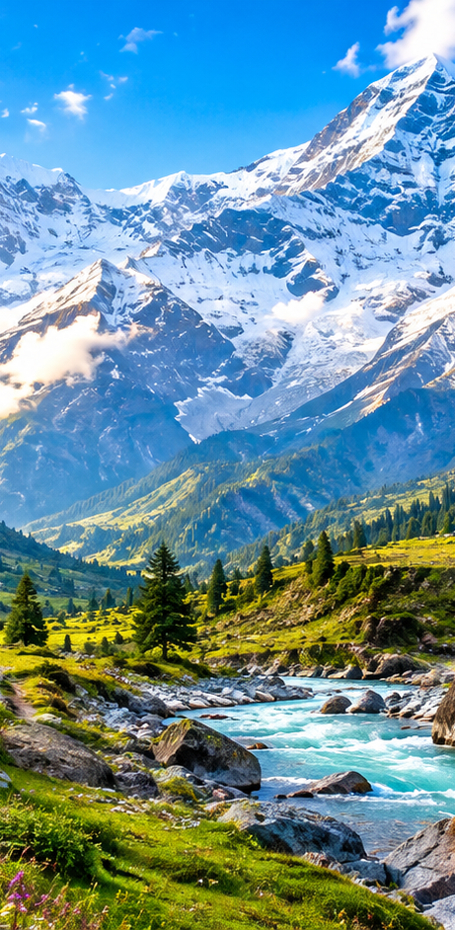
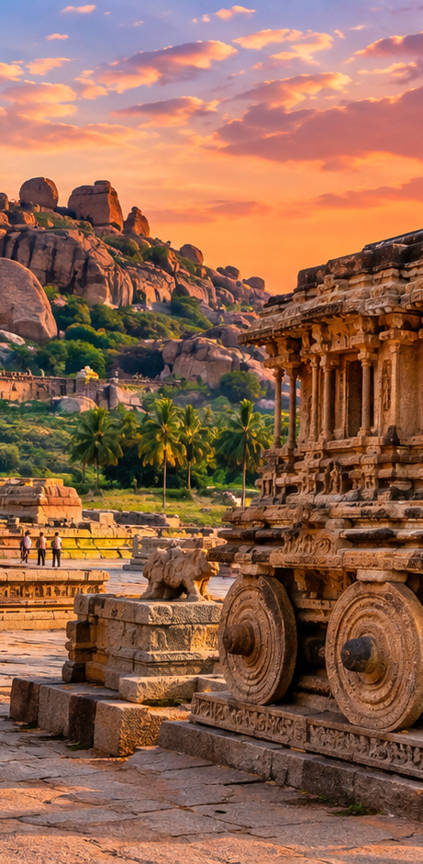

07
Destination Showcase
A visual tourism interface can present very different Indian travel experiences
TAJ MAHAL
KERALA
HIMALAYAS
HAMPI
GOA
Agra • Heritage
Backwaters • Nature
Adventure • Mountains
History • Architecture
Beaches • Leisure
The same API-powered architecture can support many destinations and categories.
INCREDIBLE INDIA TOURISM • API PROJECT 07

Slide 8
08
API Working Flow & Conclusion
From destination search to a dynamic tourism result
1
2
3
4
5
USER
REQUEST
SERVER
JSON
DISPLAY
Select / search destination
JavaScript sends API request
API processes the request
Data returns as JSON
Website shows map / places / cards
PROJECT OUTCOME
A colorful, responsive tourism website that combines destination discovery with API-powered location data.
https://incredindia.netlify.app/
THANK YOU
INCREDIBLE INDIA TOURISM • API PROJECT 08

