Slide 1
TEAM ID : PTID-CDA-NOV-25-893
PROJECT ID : PRSQ-01
NAME : RAMESH KUMAR V
MONIKA RAMESH
MIDUN RAJA SEKAR R M
EMAIL ID : rameshshanmu04@gmail.com monikaramesh846@gmail.com midunrajasekarrm@gmail.com
Medical Data History - SQL

Slide 2
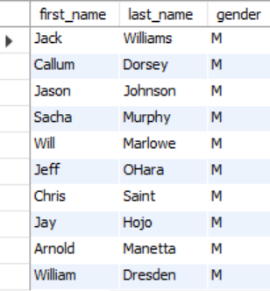
Medical Data History
Show first name, last name, and gender of patients who's gender is 'M'
SELECT first_name, last_name, gender
FROM patients
WHERE gender = 'M';

Slide 3
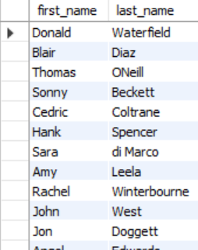
Medical Data History
Show first name and last name of patients who does not have allergies.
SELECT first_name, last_name
FROM patients
WHERE allergies IS NULL;

Slide 4
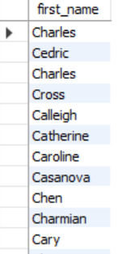
Medical Data History
Show first name of patients that start with the letter ‘C’
SELECT first_name
FROM patients
WHERE first_name LIKE 'C%';

Slide 5
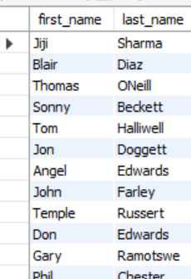
Medical Data History
Show first name and last name of patients that weight within the range of 100 to 120 (inclusive)
SELECT first_name, last_name
FROM patients
WHERE weight BETWEEN 100 AND 120;

Slide 6
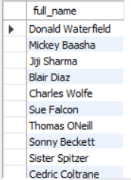
Medical Data History
Show first name and last name concatenated into one column to show their full name.
SELECT CONCAT(first_name, ' ', last_name) AS full_name
FROM patients;

Slide 7
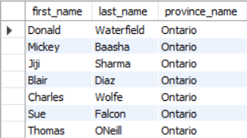
Medical Data History
Show first name, last name, and the full province name of each patient.
SELECT p.first_name , p.last_name , n.province_name
FROM patients AS p LEFT JOIN province_names AS n
ON p.province_id = n.province_id;

Slide 8

Medical Data History
Show how many patients have a birth_date with 2010 as the birth year.
SELECT COUNT(*) AS total_patients
FROM patients
WHERE YEAR(birth_date) = 2010;

Slide 9

Medical Data History
Show the first_name, last_name, and height of the patient with the greatest height.
SELECT first_name, last_name, height
FROM patients ORDER BY height
DESC LIMIT 1;

Slide 10
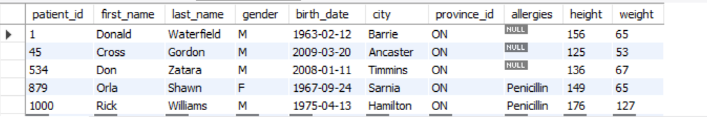
Medical Data History
Show all columns for patients who have one of the following patient_ids: 1,45,534,879,1000
SELECT *
FROM patients
WHERE patient_id IN (1, 45, 534, 879, 1000);

Slide 11

Medical Data History
Show the total number of admissions
SELECT COUNT(*) AS total_admissions
FROM admissions;

Slide 12
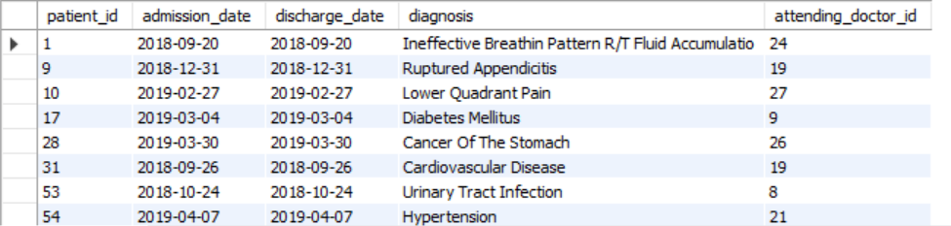
Medical Data History
Show all the columns from admissions where the patient was admitted and discharged on the same day.
SELECT *
FROM admissions
WHERE DATE(admission_date) = DATE(discharge_date);

Slide 13

Medical Data History
Show the total number of admissions for patient_id 579.
SELECT COUNT(*) AS total_admissions
FROM admissions
WHERE patient_id = 579;

Slide 14
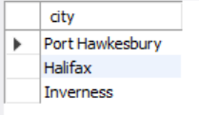
Medical Data History
Based on the cities that our patients live in, show unique cities that are in province_id 'NS’?
SELECT DISTINCT city
FROM patients
WHERE province_id = 'NS';

Slide 15
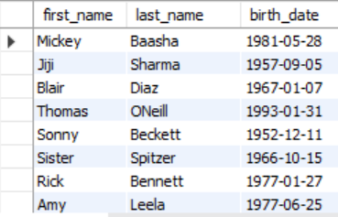
Medical Data History
Write a query to find the first_name, last name and birth date of patients who have height more than 160 and weight more than 70
SELECT first_name, last_name, birth_date
FROM patients
WHERE height > 160 AND weight > 70;

Slide 16
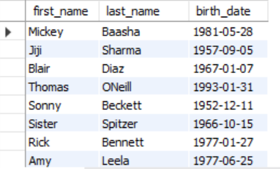
Medical Data History
Show unique birth years from patients and order them by ascending.
SELECT DISTINCT YEAR(birth_date) AS birth_year
FROM patients
ORDER BY birth_year ASC;

Slide 17
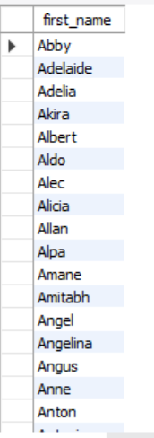
Medical Data History
Show unique first names from the patients table which only occurs once in the list.
SELECT first_name
FROM patients
GROUP BY first_name
HAVING COUNT(*)=1;

Slide 18
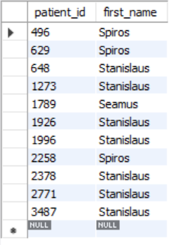
Medical Data History
Show patient_id and first_name from patients where their first_name start and ends with 's' and is at least 6 characters long.
SELECT patient_id, first_name
FROM patients WHERE first_name
LIKE 's%' AND LOWER(first_name) LIKE '%s’
AND CHAR_LENGTH(first_name) >= 6;

Slide 19
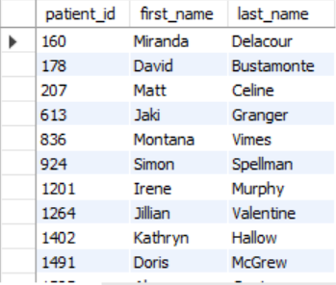
Medical Data History
Show patient_id, first_name, last_name from patients whos diagnosis is 'Dementia'. Primary diagnosis is stored in the admissions table.
SELECT DISTICNT p.patient_id, p.first_name, p.last_name
FROM patients p
JOIN admissions a
ON p.patient_id = a.patient_id
WHERE a.diagnosis = 'Dementia';

Slide 20
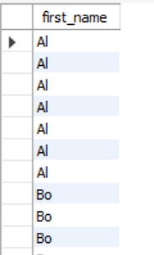
Medical Data History
Display every patient's first_name. Order the list by the length of each name and then by alphbetically.
SELECT first_name
FROM patients
ORDER BY CHAR_LENGTH(first_name),first_name;

Slide 21

Medical Data History
Show the total amount of male patients and the total amount of female patients in the patients table. Display the two results in the same row
SELECT
SUM(CASE WHEN gender = 'M' THEN 1 ELSE 0 END) AS male_count,
SUM(CASE WHEN gender = 'F' THEN 1 ELSE 0 END) AS female_count
FROM patients;

Slide 22
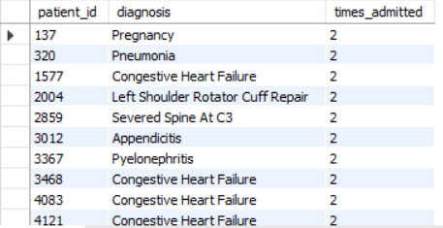
Medical Data History
Show patient_id, diagnosis from admissions. Find patients admitted multiple times for the same diagnosis.
SELECT patient_id, diagnosis,
COUNT(*) AS times_admitted
FROM admissions GROUP BY patient_id, diagnosis
HAVING COUNT(*) > 1;

Slide 23
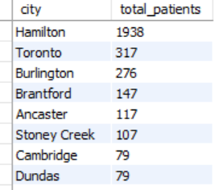
Medical Data History
Show the city and the total number of patients in the city. Order from most to least patients and then by city name ascending.
SELECT city, COUNT(*) AS total_patients
FROM patients
GROUP BY city
ORDER BY total_patients DESC, city ASC;

Slide 24
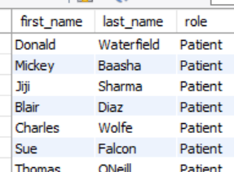
Medical Data History
Show first name, last name and role of every person that is either patient or doctor. The roles are either "Patient" or "Doctor"
SELECT first_name, last_name, 'Patient' AS role
FROM patients
UNION ALL
SELECT first_name, last_name, 'Doctor' AS role
from doctors;

Slide 25
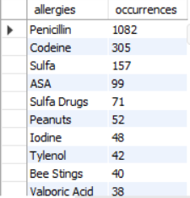
Medical Data History
Show all allergies ordered by popularity. Remove NULL values from query.
SELECT allergies, COUNT(*) AS occurrences
FROM patients WHERE allergies IS NOT NULL AND
TRIM(allergies) <> ‘' GROUP BY allergies
ORDER BY occurrences DESC;

Slide 26
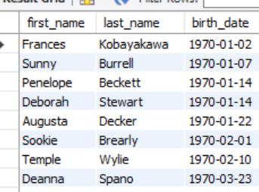
Medical Data History
Show all patient's first_name, last_name, and birth_date who were born in the 1970s decade. Sort the list starting from the earliest birth_date.
SELECT first_name, last_name, birth_date
FROM patients
WHERE birth_date BETWEEN '1970-01-01' AND '1979-12-31’
ORDER BY birth_date ASC;

Slide 27

Medical Data History
We want to display each patient's full name in a single column. Their last_name in all upper letters must appear first, then first_name in all lower case letters. Separate the last_name and first_name with a comma. Order the list by the first_name in decending order EX: SMITH,jane
SELECT
CONCAT(UPPER(last_name), ‘,’ ,
LOWER(first_name)) AS full_name
FROM patients
ORDER BY LOWER(first_name) DESC;

Slide 28
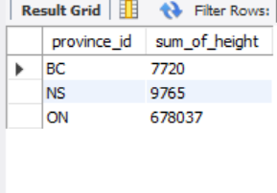
Medical Data History
Show the province_id(s), sum of height; where the total sum of its patient's height is greater than or equal to 7,000.
SELECT province_id,
SUM(height) AS sum_of_height
FROM patients
GROUP BY
province_id
HAVING
SUM(height) >= 7000;

Slide 29
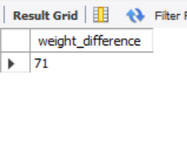
Medical Data History
Show the difference between the largest weight and smallest weight for patients with the last name 'Maroni’
SELECT
MAX(weight) - MIN(weight) AS
weight_difference
FROM patients
WHERE last_name=‘Maroni’ ;

Slide 30
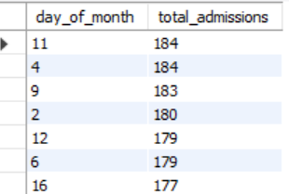
Medical Data History
Show all of the days of the month (1-31) and how many admission_dates occurred on that day. Sort by the day with most admissions to least admissions.
SELECT
DAY(admission_date) AS day_of_month,
COUNT(*) AS total_admissions
FROM admissions
GROUP BY DAY(admission_date)
ORDER BY total_admissions DESC;

Slide 31
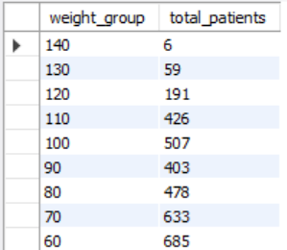
Medical Data History
Show all of the patients grouped into weight groups. Show the total amount of patients in each weight group. Order the list by the weight group decending. e.g. if they weight 100 to 109 they are placed in the 100 weight group, 110-119 = 110 weight group, etc.
SELECT
(FLOOR(weight / 10) * 10) AS
weight_group,
COUNT(*) AS total_patients
FROM patients
GROUP BY weight_group
ORDER BY weight_group DESC;

Slide 32
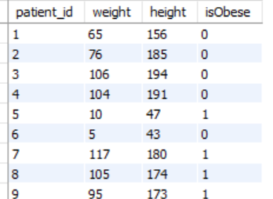
Medical Data History
Show patient_id, weight, height, isObese from the patients table. Display isObese as a boolean 0 or 1. Obese is defined as weight(kg)/(height(m). Weight is in units kg. Height is in units cm.
SELECT patient_id, weight, height,
CASE
WHEN weight / POW(height / 100.0, 2) >= 30
THEN 1
ELSE 0
END AS isObese
FROM patients;

Slide 33
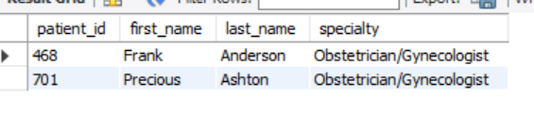
Medical Data History
Show patient_id, first_name, last_name, and attending doctor's specialty. Show only the patients who has a diagnosis as 'Epilepsy' and the doctor's first name is 'Lisa'. Check patients, admissions, and doctors tables for required information.
SELECT p.patient_id, p.first_name,
p.last_name, d.specialty
FROM patients p
JOIN admissions a
ON p.patient_id = a.patient_id
JOIN doctors d
ON a.attending_doctor_id = d.doctor_id
WHERE a.diagnosis = 'Epilepsy'
AND d.first_name = 'Lisa';

Slide 34


