Slide 1






Wayanamac Education Trust ^{(R)}
DON BOSCO INSTITUTE OF TECHNOLOGY
An Autonomous Institute under VTU, Approved by AICTE, New Delhi,
Recognized by Govt. of Karnataka, Accredited by NAAC & NBA
Mysore Road, Kumbalagodu, Bengaluru-560 074.
SPONSORED BY
International Conference on
Cybernetics, Cognition & Machine Learning Applications(IC3MLA-2025)
All India Council for Technical Education (AICTE), New Delhi
28th and 29th November, 2025
Title of the Paper: Smart Agriculture System Using Machine Learning
Authors
1. Sanganabasava (1DB22CI093)
2. Ramesh (1DB22CI088)
3. Prajwal K J (1DB22CI080)
4. Vinay G K (1DB22CI120)

Slide 2
Contents
Introduction
Problem statement
Literature review
Methodology experimental design
Result
Conclusion and future work

Slide 3
INTRODUCTION
Agriculture is crucial for global food production, economic development, and rural livelihoods.
The sector faces increasing challenges such as climate change, erratic rainfall, declining soil fertility, pest outbreaks, and inefficient resource utilization.
Traditional farming methods, often relying on experience, are inadequate for adapting to changing agricultural conditions.
Machine Learning (ML) offers a data-centric approach to modernize farming practices, enabling precise decision-making, real-time insights, and flexible crop management.
The integration of ML in agriculture has emerged as a transformative approach for precision farming, facilitating analysis of complex agricultural datasets and providing predictive insights.
Internet of Things (IoT) devices are key enablers of smart agriculture, collecting real-time data on environmental and soil parameters.
The fusion of machine learning with sensor-based monitoring and cloud computing provides a robust framework for developing intelligent agriculture systems.

Slide 4
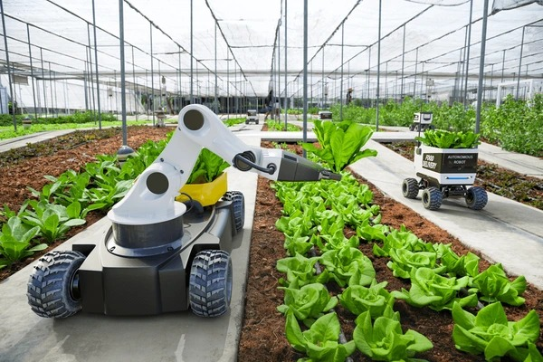
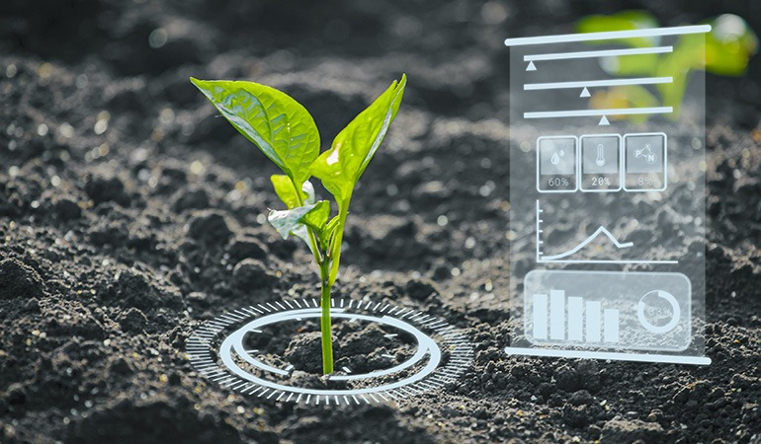
PROBLEM STATEMENT
Inefficient Resource Management: Traditional farming methods lead to excessive use of water, fertilizers, and pesticides due to a lack of real-time monitoring and precision tools.
Low Productivity and Crop Losses: Inadequate forecasting, delayed disease detection, and lack of data-driven decision-making reduce crop yield and increase losses.
Limited Technological Adoption: Most farmers lack access to modern technologies like IoT, machine learning, and automated systems, making agriculture less efficient and sustainable.
Market and Knowledge Gaps: Farmers often face challenges accessing timely information, expert guidance, and fair market prices, leading to poor planning and financial instability.

Slide 5
Literature review
Paper | Feature Title | Algorithms | Methodology | Results | Advantages | Limitation
Preety Chaudhary et al. | A Comparison of ML Technologies for Soil Analysis | XGBoost, SVM, Decision Tree, RF, Naïve Bayes | Compared ML models on soil datasets | XGBoost ~92% | Comprehensive comparison of ML models for soil fertility | Limited to soil data; lacks integration with real-time sensors
T. Sathies Kumar et al. | Crop Selection and Cultivation using ML | Decision Trees, Neural Networks, Ensemble Models | Analyzed soil, weather, and historical crop data | ~90% | Real-time data integration with IoT | Does not address fertilizer or pest recommendations
R.R. Rubia Gandhi et al. | ML Approaches for Smart Agriculture | ANN, AI Decision Systems | Multi-domain data modeling (soil, weed, animal) | Not specified | Full-farm managemen t perspective | Accuracy metrics not quantified; lacks field deployment data
Midhunadharshini G et al. | Smart Agriculture for Crop Productivity | Not explicitly stated | Used past yield, soil & weather trends | Not specified | Market-aware prediction with e- commerce integration | Model details and metrics missing
Atla Devikarani et al. | Towards Smart Agriculture using ML | KNN, SVM, RF, NN | IoT-based data + ML prediction | NN >90% | Strong focus on irrigation and disease diagnosis | IoT security concerns not addressed
Manas Rai et al. | Smart Farming Using ML | RF, SVM, Decision Tree, Logistic Regression | Used field/environmental data for crop selection | RF ~99% | High accuracy in crop recommendation | Focused on North India only; not generalizable
Depavath Harinath et al. | Smart Farming System for Yield Prediction | ML (unspecified) | Used ML for crop monitoring & forecasting | Not specified | Yield optimization using sensor- based prediction | Lack of algorithm specifics and evaluation criteria

Slide 6
METHODOLOGY
Data Collection: The first step involves gathering data from various sources such as sensors (for soil moisture, temperature, humidity), satellite images, drones, and weather APIs. Additionally, historical crop data, market prices, and pest occurrence records are collected. This data is essential for training and validating machine learning models
Data Preprocessing: Once collected, the data is cleaned and preprocessed. This includes handling missing values, noise removal, normalization, and converting categorical data into numerical format. For image data (like diseased leaves or aerial farm views), preprocessing may include resizing, grayscale conversion, or edge detection. This step ensures high quality input for the machine learning models. .
Feature Selection and Extraction: In this stage, important features are selected from the dataset that significantly affect the outcome. For example, soil pH, nitrogen level, and rainfall might be key features for crop recommendation. For image-based tasks, features like texture, shape, and color are extracted. Reducing irrelevant features improves the model's efficiency and accuracy.
Model Selection and Training: Appropriate machine learning models are chosen based on the problem type—classification, regression, or clustering. For example, Random Forests for yield prediction, and Decision Tree, XG Boosting for soil classification. These models are trained using the preprocessed and labeled dataset.

Slide 7
5. Model Evaluation and Optimization: The trained models are tested on unseen data to evaluate their accuracy, precision, recall, or RMSE (for regression tasks). Techniques like cross-validation, hyperparameter tuning, and confusion matrix analysis are used to improve performance. This ensures the models are reliable and generalizable.
6. Deployment and Integration: After evaluation, the best-performing model is deployed into a smart agriculture platform. It can be integrated with IoT systems, mobile apps, or cloud dashboards to provide real-time recommendations to farmers, such as watering alerts, disease warnings, or crop suggestions.
7. Continuous Learning and Updates: The system is regularly updated with new data to retrain models, ensuring adaptability to changing weather, soil, and crop conditions. This continuous learning approach keeps the smart agriculture system relevant and effective over time.

Slide 8
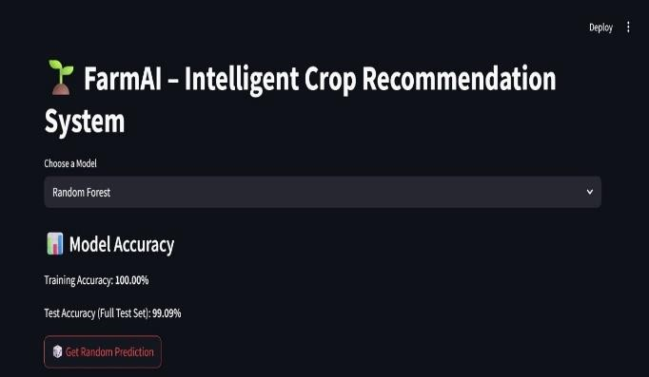
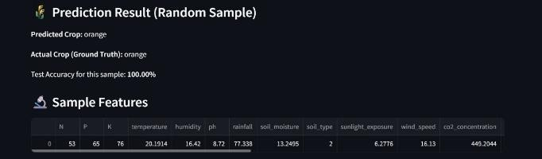
RESULT

Slide 9
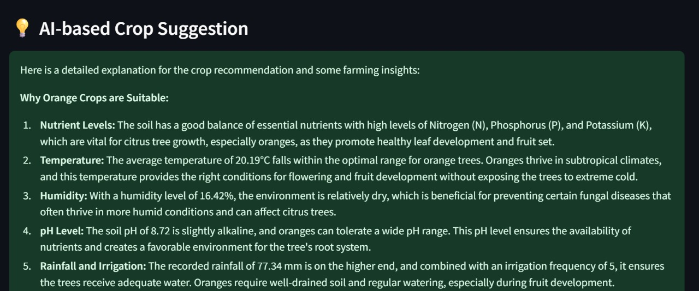
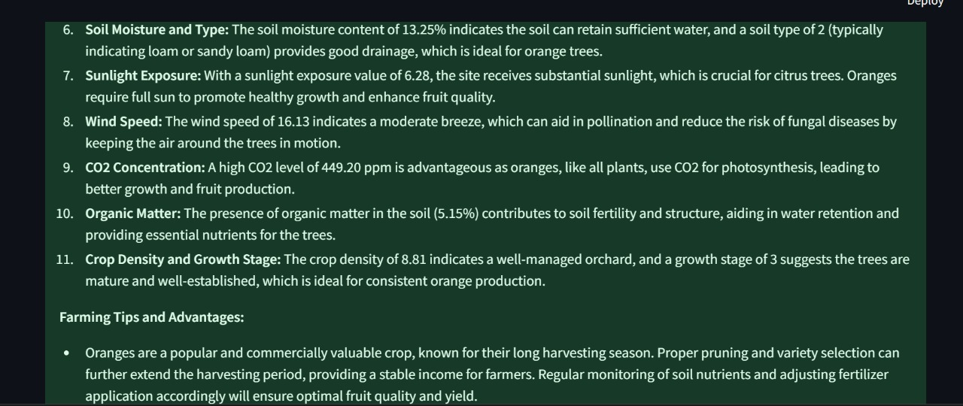

Slide 10
CONCLUSION
The system is expected to enhance overall farm productivity through accurate crop recommendation, predictive yield analysis, automated irrigation planning, and early disease detection.
Implementation of models such as Random Forest for crop selection, CNN for disease identification, and LSTM for time-series forecasting is projected to yield high prediction accuracies, often exceeding 90%.
Farmers will be able to make informed decisions regarding crop choice, irrigation timing, and fertilizer application, ultimately improving yield while reducing input waste.
The system will provide disease alerts and suggest protective actions based on sensor and image inputs, minimizing crop losses due to late diagnosis.
The project promotes sustainable farming by optimizing water usage through smart irrigation and recommending environmentally responsible fertilizer application

Slide 11
FUTURE WORK
The developed FarmAI – Intelligent Crop Recommendation System successfully demonstrates the potential of Machine Learning (ML) in transforming traditional agriculture into a data driven, intelligent, and sustainable practice. Using algorithms such as Random Forest, Decision Tree, and XGBoost, the system effectively predicts suitable crops, identifies disease patterns, and provides actionable recommendations for improved farming outcomes. Among the models implemented, Random Forest achieved the highest performance with 99.09% test accuracy and 100% training accuracy, while XGBoost delivered robust yield and disease prediction capabilities. The inclusion of Generative AI (GenAI) powered by Cohere further enhances the system’s intelligence by generating human-readable suggestions, context-aware insights, and crop-specific recommendations that guide farmers toward efficient decision-making. Overall, the project bridges the gap between machine intelligence and agricultural expertise, empowering farmers to optimize productivity, reduce resource wastage, and achieve higher [4] profitability through predictive analytics and AI driven insights.

Slide 12
THANK YOU!

