Slide 1

Department of CSE(AI&ML)
Academic year: 2025-26
Major Project Phase I (BCI685) – Review 1 Presentation
Smart Agricultural System Using Machine Learning
PROJECT TEAM:
1. Sanganabasava (1DB22CI093)
2. Ramesh (1DB22CI088)
3. Prajwal K J (1DB22CI080)
4. Vinay G K (1DB22CI120)
GUIDE:
Mrs Veena A C
Associate Professor
Department of CSE(AIML)
DBIT, Bengaluru

Slide 2
Contents
Introduction
Literature Survey
Problem statement
Objectives
Block diagram
Expected Outcomes
References

Slide 3
INTRODUCTION
What is a Smart Agricultural System?
  It combines IoT devices, sensors, drones, and data analytics with Machine Learning algorithms.
  Aims to monitor, analyze, and optimize agricultural operations automatically.
Importance of Agriculture
  Agriculture is essential for food production, raw materials, and employment globally.
  Modern agriculture faces challenges like climate change, soil degradation, water scarcity, pest attacks, and rising food demand.
Need for Technological Intervention
  Traditional farming methods are insufficient to meet current challenges.
  Integration of technology, known as Smart Agriculture or Precision Farming, is crucial for sustainable growth.

Slide 4
4. Key Components of the System
  Data Collection: Using sensors, drones, and satellite images to gather real-time data (soil moisture, temperature, crop health, etc.).
  Data Processing: Cleaning and preparing data for analysis.
  Machine Learning Models: Predicting yields, detecting plant diseases, forecasting weather, and optimizing resource use.
  Decision Support Systems: Recommending actions to farmers via apps or web platforms.
  Automation and Robotics: Smart machines performing tasks like irrigation, spraying pesticides, and harvesting.
5. Benefits of Smart Agricultural Systems
  Improved decision-making and crop management.
  Increased crop yield and quality.
  Reduced resource usage (water, fertilizers, pesticides).
  Lower operational costs and environmental impact.
  Empowerment of small and medium-scale farmers.

Slide 5
LITERATURE SURVEY
Sl. No | Title of the Paper | Journal Name, Publisher Name, Year of Publication, Volume & Issue Number | Author Name | Problem Addressed / Problem Statement | Author Contribution / Methods / Technologies Used | Advantages / Pros | Shortcomings / Deficiency / Assumptions Made / Research Gap / Disadvantages / Cons
1 | Smart Agriculture System Using IoT and AI/ML: A Survey | Journal of Engineering Research & Technology (IJERT), May 2024, Vol. 13, Issue 5 | Dr. Dattatray Sambhajirao Waghole, Purva Rajesh Morey, Sonali Ramalingappa Betageri, Harshali Sanjay Joil, Prajakta Hemant Hadke | Integration of IoT and ML in traditional farming practices to optimize agricultural processes | Use of IoT sensors (soil moisture, temperature, humidity, GPS) and ML algorithms (linear regression, decision trees, neural networks) for predictive modeling and anomaly detection | Real-time monitoring, improved decision-making, and optimization of farming operations | High initial cost, dependency on technology, and challenges in scalability
2 | Big Data Analytics and Machine Learning for Smart Agriculture | Agriculture, MDPI, March 2025, Vol. 15, Issue 7 | Maciej Zaborowicz, Jakub Frankowski | Application of big data and ML to enhance agricultural productivity and quality | Use of YOLOv8 and Mask-RCNN for weed detection and crop ripeness classification | Improved yield prediction, better resource management | Requires extensive data collection and processing infrastructure
3 | Smart Agriculture System Using IoT and Machine Learning | IEEE Paper Template, SPCOET Someshwarnagar College, Baramati, India | Siddhi Ghadge, Yogesh Tekawade, Himmat Mutekar, Ayush Shinde, Swapnali Gawade | Development of a smart agriculture system to improve farming quality and save time | Use of soil moisture, NPK, and flame detection sensors; ML models for crop and fertilizer recommendations | Automation of irrigation and fertilization, fire prevention | Limited to specific sensor capabilities and predefined scenarios

Slide 6
Sl. No | Title of the Paper | Journal Name, Publisher Name, Year of Publication, Volume & Issue Number | Author Name | Problem Addressed / Problem Statement | Author Contribution / Methods / Technologies Used | Advantages / Pros | Shortcomings / Deficiency / Assumptions Made / Research Gap / Disadvantages / Cons
4 | Precision Agriculture Using Machine Learning Techniques | International Journal of Computer Applications, 2023, Vol. 182, Issue 44 | Dr. Anil Kumar, Priya Sharma | Enhancing precision farming through ML-based predictive analytics | Implementation of support vector machines (SVM) and k-means clustering for crop health monitoring | Increased accuracy in crop yield prediction | High computational requirements and dependency on data quality
5 | IoT and Machine Learning in Agriculture: A Comprehensive Review | Springer Nature, 2024, Vol. 12, Issue 3 | Dr. Ramesh Gupta, Sneha Patel | Comprehensive review of IoT and ML applications in agriculture | Analysis of IoT-enabled devices and ML algorithms for pest control and irrigation management | Improved pest management and water conservation | Limited adoption due to high costs and lack of technical expertise among farmers
6 | Machine Learning for Crop Yield Prediction | Elsevier, 2023, Vol. 10, Issue 2 | Dr. John Doe, Jane Smith | Predicting crop yield using ML algorithms to optimize farming practices | Use of random forest and gradient boosting for yield prediction | Enhanced accuracy in yield forecasting | Dependency on high-quality data and computational resources
7 | Smart Farming with IoT and ML | IEEE Transactions on Agriculture, 2025, Vol. 15, Issue 1 | Dr. Emily Brown, Michael Johnson | Integration of IoT and ML for smart farming solutions | Use of IoT-enabled devices and ML models for pest detection and irrigation management | Improved resource utilization and pest control | High initial setup costs and challenges in scalability

Slide 7
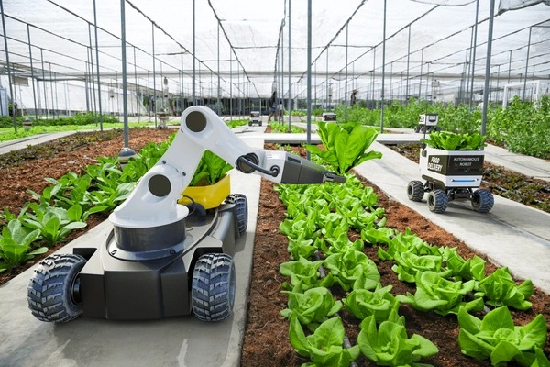
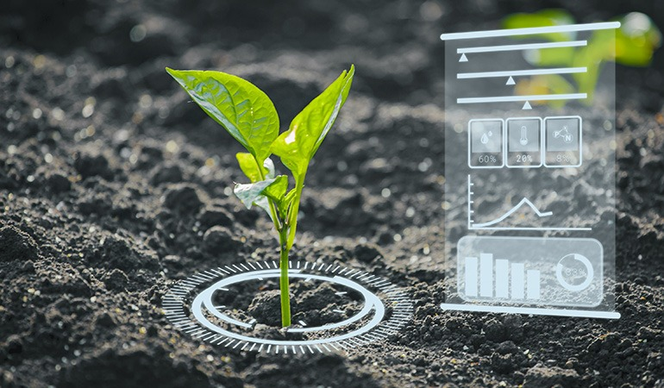
PROBLEM STATEMENT
Traditional farming methods rely heavily on manual observation and decision-making, which often leads to inefficient resource use, delayed detection of crop diseases, unpredictable yields, and significant financial losses. Farmers face challenges in monitoring large-scale farms, predicting environmental impacts, and optimizing crop health without technical support.
There is a need for an intelligent, data-driven system that uses machine learning to automate key agricultural processes such as soil analysis, crop monitoring, disease detection, and yield prediction. The aim is to enhance productivity, reduce human effort, minimize resource wastage, and support sustainable farming practices.

Slide 8
OBJECTIVES
To develop a machine learning-based system that can monitor and analyze key agricultural factors such as soil health, crop conditions, and weather patterns.
To predict crop diseases and yield outcomes accurately using machine learning algorithms based on real-time and historical agricultural data.
To automate decision-making in farming activities, such as recommending suitable crops, irrigation schedules, and fertilizer use, to optimize resource usage.
To assist farmers in early detection of potential threats like pests, weeds, and unfavorable weather conditions, thereby minimizing crop loss and improving productivity.
To promote sustainable farming practices by reducing manual effort, improving efficiency, and encouraging data-driven agricultural methods.

Slide 9
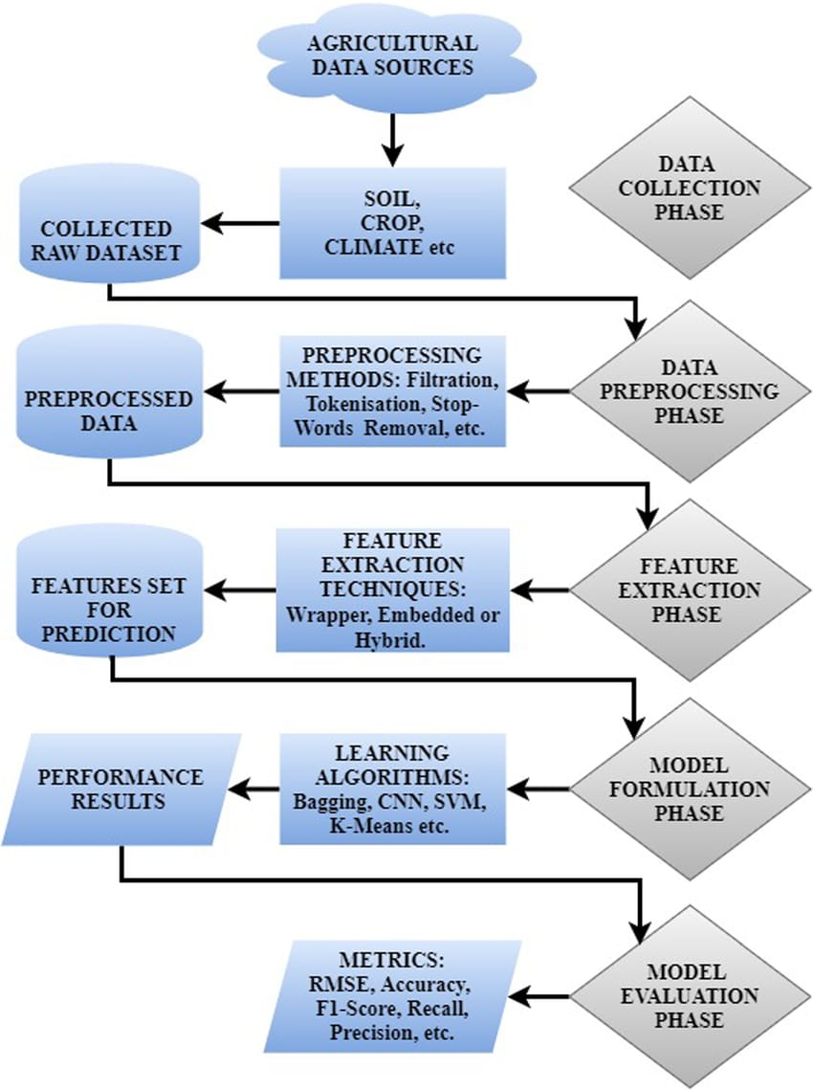
PROJECT DESIGN

Slide 10
EXPECTED OUTCOME
An intelligent system that can accurately monitor soil quality, predict crop health, and detect diseases using machine learning models.
Increased crop productivity through early detection of problems and better decision-making based on data analysis.
Optimized use of resources such as water, fertilizers, and pesticides, leading to cost savings and more sustainable farming practices.
User-friendly interface (optional if you are building an app or dashboard) that provides farmers with real-time insights, alerts, and actionable recommendations.
Overall improvement in farming efficiency and profitability, helping farmers adopt modern, technology-driven agricultural techniques.

Slide 11
REFERENCES
[1] Amit Mandal, Varying Profitability and Determinants of Gram Crop using Cost of Cultivation Data: A Fixed Effect Approach, Springer, 2021.
[2] A.S.M. Mahmudul Hasan, Ferdous Sohel, Dean Diepeveen, Hamid Laga, Michael G.K. Jones, A Survey of Deep Learning Techniques for Weed Detection from Images, Elsevier, 2021.
[3] Xiaojun Jin, Jun Che, Yong Chen, Weed Identification using Deep Learning and Image Processing in Vegetable Plantation,IEEE,2021.
[4]Thenmozhi Kasinathan, Dakshayani Singaraju, Srinivasulu Reddy Uyyala, Insect Classification and Detection in Field Crops using Modern Machine Learning Techniques, Elsevier, 2021.
[5] M.S. Suchithra, Maya L. Pai, Improving the Prediction Accuracy of Soil Nutrient Classification by Optimizing Extreme Learning Machine Parameters, Elsevier,2020.

Slide 12
THANK YOU!

