Slide 1
Livestock Remote Monitoring using Machine Learning Classification Technique
Objective:
To develop an accurate classification model for predicting target behaviours of livestock.

Slide 2
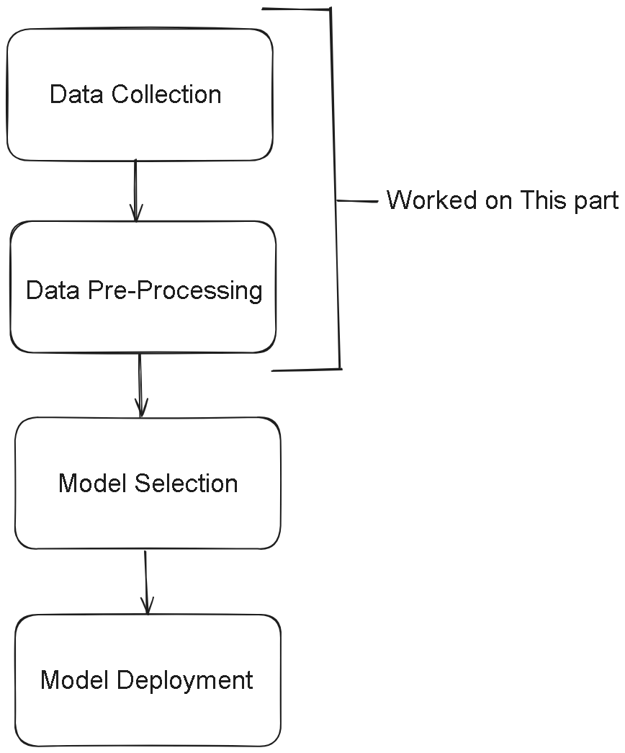
WORK DONE
1)Searched for Online Dataset
2)Data Pre-processing of the Dataset for Model Training.

Slide 3
Data Collection
Sen

