Slide 1
Livestock Remote Monitoring using Machine Learning Classification Technique
Objective:
To develop an accurate classification model for predicting target behaviours of livestock.

Slide 2
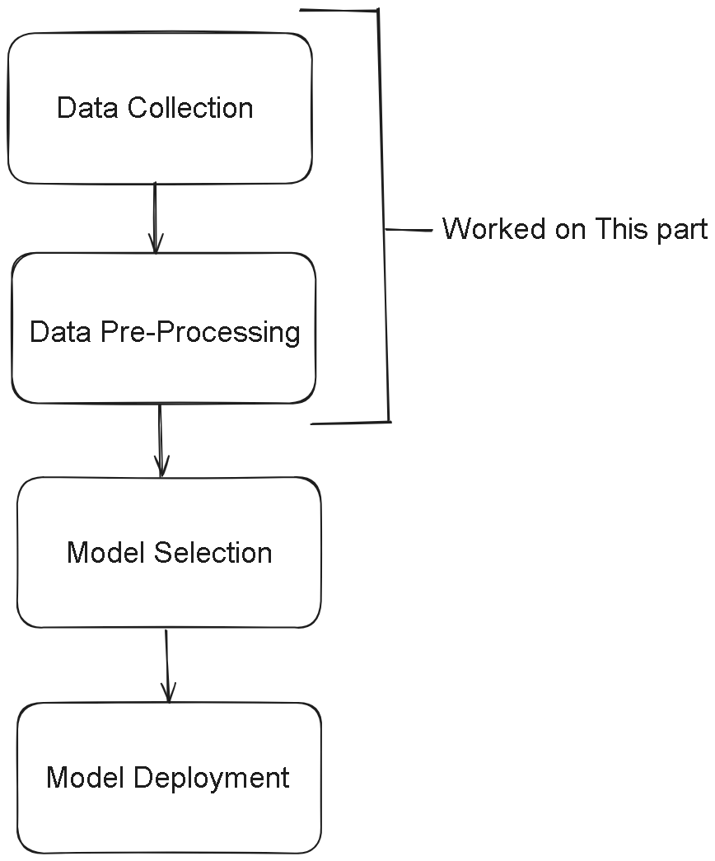
WORK DONE
1)Searched for Online Dataset
2)Data Pre-processing of the Dataset for Model Training.

Slide 3
Data Collection
An online dataset was used for the project. The dataset was collected from an sensor containing accelerometer tied to the jaw of sheep, with sampling rate of 1Hz which was already labelled with behavioural labels (standing, sitting, walking and grazing). Characteristics of the dataset,
Link: https://www.kaggle.com/datasets/ianharris/wa-sheep-behaviour-accelerometer-data
Breed of Sheep: Australian Merinos sheep
Total time duration: 17.37 hours
Number of Columns: 8
Number of features: 3 (x, y, z)
Number of labels: 4
Target behaviour labels: standing, sitting, walking and grazing
Number of rows: 62540
Number of readings for each behaviour:
Sitting: 11810
Standing: 44870
Walking: 18130
Grazing: 25490
Number of readings falling in the intersection of behaviour: 28680

Slide 4
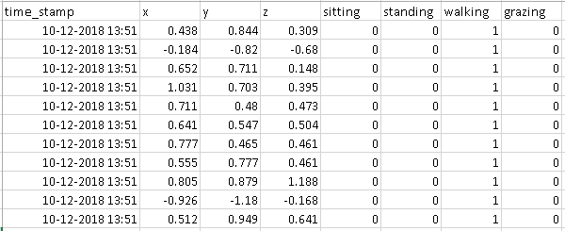
Dataset Format:
…

Slide 5
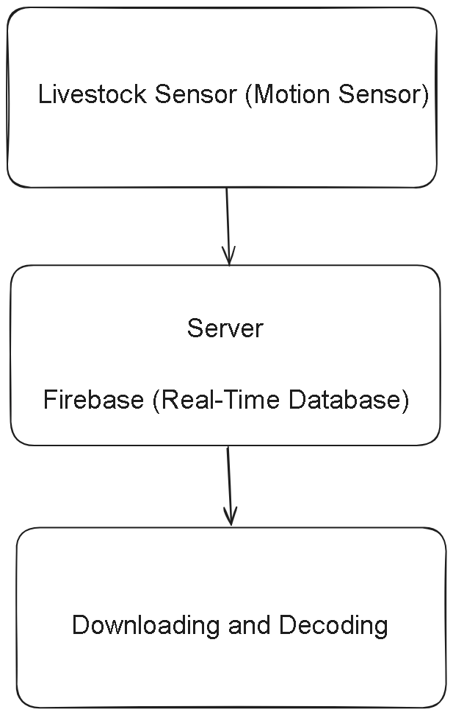
Decoding Sensor Data:
The livestock sensor data is stored real time in fire base database and downloaded as a CSV file. The data that is received is in a nested dictionary format, similar to JSON. Each timestamp is a key, and its value is another dictionary with attributes like 'driverId', 'lat', 'lng', 'timestamp', 'x', 'y', and 'z'.

Slide 6
