Slide 1
Layout Management

Slide 2
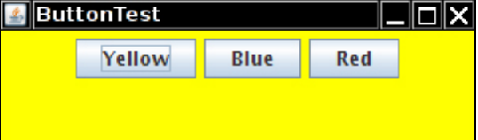
Introduction to Layout Management
Unlike Visual Basic, the JDK has no form designer. You need to write code to position (lay out) the user interface components where you want them to be
Of course, if you have a Java-enabled development environment, it will probably have a layout tool that automates some or all of these tasks.
Nevertheless, it is important to know exactly what goes on “under the hood” because even the best of these tools will usually require hand-tweaking
Let’s start by reviewing the program from unit 1.7 that used buttons to change the background color of a frame

Slide 3
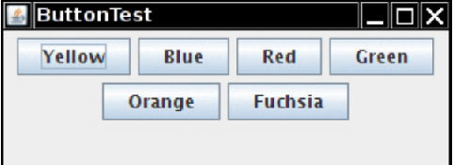
Introduction to Layout Management
The buttons are contained in a JPanel object and are managed by the flow layout manager, the default layout manager for a panel.
Figure below shows what happens when you add more buttons to the panel. As you can see, a new row is started when there is no more room.
A panel with six buttons managed by a flow layout

Slide 4
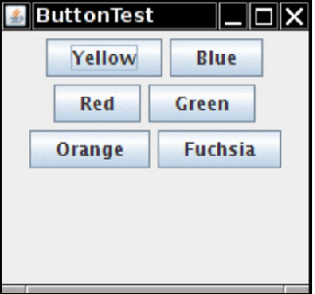
Introduction to Layout Management
Moreover, the buttons stay centered in the panel, even when the user resizes the frame
Changing the panel size rearranges the buttons automatically

Slide 5
Introduction to Layout Management
In general, components are placed inside containers, and a layout manager determines the positions and sizes of components in a container.
Buttons, text fields, and other user interface elements extend the class Component.
Components can be placed inside containers, such as panels.
Containers can themselves be put inside other containers, so the class Container extends Component.

Slide 6
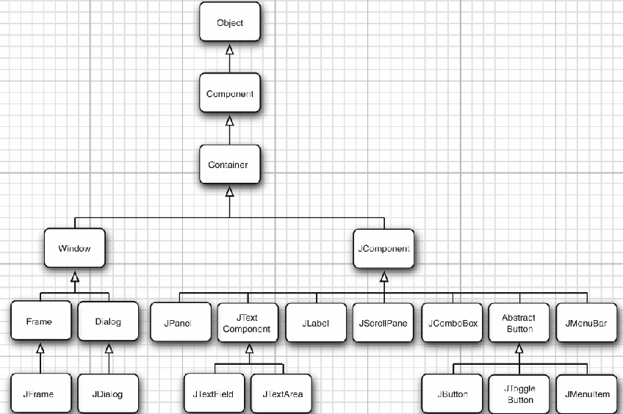
Inheritance hierarchy for the Component class

Slide 7
Introduction to Layout Management
Each container has a default layout manager, but you can always set your own.
For example, the statement panel.setLayout(new GridLayout(4, 4));
uses the GridLayout class to lay out the components in four rows and four columns.
When you add components to the container, the add method of the container passes the component and any placement directions to the layout manager.

Slide 8
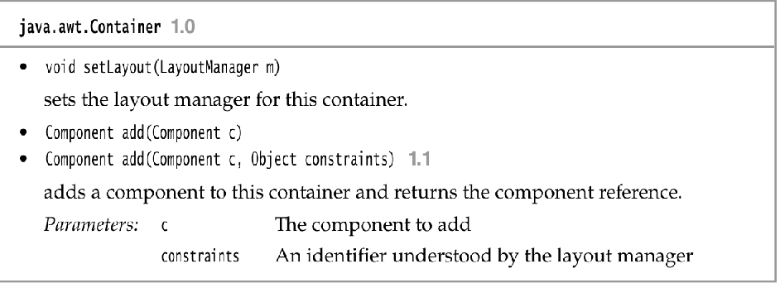
Introduction to Layout Management

Slide 9
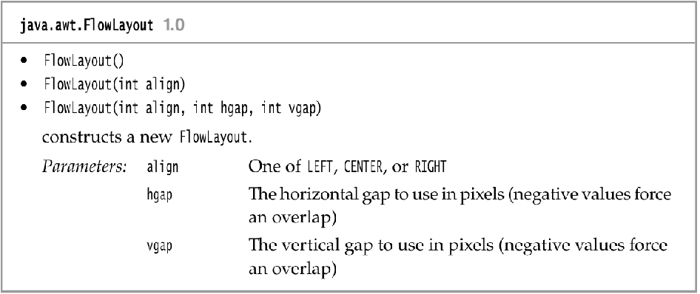
Introduction to Layout Management

Slide 10
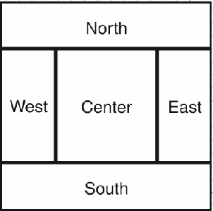
Border Layout
The border layout manager is the default layout manager of the content pane of every JFrame.
Unlike the flow layout manager, which completely controls the position of each component, the border layout manager lets you choose where you want to place each component.
You can choose to place the component in the center, north, south, east, or west of the content pane

Slide 11
Border Layout
The border layout manager is the default layout manager of the content pane of every JFrame.
Unlike the flow layout manager, which completely controls the position of each component, the border layout manager lets you choose where you want to place each component.
You can choose to place the component in the center, north, south, east, or west of the content pane
For example: frame.add(component, BorderLayout.SOUTH);

Slide 12
Border Layout
The edge components are laid out first, and the remaining available space is occupied by the center.
When the container is resized, the dimensions of the edge components are unchanged, but the center component changes its size.
Add components by specifying a constant CENTER , NORTH, SOUTH , EAST , or WEST of the BorderLayout class.
Not all of the positions need to be occupied. If you don’t supply any value, CENTER is assumed.
NOTE: The BorderLayout constants are defined as strings. For example,BorderLayout.SOUTH is defined as the string "South" . This is safer than using strings.If you accidentally misspell a string, for example, frame.add(component, "south"), the compiler won’t catch that error.
Unlike the flow layout, the border layout grows all components to fill the available space. (The flow layout leaves each component at its preferred size.)
This is a problem when you add a button: frame.add(yellowButton, BorderLayout.SOUTH); // don't

Slide 13
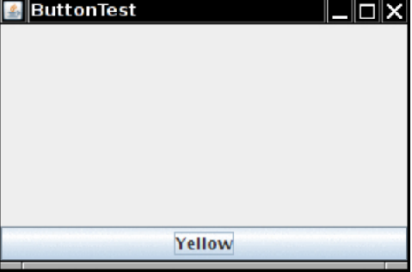
Single Button managed by a Border Layout
Figure shows what happens when you use the preceding code fragment.
The button has grown to fill the entire southern region of the frame.
And, if you were to add another button to the southern region, it would just displace the first button.

Slide 14
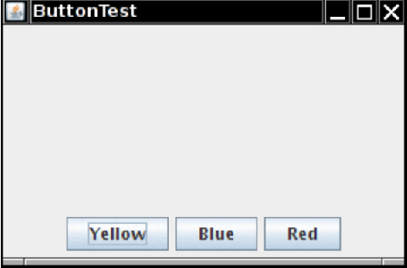
Panel placed in southern region of frame
To solve this problem, use additional panels.
For example, look at Figure
The three buttons at the bottom of the screen are all contained in a panel.
The panel is put into the southern region of the content pane.

Slide 15
Panel placed in southern region of frame
To achieve this configuration, first create a new JPanel object, then add the individual buttons to the panel.
The default layout manager for a panel is a FlowLayout, which is a good choice for this situation.
Add the individual buttons to the panel, using the add method you have seen before.
The position and size of the buttons is under the control of the FlowLayout manager.
This means the buttons stay centered within the panel and do not expand to fill the entire panel area.
Finally, add the panel to the content pane of the frame.
JPanel panel = new Jpanel(); panel.add(yellowButton); panel.add(blueButton); panel.add(redButton); frame.add(panel, BorderLayout.SOUTH);
The border layout expands the size of the panel to fill the entire southern region.

Slide 16
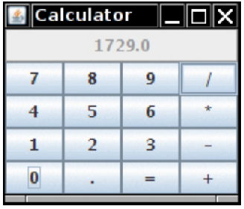
The Grid Layout
The grid layout arranges all components in rows and columns like a spreadsheet.
All components are given the same size.
The calculator program in Figure 12.12 uses a grid layout to arrange the calculator buttons.
When you resize the window, the buttons grow and shrink, but all buttons have identical sizes.

Slide 17
The Grid Layout
In the constructor of the grid layout object, you specify how many rows and columns you need. panel.setLayout(new GridLayout(4, 4));
Add the components, starting with the first entry in the first row, then the second entry in the first row, and so on. panel.add(new Jbutton("1")); panel.add(new Jbutton("2"));
Listing 12.1 shows the panel class of the calculator program.
This is a regular calculator, not the “reverse Polish” variety that is so oddly popular in Java tutorials.
In this program, we call the pack method after adding the component to the frame.
This method uses the preferred sizes of all components to compute the width and height of the frame.

Slide 18
The Grid Layout
Of course, few applications have as rigid a layout as the face of a calculator.
In practice, small grids (usually with just one row or one column) can be useful to organize partial areas of a window.
For example, if you want to have a row of buttons of identical sizes, you can put the buttons inside a panel that is governed by a grid layout with a single row.

Slide 19
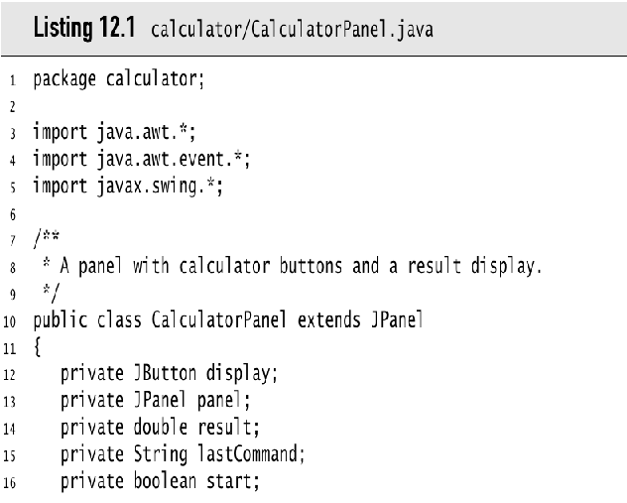
Listing 12.1

Slide 20
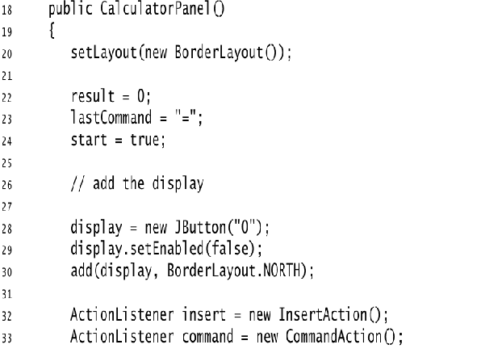

Slide 21
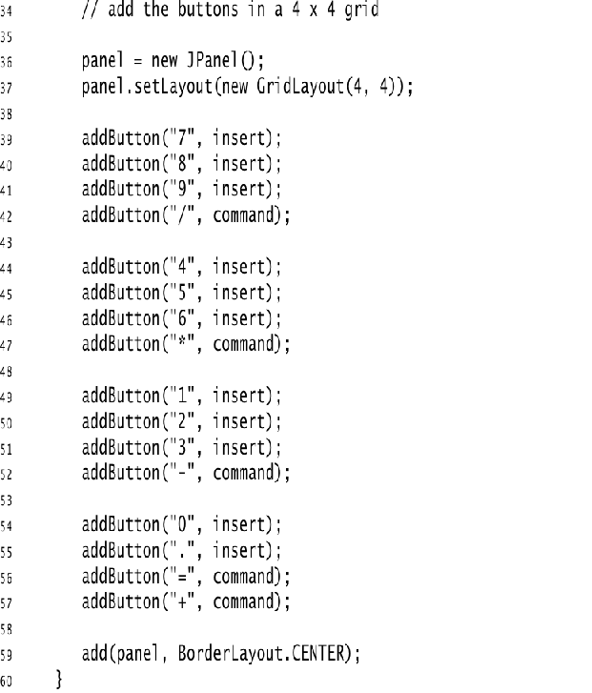
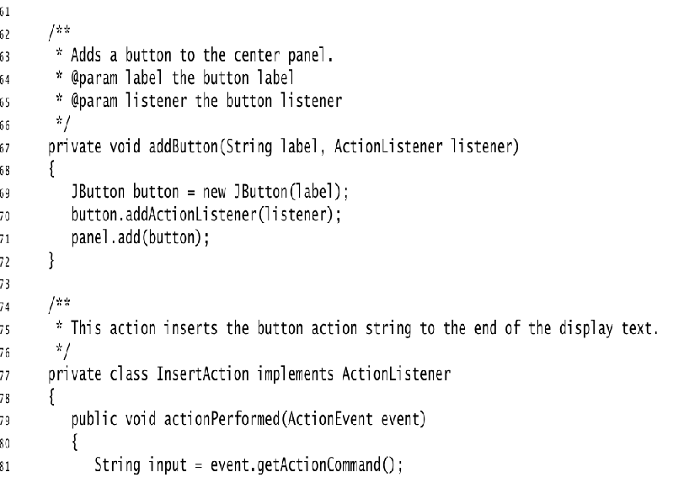

Slide 22
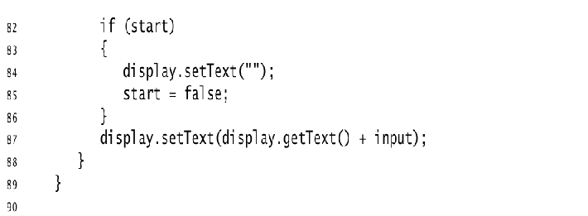
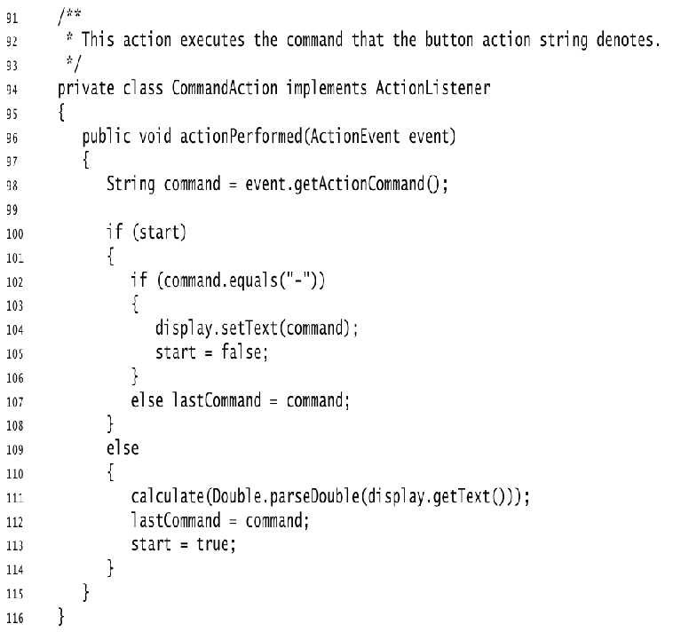

Slide 23
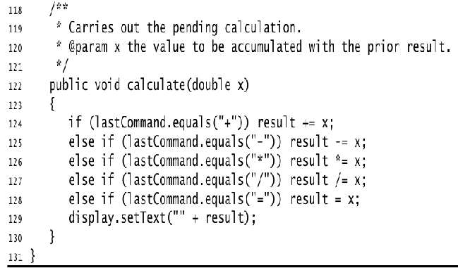

Slide 24
