Slide 1
Basic Swing Components

Slide 2
Text Inputs
We are finally ready to start introducing the Swing user interface components.
We begin with the components that let a user input and edit text.
You can use the JTextField and JTextArea components for text input.
A text field can accept only one line of text; a text area can accept multiple lines of text.
A JPasswordField accepts one line of text without showing the contents.
All three of these classes inherit from a class called JTextComponent .
You will not be able to construct a JTextComponent yourself because it is an abstract class.
On the other hand, as is so often the case in Java, when you go searching through the API documentation, you may find that the methods you are looking for are actually in the parent class JTextComponent rather than the derived class.
For example, the methods that get or set the text in a text field or text area are actually in JTextComponent

Slide 3
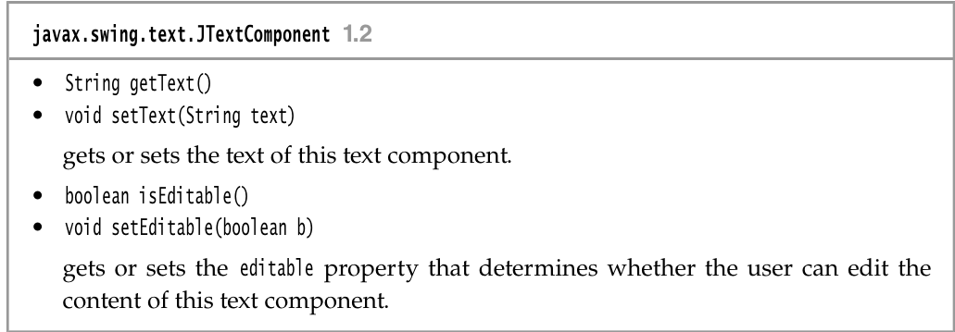
Text Inputs

Slide 4
Text Fields
The usual way to add a text field to a window is to add it to a panel or other container—just as you would add a button: JPanel panel = new Jpanel(); JTextField textField = new JTextField("Default input", 20); panel.add(textField);
This code adds a text field and initializes it by placing the string "Default input" inside it.
The second parameter of this constructor sets the width. In this case, the width is 20 “columns.” Unfortunately, a column is a rather imprecise measurement.
One column is the expected width of one character in the font you are using for the text.
The idea is that if you expect the inputs to be n characters or less, you are supposed to specify n as the column width.
In practice, this measurement doesn’t work out too well, and you should add 1 or 2 to the maximum input length to be on the safe side.
Also, keep in mind that the number of columns is only a hint to the AWT that gives the preferred size. If the layout manager needs to grow or shrink the text field, it can adjust its size

Slide 5
Text Fields
The column width that you set in the JTextField constructor is not an upper limit on the number of characters the user can enter.
The user can still type in longer strings, but the input scrolls when the text exceeds the length of the field.
Users tend to find scrolling text fields irritating, so you should size the fields generously.
If you need to reset the number of columns at runtime, you can do that with the setColumns method.
In general, users add text (or edit an existing text) in a text field.
Quite often these text fields start out blank. To make a blank text field, just leave out the string as a parameter for the JTextField constructor: JTextField textField = new JTextField(20);
You can change the content of the text field at any time by using the setText method from the JTextComponent parent class mentioned in the previous section. For example: textField.setText("Hello!");

Slide 6
Text Fields
And, as was mentioned in the previous section, you can find out what the user typed by calling the getText method.
This method returns the exact text that the user has typed.
To trim any extraneous leading and trailing spaces from the data in a text field, apply the trim method to the return value of getText: String text = textField.getText().trim();
To change the font in which the user text appears, use the setFont method.

Slide 7
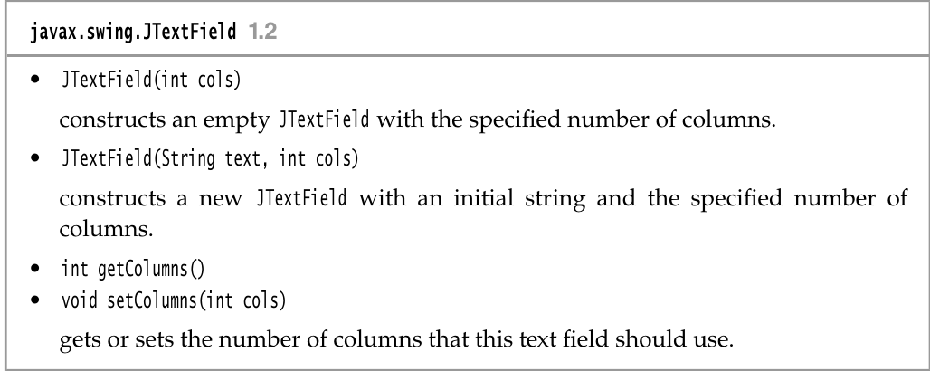
Text Fields

Slide 8
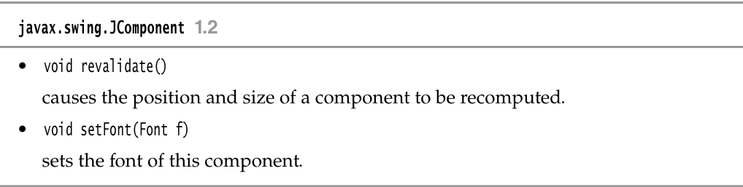
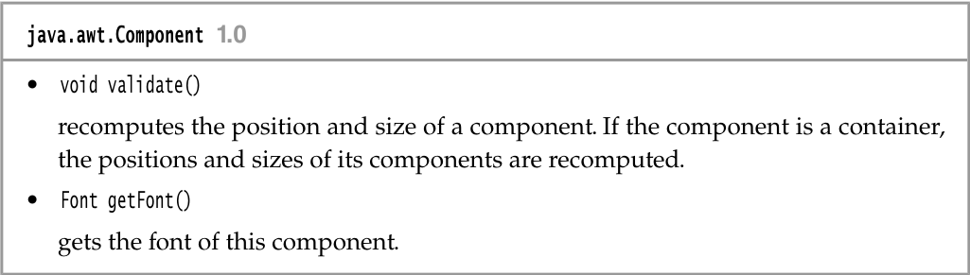
Text Fields

Slide 9
Labels and Labeling Components
Labels are components that hold text.
They have no decorations (for example, no boundaries).
They also do not react to user input. You can use a label to identify components.
For example, unlike buttons, text fields have no label to identify them.
To label a component that does not itself come with an identifier:
1. Construct a JLabel component with the correct text.
2.Place it close enough to the component you want to identify so that the user can see that the label identifies the correct component.
The constructor for a JLabel lets you specify the initial text or icon and, optionally, the alignment of the content.
You use constants from the SwingConstants interface to specify alignment.
That interface defines a number of useful constants such as LEFT , RIGHT , CENTER , NORTH , EAST , and so on.

Slide 10
Labels and Labeling Components
The JLabel class is one of several Swing classes that implement this interface.
Therefore, you can specify a right-aligned label either as JLabel label = new JLabel("User name: ", SwingConstants.RIGHT);
Or JLabel label = new JLabel("User name: ", Jlabel.RIGHT);
The setText and setIcon methods let you set the text and icon of the label at runtime.
TIP: You can use both plain and HTML text in buttons, labels, and menu items.
We don’t recommend HTML in buttons—it interferes with the look-and-feel.
But HTML in labels can be very effective. Simply surround the label string with <html>. . .</html>, like this: label = new JLabel("<html><b>Required</b> entry:</html>");
Labels can be positioned inside a container like any other component.
This means you can use the techniques you have seen before to place your labels where you need them.

Slide 11
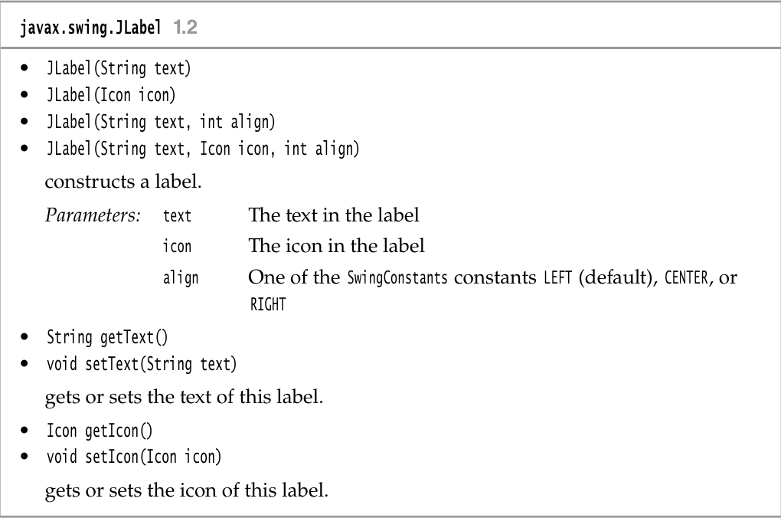
javax.swing.Label

Slide 12
Password Fields
Password fields are a special kind of text field.
To prevent nosy bystanders from seeing your password, the characters that the user enters are not actually displayed.
Instead, each typed character is represented by an echo character, typically an asterisk (* ).
Swing supplies a JPasswordField class that implements such a text field.
The password field is another example of the power of the model-view-controller architecture pattern.
The password field uses the same model to store the data as a regular text field, but its view has been changed to display all characters as echo characters.

Slide 13
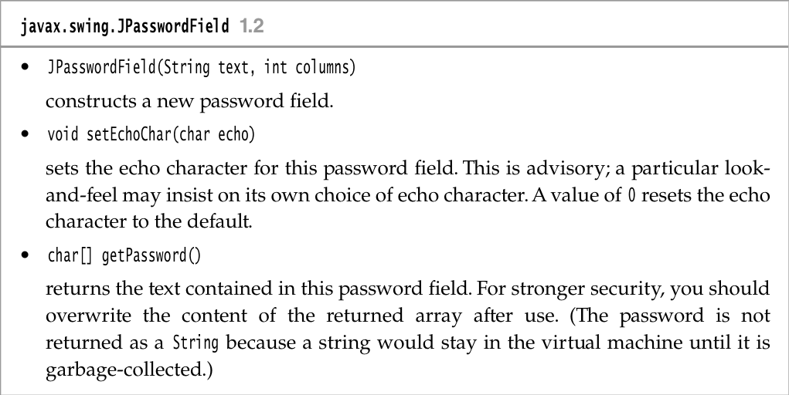
javax.swing.JPasswordField

Slide 14
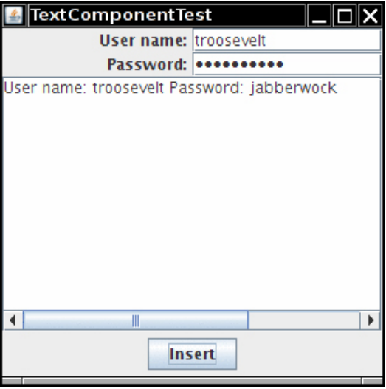
Text Areas
Sometimes, you need to collect user input that is more than one line long.
As mentioned earlier, you can use the JTextArea component for this.
When you place a text area component in your program, a user can enter any number of lines of text, using the Enter key to separate them.
Each line ends with a '\n'. Figure \|/ shows a text area at work.

Slide 15
Text Areas
In the constructor for the JTextArea component, specify the number of rows and columns for the text area.
For example, textArea = new JTextArea(8, 40); // 8 lines of 40 columns each
where the columns parameter works as before—and you still need to add a few more columns for safety’s sake.
Also, as before, the user is not restricted to the number of rows and columns; the text simply scrolls when the user inputs too much.
You can also use the setColumns method to change the number of columns and the setRows method to change the number of rows.
These numbers only indicate the preferred size—the layout manager can still grow or shrink the text area.
If there is more text than the text area can display, the remaining text is simply clipped. You can avoid clipping long lines by turning on line wrapping: textArea.setLineWrap(true); // long lines are wrapped
This wrapping is a visual effect only; the text in the document is not changed—no automatic '\n' characters are inserted into the text.

Slide 16
Scroll Panes
In Swing, a text area does not have scrollbars. If you want scrollbars, you have to place the text area inside a scroll pane. textArea = new JTextArea(8, 40); JScrollPane scrollPane = new JScrollPane(textArea);
The scroll pane now manages the view of the text area.
Scrollbars automatically appear if there is more text than the text area can display, and they vanish again if text is deleted and the remaining text fits inside the area.
The scrolling is handled internally by the scroll pane—your program does not need to process scroll events.
This is a general mechanism that works for any component, not just text areas.
To add scrollbars to a component, put them inside a scroll pane.
Listing 12.2 demonstrates the various text components.
This program shows a text field, a password field, and a text area with scrollbars.
The text field and password field are labeled. Click on “Insert” to insert the field contents into the text area.

Slide 17
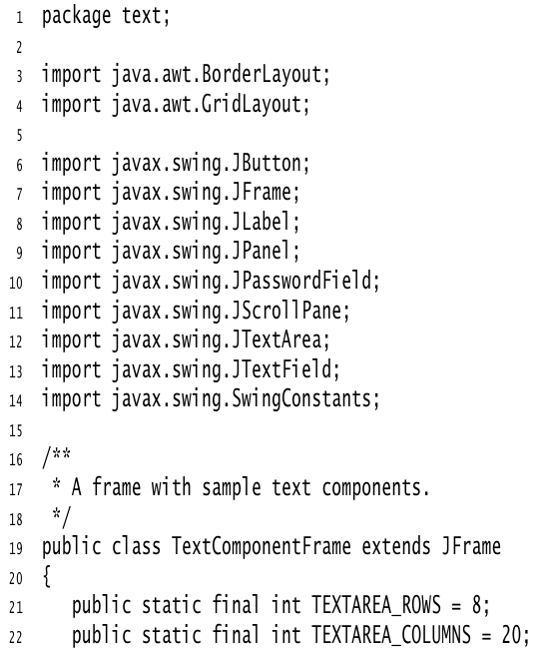
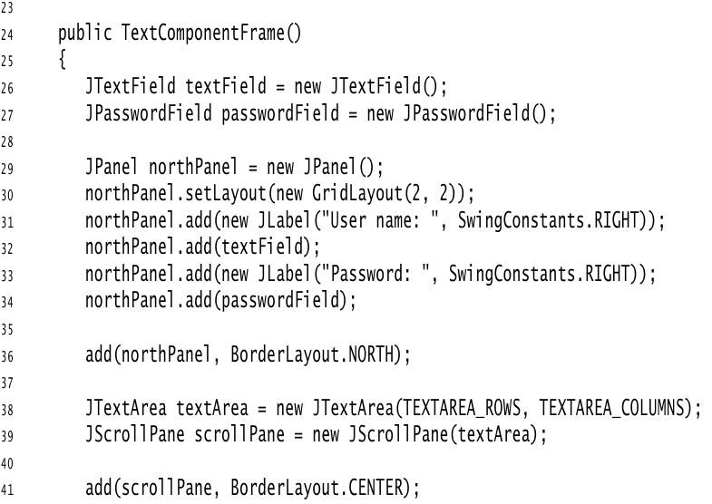
Listing 12.2 text/TextComponentFrame.java

Slide 18
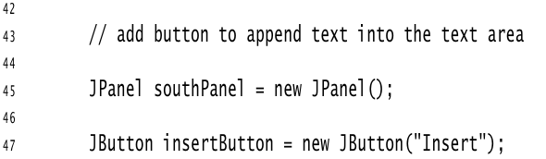
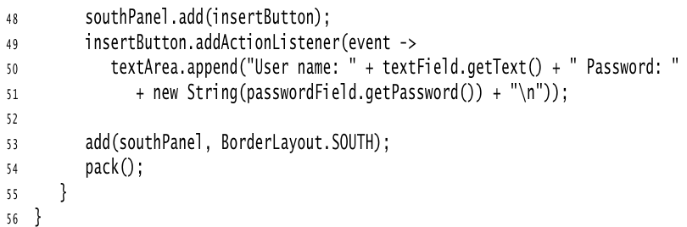
Listing 12.2 text/TextComponentFrame.java

Slide 19
Choice Components (CheckBoxes)
You now know how to collect text input from users, but there are many occasions where you would rather give users a finite set of choices than have them enter the data in a text component.
Using a set of buttons or a list of items tells your users what choices they have. (It also saves you the trouble of error checking.)
If you want to collect just a “yes” or “no” input, use a checkbox component.
Checkboxes automatically come with labels that identify them.
The user can check the box by clicking inside it and turn off the checkmark by clicking inside the box again.
Pressing the space bar when the focus is in the checkbox also toggles the checkmark
Figure 12.14 shows a simple program with two checkboxes, one for turning the italic attribute of a font on or off, and the other for boldface.
Note that the second checkbox has focus, as indicated by the rectangle around the label.
Each time the user clicks one of the checkboxes, the screen is refreshed, using the new font attributes.

Slide 20
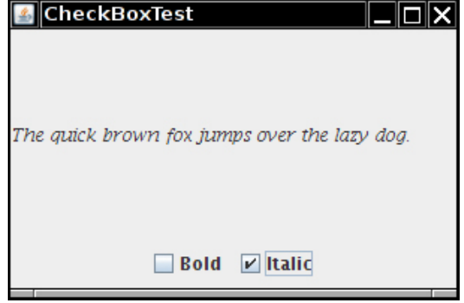
Figure 12.4 Checkboxes

Slide 21
CheckBoxes
Checkboxes need a label next to them to identify their purpose.
Give the label text in the constructor: bold = new JCheckBox("Bold");
Use the setSelected method to turn a checkbox on or off. For example: bold.setSelected(true);
The isSelected method then retrieves the current state of each checkbox. It is false if unchecked, true if checked.
When the user clicks on a checkbox, this triggers an action event.
As always, you attach an action listener to the checkbox. In our program, the two checkboxes share the same action listener.
ActionListener listener = . . . bold.addActionListener(listener); italic.addActionListener(listener);

Slide 22
CheckBoxes
The listener queries the state of the bold and italic checkboxes and sets the font of the panel to plain, bold, italic, or both bold and italic.
ActionListener listener = event -> { int mode = 0; if (bold.isSelected()) mode += Font.BOLD; if (italic.isSelected()) mode += Font.ITALIC; label.setFont(new Font(Font.SERIF, mode, FONTSIZE)); };
Listing 12.3 is the program listing for the checkbox example.

Slide 23
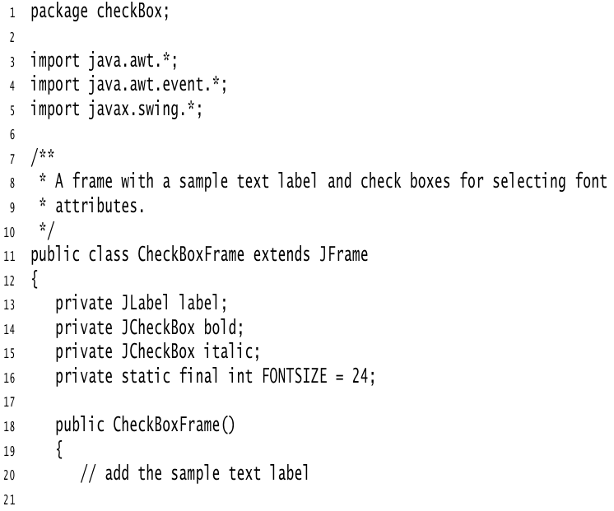
Listing 12.3 checkBox/CheckBoxFrame.java

Slide 24
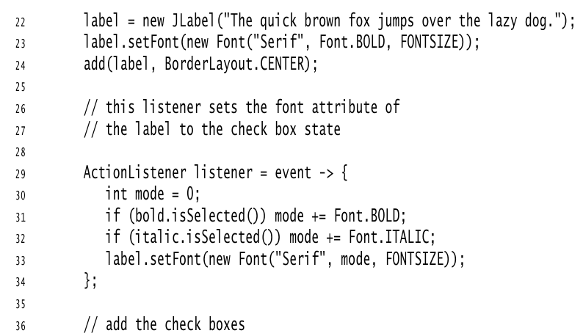
Listing 12.3 checkBox/CheckBoxFrame.java

Slide 25
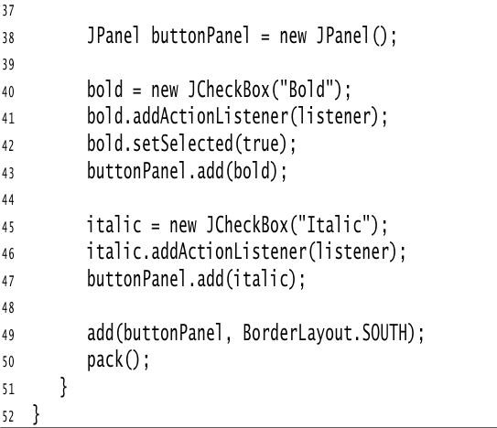
Listing 12.3 checkBox/CheckBoxFrame.java

Slide 26
Radio Buttons
In the previous example, the user could check either, both, or neither of the two checkboxes.
In many cases, we want the user to check only one of several boxes.
When another box is checked, the previous box is automatically unchecked.
Such a group of boxes is often called a radio button group because the buttons work like the station selector buttons on a radio.
When you push in one button, the previously depressed button pops out.
Figure 12.15 shows a typical example.
We allow the user to select a font size from among the choices—Small, Medium, Large, or Extra large—but, of course, we will allow selecting only one size at a time.

Slide 27
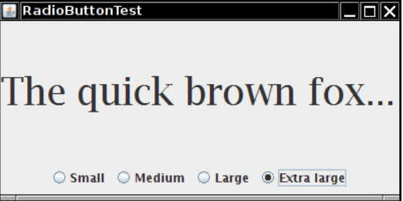
Figure 12.5 A radio button group

Slide 28
Radio Buttons
Implementing radio button groups is easy in Swing.
You construct one object of type ButtonGroup for every group of buttons.
Then, you add objects of type JradioButton to the button group.
The button group object is responsible for turning off the previously set button when a new button is clicked. ButtonGroup group = new ButtonGroup(); JRadioButton smallButton = new JRadioButton("Small", false); group.add(smallButton); JRadioButton mediumButton = new JRadioButton("Medium", true); group.add(mediumButton); . . .
The second argument of the constructor is true for the button that should be checked initially and false for all others.
Note that the button group controls only the behavior of the buttons; if you want to group the buttons for layout purposes, you also need to add them to a container such as a JPanel .

Slide 29
Radio Buttons
If you look again at Figures 12.14 and 12.15, you will note that the appearance of the radio buttons is different from that of checkboxes. Checkboxes are square and contain a checkmark when selected.
Radio buttons are round and contain a dot when selected.
The event notification mechanism for radio buttons is the same as for any other buttons.
When the user checks a radio button, the button generates an action event.
In our example program, we define an action listener that sets the font size to a particular value: ActionListener listener = event -> label.setFont(new Font("Serif", Font.PLAIN, size));
Compare this listener setup to that of the checkbox example.
Each radio button gets a different listener object.
Each listener object knows exactly what it needs to do—set the font size to a particular value.
With checkboxes, we used a different approach: Both checkboxes have the same action listener that calls a method looking at the current state of both checkboxes.

Slide 30
Radio Buttons
Could we follow the same approach here? We could have a single listener that computes the size as follows: if (smallButton.isSelected()) size = 8; else if (mediumButton.isSelected()) size = 12; . . .
However, we prefer to use separate action listener objects because they tie the size values more closely to the buttons.
Listing 12.4 is the complete program for font size selection that puts a set of radio buttons to work.

Slide 31
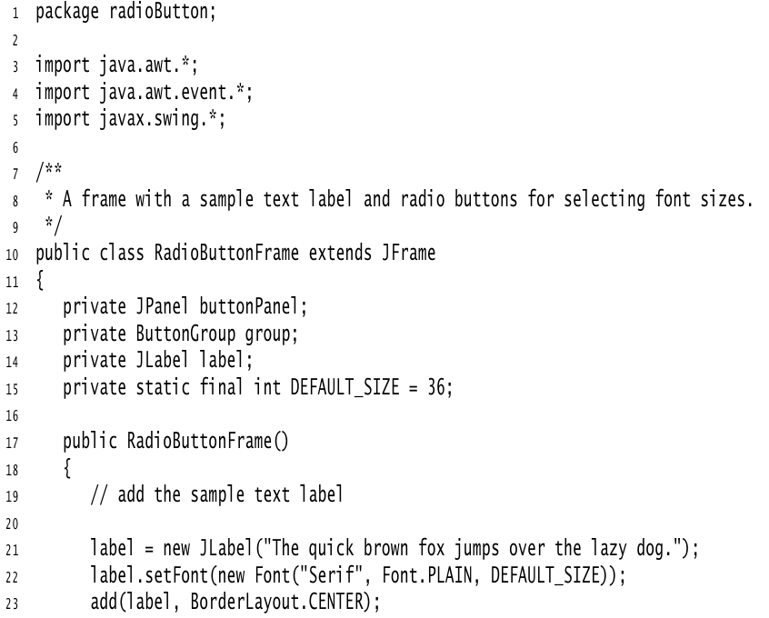
Listing 12.4 radioButton/RadioButtonFrame.java

Slide 32
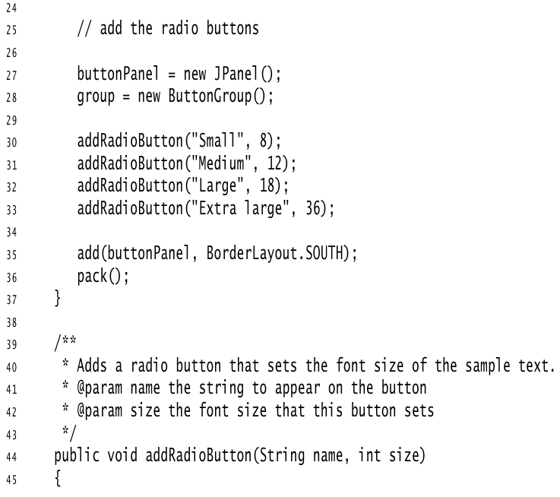

Slide 33
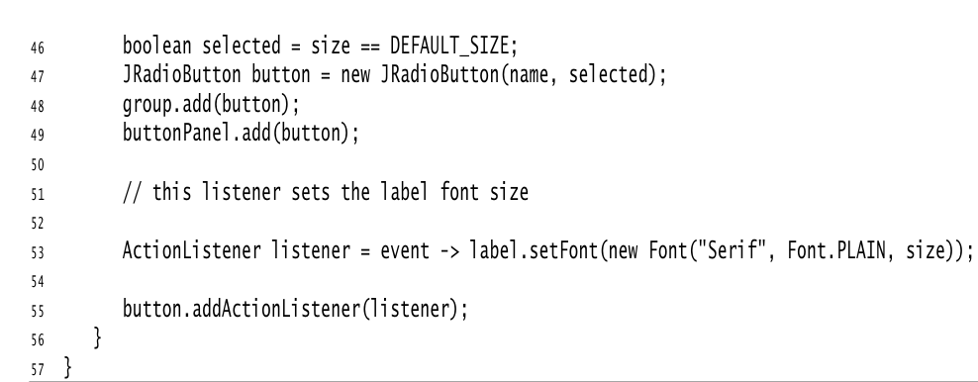

Slide 34
Borders
If you have multiple groups of radio buttons in a window, you will want to visually indicate which buttons are grouped.
Swing provides a set of useful borders for this purpose.
You can apply a border to any component that extends Jcomponent.
The most common usage is to place a border around a panel and fill that panel with other user interface elements, such as radio buttons.
You can choose from quite a few borders, but you need to follow the same steps for all of them.

Slide 35
Borders
Call a static method of the BorderFactory to create a border. You can chooseamong the following styles (see Figure 12.16)
Lowered bevel
Raised bevel
Etched
Line
Matte
Empty (just to create some blank space around the component)

Slide 36
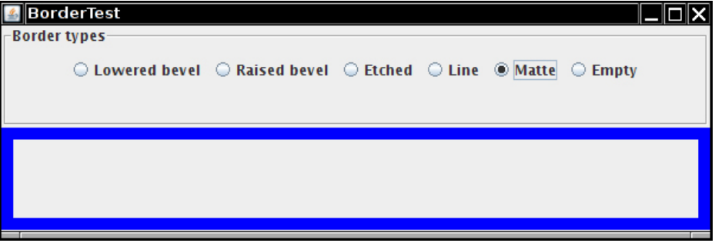
Borders

Slide 37
Borders
If you like, add a title to your border by passing your border to BorderFactory.createTitledBorder.
If you really want to go all out, combine several borders with a call to BorderFactory.createCompoundBorder.
Add the resulting border to your component by calling the setBorder method of the JComponent class.
For example, here is how you add an etched border with a title to a panel: Border etched = BorderFactory.createEtchedBorder(); Border titled = BorderFactory.createTitledBorder(etched, "A Title"); panel.setBorder(titled);
Run the program in Listing 12.5 to get an idea what the various borders look like.

Slide 38
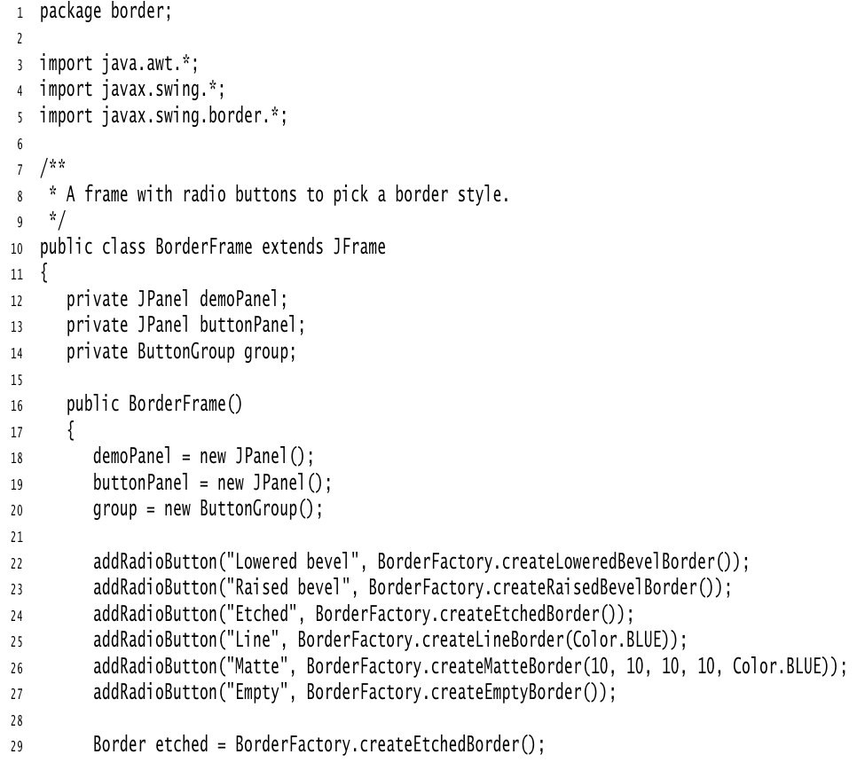
Listing 12.5 border/BorderFrame.java

Slide 39
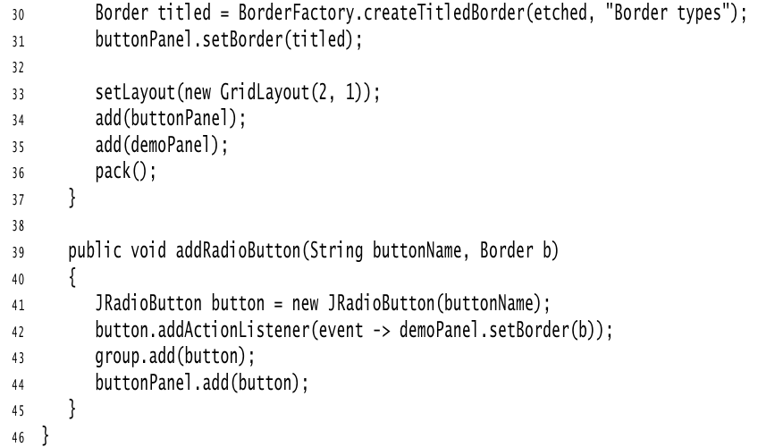
Listing 12.5 border/BorderFrame.java

Slide 40
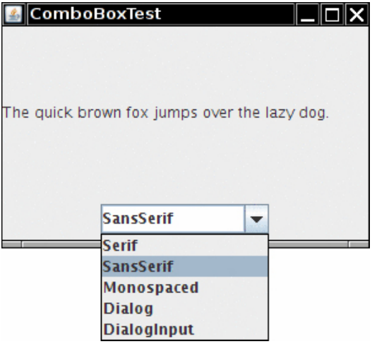
Combo Boxes
If you have more than a handful of alternatives, radio buttons are not a good choice because they take up too much screen space.
Instead, you can use a combo box.
When the user clicks on this component, a list of choices drops down, and the user can then select one of them (see Figure ).

Slide 41
Combo Boxes
If the drop-down list box is set to be editable, you can edit the current selection as if it were a text field.
For that reason, this component is called a combo box—it combines the flexibility of a text field with a set of predefined choices.
The JcomboBox class provides a combo box component.
As of Java SE 7, the JComboBox class is a generic class.
For example, a JcomboBox<String> holds objects of type String, and a JComboBox<Integer> holds integers.
Call the setEditable method to make the combo box editable. Note that editing affects only the selected item. It does not change the list of choices in any way.
You can obtain the current selection, which may have been edited if the combo box is editable, by calling the getSelectedItem method.
However, for an editable combo box, that item may have any type, depending on the editor that takes the user edits and turns the result into an object.
If your combo box isn’t editable, you are better off calling combo.getItemAt(combo.getSelectedIndex()) which gives you the selected item with the correct type.

Slide 42
Combo Boxes
In the example program, the user can choose a font style from a list of styles (Serif, SansSerif, Monospaced, etc.).
The user can also type in another font. Add the choice items with the addItem method. In our program, addItem is called only in the constructor, but you can call it any time. JComboBox<String> faceCombo = new JcomboBox<>(); faceCombo.addItem("Serif"); faceCombo.addItem("SansSerif"); . . .
This method adds the string to the end of the list. You can add new items anywhere in the list with the insertItemAt method: faceCombo.insertItemAt("Monospaced", 0); // add at the beginning
You can add items of any type—the combo box invokes each item’s toString method to display it.
If you need to remove items at runtime, use the removeItem or removeItemAt method, depending on whether you supply the item to be removed or its position. faceCombo.removeItem("Monospaced"); faceCombo.removeItemAt(0); // remove first item
The removeAllItems method removes all items at once.

Slide 43
Combo Boxes
When the user selects an item from a combo box, the combo box generates an action event.
To find out which item was selected, call getSource on the event parameter to get a reference to the combo box that sent the event.
Then call the getSelectedItem method to retrieve the currently selected item.
You will need to cast the returned value to the appropriate type, usually String. ActionListener listener = event -> label.setFont(new Font( faceCombo.getItemAt(faceCombo.setSelectedIndex()), Font.PLAIN, DEFAULT_SIZE));
Listing 12.6 shows the complete program.

Slide 44
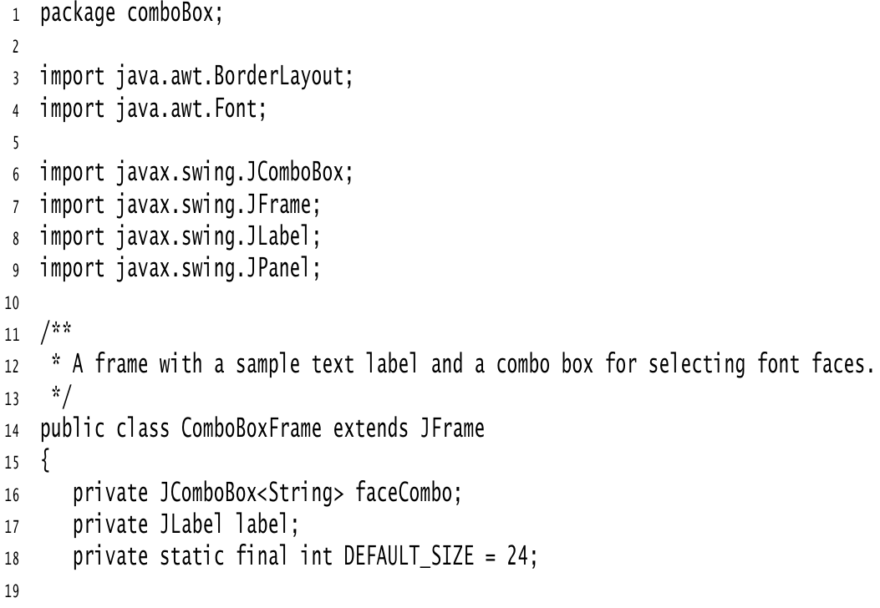
Listing 12.6 comboBox/ComboBoxFrame.java

Slide 45
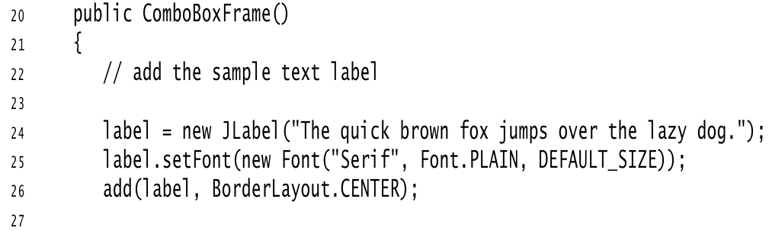
Listing 12.6 comboBox/ComboBoxFrame.java

Slide 46
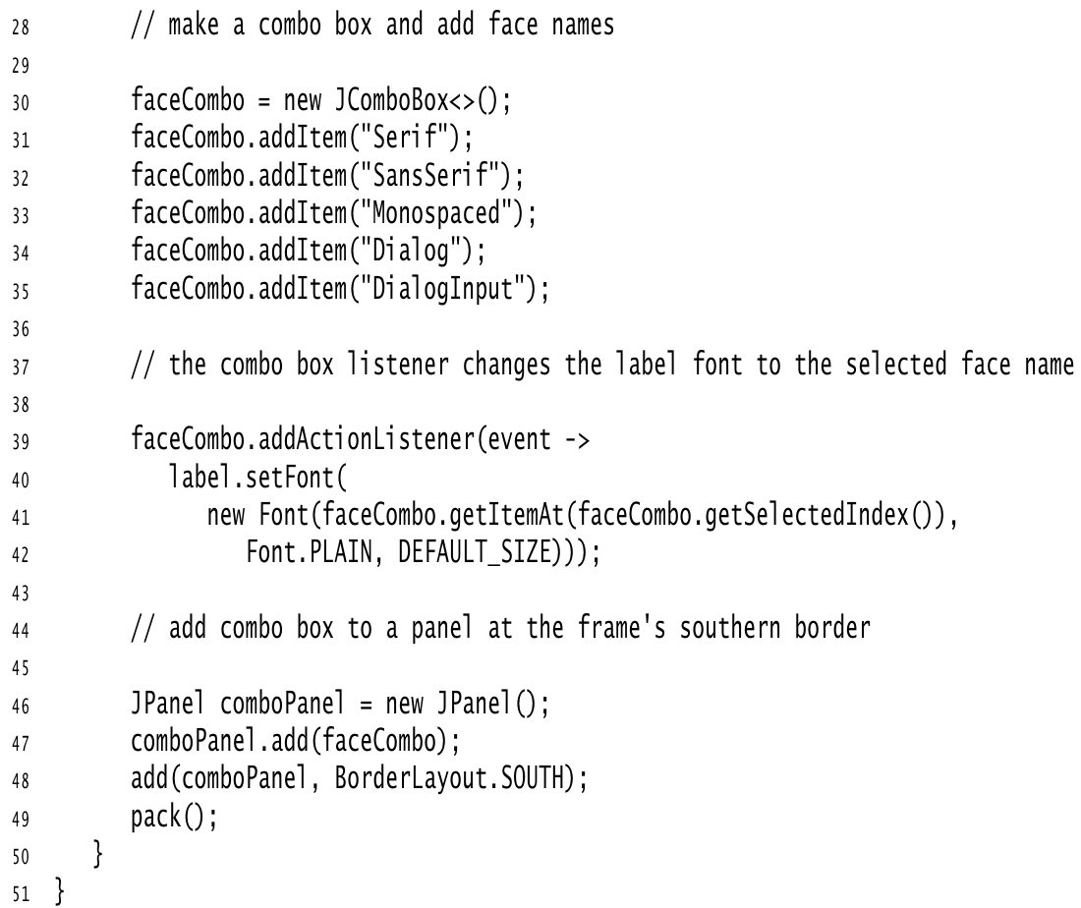

Slide 47
Sliders
Combo boxes let users choose from a discrete set of values. Sliders offer a choice from a continuum of values—for example, any number between 1 and 100.
The most common way of constructing a slider is as follows: JSlider slider = new JSlider(min, max, initialValue);
If you omit the minimum, maximum, and initial values, they are initialized with 0, 100 , and 50, respectively.
Or if you want the slider to be vertical, use the following constructor call: JSlider slider = new JSlider(SwingConstants.VERTICAL, min, max, initialValue);
These constructors create a plain slider, such as the top slider in Figure 12.18.
You will see presently how to add decorations to a slider.

Slide 48
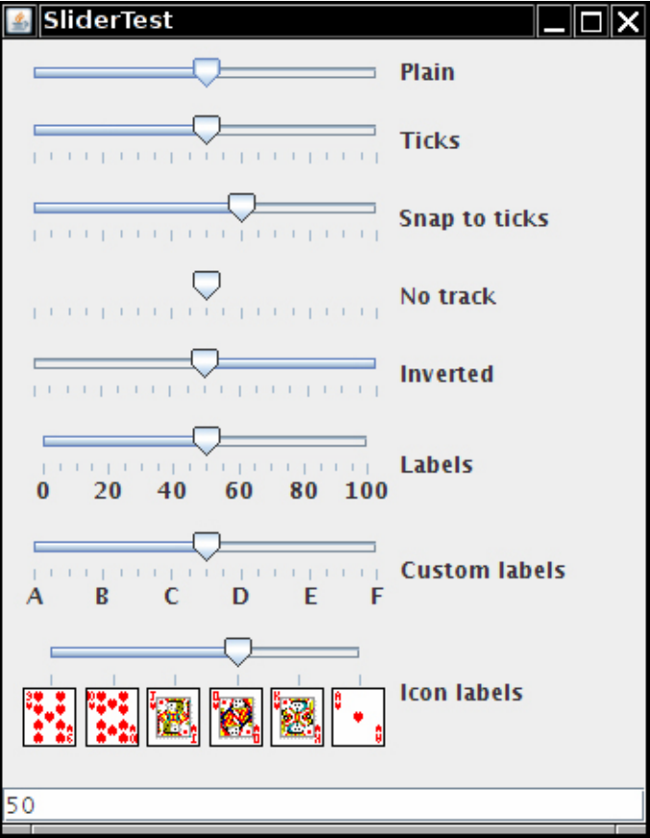
Figure 12.8 Sliders

Slide 49
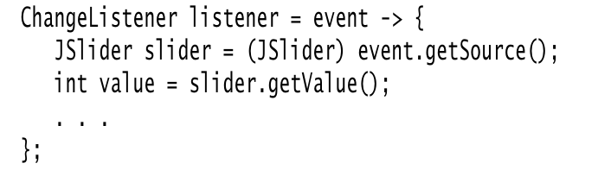
Sliders
As the user slides the slider bar, the value of the slider moves between the minimum and the maximum values.
When the value changes, a ChangeEvent is sent to all change listeners.
To be notified of the change, call the addChangeListener method and install an object that implements the functional ChangeListener interface.
In the callback, retrieve the slider value:

Slide 50
Sliders
You can embellish the slider by showing ticks. For example, in the sample program, the second slider uses the following settings: slider.setMajorTickSpacing(20); slider.setMinorTickSpacing(5);
The slider is decorated with large tick marks every 20 units and small tick marks every 5 units.
The units refer to slider values, not pixels.
These instructions only set the units for the tick marks. To actually have the tick marks appear, call slider.setPaintTicks(true);
The major and minor tick marks are independent.
For example, you can set major tick marks every 20 units and minor tick marks every 7 units, but that will give you a very messy scale.
You can force the slider to snap to ticks. Whenever the user has finished dragging a slider in snap mode, it is immediately moved to the closest tick.
You activate this mode with the call slider.setSnapToTicks(true);

Slide 51
Sliders
You can display tick mark labels for the major tick marks by calling slider.setPaintLabels(true);
For example, with a slider ranging from 0 to 100 and major tick spacing of 20, the ticks are labeled 0, 20, 40, 60, 80, and 100.
You can also supply other tick mark labels, such as strings or icons (see Figure 12.18). The process is a bit convoluted.
You need to fill a hash table with keys of type Integer and values of type Component .
You then call the setLabelTable method.
The components are placed under the tick marks. Usually, JLabel objects are used.
Here is how you can label ticks as A, B, C, D, E, and F: Hashtable<Integer, Component> labelTable = new Hashtable<Integer, Component>(); labelTable.put(0, new Jlabel("A")); labelTable.put(20, new Jlabel("B")); . . . labelTable.put(100, new Jlabel("F")); slider.setLabelTable(labelTable);

Slide 52
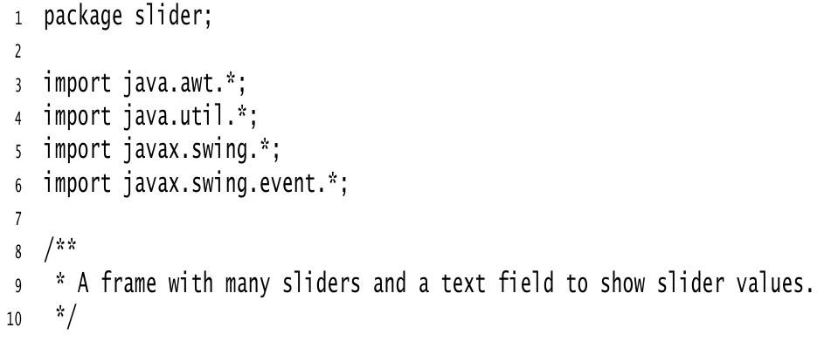
Listing 12.7 slider/SliderFrame.java

Slide 53
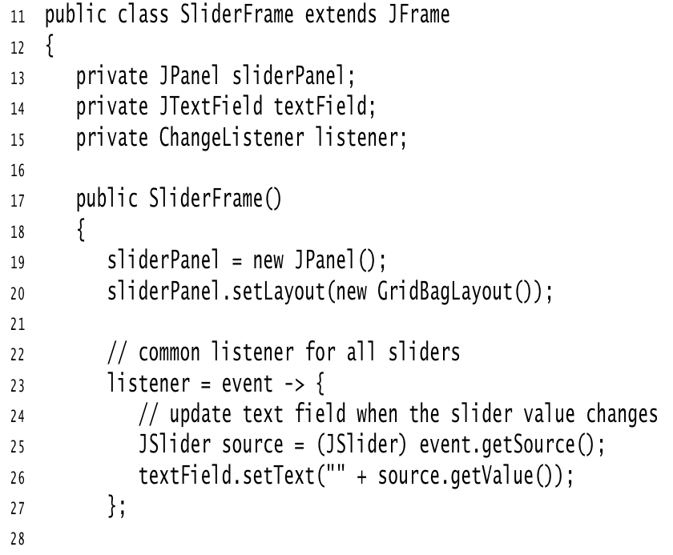

Slide 54
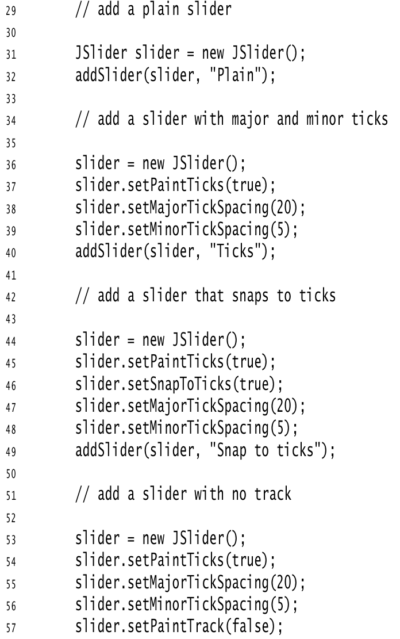
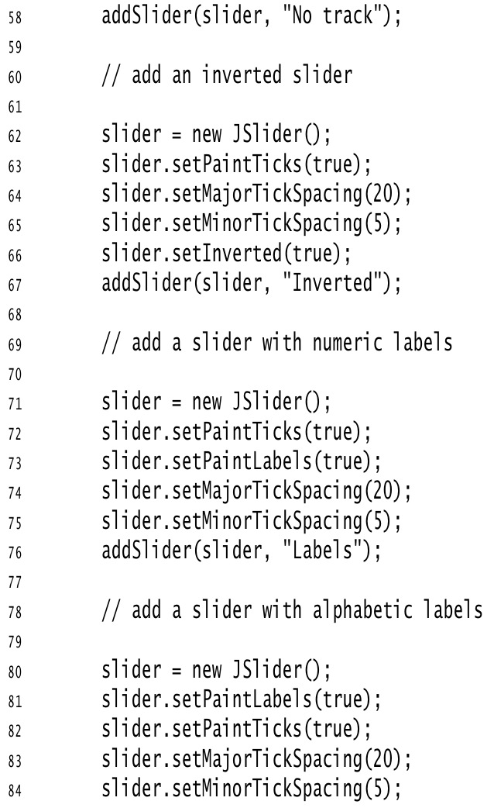

Slide 55
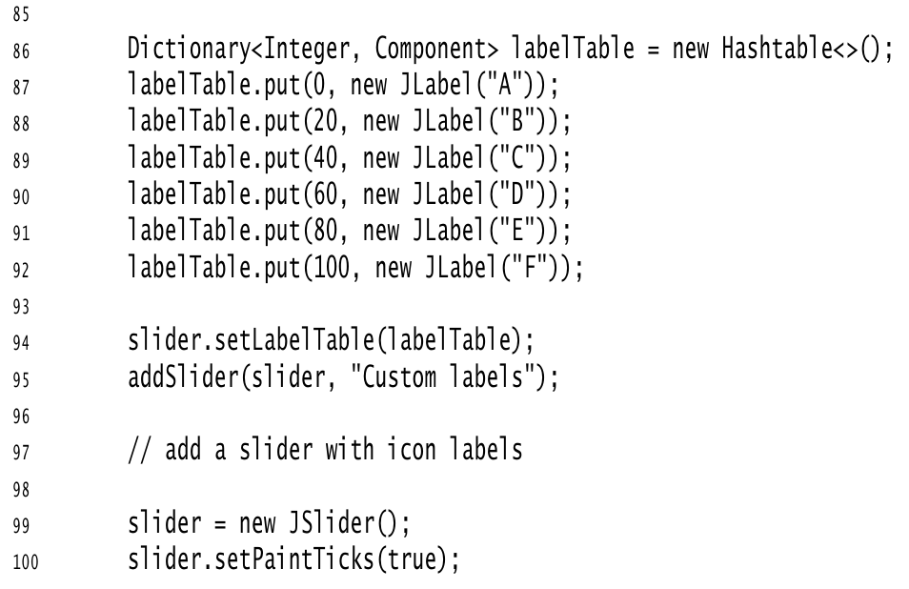

Slide 56
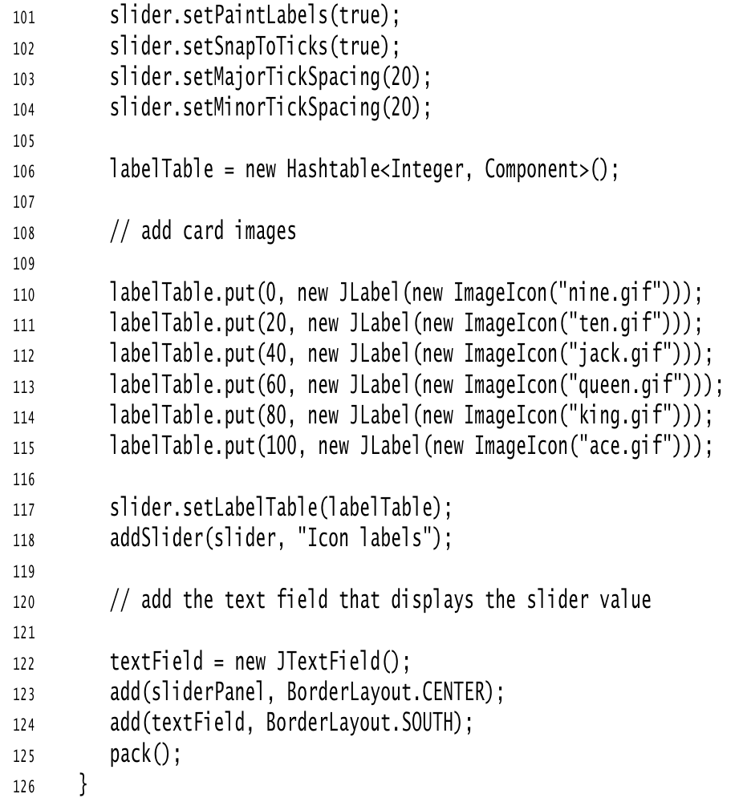
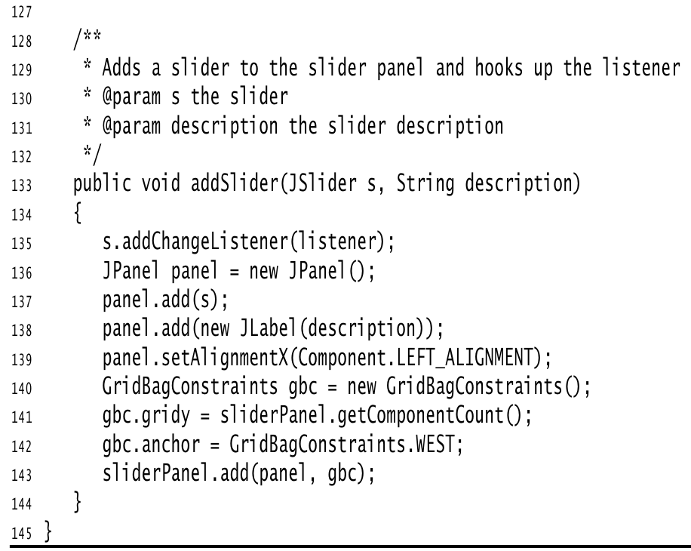

Slide 57
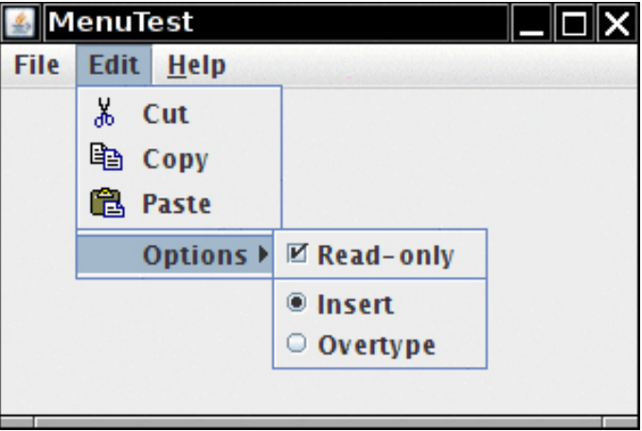
Menus
A menu bar at the top of a window contains the names of the pull-down menus.
Clicking on a name opens the menu containing menu items and submenus.
When the user clicks on a menu item, all menus are closed and a message is sent to the program. Figure shows a typical menu with a submenu.

Slide 58
Menu Building
Building menus is straightforward. First, create a menu bar: JMenuBar menuBar = new JMenuBar();
A menu bar is just a component that you can add anywhere you like.
Normally, you want it to appear at the top of a frame. You can add it there with the setJMenuBar method: frame.setJMenuBar(menuBar);
For each menu, you create a menu object: JMenu editMenu = new JMenu("Edit");
Add the top-level menus to the menu bar: menuBar.add(editMenu);
Add menu items, separators, and submenus to the menu object: JMenuItem pasteItem = new JmenuItem("Paste"); editMenu.add(pasteItem); editMenu.addSeparator(); JMenu optionsMenu = . . .; // a submenu editMenu.add(optionsMenu);

Slide 59
Menu Building
You can see separators in Figure 12.19 above the Paste and Read-only menu items. When the user selects a menu, an action event is triggered. You need to install an action listener for each menu item: ActionListener listener = . . .; pasteItem.addActionListener(listener);
The method JMenu.add(String s) conveniently adds a menu item to the end of a menu. For example: editMenu.add("Paste");
The add method returns the created menu item, so you can capture it and add the listener, as follows: JMenuItem pasteItem = editMenu.add("Paste"); pasteItem.addActionListener(listener);
It often happens that menu items trigger commands that can also be activated through other user interface elements such as toolbar buttons.
In Chapter Event Handling, you saw how to specify commands through Action objects.
You define a class that implements the Action interface, usually by extending the AbstractAction convenience class, specify the menu item label in the constructor of the AbstractAction object, and override the actionPerformed method to hold the menu action handler.

Slide 60
Menu Building
For example: Action exitAction = new AbstractAction("Exit") // menu item text goes here { public void actionPerformed(ActionEvent event) { // action code goes here System.exit(0); } };
You can then add the action to the menu: JMenuItem exitItem = fileMenu.add(exitAction);
This command adds a menu item to the menu, using the action name.
The action object becomes its listener. This is just a convenient shortcut for JMenuItem exitItem = new JmenuItem(exitAction); fileMenu.add(exitItem);

Slide 61
Menu Building
Icons in Menu Items
Checkbox and Radio Button Menu Items
Pop-Up Menus
Keyboard Mnemonics and Accelerators
Enabling and Disabling Menu Items
Toolbars and Tooltips
Listing 12.8 is a sample program that generates a set of menus.
It shows all the features that you saw in this section: nested menus, disabled menu items, checkbox and radio button menu items, a pop-up menu, and keyboard mnemonics and accelerators.

Slide 62
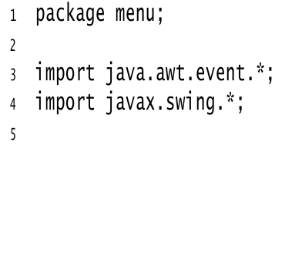
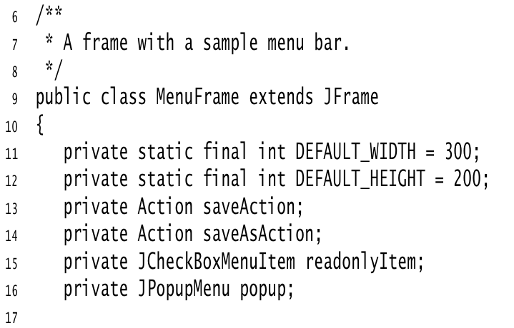
Listing 12.8 menu/MenuFrame.java

Slide 63
