Slide 1
Displaying Information in Components

Slide 2
Positioning a Frame
The JFrame class itself has only a few methods for changing how frames look
most of the methods for working with the size and position of a frame come from the various superclasses of Jframe
The setLocation and setBounds methods for setting the position of the frame
The setIconImage method, which tells the windowing system which icon to display in the title bar, task switcher window, and so on
The setTitle method for changing the text in the title bar
The setResizable method, which takes a boolean to determine if a frame will be resizeable by the user

Slide 3
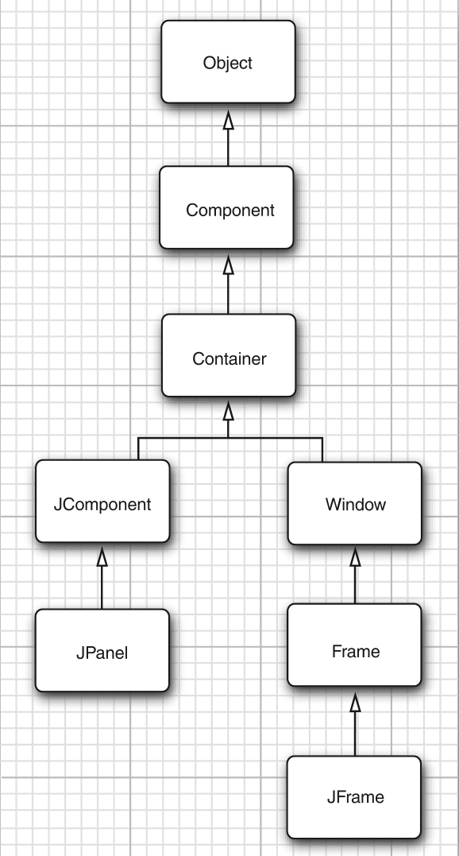
Inheritance hierarchy for the frame and component classes in AWT and Swing

Slide 4
Frame Properties
Many methods of component classes come in getter/setter pairs, such as the following methods of the Frame class:
public String getTitle()
public void setTitle(String title)
Such a getter/setter pair is called a property.
A property has a name and a type.
The name is obtained by changing the first letter after the get or set to lowercase.
For example, the Frame class has a property with name title and type String

Slide 5
Determining a good Frame Size
Remember: If you don’t explicitly size a frame, all frames will default to 0 by 0 pixels
In a professional application, you should check the resolution of the user’s screen and write code that resizes the frames accordingly
To find out the screen size, use the following steps.
Call the static getDefaultToolkit method of the Toolkit class to get the Toolkit object.
Then call the getScreenSize method, which returns the screen size as a Dimension object.
A Dimension object simultaneously stores a width and a height, in public instance variables width and height

Slide 6
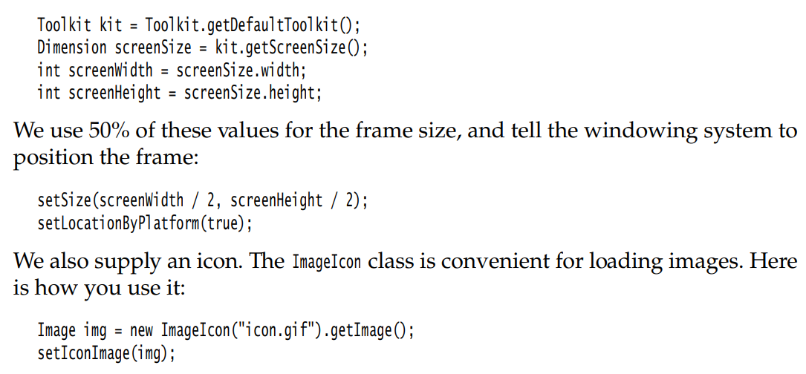
Here is the code

Slide 7
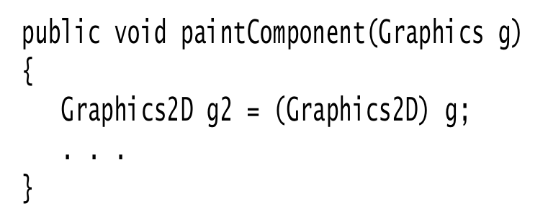
Working with 2D Shapes
To draw shapes in the Java 2D library, you need to obtain an object of the Graphics2D class.
This class is a subclass of the Graphics class.
Ever since Java SE 2, methods such as paintComponent automatically receive an object of the Graphics2D class.
Simply use a cast, as follows:

Slide 8
Working with 2D Shapes
The Java 2D library organizes geometric shapes in an object-oriented fashion.
In particular, there are classes to represent lines, rectangles, and ellipses
Line2D
Rectangle2D
Ellipse2D
These classes all implement the Shape interface.
To draw a shape, you first create an object of a class that implements the Shape interface and then call the draw method of the Graphics2D class:
Rectangle2D rect = . . .;
g2.draw( rect );

Slide 9
Working with 2D Shapes
Using the Java 2D shape classes introduces some complexity
Java 2D shapes use floating-point coordinates
The Java 2D library uses single-precision float quantities for many of its internal floating-point calculations
Manipulating float values is sometimes inconvenient for the programmer because Java is adamant about requiring casts when converting double values into float values
Rectangle2D r = . . .
float f = r.getWidth(); // Error
float f = (float) r.getWidth(); // OK

Slide 10
Working with 2D Shapes
2D library supply two versions of each shape class: one with float coordinates
one with double coordinates
Consider the Rectangle2D class.
This is an abstract class with two concrete subclasses, which are also static inner classes
Rectangle2D.Float
Rectangle2D.Double

Slide 11
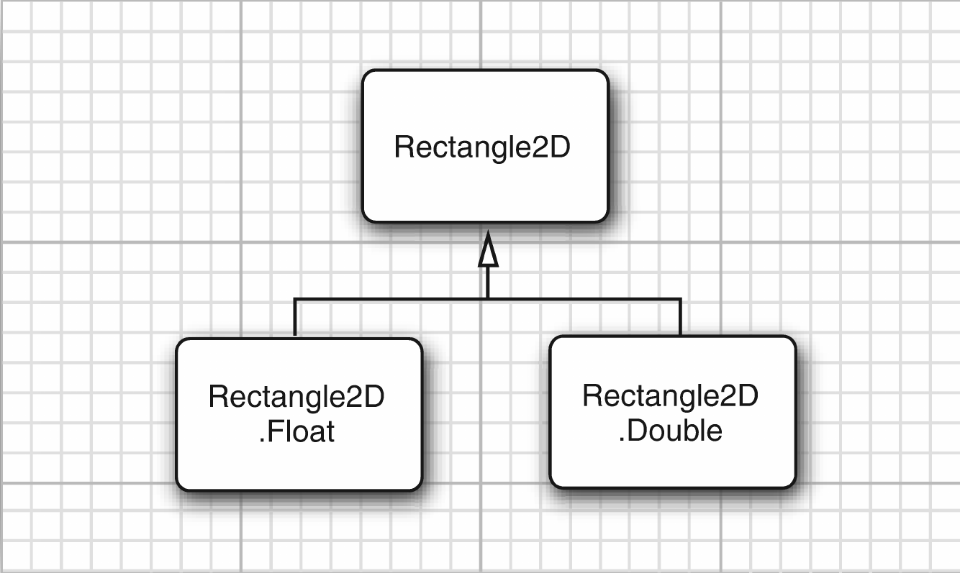
2D Rectangle Classes

Slide 12
Working with 2D Shapes
When we construct a Rectangle2D.Float object, we supply the coordinates as float numbers.
For a Rectangle2D.Double object, we supply them as double numbers
Rectangle2D.Float floatRect = new Rectangle2D.Float(10.0F, 25.0F, 22.5F, 20.0F);
Rectangle2D.Double doubleRect = new Rectangle2D.Double(10.0, 25.0, 22.5, 20.0);
We can simply use Rectangle2D variables to hold the rectangle references
Rectangle2D floatRect = new Rectangle2D.Float(10.0F, 25.0F, 22.5F, 20.0F);
Rectangle2D doubleRect = new Rectangle2D.Double(10.0, 25.0, 22.5, 20.0);

Slide 13
Working with 2D Shapes
The Rectangle2D methods use double parameters and return values.
For example, the getWidth method returns a double value, even if the width is stored as a float in a Rectangle2D.Float object
What we just discussed for the Rectangle2D classes holds for the other shape classes as well.
Furthermore, there is a Point2D class with subclasses Point2D.Float and Point2D.Double.
Here is how to make a point object:
Point2D p = new Point2D.Double(10, 20);

Slide 14
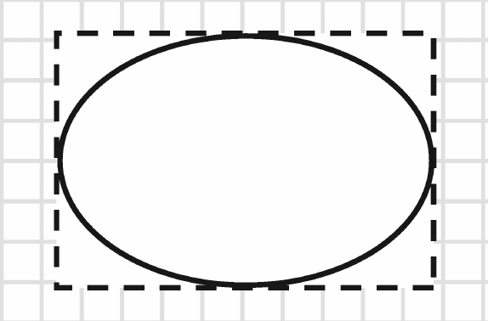
Working with 2D Shapes
The RectangularShape class defines over 20 methods that are common to these shapes,
among them such useful methods as getWidth , getHeight , getCenterX , and getCenterY (but, not a getCenter method that would return the center as a Point2D object)
Fig: Bounding Rectangle of ellipse

Slide 15
Working with 2D Shapes
Rectangle2D and Ellipse2D objects are simple to construct. You need to specify
The x and y coordinates of the top left corner; and
The width and height.
For ellipses, these refer to the bounding rectangle. For example
Ellipse2D e = new Ellipse2D.Double(150, 200, 100, 50);
constructs an ellipse that is bounded by a rectangle with the top left corner at (150, 200), width of 100, and height of 50

Slide 16
Thank you
Niraj Pokharel
niraj.pokharel@gmail.com
nuptse.com.np

