Slide 1
Using Color

Slide 2
Using Color
The setPaint method of the Graphics2D class lets you select a color that is used for all subsequent drawing operations on the graphics context. For example:
g2.setPaint(Color.RED);
g2.drawString(“Warning!”, 100, 100);
You can fill the interiors of closed shapes (such as rectangles or ellipses) with a color. Simply call fill instead of draw :
Rectangle2D rect = …;
g2.setPaint(Color.RED);g2.fill(rect) // fills rect with red
To draw in multiple colors, select a color, draw or fill, then select another color, and draw or fill again

Slide 3
Using Color
Define colors with the Color class. The java.awt.Color class offers predefined constants for the following 13 standard colors:
BLACK, BLUE, CYAN, DARK_GRAY, GRAY, GREEN, LIGHT_GRAY, MAGENTA, ORANGE, PINK, RED, WHITE, YELLOW
You can specify a custom color by creating a Color object by its red, green, and blue components. Using a scale of 0–255 (that is, one byte) for the redness, blueness,and greenness, call the Color constructor like this:
Color(int redness, int greenness, int blueness);
Here’s an example of settings a custom color:
g2.setPaint(new Color(0,128,128)); // a dull blue green
g2.drawString(“Welcome!”, 75, 125);

Slide 4
Using Color
To set the background color, use the setBackground method of the Component class, an ancestor of Jcomponent
MyComponent p = new MyComponent();
p.setBackground(Color.PINK);
There is also a setForeground method. It specifies the default color that is used for drawing on the component.
Java gives you predefined names for many more colors in its SystemColor class.
The constants in this class encapsulate the colors used for various elements of the user’s system.
For eg: p.setBackground(SystemColor.window) sets the background color of the component to the default used by all window’s on the user’s desktop.
Using the colors in the SystemColor class is particularly useful when you want to draw user interface elements so that the colors match those already found on the user’s desktop

Slide 5
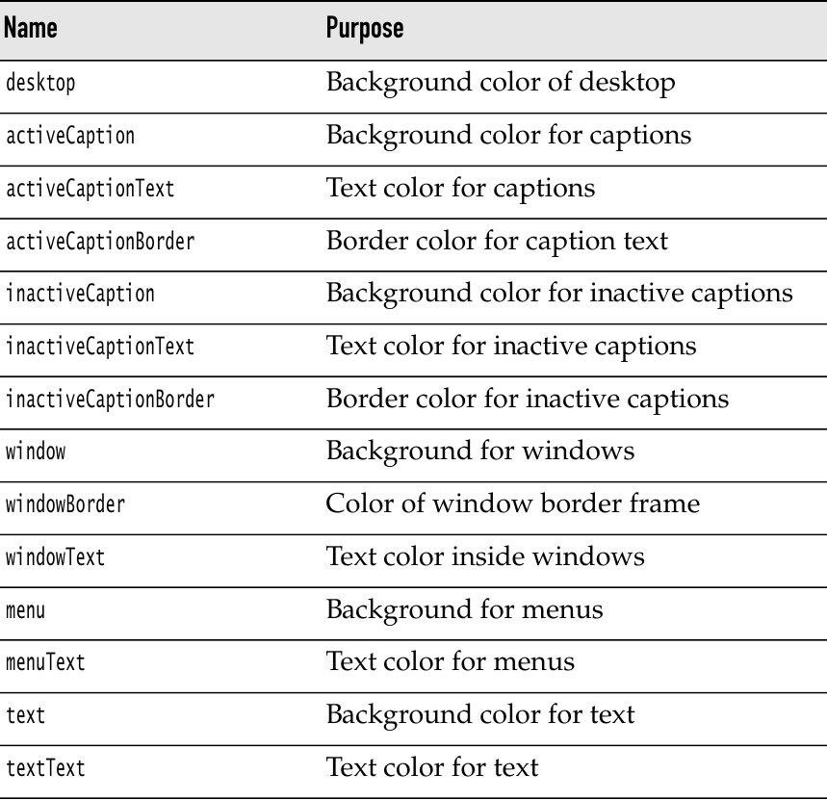
System Colors

Slide 6
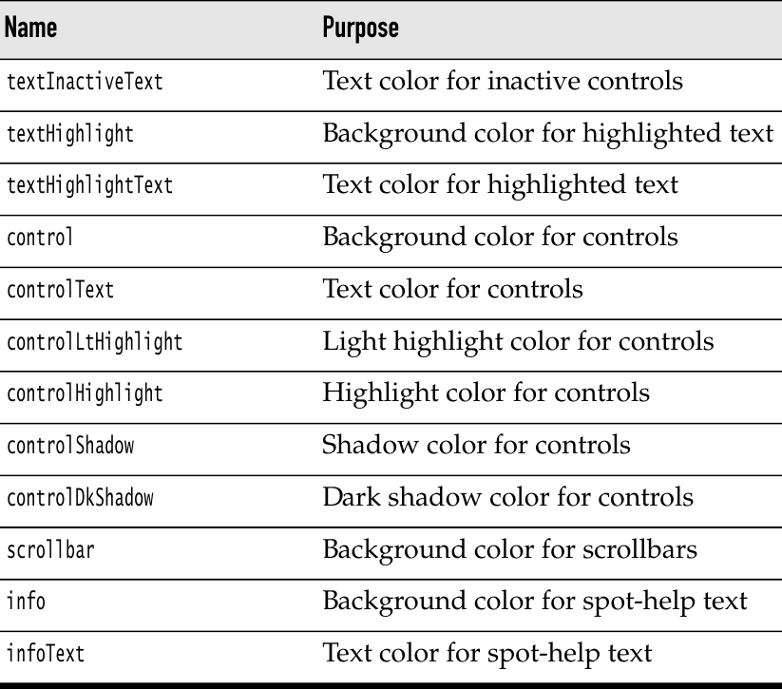
System Colors

Slide 7
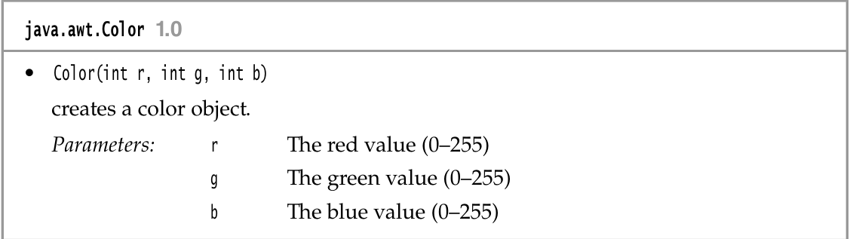
System Colors

Slide 8
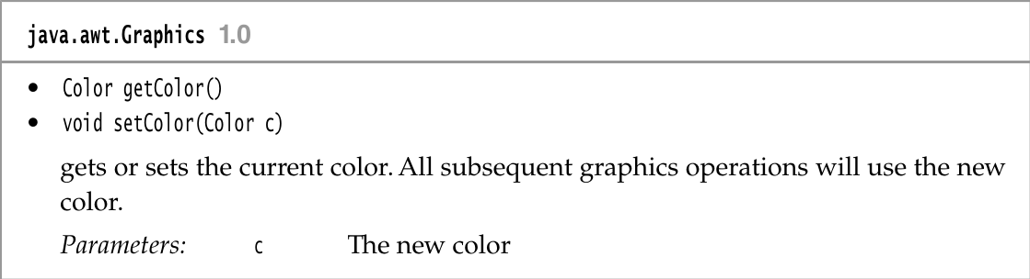
System Colors

Slide 9
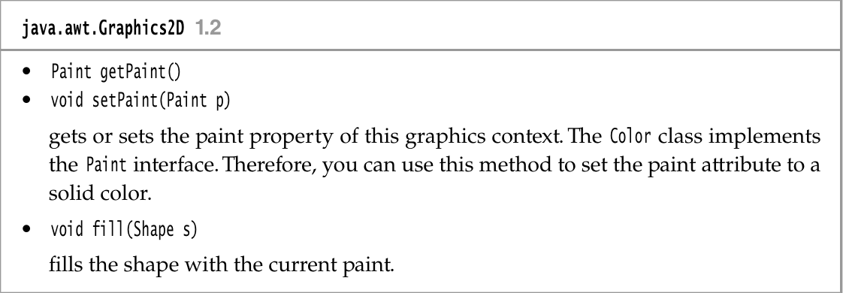
System Colors

Slide 10
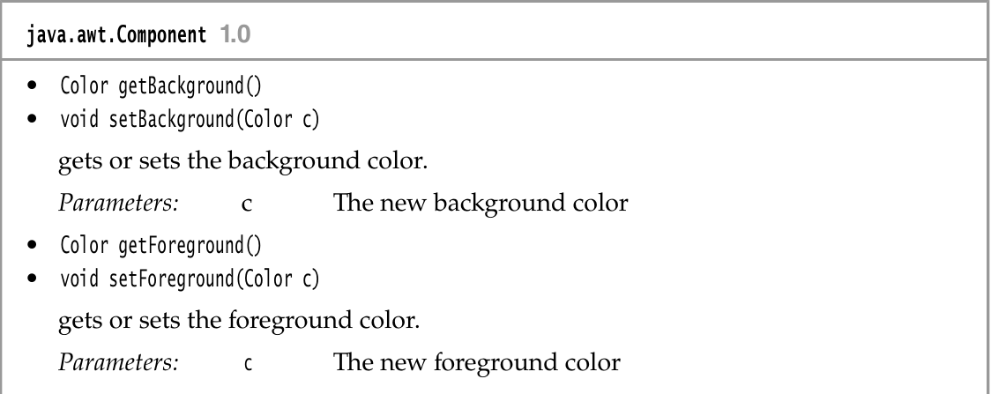
System Colors

