Slide 1
Using Special Fonts For Text

Slide 2
Using Special Fonts for Text
The “Not a Hello World” program at the beginning of this chapter displayed a string in the default font.
Sometimes, you will want to show your text in a different font.
You can specify a font by its font face name. A font face name is composed of a font family name, such as “Helvetica,” and an optional suffix such as “Bold.”
For example, the font faces “Helvetica” and “Helvetica Bold” are both considered to be part of the family named “Helvetica.”
To find out which fonts are available on a particular computer, call the getAvailableFontFamilyNames method of the GraphicsEnvironment class
The method returns an array of strings containing the names of all available fonts
To obtain an instance of the GraphicsEnvironment class that describes the graphics environment of the user’s system, use the static getLocalGraphicsEnvironment method`

Slide 3
Program to List all fonts in your system
import java.awt.*;
public class ListFonts {
public static void main(String[] args) {
String[] fontNames = GraphicsEnvironment
.getLocalGraphicsEnvironment()
.getAvailableFontFamilyNames();
for (String fontName : fontNames)
System.out.println(fontName);
}
}

Slide 4
Font Faces
Font face names can be trademarked, and font designs can be copyrighted in some jurisdictions.
Thus, the distribution of fonts often involves royalty payments to a font foundry.
Of course, just as there are inexpensive imitations of famous perfumes, there are lookalikes for name-brand fonts.
For example, the Helvetica imitation that is shipped with Windows is called Arial
To establish a common baseline, the AWT defines five logical font names: SansSerif, Serif, Monospaced, Dialog, DialogInput
These names are always mapped to some fonts that actually exist on the client machine. For example, on a Windows system, SansSerif is mapped to Arial
In addition, the Oracle JDK always includes three font families named “Lucida Sans,” “Lucida Bright,” and “Lucida Sans Typewriter”.

Slide 5
Draw Characters in a Font
To draw characters in a font, you must first create an object of the class Font
Specify the font face name, the font style, and the point size
Here is an example of how you construct a Font object
Font sansbold14 = new Font("SansSerif", Font.BOLD, 14);
The third argument is the point size.
Points are commonly used in typography to indicate the size of a font. There are 72 points per inch
You can use a logical font name in place of the font face name in the Font constructor.
Specify the style (plain, bold, italic, or bold italic) by setting the second Font constructor argument to one of the following values:
Font.PLAIN Font.BOLD Font.ITALIC Font.BOLD + Font.ITALIC

Slide 6
Font Files
You can read font files in TrueType, OpenType, or PostScript Type 1 formats.
You need an input stream for the font—typically from a file or URL
Then, call the static Font.createFont method
URL url = new URL("http://www.fonts.com/Wingbats.ttf");
InputStream in = url.openStream();
Font f1 = Font.createFont(Font.TRUETYPE_FONT, in);
The font is plain with a font size of 1 point. Use the deriveFont method to get a font of the desired size:
Font f = f1.deriveFont(14.0F);

Slide 7
ASCII Characters
The Java fonts contain the usual ASCII characters as well as symbols.
For example, if you print the character '\u2297' in the Dialog font, you get a X character.
Only the symbols defined in the Unicode character set are available
Here’s the code that displays the string “Hello, World!” in the standard sans serif font on your system, using 14-point bold type
Font sansbold14 = new Font("SansSerif", Font.BOLD, 14);
g2.setFont(sansbold14);
String message = "Hello, World!";
g2.drawString(message, 75, 100);

Slide 8
More on Fonts
Next, let’s center the string in its component instead of drawing it at an arbitrary position.
We need to know the width and height of the string in pixels.
These dimensions depend on three factors:
The font used (in our case, sans serif, bold, 14 point);
The string (in our case, “Hello, World!”); and
The device on which the font is drawn (in our case, the user’s screen) .
To obtain an object that represents the font characteristics of the screen device, call the getFontRenderContext method of the Graphics2D class.
It returns an object of the FontRenderContext class.
Simply pass that object to the getStringBounds method of the Font class
FontRenderContext context = g2.getFontRenderContext();
Rectangle2D bounds = sansbold14..getStringBounds(message, context);

Slide 9
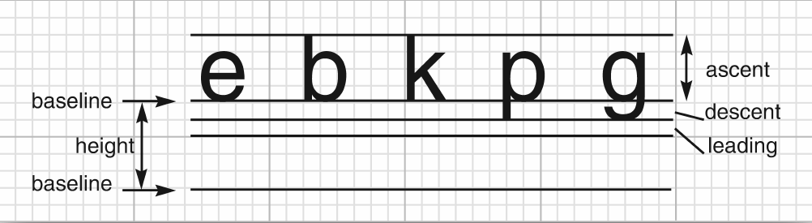
More on Fonts
The getStringBounds method returns a rectangle that encloses the string
To interpret the dimensions of that rectangle, you should know some basic typesetting terms

Slide 10
Typesetting Terms
The baseline is the imaginary line where, for example, the bottom of a character like “e” rests.
The ascent is the distance from the baseline to the top of an ascender, which is the upper part of a letter like “b” or “k,” or an uppercase character.
The descent is the distance from the baseline to a descender, which is the lower portion of a letter like ‘p’ or ‘g
Leading is the space between the descent of one line and the ascent of the next line. (The term has its origin from the strips of lead that typesetters used to separate lines).
The height of a font is the distance between successive baselines, which is the same as descent + leading + ascent
The width of the rectangle that the getStringBounds method returns is the horizontal extent of the string.
The height of the rectangle is the sum of ascent, descent, and leading.
The rectangle has its origin at the baseline of the string. The top y coordinate of the rectangle is negative

Slide 11
Typesetting Terms
Thus, you can obtain string width, height, and ascent as follows:
double stringWidth = bounds.getWidth();
double stringHeight = bounds.getHeight();
double ascent = -bounds.getY();
If you need to know the descent or leading, use the getLineMetrics method of the Font class. That method returns an object of the LineMetrics class, which has methods to obtain the descent and leading:
LineMetrics metrics = f.getLineMetrics(message, context);
float descent = metrics.getDescent();
float leading = metrics.getLeading();

Slide 12
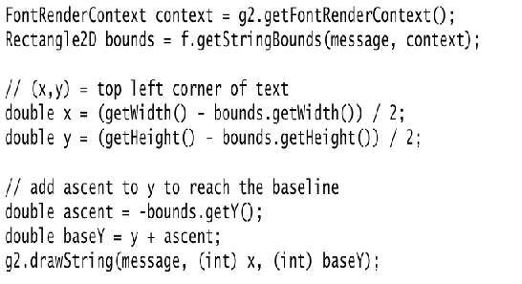
Typesetting Terms
The following code uses all this information to center a string in its surrounding component:

Slide 13
Typesetting Terms
To understand the centering, consider that getWidth() returns the width of the component.
A portion of that width, namely bounds.getWidth() , is occupied by the message string.
The remainder should be equally distributed on both sides.
Therefore, the blank space on each side is half the difference.
The same reasoning applies to the height.

Slide 14
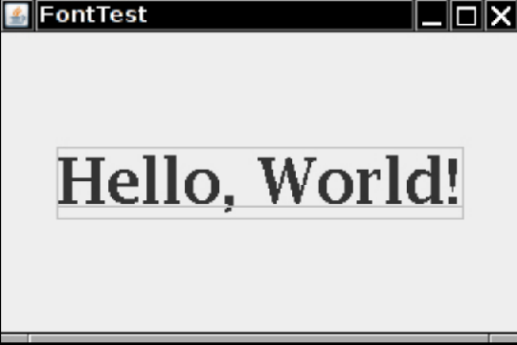
Exercise 3
Draw the baseline and string bounds as in following figure

