Slide 1
Displaying Images

Slide 2
Displaying Images
You have already seen how to build up simple drawings by painting lines and shapes.
Complex images, such as photographs, are usually generated externally—for example, with a scanner or special image-manipulation software.
It is also possible to produce an image, pixel by pixel
Once images are stored in local files or someplace on the Internet, you can read them into a Java application and display them on Graphics objects.
There are many ways of reading images.
Here, we use the ImageIcon class:
Image image = new ImageIcon(filename).getImage();
Now the variable image contains a reference to an object that encapsulates the image data

Slide 3
Displaying Images
You can display the image with the drawImage method of the Graphics class
public void paintComponent(Graphics g) {
. . .
g.drawImage(image, x, y, null);
}

Slide 4
Displaying Images
Listing 1.5 takes this a little bit further and tiles the window with the graphics image.
The result looks like the screen shown in Figure 1.5. We do the tiling in the paintComponent method.
We first draw one copy of the image in the top left corner and then use the copyArea call to copy it into the entire window:
for (int i = 0; i * imageWidth <= getWidth(); i++)
for (int j = 0; j * imageHeight <= getHeight(); j++)
if (i + j > 0)
g.copyArea(0, 0, imageWidth, imageHeight, i * imageWidth, j * imageHeight);

Slide 5
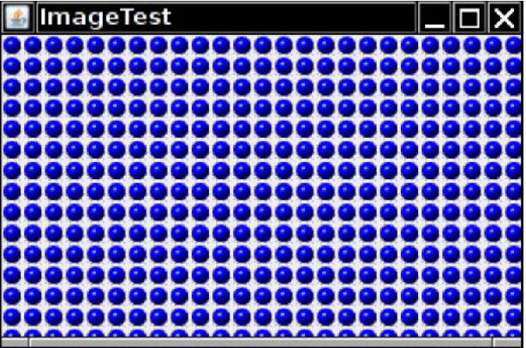
Figure 1.5

Slide 6
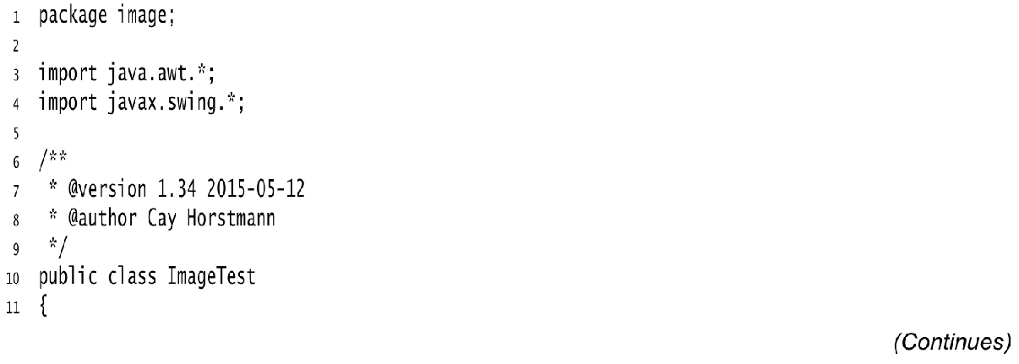
Listing 1.5 image/ImageTest.java

Slide 7
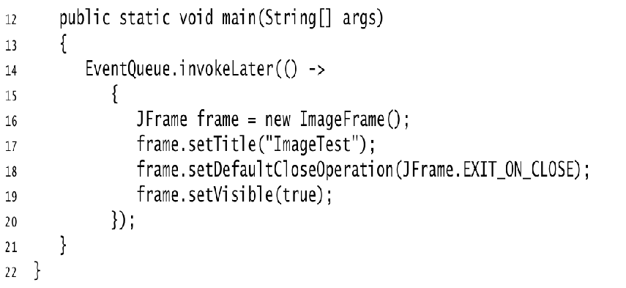
Listing 1.5 image/ImageTest.java

Slide 8
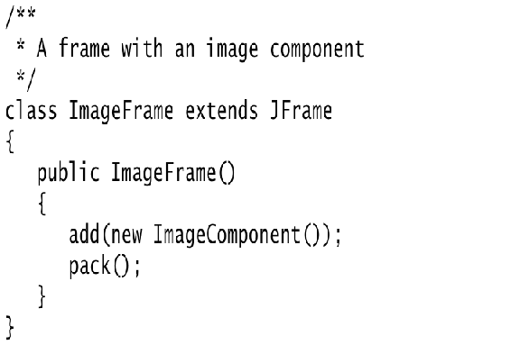
Listing 1.5 image/ImageTest.java

Slide 9
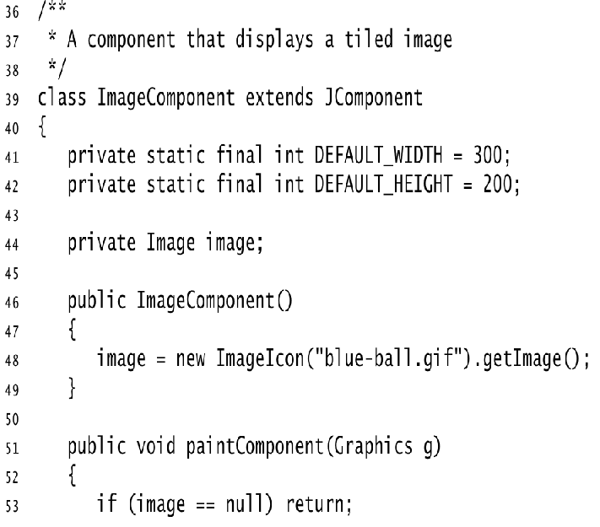
Listing 1.5 image/ImageTest.java

Slide 10
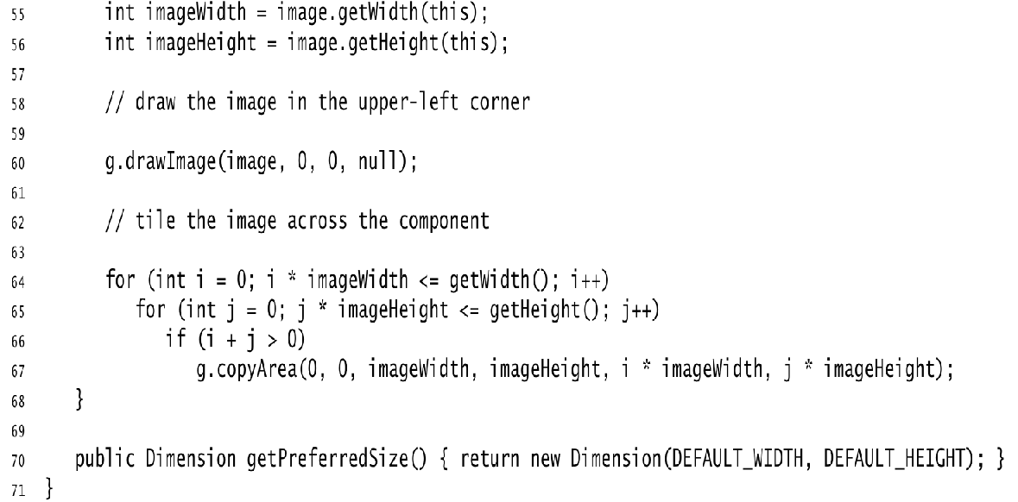
Listing 1.5 image/ImageTest.java

Slide 11
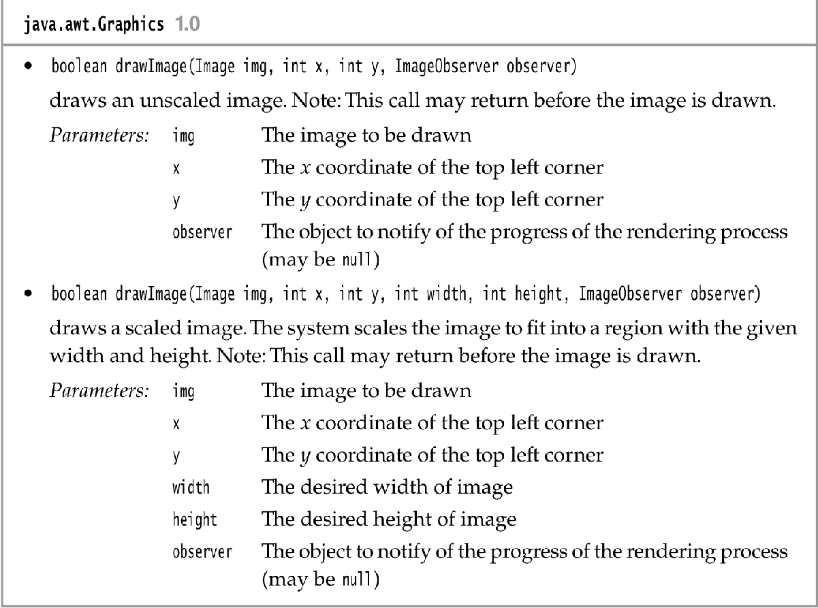

Slide 12
