Slide 1
Event Handling

Slide 2
Event Handling Basics
Event handling is of fundamental importance to programs with a graphical user interface.
To implement user interfaces, you have to master the way in which Java handles events
Any operating environment that supports GUIs constantly monitors events such as keystrokes or mouse clicks.
The operating environment reports these events to the programs that are running.
Each program then decides what, if anything, to do in response to these events
In languages like Visual Basic, the correspondence between events and code is obvious. One writes code for each specific event of interest and places the code in what is usually called an event procedure
For example, a Visual Basic button named “HelpButton” would have a HelpButton_Click event procedure associated with it
The code in this procedure executes whenever that button is clicked. Each Visual Basic GUI Component responds to a fixed set of events, and it is impossible to change the events to which it responds.

Slide 3
Event Handling Basics
On the other hand, if you use a language like raw C to do event-driven programming, you need to write the code that constantly checks the event queue for what the operating environment is reporting.
This is usually done by encasing your code in a loop with a massive switch statement.
This technique is obviously ugly and, in any case, much more difficult to code.
Its advantage is that the events you can respond to are not as limited as in the languages which, like Visual Basic, go to great lengths to hide the event queue from the programmer.

Slide 4
Event Handling Basics
The Java programming environment takes an approach somewhere in between the Visual Basic and the raw C in terms of power and the resulting complexity.
Within the limits of the events that the AWT knows about, you completely control how events are transmitted from the event sources (such as buttons or scrollbars) to event listeners.
You can designate any object to be an event listener—in practice, you pick an object that can conveniently carry out the desired response to the event.
This event delegation model gives you much more flexibility than is possible with Visual Basic, in which the listener is predetermined
Event sources have methods that allow you to register event listeners with them.
When an event happens to the source, the source sends a notification of that event to all the listener objects that were registered for that event.

Slide 5
Event Handling Basics
As one would expect in an object-oriented language like Java, the information about the event is encapsulated in an event object.
In Java, all event objects ultimately derive from the class java.util.EventObject.
Of course, there are subclasses for each event type, such as ActionEvent and WindowEvent .
Different event sources can produce different kinds of events.
For example, a button can send ActionEvent objects, whereas a window can send WindowEvent objects.

Slide 6
How Event Handling in AWT Works
A listener object is an instance of a class that implements a special interface called (naturally enough) a listener interface
An event source is an object that can register listener objects and send them event objects
The event source sends out event objects to all registered listeners when that event occurs
The listener objects will then use the information in the event object to determine their reaction to the event

Slide 7
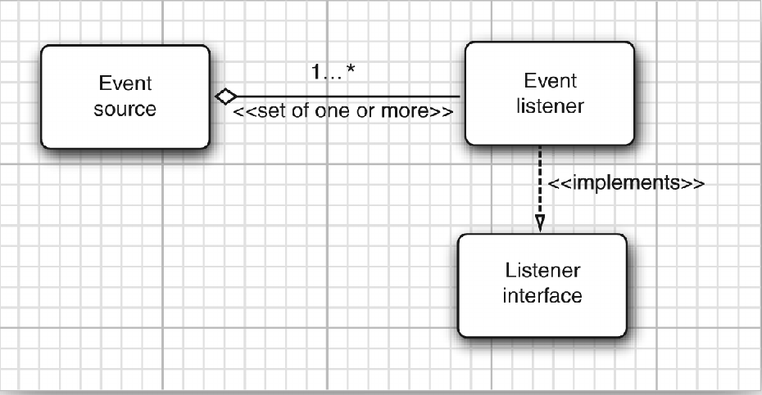
Relationship Between event sources and listeners

Slide 8
Here is an example for specifying a listener
ActionListener listener = . . .;
JButton button = new JButton("OK");
button.addActionListener(listener);
Now the listener object is notified whenever an “action event” occurs in the button.
For buttons, as you might expect, an action event is a button click.
To implement the ActionListener interface, the listener class must have a method called actionPerformed that receives an ActionEvent object as a parameter.
class MyListener implements ActionListener { . . . public void actionPerformed(ActionEvent event) { // reaction to button click goes here . . . } }

Slide 9
How Event Handling in AWT Works
Whenever the user clicks the button, the JButton object creates an ActionEvent object and calls listener.actionPerformed(event), passing that event object.
An event source such as a button can have multiple listeners.
In that case, the button calls the actionPerformed methods of all listeners whenever the user clicks the button.

Slide 10
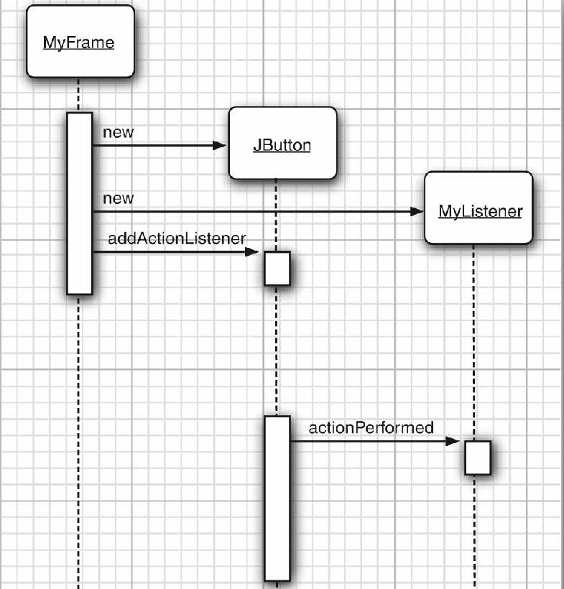
Event Notification

