Slide 1
Handling a Button Click

Slide 2
Event Handling ( Button Click Example )
As a way of getting comfortable with the event delegation model, let’s work through all the details needed for the simple example of responding to a button click.
For this example, we will show a panel populated with three buttons.
Three listener objects are added as action listeners to the buttons
With this scenario, each time a user clicks on any of the buttons on the panel, the associated listener object receives an ActionEvent that indicates a button click.
In our sample program, the listener object will then change the background color of the panel
Before we write the program that listens to button clicks, we first need to know how to create buttons and how to add them to a panel
To create a button, specify a label string, an icon, or both in the button constructor. Here are two examples:
JButton yellowButton = new JButton("Yellow");
JButton blueButton = new JButton(new ImageIcon("blue-ball.gif"));

Slide 3
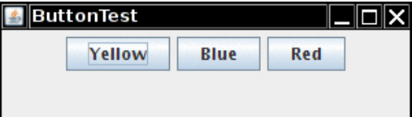
Event Handling ( Button Click Example )
Call the add method to add the buttons to a panel:
JButton yellowButton = new Jbutton("Yellow"); JButton blueButton = new Jbutton("Blue"); JButton redButton = new Jbutton("Red");
buttonPanel.add(yellowButton); buttonPanel.add(blueButton); buttonPanel.add(redButton);

Slide 4
Event Handling ( Button Click Example )
Next, we need to add code that listens to these buttons.
This requires classes that implement the ActionListener interface, which, as we just mentioned, has one method: actionPerformed , whose signature looks like this:
public void actionPerformed(ActionEvent event)
NOTE: The ActionListener interface we used in the button example is not restricted to button clicks. It is used in many separate situations:
When an item is selected from a list box with a double click When a menu item is selected When the Enter key is pressed in a text field When a certain amount of time has elapsed for a Timer component
The way to use the ActionListener interface is the same in all situations: The actionPerformed method (which is the only method in ActionListener ) takes an object of type ActionEvent as a parameter.
This event object gives you information about the event that happened

Slide 5
Event Handling ( Button Click Example )
When a button is clicked, we want the background color of the panel to change to a particular color. We store the desired color in our listener class.
class ColorAction implements ActionListener { private Color backgroundColor; public ColorAction(Color c) { backgroundColor = c; } public void actionPerformed(ActionEvent event) { // set panel background color. . . } }
We then construct one object for each color and set the objects as the button listeners. ColorAction yellowAction = new ColorAction(Color.YELLOW); ColorAction blueAction = new ColorAction(Color.BLUE); ColorAction redAction = new ColorAction(Color.RED);
yellowButton.addActionListener(yellowAction); blueButton.addActionListener(blueAction); redButton.addActionListener(redAction);

Slide 6
Event Handling ( Button Click Example )
For example, if a user clicks on the button marked “Yellow,” the actionPerformed method of the yellowAction object is called.
Its backgroundColor instance field is set to Color.YELLOW, and it can now proceed to set the panel’s background color
Just one issue remains. The ColorAction object doesn’t have access to the buttonPanel variable.
You can solve this problem in two ways. You can store the panel in the ColorAction object and set it in the ColorAction constructor.
Or, more conveniently, you can make ColorAction into an inner class of the ButtonFrame class. Its methods can then access the outer panel automatically.
We follow the later approach. Here is how you place the ColorAction class inside the ButtonFrame class

Slide 7
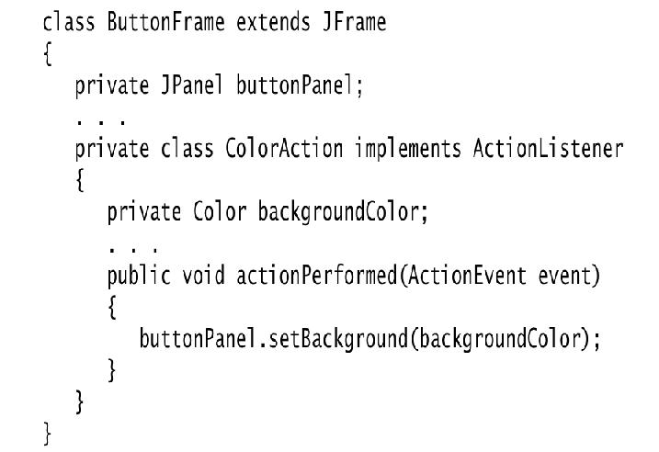
Event Handling ( Button Click Example )

Slide 8
Event Handling ( Button Click Example )
Look closely at the actionPerformed method. The ColorAction class doesn’t have a buttonPanel field. But the outer ButtonFrame class does.
This situation is very common.
Event listener objects usually need to carry out some action that affects other objects.
You can often strategically place the listener class inside the class whose state the listener should modify.

Slide 9
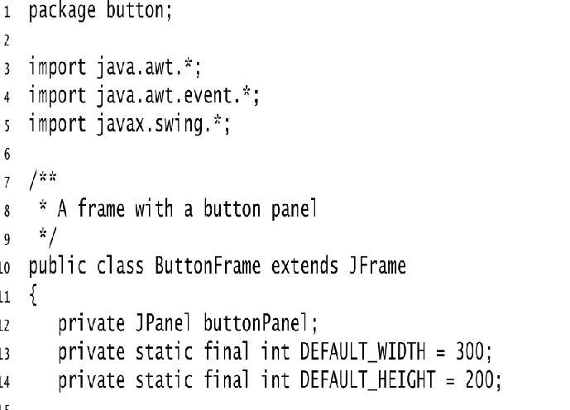
ButtonFrame.java Example

Slide 10
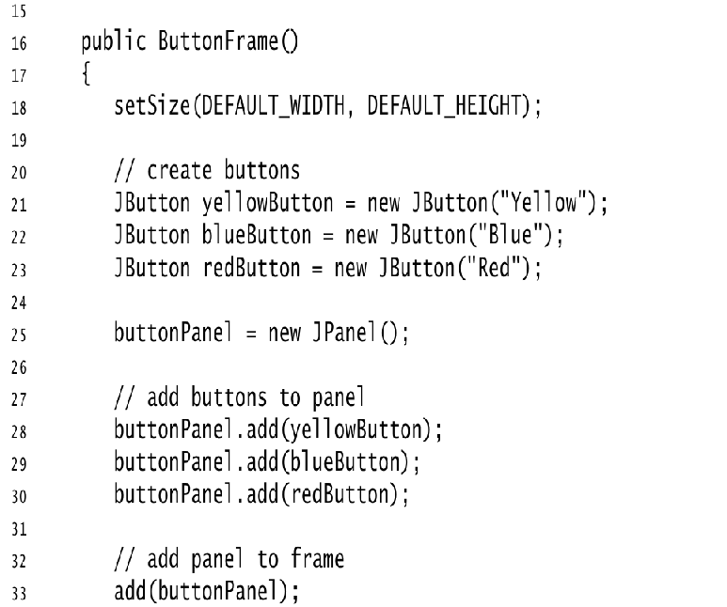

Slide 11
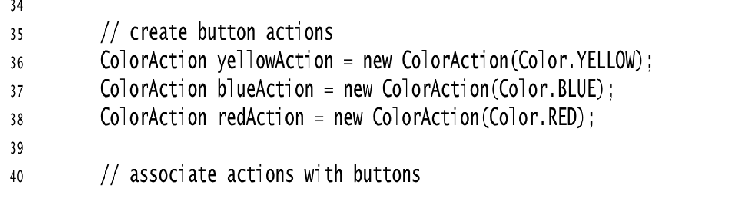

Slide 12
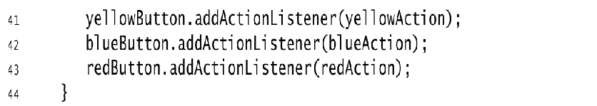

Slide 13
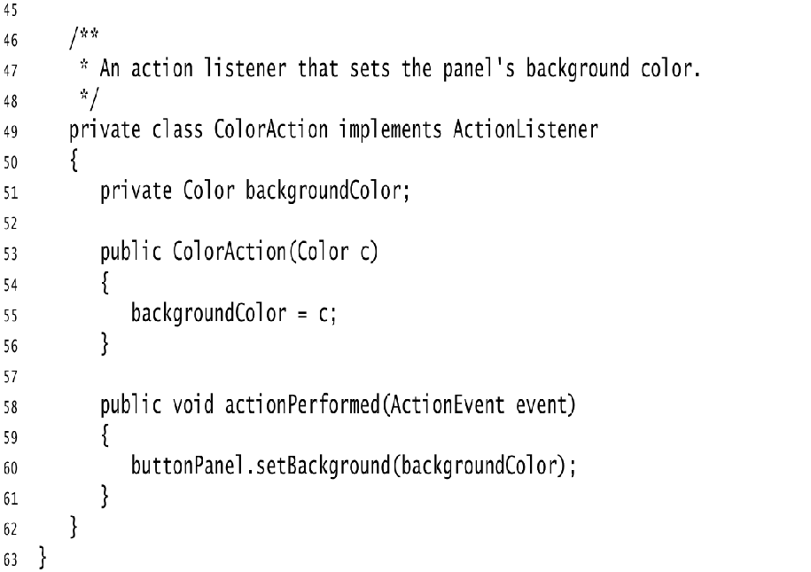

Slide 14
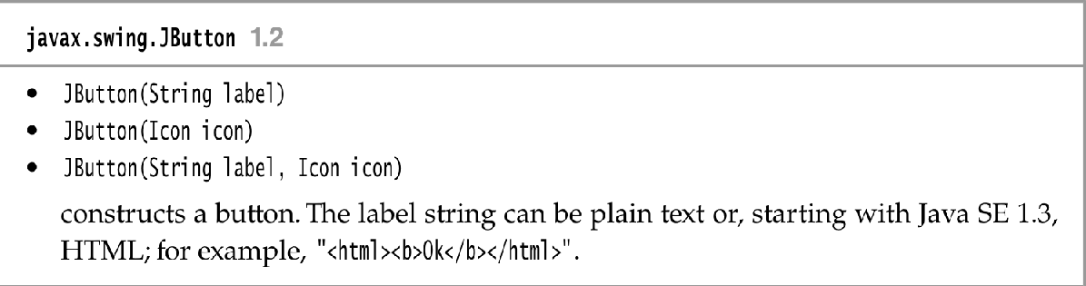
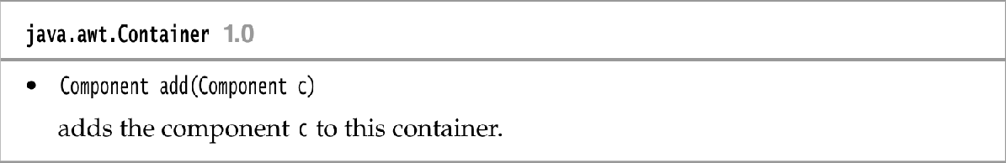

Slide 15
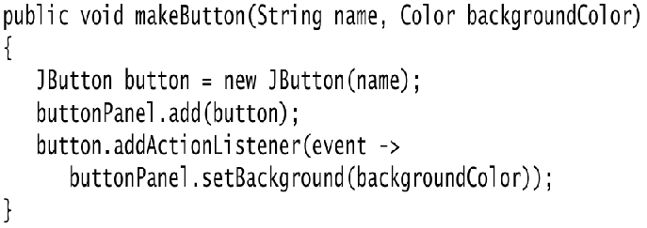
Specifying Listeners Concisely
In the preceding section, we defined a class for the event listener and constructed three objects of that class. It is not all that common to have multiple instances of a listener class.
Most commonly, each listener carries out a separate action. In that case, there is no need to make a separate class. Simply use a lambda expression:
exitButton.addActionListener(event -> System.exit(0));
Now consider the case in which we have multiple related actions, such as the color buttons of the preceding section. In such a case, implement a helper method

Slide 16
Specifying Listeners Concisely
Note that the lambda expression refers to the parameter variable backgroundColor .
Then we simply call makeButton("yellow", Color.YELLOW); makeButton("blue", Color.BLUE); makeButton("red", Color.RED);
Here, we construct three listener objects, one for each color, without explicitly defining a class.
Each time the helper method is called, it makes an instance of a class that implements the ActionListener interface.
Its actionPerformed action references the backGroundColor value that is, in fact, stored with the listener object.
However, all this happens without having to explicitly define listener classes, instance variables, or constructors that set them.

