Slide 1
Event Listeners

Slide 2
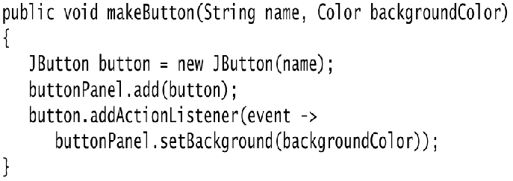
Specifying Listeners Concisely
In the preceding section, we defined a class for the event listener and constructed three objects of that class. It is not all that common to have multiple instances of a listener class.
Most commonly, each listener carries out a separate action. In that case, there is no need to make a separate class. Simply use a lambda expression:
exitButton.addActionListener(event -> System.exit(0));
Now consider the case in which we have multiple related actions, such as the color buttons of the preceding section. In such a case, implement a helper method

Slide 3
Specifying Listeners Concisely
Note that the lambda expression refers to the parameter variable backgroundColor .
Then we simply call makeButton("yellow", Color.YELLOW); makeButton("blue", Color.BLUE); makeButton("red", Color.RED);
Here, we construct three listener objects, one for each color, without explicitly defining a class.
Each time the helper method is called, it makes an instance of a class that implements the ActionListener interface.
Its actionPerformed action references the backGroundColor value that is, in fact, stored with the listener object.
However, all this happens without having to explicitly define listener classes, instance variables, or constructors that set them.

Slide 4
Specifying Listeners Concisely
NOTE: Some programmers are not comfortable with inner classes or lambda expressions and instead make the container of the event sources implement the ActionListener interface.
Then, the container sets itself as the listener, like this: yellowButton.addActionListener(this); blueButton.addActionListener(this); redButton.addActionListener(this);
Now the three buttons no longer have individual listeners. They share a single listener object—namely, the frame. Therefore, the actionPerformed method must figure out which button was clicked.
Object source = event.getSource(); if(source == yellowButton) … …
We do not recommend this strategy

Slide 5
Example: Changing the Look-and-Feel
By default, Swing programs use the Metal look-and-feel. There are two ways to change to a different look-and-feel.
The first is to supply a file swing.properties in the jre/lib subdirectory of your Java installation.
In that file, set the property swing.defaultlaf to the class name of the look-and-feel that you want. For example: swing.defaultlaf=com.sun.java.swing.plaf.motif.MotifLookAndFeel
Note that the Metal and Nimbus look-and-feels are located in the javax.swing package.
The other look-and-feel packages are located in the com.sun.java package and need not be present in every Java implementation
For example, for copyright reasons, the Windows and Macintosh look-and-feel packages are only shipped with the Windows and Macintosh versions of the Java runtime environment.

Slide 6
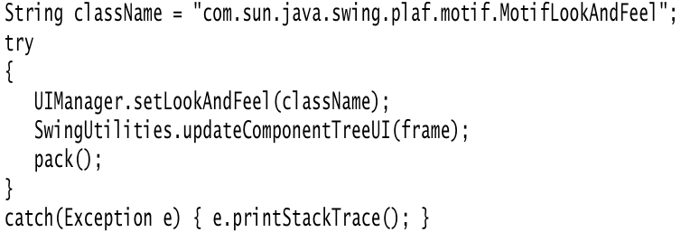
Example: Changing the Look-and-Feel
The second way is to change the look-and-feel dynamically.
Call the static UIManager.setLookAndFeel method and give it the name of the look-and-feel class that you want.
Then call the static method SwingUtilities.updateComponentTreeUI to refresh the entire set of components.
You need to supply one component to that method; it will find all others. Here is an example showing how you can switch to the Motif look-and-feel in your program:

Slide 7
Example: Changing the Look-and-Feel
To enumerate all installed look-and-feel implementations, call
UIManager.LookAndFeelInfo[] infos = UIManager.getInstalledLookAndFeels();
Then you can get the name and class name for each look-and-feel as String name = infos[i].getName(); String className = infos[i].getClassName();
Listing 1.8 is a complete program that demonstrates how to switch the look-and-feel.
The program is similar to Listing 1.7.
Following the advice of the preceding section, we use a helper method makeButton and a lambda expression to specify the button action—namely, to switch the look-and-feel

Slide 8
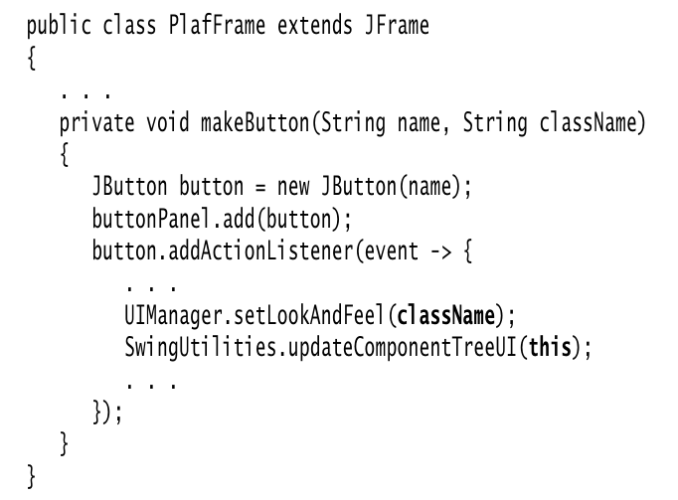
Example: Changing the Look-and-Feel

Slide 9
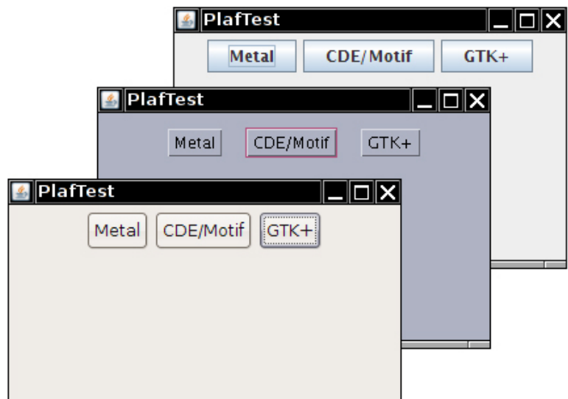
Switching the Look-and-Feel

Slide 10
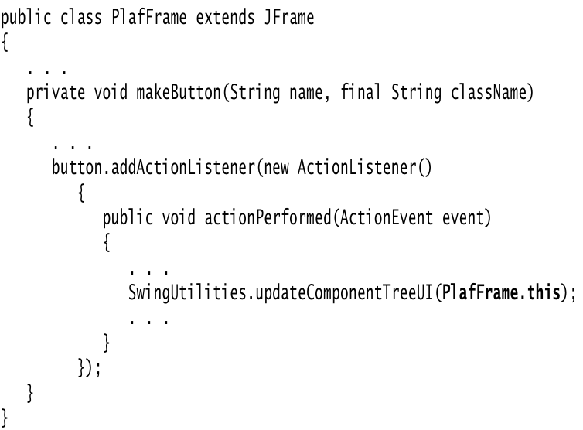
Example: Changing the Look-and-Feel
NOTE: In previous versions, we used an anonymous inner class to define this listener. At that time, we had to be careful to pass PlafFrame.this (and not the this reference of the inner class) to SwingUtilities.updateComponentTreeUI :

Slide 11
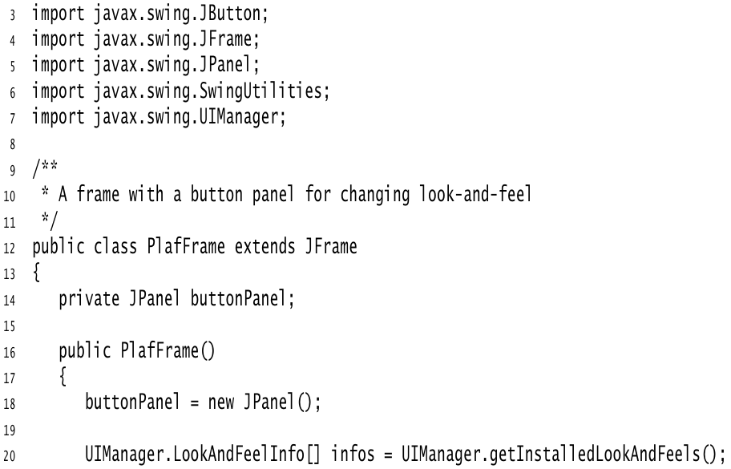
Listing 1.8 [ platform/PlatformTest.java ]

Slide 12
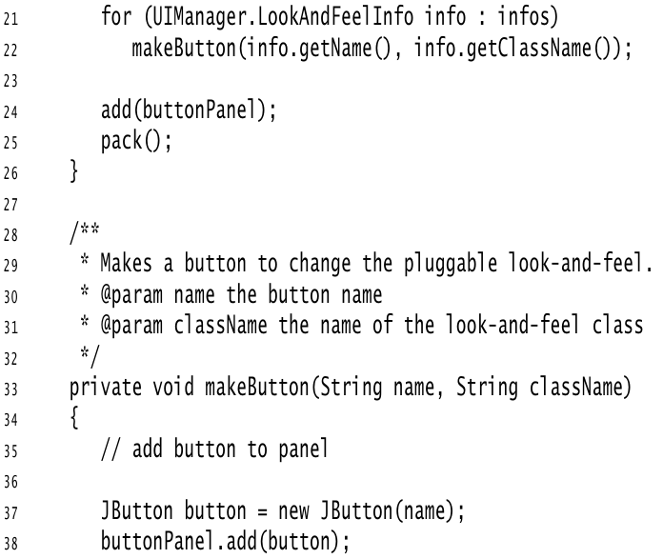

Slide 13
