Slide 1
Adapter Classes

Slide 2
Adapter Classes
Not all events are as simple to handle as button clicks.
In a non-toy program, you will want to monitor when the user tries to close the main frame because you don’t want your users to lose unsaved work.
When the user closes the frame, you want to put up a dialog and exit the program only when the user agrees
When the user tries to close a window, the JFrame object is the source of a WindowEvent .
If you want to catch that event, you must have an appropriate listener object and add it to the frame’s list of window listeners WindowListener listener = . . .; frame.addWindowListener(listener);
The window listener must be an object of a class that implements the WindowListener interface. There are actually seven methods in the WindowListener interface.
The frame calls them as the responses to seven distinct events that could happen to a window.

Slide 3
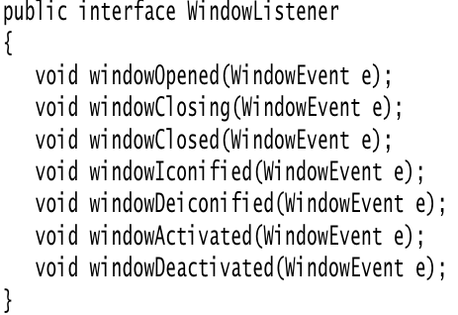
Adapter Classes
The names are self-explanatory, except that “iconified” is usually called “minimized” under Windows. Here is the complete WindowListener interface:

Slide 4
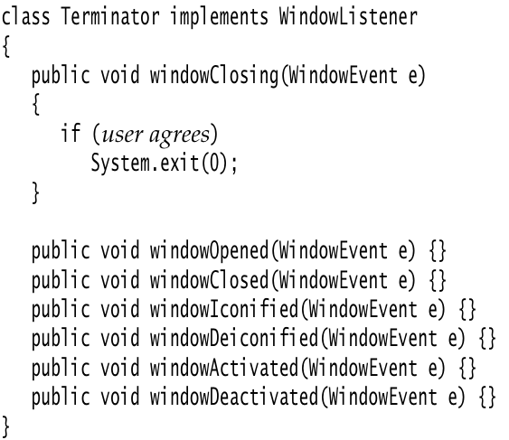
Adapter Classes
As is always the case in Java, any class that implements an interface must implement all its methods; in this case, that means implementing seven methods.
Recall that we are only interested in one of these seven methods, namely the windowClosing method.
Of course, we can define a class that implements the interface, add a call to System.exit(0) in the windowClosing method, and write do-nothing functions for the other six methods

Slide 5
Adapter Classes
Typing code for six methods that don’t do anything is the kind of tedious busywork that nobody likes.
To simplify this task, each of the AWT listener interfaces that have more than one method comes with a companion adapter class that implements all the methods in the interface but does nothing with them.
For example, the WindowAdapter class has seven do-nothing methods.
This means the adapter class automatically satisfies the technical requirements that Java imposes for implementing the associated listener interface.
You can extend the adapter class to specify the desired reactions to some, but not all, of the event types in the interface.
(An interface such as ActionListener that has only a single method does not need an adapter class.)
Let us make use of the window adapter. We can extend the WindowAdapter class, inherit six of the do-nothing methods, and override the windowClosing method

Slide 6
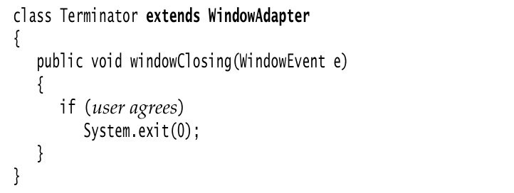
Adapter Classes

Slide 7
Adapter Classes
Now you can register an object of type Terminator as the event listener:
WindowListener listener = new Terminator(); frame.addWindowListener(listener);
Whenever the frame generates a window event, it passes it to the listener object by calling one of its seven methods
Six of those methods do nothing; the windowClosing method calls System.exit(0), terminating the application.
Creating a listener class that extends the WindowAdapter is an improvement, but we can go even further.
There is no need to give a name to the listener object. Simply write frame.addWindowListener(new Terminator());
But why stop there? We can make the listener class into an anonymous inner class of the frame.

Slide 8
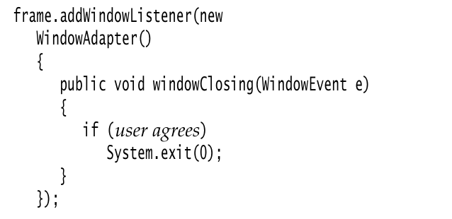
Adapter Classes

Slide 9
This code does the following:
Defines a class without a name that extends the WindowAdapter class
Adds a windowClosing method to that anonymous class (as before, this method exits the program)
Inherits the remaining six do-nothing methods from WindowAdapter
Creates an object of this class; that object does not have a name, either
Passes that object to the addWindowListener method
Again, the syntax for using anonymous inner classes takes some getting used to.
The payoff is that the resulting code is as short as possible.
NOTE: Nowadays, one would implement do-nothing methods of the WindowListener interface as default methods. However, Swing was invented many years before there were default methods.

