Slide 1
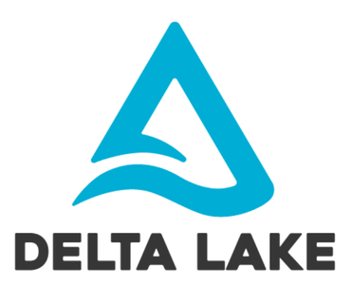

Slide 2
Agenda
Introduction
Why Delta Lake
Key Features
How Delta Lake works
Limitations
Demo

Slide 3
Why Delta?
Challenges in implementation of a data lake.
Missing ACID properties in spark.
Schema enforcement.
Too many small files.

Slide 4
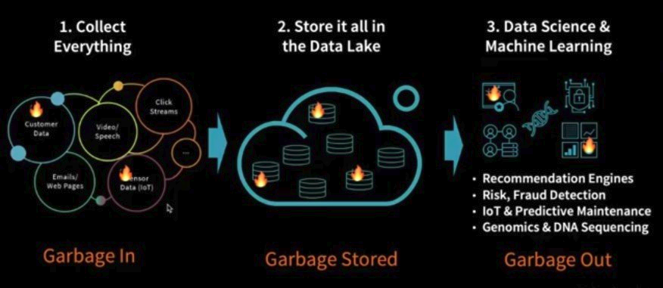
Challenges faced by most of the data lakes these days, if we don’t build them properly
Source: databricks

Slide 5
Introduction
Delta Lake is an open source storage layer that brings reliability to data lakes.
Delta Lake provides ACID transactions, scalable metadata handling
Delta Lake runs on top of your existing data lake and is fully compatible with Apache Spark APIs.
Delta Lake supports Parquet format

Slide 6
Key Features
ACID Transactions
Scalable metadata handling
Time Travelling
Audit Logging
Vacuum
Updates and Deletes
Schema Enforcement

Slide 7
How Delta Lake Works
Delta lake provides a storage layer on top of existing storage data lake. It acts as a middle layer between Spark runtime and storage
Delta Lake will generate delta logs for each committed transactions
Delta logs will have delta files stored as JSON which has information about the operations occurred
Delta files are sequentially increasing named JSON files and together make up the log of all changes that have occurred to a table

Slide 8
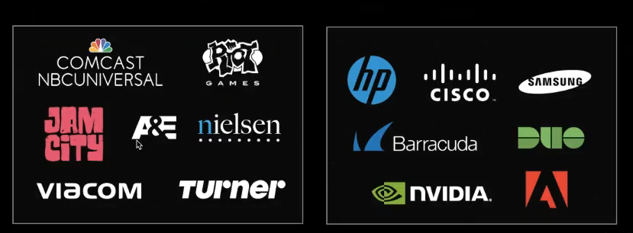
Who is using Delta Lake
Source: databricks

Slide 9
DEMO TIME

Slide 10
Limitations
Supports only parquet format
Delta does not support the DStream API.
Delta does not support multi-table transactions and foreign keys.

Slide 11
References
https://delta.io/
https://www.learningjournal.guru/

Slide 12
Happy coding
Notes:
TODO – List(1, 2) co se presne vola? Scala.List

