Slide 1
Machine Learning – Case Study on Classification

Slide 2
1
Problem defined
AGENDA
2
Exploratory Analysis
3
Feature Selection
4
Model Comparisons

Slide 3
Mushroom Classification
Identify Species / Class of mushroom characteristics which determine which features spell certain death and which are most palatable in the given dataset of mushroom characteristics using Machine Learning models

Slide 4
Mushroom Classification Cycle
GLM
Decision Trees
Data
Preprocessing
Train/Test Split
Random Forest
1.) First run each model against all the variables
2.) Add one by one variable and then compare the score with initial one , if it is improving the score significantly then keep the variable
3.)show the variable importance of each model.
4.) Compares each model accuracy
Gradient Boost
4

Slide 5
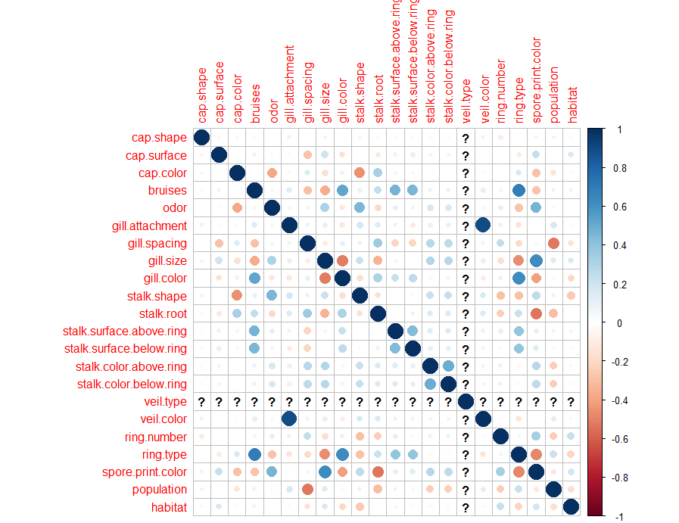
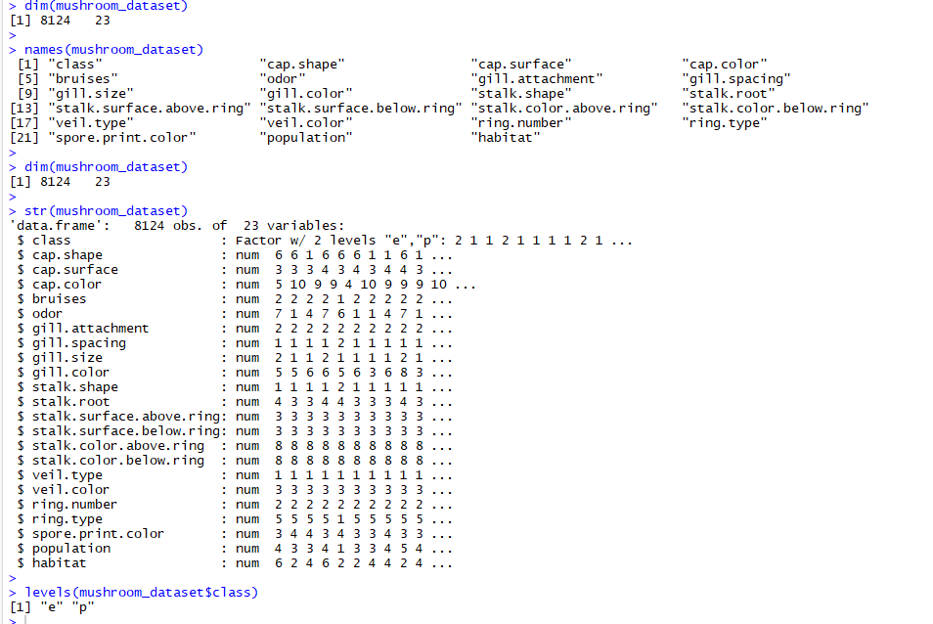
Exploratory Analysis
correlation chart
Provides the details of the data
How many observations and variables are present in the dataset and its data types and level of the target variable

Slide 6
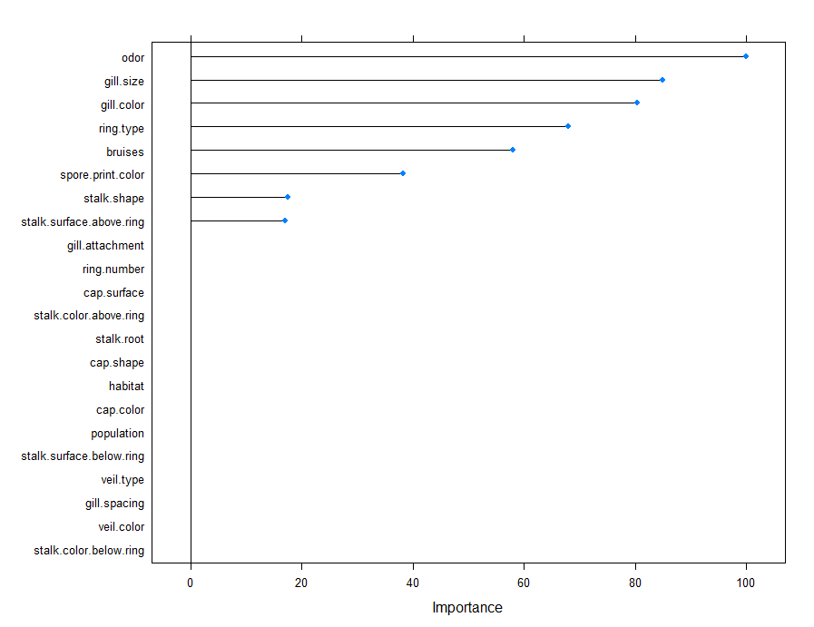
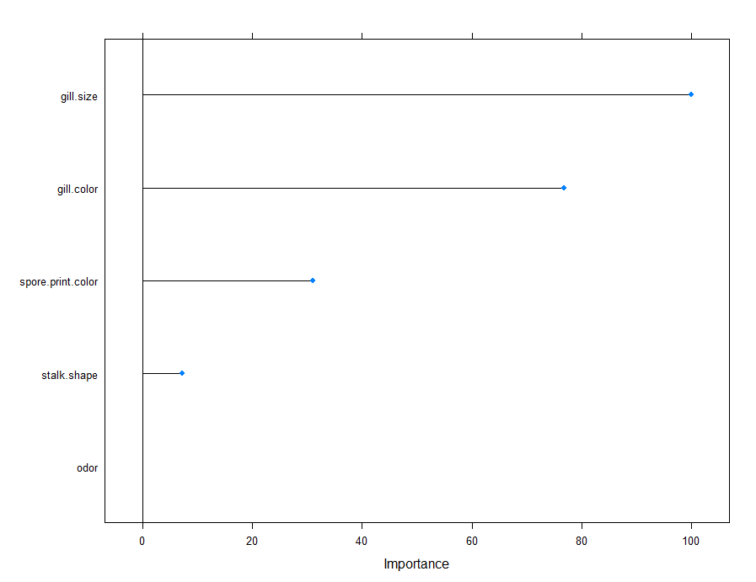
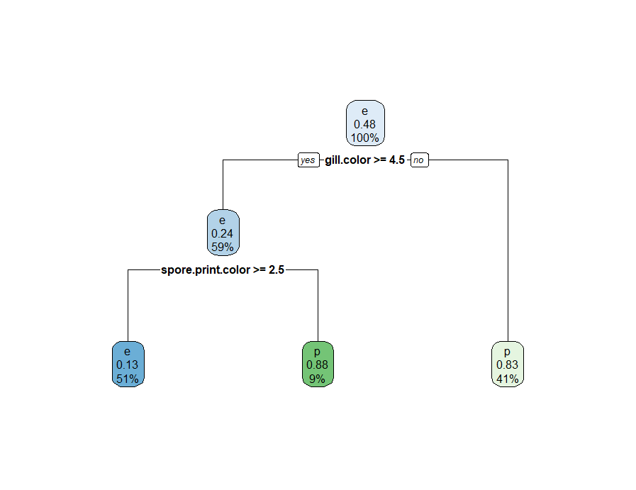
Feature Selection
GLM Variable Importance
Decision Tree Variable Importance

Slide 7
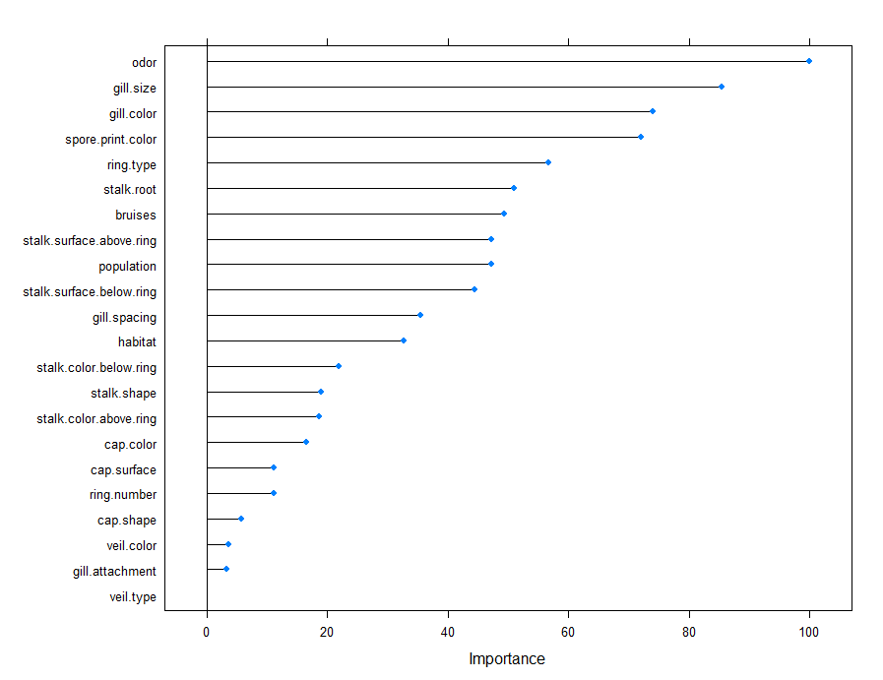
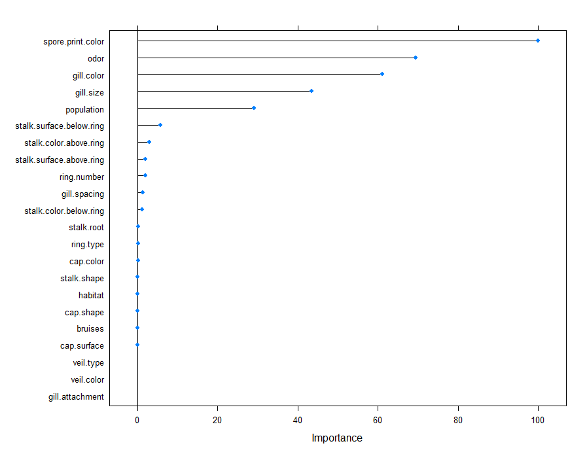
Feature Selection Contd..
Random Forest Variable Importance
GBM Tree Variable Importance

Slide 8
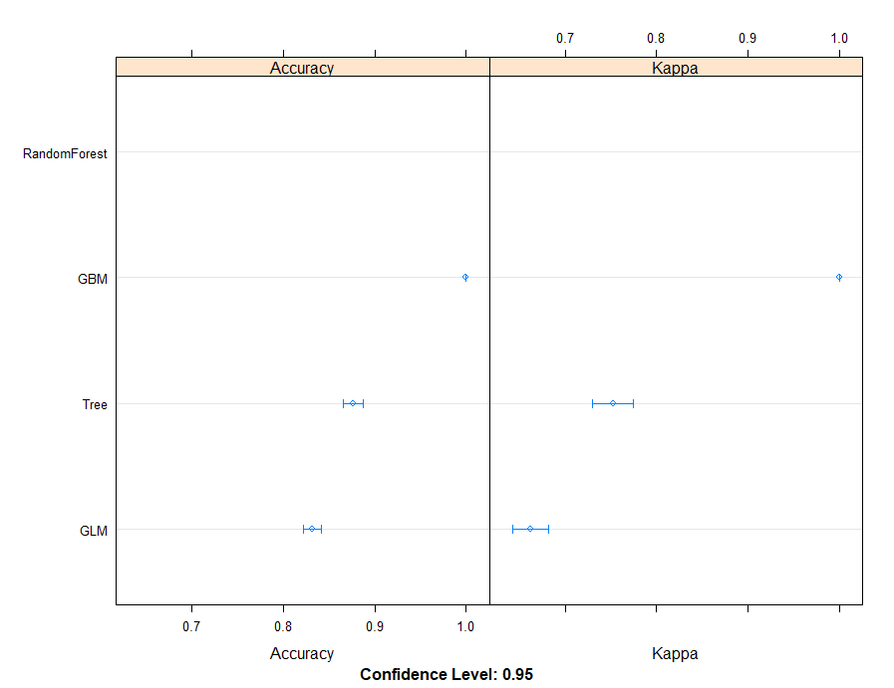
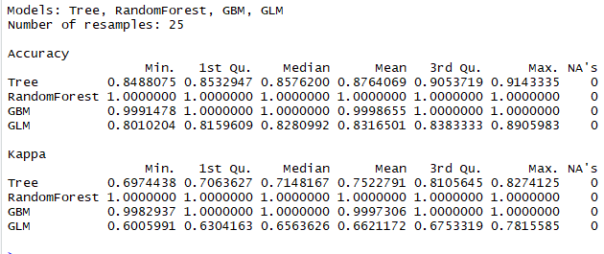
Model Comparisons

