Slide 1
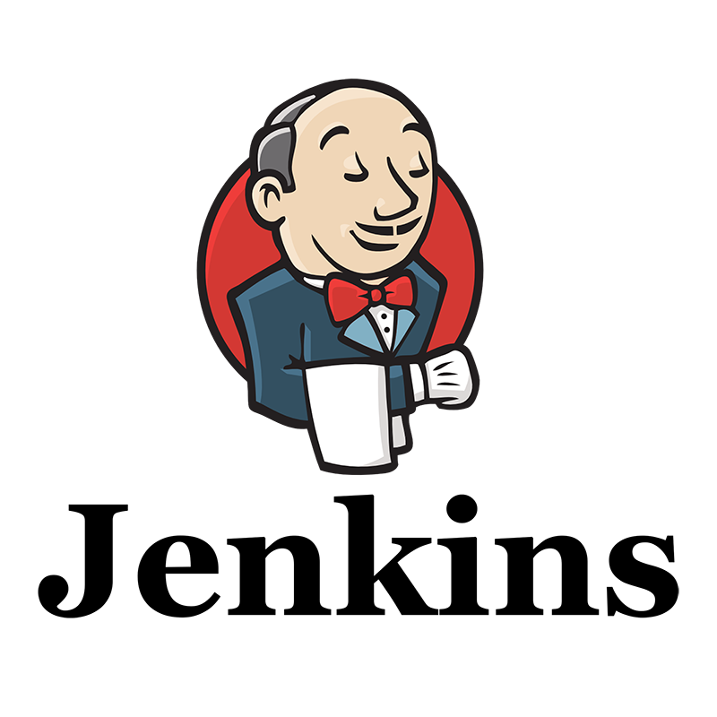

Slide 2
Jenkins
Jenkins is an open source automation server.
It helps automate the parts of software development related to building, testing, and deploying, facilitating continuous integration and continuous delivery.
Repository: GitHub
License: MIT License
Written in: Java
Platform: Java 8, Java 11
Initial release: 2 February 2011
Original author(s): Kohsuke Kawaguchi.

Slide 3
Jenkins is
Easy to install.
Easy to configure.
Pluggable with custom Plugins & hence highly extensible.
More than everything, Jenkins is inherently distributed in nature and hence can support any scale by distributing the workloads across nodes & agents.

Slide 4
Jenkins used for
Jenkins is an open source continuous integration/continuous delivery and deployment (CI/CD) automation software DevOps tool written in the Java programming language. It is used to implement CI/CD workflows, called pipelines.
Continuous Integration: Continuous integration is a DevOps software development practice where developers regularly merge their code changes into a central repository, after which automated builds and tests are run.
Continuous Delivery: Continuous delivery is a software development practice where code changes are automatically prepared for a release to production.
Continuous Deployment: Continuous Deployment (CD) is a software release process that uses automated testing to validate if changes to a codebase are correct and stable for immediate autonomous deployment to a production environment.

Slide 5
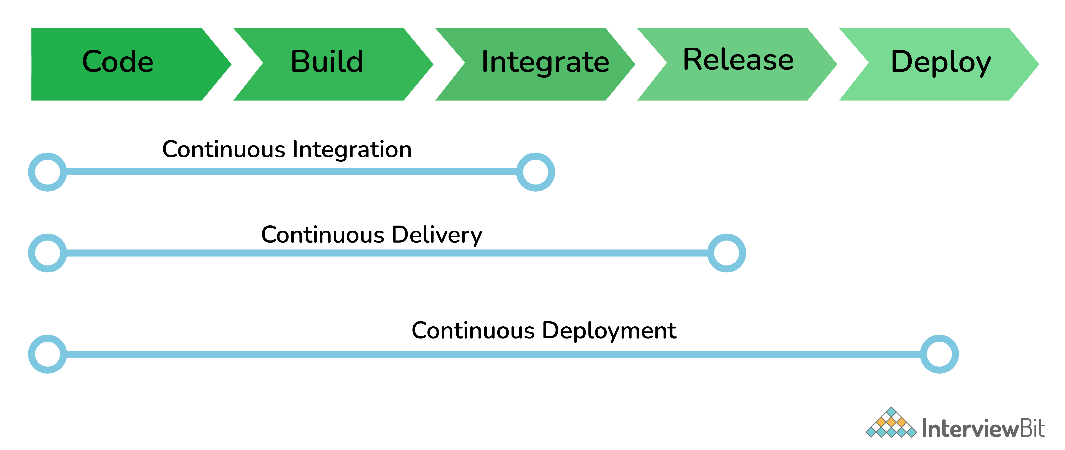

Slide 6
The common use cases Jenkins is used for
Software build jobs
Sanity/Smoke/CI/Regression test jobs
Web/Data Scraping related jobs
Code coverage measurement jobs
General-purpose automation
Reverse Engineering jobs
Key Decoding jobs & many other jobs where software automation will be applicable.

Slide 7
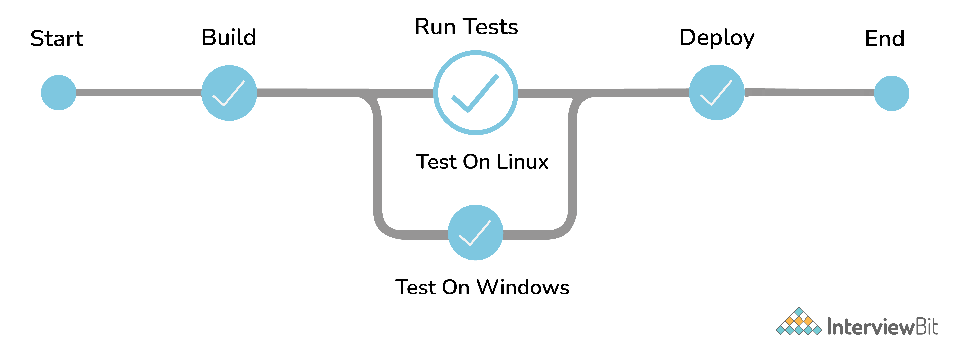
Jenkins Pipeline
The pipeline is a special type of Jenkins job - simply a sequence of steps controlled by a defined logic - which Orchestrates long-running activities that can span across multiple build agents. It is suitable for building pipelines (formerly known as workflows) and/or organizing complex activities that cannot be easily achieved using a freestyle job.
Understand how to create your first pipeline here

Slide 8
The ways to trigger a Jenkins Job/Pipeline
There are many ways we can trigger a job in Jenkins. Some of the common ways are as below -
Trigger an API (POST) request to the target job URL with the required data.
Trigger it manually from the Jenkins web application.
Trigger it using Jenkins CLI from the master/slave nodes.
Time-based Scheduled Triggers like a cron job.
Event-based Triggers like SCM Actions (Git Commit, Pull Requests), WebHooks, etc.
Upstream/Downstream triggers by other Jenkins jobs.

Slide 9
The credential types supported by Jenkins
Secret text - A token such as an API token, JSON token, etc.
Username and password - Basic Authentication can be stored as a credential as well.
Secret file - A secret file used to authenticate some secure data services & security handshakes.
SSH Username with a private key - An SSH public/private key pair for Machine to Machine authentication.
Certificate - a PKCS#12 certificate file and an optional password.
Docker Host Certificate Authentication credentials.
And as we can guess, this can be extended to several other extensible credential types like - AWS credential, Azure secrets, etc. using commonly available plugins

Slide 10
Advantages of Jenkins
It is an open-source tool with great community support.
It is easy to install.
It has 1000+ plugins to ease your work. ...
It is free of cost.
It is built with Java and hence, it is portable to all the major platforms.

Slide 11
Disadvantages of Jenkins
All plug-ins are not compatible with the declarative pipeline syntax.
Jenkins has many plug-ins in its library, but it seems like they are not maintained by the developer team from time to time. ...
Lots of plug-ins have a problem with the updating process.

Slide 12
Thank You

