Slide 1
ELK

Slide 2
ELASTIC SEARCH,
LOGSTASH,
KIBANA
& BEATS

Slide 3
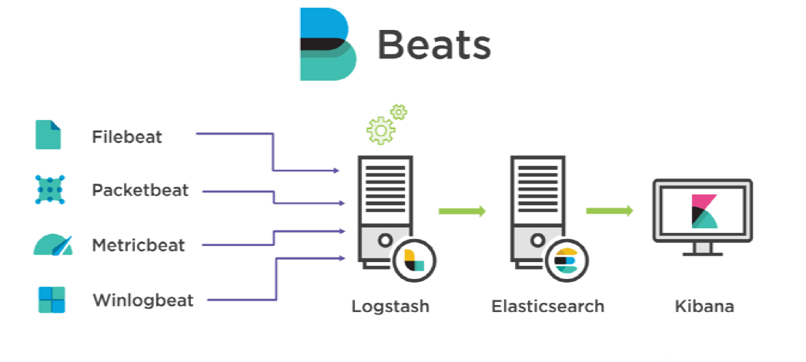

Slide 4
Installing ElasticSearch
Lunch the ubuntu 16 Server with 4gb ram,EIP.
install java using(#apt-get install openjdk-8-jre-headless)
Create a directory and download elastic search package #mkdir pkg #cd pkg #wget https://artifacts.elastic.co/downloads/elasticsearch/elasticsearch-5.6.3.deb
#dpkg -i elasticsearch-5.6.3.deb

Slide 5
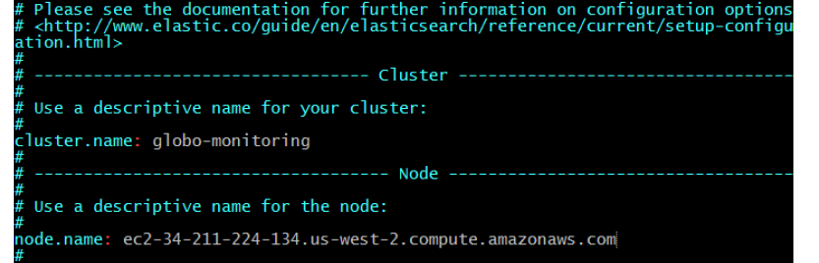
Change the vi /etc/elasticsearch/elasticsearch.yml
cluster.name : globo-clustering
Node.name : public DNS of Elasticsreach (in production only private DNS)
Network.host : private ip of elasticsreach

Slide 6
Increase the memory map count by ‚ # sysctl -w vm.max_map_count=262144
Restart services
# service elasticsearch start
# c
Test by executing
http://<ipadress>:9200
SG allow All traffic
By default elasticsearch runs on port 9200

Slide 7
Install Logstash:

Slide 8
Lunch instant of Ubuntu 16.04 2gb ram
#apt-get update
Install java #apt-get install openjdk-8-jre-headless
#wget -qO - https://packages.elastic.co/GPG-KEY-elasticsearch | sudo apt-key add -
#echo "deb https://artifacts.elastic.co/packages/5.x/apt stable main" | sudo tee -a /etc/apt/sources.list.d/elasticsearch-5.x.list
Execute #apt-get update && apt-get install logstash‛
Logstash is stored in # /usr/share/logstash and move to this directory using cd
Now execute this command #bin/logstash -e "input { stdin {} } output { stdout {} }" enter some value.

Slide 9
Kibana

Slide 10
Lunch instance of Ubuntu 16.04 2gb ram
#apt-get update #wget -qO - https://packages.elastic.co/GPG-KEY-elasticsearch | sudo apt-key add -
# echo "deb https://artifacts.elastic.co/packages/5.x/apt stable main" | sudo tee -a /etc/apt/sources.list.d/elasticsearch-5.x.list
#apt-get update
#apt-get install kibana

Slide 11
#vi /etc/kibana/kibana.yml
server.host: private <ipaddress> of kibina
server.name: private <hostname> of kibina
elasticsearch.url: <elasticsearchurl> of electric search
#service kibana start
http://kinbapublicip:5601

Slide 12
Beats

Slide 13
Install winlogbeat on windows

Slide 14
https://artifacts.elastic.co/downloads/beats/winlogbeat/winlogbeat-5.6.3-windows-x86_64.zip
https://artifacts.elastic.co/downloads/beats/winlogbeat/winlogbeat-6.3.2-windows-x86.zip
Extract
Rename to winlogbeat, then copy paste in c://program files
open vi winlogbeat.yml
tags: ["ap-southeast-1"]
fields:
globo_environment: production
Comment the elasticsearch
#----------------------------- Logstash output --------------------------------
output.logstash:
# The Logstash hosts
hosts: ["13.229.50.243:5044"]

Slide 15
From powershell install winlogbeat template by using following command
Cd /program files/winlogbeat
Invoke-WebRequest -Method Put -InFile winlogbeat.template.json -Uri http://54.255.170.251:9200/_template/winlogbeat?pretty -ContentType application/json
From Powershell install winlogbeat service using following command \install-service-winlogbeat.ps1
Start service using start-service winlogbeat

Slide 16
Logtash:
#Services logstash status
#cd /etc/logstash/conf.d
#vi beats.conf
input {
beats {
port => "5044"
}
}
output {
elasticsearch {
hosts => [ "54.255.170.251:9200" ]
index => "%{[@metadata][beat]}-%{+YYYY.MM.dd}"
document_type => "%{[@metadata][type]}"
}
}

Slide 17
#Cd /usr/share/logstash
#bin/logstash -f /etc/logstash/conf.d/
Service and restart the Winlogbeat on windows
service kibana start
http://54.169.238.188:5601
winlogbeat-*
timestap@
Create

Slide 18
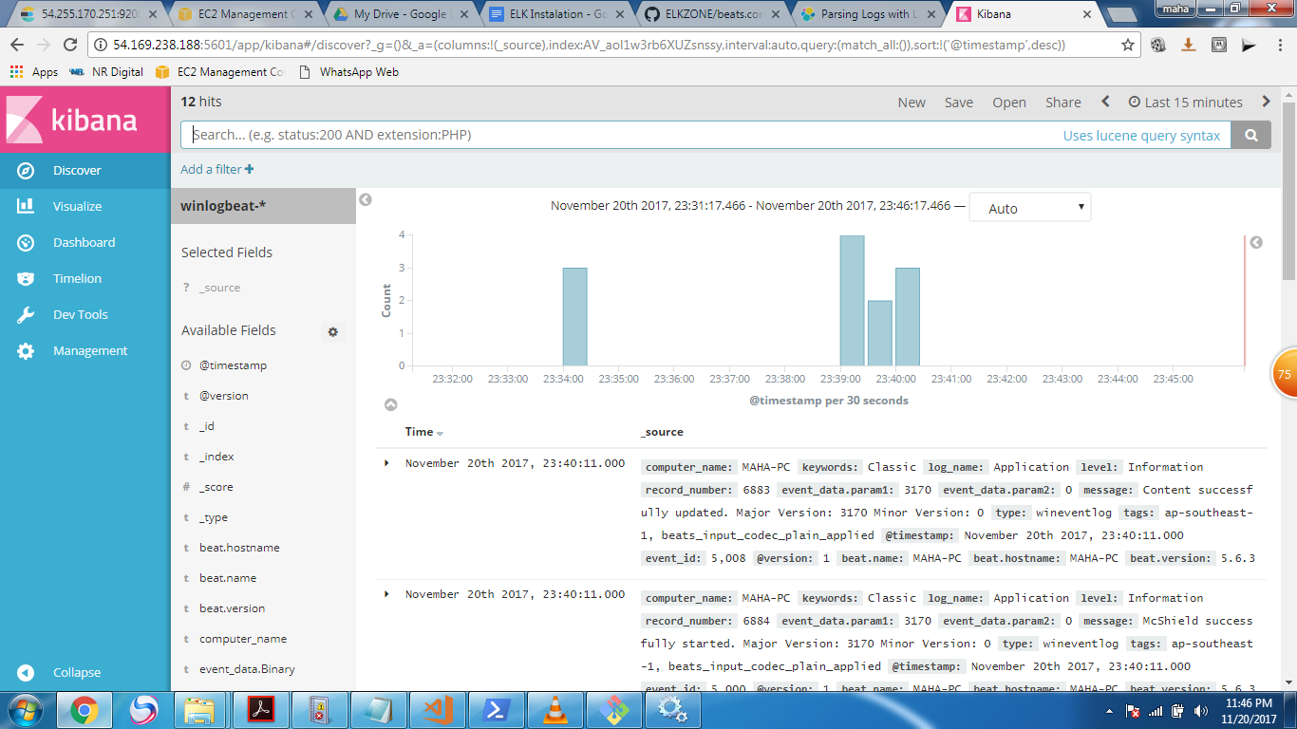

Slide 19
Install
Filebeat on redhat:

Slide 20
Lunch redhat instance
#curl -L -O https://artifacts.elastic.co/downloads/beats/filebeat/filebeat-5.6.4-x86_64.rpm
#sudo rpm -vi filebeat-5.6.4-x86_64.rpm
#cd /etc/filebeat/

Slide 21
Vi filebeat.yml
tags: ["ap-southeast-1"]
fields:
globo_environment: production
#----------------------------- Logstash output --------------------------------
output.logstash:
# The Logstash hosts
hosts: ["13.229.50.243:5044"]

Slide 22
curl -H 'Content-Type: application/json' -XPUT 'http://52.221.196.45:9200/_template/filebeat' -d@/etc/filebeat/filebeat.template.json
sudo /etc/init.d/filebeat start
Open kibana and create pattern

