Slide 1
Autonomous Operations Factory
Working prototype: the design, and why each decision was made

Slide 2
The pipeline
Blueprint
resolve
Deployment Spec
DAG (Airflow)
platform admin
developer's answers
one per spec
DAG tasks
scaffold
build
deploy_staging
checks
sign_off
promote_production
Control plane generates the kustomize tree
naming the image build produced (tag = commit)
deploy / promote:
render overlay → kubectl apply
A failed build leaves no tree: nothing names an image that was never built.
Notes:
Blueprint is the template; the deployment spec is one resolved instance; the DAG realises it. The kustomize tree is generated by the control plane only after build has produced an image.

Slide 3
Who writes what, and when
Artifact | Written by | When
Blueprint | platform admin | publish
Deployment Spec | control plane, from the developer's answers | submission
DAG | DAG factory, from the spec in the store | Airflow parse
Image | build task, tagged with the commit | after scaffold
kustomize tree | control plane, asked by the build task | after build
Why after build: a tree for an image that was never built records a deployment that cannot happen
How: build calls POST /api/deployments/:id/manifests with its image. A blueprint with no build calls it before the first deploy, with the answered image
Once per spec: a second call is refused (409), so a retry cannot replace a tree a deploy may be applying
control-plane/src/manifests.js · orchestrator/dags/factory_manifests.py
Notes:
The tree is generated by the control plane, asked for over HTTP by the DAG. Airflow orchestrates; it does not generate.

Slide 4
Blueprint
DECISION
One document holds the governance and the workload envelope
Governance: questions, boundaries, sequence, gate, record, acceptance
Workload: replicas, cpu, memory, per environment
Why: an operation is governed in one place, authored once, reused by many deployments
Refused at publish: a sequence that cannot run: a cycle, or a needs that points nowhere
name: foo
version: 1.0.0
owner_team: platform
visibility: shared
questions: [app_name, ...]
boundaries: {...}
workload: {...}
sequence: [...]
acceptance: [...]
control-plane/src/blueprint.js · sequence.js
Notes:
Authored once by the platform admin. Validated before publish.

Slide 5
Deployment Spec
DECISION
Blueprint + answers, resolved into one immutable document
Why two documents: one blueprint serves many deployments, so it cannot hold instance values. Same split as Helm chart → release
Immutable: a new blueprint version produces a new spec; the audit keeps what was actually deployed
Target: type selects it; k8s is the one implemented
Submission: writing the spec submits it. No run button, and the submission is audited
Image: not in the spec. The build reports it; it is recorded beside the spec
control-plane/src/resolve.js · submit.js
Notes:
One resolved instance of a blueprint. Immutable.

Slide 6
Spec → DAG
DECISION
One DAG per spec, holding the whole sequence
How: a DAG factory reads every spec from the store; nothing is written into the dags folder
Graph: steps declare needs, so they can fork and join (scan and load-test, then the gate)
Why Airflow: open source, extensible; runs are durable entities with state
Rejected: one DAG per gate. A sensor in reschedule mode already frees its worker while it waits; splitting lost the end-to-end graph
Rejected: Temporal: narrower ecosystem
control-plane/src/dag.js · orchestrator/dags/factory_dags.py
Notes:
One DAG per spec. The sequence is a graph, walked directly.

Slide 7
DAG tasks
Task | Does
scaffold | creates a git repo holding a working Node service
build | builds the image, tagged with the commit; then asks for the kustomize tree
deploy_staging | renders the staging overlay and applies it
checks | makes the deployment measurable, then evaluates acceptance
sign_off | sensor: waits for a person with the gate's role
promote_production | renders the production overlay and applies it
Rejected: generating at submission with a pre-named :latest tag (the earlier version). A failed build left manifests for an image that did not exist, and two specs of one app shared an image
orchestrator/dags/factory.py · factory_scaffold.py
Notes:
Each task goes through the policy check before it acts.

Slide 8
Target: k8s + kustomize
DECISION
The target is an option on the spec (type); k8s is the first, not the model
Why k8s first: a real deployment, so acceptance is measured against something running
Why kustomize: one overlay per blueprint environment
the kustomization is the editable artifact; a rendered manifest is raw YAML
the tree belongs to one spec: no shared file to edit between build and apply
Guard: the orchestrator refuses a target it cannot realise
 | base | production
replicas | 1 | 2
cpu | 50m / 200m | 200m / 1000m
memory | 64Mi / 128Mi | 256Mi / 512Mi
namespace | — | payments-production
foo / bar: the overlay patches only what differs
control-plane/src/kustomize.js · resolve.js:14 · factory.py (target check)
Notes:
The target is an option on the spec. k8s is the first implemented.

Slide 9
Policy at every action
DECISION
The worker decides nothing: it states intent and asks OPA
allow
deny
cannot_tell
cannot_tell refuses, but is recorded as a different fact
Inputs: intent and identity from the caller; boundaries, team and approvals from the store
Why: a worker asking to promote cannot also assert that it was approved
Effect: a run posted straight at promote is refused: no approval on record
RBAC: one input (the gate's role), not the decision
policies/factory.rego · factory.py: request_action
Notes:
Policy-bound actions: PBAC, with RBAC as one input.

Slide 10
Identity
DECISION
Signed JWT, verified against the issuer's key set
 | Person | Agent
gets a token by | signing in | client_credentials
principal_type | person | agent
may approve a gate | yes, with the gate's role | no
Why: team and roles come from the token, never from a body, query or header
OPEN: the manifests endpoint is not authenticated yet; intended: a run-scoped token checked by policy
control-plane/src/principal.js · identity/
Notes:
Every caller is authenticated; the token, not the request, says who they are.

Slide 11
Acceptance
DECISION
The app exposes raw counters; the factory judges
app /metrics
Prometheus
alert rule per spec
verdict
Why: an app that graded itself could report whatever it liked
Rule: rendered from the blueprint's acceptance block, e.g. error_rate < {{ slo_error_rate }}
orchestrator/dags/factory_metrics.py
Notes:
The criterion is the admin's; the threshold is the developer's answer.

Slide 12
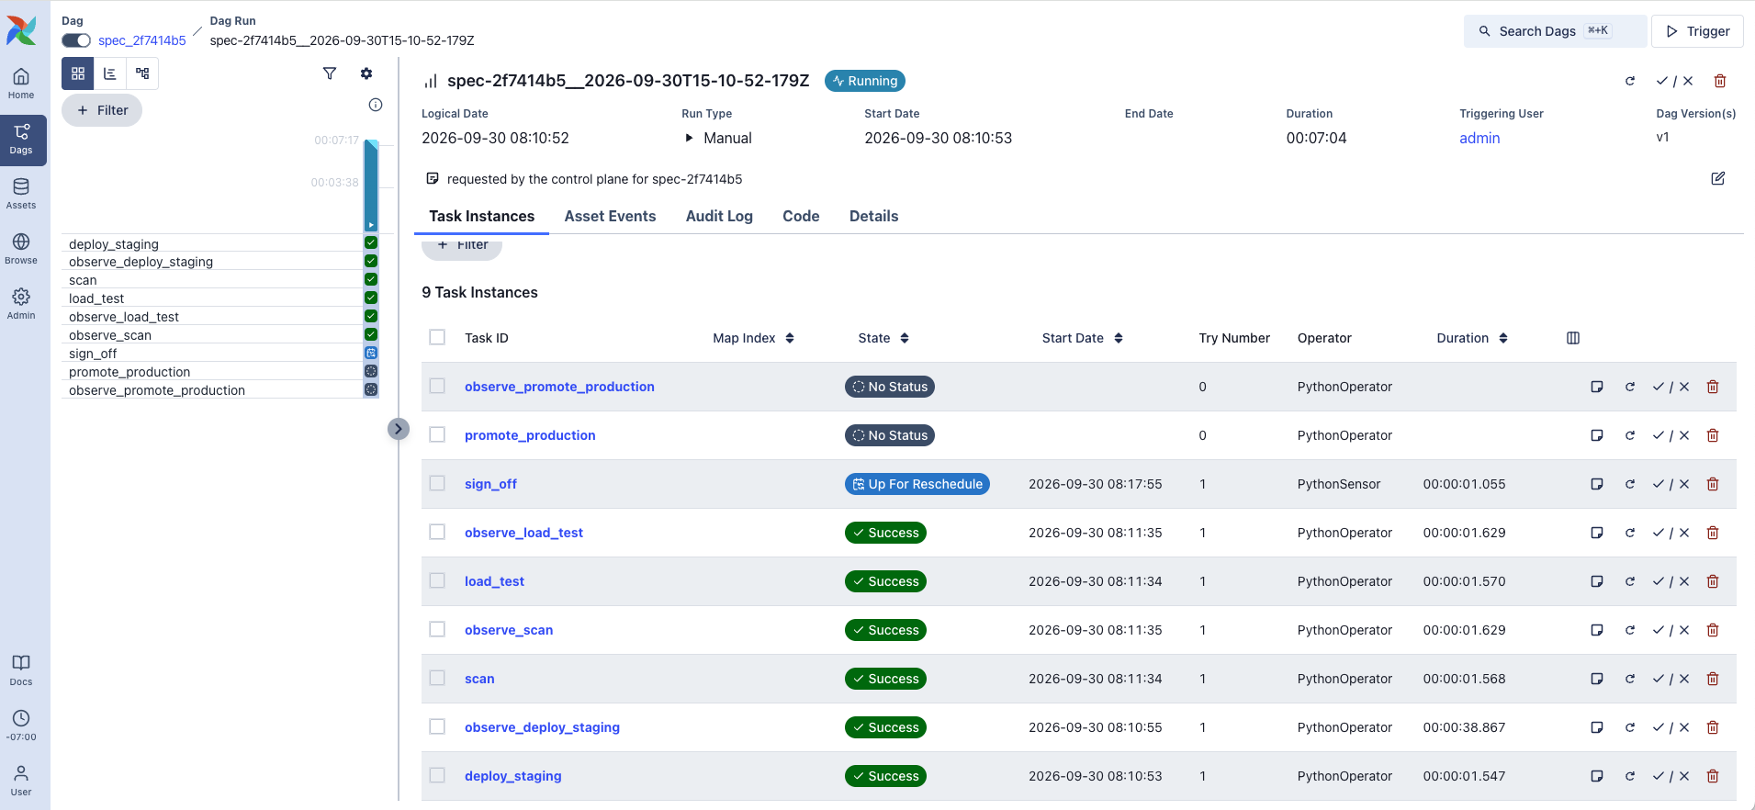
Demo, over MCP
whoami
→ agent:developer:payments
deployment_create {
blueprint: foo,
answers: { app_name: bar }
}
→ spec-<id>, DAG spec_<id>
Earlier run in Airflow: staging done, sign_off waiting (sensor, up for reschedule)
Written
At submission: deployments/<id>/spec.yaml
After build: kustomize/base, kustomize/overlays/{staging,production}
Notes:
From Claude Code through the factory MCP server. The screenshot is an earlier run, before manifests moved after build.

Slide 13
Prototype limits
Prototype | Production
SQLite store | Managed DB
Mock OIDC issuer | Real IdP
Prometheus on emptyDir, 2 h retention | Durable metrics backend
kind, one cluster | Real clusters
One target type (k8s) | Further targets per type
Image tagged with its commit, loaded into kind | Registry, pinned by digest
Manifests endpoint unauthenticated (OPEN) | Run-scoped token, checked by policy
Notes:
Each stand-in sits behind an interface; replacing it does not change the design.

