Slide 1

CompletableFuture in Java 8

Slide 2
Limitations Of Future
It cannot be manually completed.
We cannot perform further action on a Future’s result without blocking.
We don’t have the ability to attach a callback function to the Future and have it get called automatically when the Future’s result is available.
Multiple Futures cannot be chained together.
We can not create asynchronous workflow with Futures.
We can not combine multiple Futures together.
No Exception Handling :

Slide 3
Creating CompletableFuture
The trivial example –
CompletableFuture<T> completableFuture = new CompletableFuture<T>();
Running asynchronous computation using runAsync().
CompletableFuture<Void> future = CompletableFuture.runAsync(() -> {
// Simulate a long-running Job
try {
TimeUnit.SECONDS.sleep(1);
} catch (InterruptedException e) {
throw new IllegalStateException(e);
}
System.out.println("I'll run in a separate thread than the main thread.");
});
Run a task asynchronously and return the result using supplyAsync().
CompletableFuture<String> future = CompletableFuture.supplyAsync(() -> {
try {
TimeUnit.SECONDS.sleep(1);
} catch (InterruptedException e) {
throw new IllegalStateException(e);
}
return "Result of the asynchronous computation";
});

Slide 4
Threadpool Size
Default Threadpool is obtained from the global ForkJoinPool.commonPool()
We can also create a Thread Pool and pass it to runAsync() and supplyAsync() methods to let them execute their tasks in a thread obtained from your thread pool.
Executor executor = Executors.newFixedThreadPool(10);
CompletableFuture<String> future = CompletableFuture.supplyAsync(() -> {
try {
TimeUnit.SECONDS.sleep(1);
} catch (InterruptedException e) {
throw new IllegalStateException(e);
}
return "Result of the asynchronous computation";
}, executor);

Slide 5
Callback Methods in CompletableFuture
thenApply():
CompletableFuture<String> welcomeText = CompletableFuture.supplyAsync(() -> {
try {
TimeUnit.SECONDS.sleep(1);
} catch (InterruptedException e) {
throw new IllegalStateException(e);
}
return "Rajeev";
}).thenApply(name -> {
return "Hello " + name;
}).thenApply(greeting -> {
return greeting + ", Welcome to the CalliCoder Blog";
});
2. thenAccept()
CompletableFuture.supplyAsync(() -> {
return ProductService.getProductDetail(productId);
}).thenAccept(product -> {
System.out.println("Got product detail from remote service " + product.getName())
});
3. thenRun()
CompletableFuture.supplyAsync(() -> {
// Run some computation
}).thenRun(() -> {
// Computation Finished.
});

Slide 6
Callback Methods in CompletableFuture
4. thenApply()Async():
CompletableFuture.supplyAsync(() -> {
return "Some Result"
}).thenApplyAsync(result -> {
// Executed in a different thread from ForkJoinPool.commonPool()
return "Processed Result"
})

Slide 7
Combining two CompletableFutures together
Combine two dependent futures using thenCompose():
CompletableFuture<Double> result = getUserDetail(userId)
.thenCompose(user -> getCreditRating(user));
2. Combine two independent futures using thenCombine()
CompletableFuture<Double> combinedFuture = weightInKgFuture
.thenCombine(heightInCmFuture, (weightInKg, heightInCm) -> {
Double heightInMeter = heightInCm/100;
return weightInKg/(heightInMeter*heightInMeter);
});

Slide 8
Combining Multiple CompletableFutures together
1. CompletableFuture.allOf()
CompletableFuture.allOf is used in scenarios when you have a List of independent futures that you want to run in parallel and do something after all of them are complete.
2. . CompletableFuture.anyOf()
CompletableFuture.anyOf() as the name suggests, returns a new CompletableFuture which is completed

Slide 9
CompletableFuture Exception Handling
1. Handle exceptions using exceptionally() callback
CompletableFuture<String> maturityFuture = CompletableFuture.supplyAsync(() -> {
if(age < 0) {
throw new IllegalArgumentException("Age can not be negative");
}
if(age > 18) {
return "Adult";
} else {
return "Child";
}
}).exceptionally(ex -> {
System.out.println("Oops! We have an exception - " + ex.getMessage());
return "Unknown!";
});
2. Handle exceptions using the generic handle() method
CompletableFuture<String> maturityFuture = CompletableFuture.supplyAsync(() -> {
if(age < 0) {
throw new IllegalArgumentException("Age can not be negative");
}
if(age > 18) {
return "Adult";
} else {
return "Child";
}
}).handle((res, ex) -> {
if(ex != null) {
System.out.println("Oops! We have an exception - " + ex.getMessage());
return "Unknown!";
}
return res;
});

Slide 10
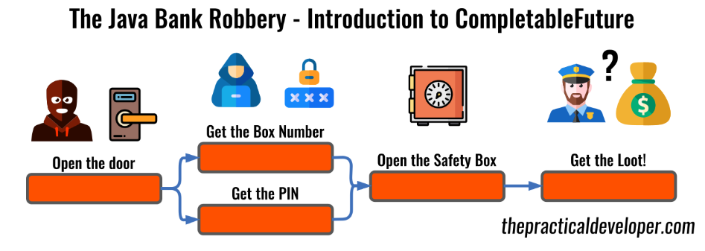

Slide 11
`
References
https://thepracticaldeveloper.com/2018/02/24/differences-between-completablefuture-future-and-streams/
https://github.com/mechero/completable-future-example

Slide 12


