Slide 1

Movie Recommender System
Submitted By:
P Kalki Venkatesh - 11717206
P Bharath Chowdary - 11702409
V Sai Sushmi - 11710764
V Ramya - 11703413
BK Ramesh - 11702409

Slide 2
Contents
01
Movie Recommendation System
03
02
Popularity Based Filtering
04
03
Collaborative Filtering
05
04
Hybrid User-Item Based Collaborative Filtering
06
05
Content Based Filtering
06

Slide 3



Recommendation System:
Recommedations engines are the programs that compute the similarity between the two entities and on that basis,it give us the targeted output.
The base of the recommendation engine is to find out the similarity between the two entities. Then, computed similarities can be used to deduce various kinds of recommendations and relationship between them
Movie Recommendation System
Recommedation are based on the following techniques:
Popularity Based Filtering
Collaborative Filtering
Hybrid user_item based collaborative filtering
Content based filtering

Slide 4
Popularity Based Filtering:
The engine recommends the most popular items to all the users. That would be generalized as everyone would be getting similar recommendations. These kinds of recommedation engines are based on the popularity based filtering
Movie Recommendation System
Uses:
The use case of popularity based filtering model would be the “Top News”Section for the day on a news website where the most popular news for everyone is same that makes a logical sense because news is generalised thing and it has nothing to do with user's interest's

Slide 5
Collaborative Filtering: Collaborative filtering techniques are broadly of two types:
User Based Collaborative Filtering:
In this model we find out the similarity score between the two users. On the basis of similarity score ,we recommend the items bougth/liked by one user assuming that he might like these items on the basis of similarity.
Netflix have their recommendation engine based on user based collaborative filtering.
Movie Recommendation System
2.Item Based Collaborative Filtering:
In item based collaborative filtering ,the similarity of an item is calculated with the existing item being consumed by the existing users. Then on the basis of amount of similarity, we can say that if User1 likes item A and a new item P is most similar to item A then it highly makes the sense for us to recommend item P to User 1

Slide 6
Hybrid User-Item Based Collaborative Filtering:
This technique is basically a mixture of both Popularity Based Filtering and Collaborative Filtering techniques where in the recommendations are not solely based on either.
uses:
Amazon uses this technique to recommend item(s) to their customer.
Movie Recommendation System
Content Based Filtering:
In this technique, the users are recommended the similar content which they have used/watched/liked the most before. For example, if a user has been mostly listening to songs of similar type (bit rate, bps, tunes etc.), he will be recommended the songs falling under the same category decided based on certain features.
Example:
The best example of Content Based Filtering would be Pandora Radio which is a music streaming and automated music recommendation internet radio service.

Slide 7
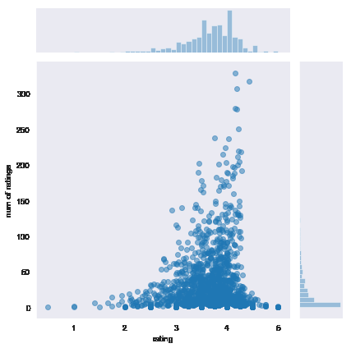
Movie Recommendation System
Add your title
we are joining a histogram and a scatterplot both using jointplot
with respect to ratings on x axis and num of ratings on y axis
the more congested region has more ratings
basically scatter plot is used in order to compare variables

Slide 8
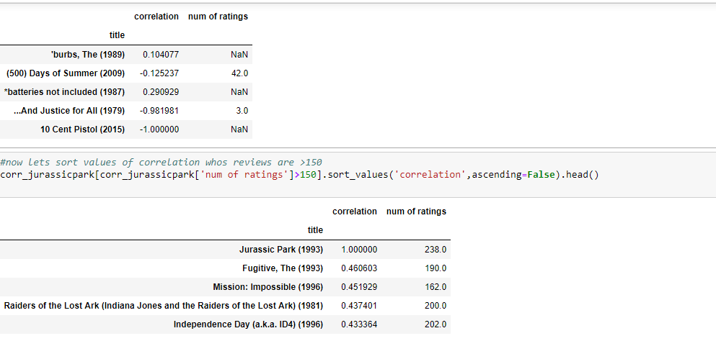
Add your title
collect all the ratings after joint plot in the form of ascending=false
Then find the corelation
now sort them by correlation values
join with number of ratings
now lets sort values of correlation whos reviews are >150
this is how we recommend movies
suppose a person has seen jurassic park now the next movie he will be recomended is fugitive.
based on correlation

Slide 9
Movie Recommendation System
Thank You

