Slide 1
PowerShell Intro
Microsoft

Slide 2
PowerShell-Scripting
A Shell is a user interface that gives access to various services of an Operating System.
Windows PowerShell is a Shell Developed by Microsoft for the purpose of Task Automation & Configuration Management

Slide 3
PowerShell Versions
PowerShell is almost eight years old, and five different PowerShell versions are currently available.
PowerShell 2.0 and PowerShell 3.0 were major releases, with many new important features.
PowerShell 4.0 was only released one year after PowerShell 3.0. Thus, we couldn’t expect too many enhancements. Its main new feature is Desired State Configuration (DSC), a new platform for managing Windows services and their environment.

Slide 4
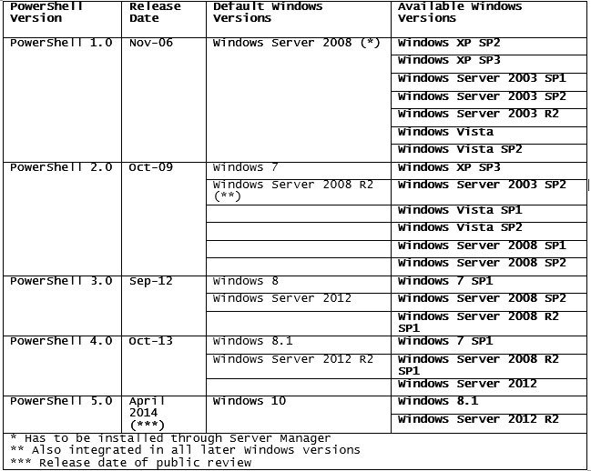
PowerShell and Windows versions

Slide 5
$psversiontable – to know the Ps version
F5 – Run script
F8 – Run Selected
F9 – Toggle point /Debug break point
F10 – Step Over
F11 – Step Into

